Slide 1
SSM Update to JDP COMM
July/13/2018
MTS – Q3 milestone 89°: 1st cut L1D 87.5°; SSM73@WW28 for polarity symmetry validation
Structure yield – Q3 milestone > 85%: next info turn WW29
  SWL subject to SD intrinsic leakage model validated; +2nm t_{SD} implemented
  New 66 reticle & low pressure 66 NCMP expecting yield improvement from 34% to 70%
S24S – Q3 milestone WW39 DBR; Rev3 tight (+1 week) ; DBR trending on track
  Analysis of schedule for a second S24S with modifications to interface with S36X under way
Switching mechanism on Write and Disturb
  Robust ∆V_{T} on SD.K2; Reset RD marginality confirmed while continue R/W inhibit disturb characterization
Stepping-up plans
  Low leakage material for alpha product: Candidates (SD.G*) merging with E_{G} > 1.9eV
  Cell and array scalability – In order to start up 14nm structure development (MTS), we must first develop a self consistent DTS and tile architecture for die size and energy. Call for Integration/Device/Design workgroup.

Slide 2
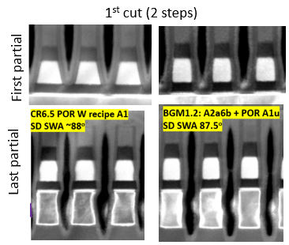
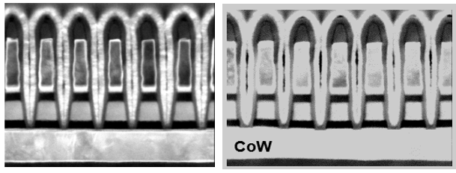
1st and 2nd cut profile demonstrated MTS with >70% PG4 structure yield and PG4 capable RWB
Specs | MTS Metric | SPEC | POR | FWD
First partial | SD top (nm) | 18.1 | 16.3 | 15.6
 | SD bot (nm) | 18.9 | 24.9 | 18
 | SD SWA (degree) | 89 | 79 | 87.5
Last partial | SD top(nm) | 18.1 | 16.1 | 15.6
 | SD mid(nm) | 18.5 | 17.2 | 18
 | SD bot (nm) | 18.9 | 17.8 | 18.1
 | SD SWA(degree) | 89 | 88 | 87.5
 | W Sep (nm) | 20.8 | 18.7 | 18.5
 | W Bot (nm) | 21.2 | 22.3 | 22
MTS Metric | SPEC | POR | FWD
HM thk (nm) | 18 | 17 | 23
W top CD (nm) | 21 | 18 | 22.5
W bot CD (nm) | 17.2 | 14 | 18.5
TEC CD (nm) | 21.3 | 18 | 19.2
SD top CD (nm) | 21.5 | 22 | 16.5
SD bot CD (nm) | 23 | 26 | 18.5
SD SWA (degree) | 89 | 84 | 87
2nd cut (single step)
Next steps:
2nd cut: MTS profile etch ->low Vt 250mV and high leakage (partial leakage fix demo w/ new clean, remaining 20% degradation). Composition model consistent with Vt offset. WIP to reduce composition offset w/ new etch.
Dry etch L1D DOE, XRF analysis of DE BKM
1st cut: SSM73 probe analysis (WW28), SSM80 inline (WW29)

Slide 3
Dual Deck CR6.5 – Status
Baseline (CR6.5)
  SD.k2 monolithic target demonstrated a RWB gap within 100mV (VDM1) on A3 Dual Deck silicon.
  SD.k2 thickness skew validated transition to 24nm, with an additional improvement of VDM1 RWB ~100mV (to be segmented), driving to RWB parity. Lead 24nm SD.k2 Dual Deck expected at probe ww30.
Cell Roadmap
  Campaign G* first 2 lots (SSM66,SSM67) completing probe.
  First results on SSM67 demonstrating split 6E (SD.G09) in target for most of parameters (including E4 and EOL)
  SD.G09 can be a good contingency to SD.K2 for S24S.
SR71 1D0 PG1 Cell RWB |  | DTS0.4 | SDk-A06 | SD.k1 | SDk-A14 | SDk-A14 |  | SD.k2
(Piecewise Built) |  |  | CR5.3 | CR5.4 | CR5.4* | CR5.4* |  | CR6.5
Deck |  |  | 1D0 | 1D0 | 1D0 | 1D0 | 1D0 | 2D0 | 2D1
Reading polarity |  |  | Neg | Neg | Neg | Neg | Pos | Neg | Neg
 |  | [mV] | [mV] | [mV] | [mV] | [mV] | [mV] | [mV] | [mV]
Structural Yield |  |  | 30% | 60% | 7% | 70% |  | 40%
Periphery Yield |  |  | 70% | 75% | 75% | 45% |  | 85%
Vertical Leakage (3.6V) [uA] |  | < 10 | 5 | 5.9 | 7.9 | 7.1 |  | 10
Vdm1 | ΔVt (1 μs) [mV] | 1380 | 935 | 1015 | 1320 | 1308 | 1109 | 1316 | 1400
 | SET σ (Vt) [mV] | 80 | 85 | 85 | 87 | 87 | 87 | 90 | 98
 | RST σ (Vt) [mV] | 100 | 101 | 105 | 113 | 100 | 95 | 111 | 113
 | SET drift (1μs-10s) [mV] | 240 | 220 | 220 | 225 | 233 | 192 | 198 | 235
 | E3 GB WE [mV] | 100 | 95 | 87 | 92 | 91 | 64 | 90 | 81
 | E3 GB RD [mV] | 0 | 380 | 310 | 355 | 330 | 315 | 318 | 334
 | X-tile [mV] |  | 100 | 80 | 45 | 72 |  | 89 | 100
 | Gap to goal [mV] |  | -520 | -355 | -105 | -80 | -176 | -91 | -98
Vmd2 | Rst drift (1μs-3s) [mV] | x | 245 | 268 | 550 | 529 | 499 | 517 | 482
 | Set drift (10s-48h) [mV] | x+200 | 320 | 295 | 240 | 203 | 203 | 224 | 232
 | Gap to goal [mV] |  | -495 | -300 | 250 | 246 | 120 | 202 | 152

Slide 4
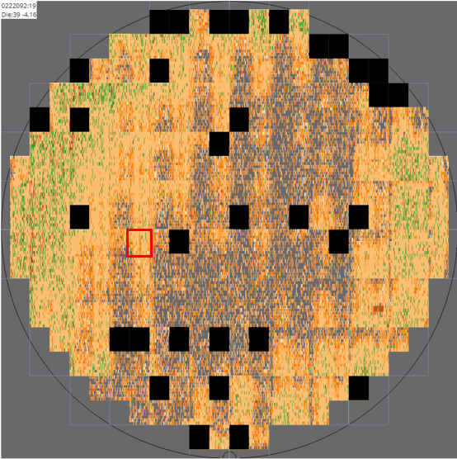
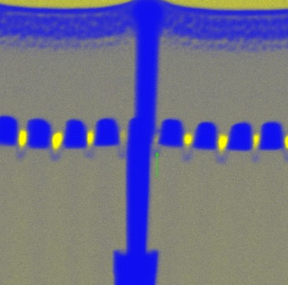
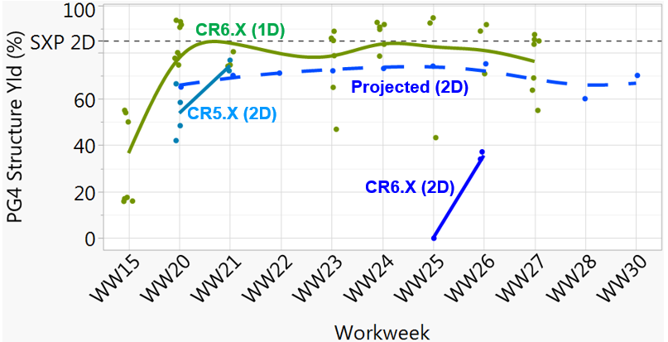
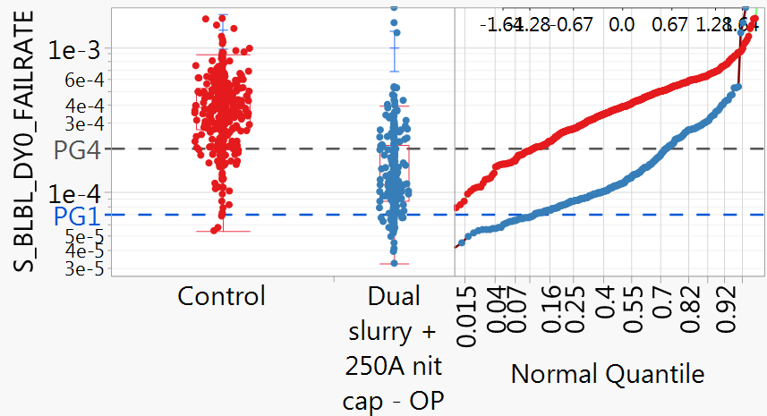
2-Deck SSM Goal to meet 50% PG1 (>85% PG4) yield for S24S startup
1
SSM Single deck and Dual deck vs SXP dual deck
66
51
66-51 shorts
10% → 70% PG4 capability by moving to SXP POR (WW26)
2
WW28/29 probe projected to improve PG4 from 34% to >70% with new 66 reticle and lower pressure 66 NCMP; 51/53 CD line shift is primary risk
1
2

Slide 5
S24S0 Design Update iWW28
Full Chip Validation and Spec Evaluation in Progress / Rev3 tight to WW32 but DBR still trending ahead of schedule:
Next Major Milestone Target (Rev3) | Current Projection: WW31 | WW32
DBR Target | Current Projection: WW39 | WW39
Die Size Target | Current Projection: Matched to S26A Size & Padout| 197.87mm² (12.65mm x 15.64mm)
DBR Rd/Wr Energy Target | Current Projection (TT/85): 84pJ/b / 168pJ/b | TBD / TBD
DBR Rd/Wr Energy Target | Current Projection (FF/85): 89pJ/b / 179pJ/b | TBD / TBD
Rd/Wr Completion Time Target (800MHz) | Current Projection: 95ns / 240ns | TBD / TBD
Rev3 focused on bitmap (check addressing with new decoders), array functionality and performance, and layout
  Bitmap on track:
    BL/WL indexing done, term tiles done, hierarchical schematics done, testmodes done, ccell decode in progress
  Array Functional Model (AFM):
    Work in progress to clean up last of the priority 1 sims – clean up and review for last of the bugs in progress
    Automation for evaluation of bulk of priority 2, 3, and 4 sims ready / priority 2 sims already run – review pending
  LVS cleanup of array partition on track to complete this week in line with DBR target
    Work in progress to resolve scope of QTT for SSM to ensure QTT DBR is aligned with S24S DBR
Energy & Performance Spec assessments captured within AFM validation suite / initial results pushed to ~WW30
1
2
1
2

Slide 6
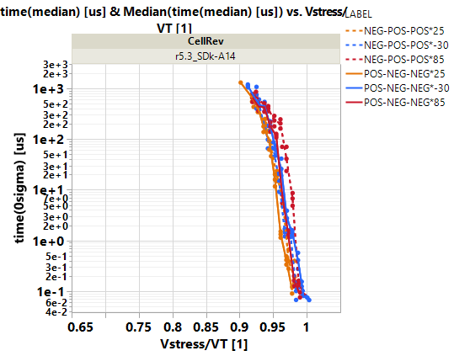
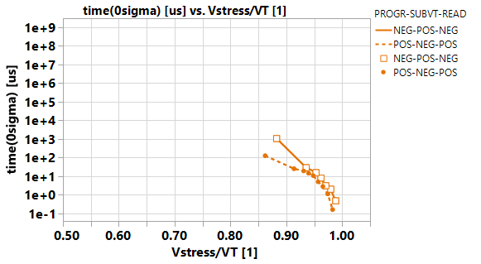
Proving a robust Memory Switching
Electrical polarity is the base of switching stimuli
  Knowns: Memory switching in on-state (40uA/40ns higher and/or longer)
  Unknowns: Will reverse subV_{T} bias switch memory state?
  (known unknowns are Vt shifts after 10 to 1000 sec of 50~75% of reverse SubVt bias.)
SubV_{T} bias operations in read/write
(negative read assumed)
State | Disturb | V_{T}@Disturb | Disturb Bias | Bias Ratio | Ops, Time
Reset | Read on target | E3, 5.3V | V_{DM}, -5.0V | 94% | 3K reads, ~150μs
Reset | Set inhibit | E3, 5.3V | V_{inh}, -3.5V | 66% | 100K writes, ~100s
Set | Reset Inhibit | E1, 5.1V | V_{inh}, +3.5V | 68% | 100K writes, ~100s
Reset | Read Inhibit | E3, 5.3V | V_{inh}, -2.8V | 53% | 1M reads, ~1Ks
Voltage-Time dilemma on Reset RD Disturb
T
-30 C
25 C
85 C
Read inhibit
Write inhibit
High Risk Projected
based on 87% to 93%
SubVt bias stress upto 10msec
~3k rd op’s (DTS)
The distance of the data to the box is margin to disturb
– NEG Read
- - POS Read
High risk:
data inside
the box
Prj (no data)
– Reset WD
-- Set WD
25C

Slide 7
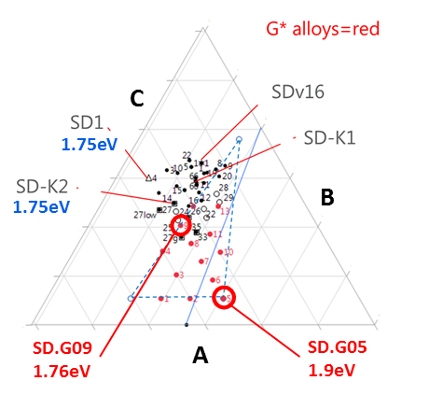
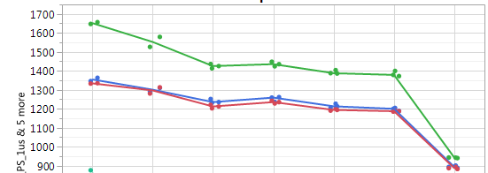
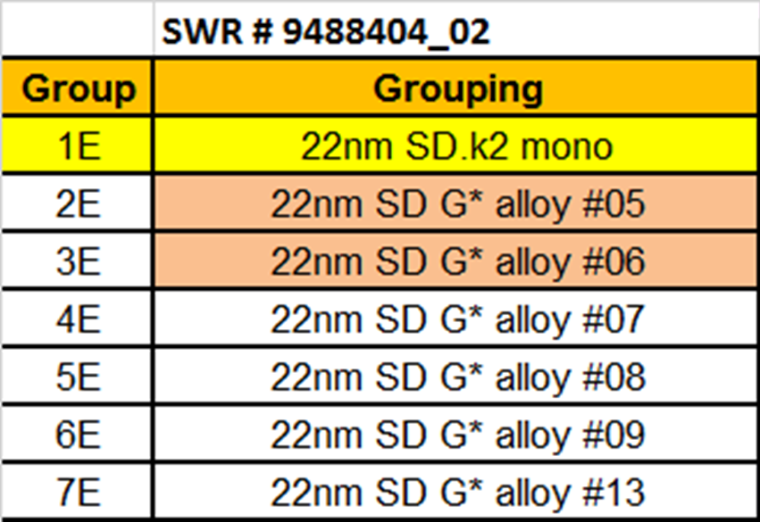
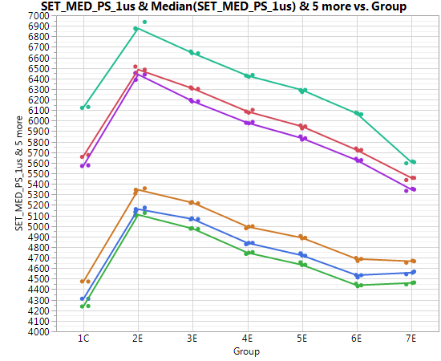
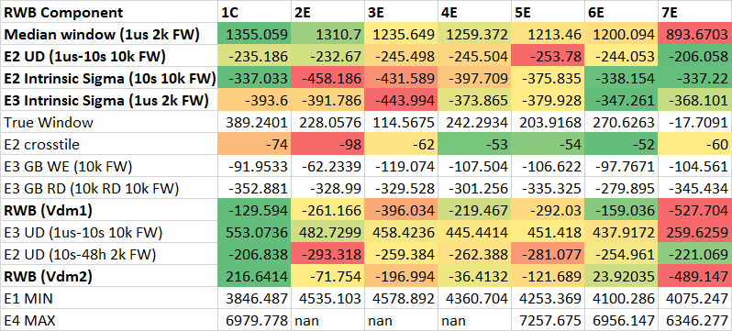
Forward Looking Material
SD.G05, E_{G}=1.9eV, demonstrates on par Array performance and potential for thickness scaling. It is a suitable candidate for Alpha Product.
10s @ 10K FW
∆V_{T} [mV]
1us @ EOS
1us @ 10K FW
Reset
10s @ 10K FW
1us @ EOS
1us @ 10K FW
Set/Reset V_{T} [mV]
Set
1us @ EOS
10s @ 10K FW
1us @ 10K FW

Slide 8
Backup

Slide 9

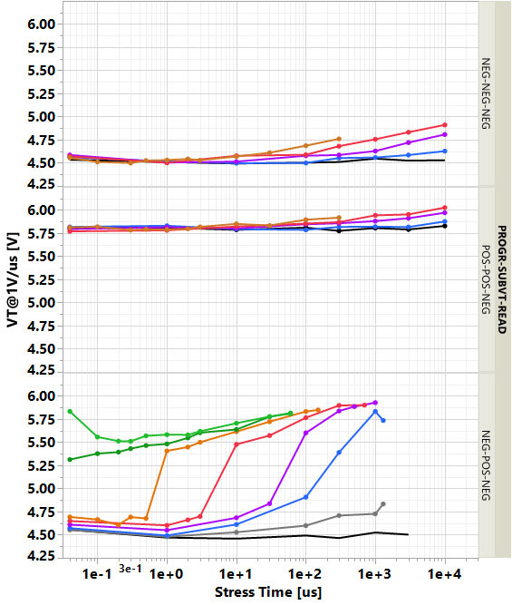
SSM Bias Drift (beyond SXP)
[V]
A1. SET BD
A2. RST BD
B. SET – Rst Inhibit
Two bias drift items
  Set/Rst State inhibits Set operation
    Same polarity bias drift (BD) as in 3DxP cell
  Set State inhibits Reset operation
    Opposite polarity bias Drift (not happening in a unipolar cross point operation like SXP)
V_{stress}/V_{T}
0.9
0.93
0.7
0.45
SET: V_{T} ~ a(t>t0)·log(t)
RST: V_{T} ~ b·log(t)
0.74
0.65
0.37
0.97
V_{stress}/V_{T}
0.93
0.99
V_{T} ~ c(t>t0)·log(t), VT_{high}·(t>tx)
0.88
0.37

Slide 10
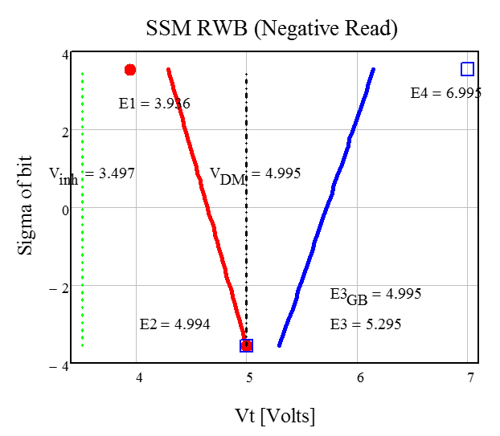
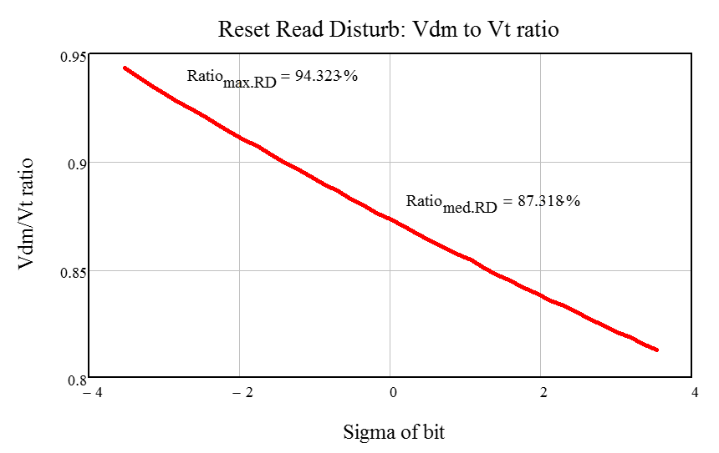
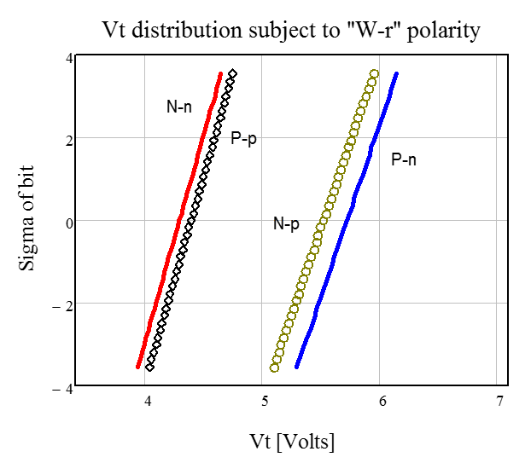
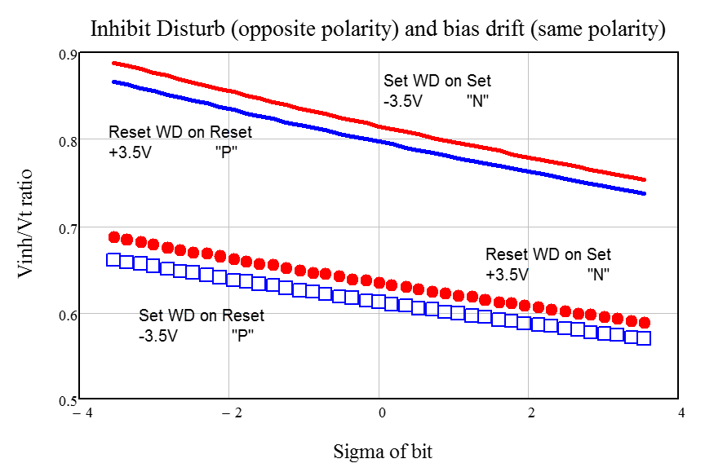
Emulated SSM Memory Window and SubV_{T} disturb

Slide 11
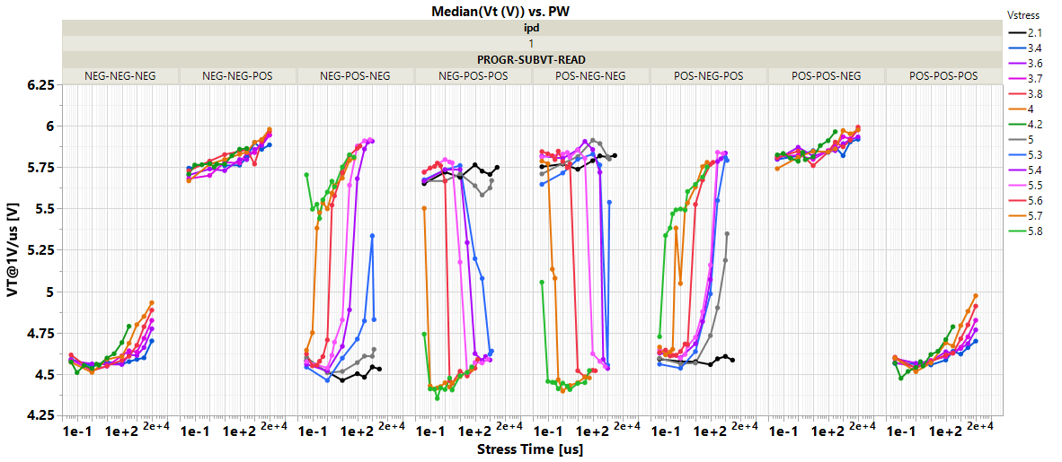
SubVt Bias Disturb/Drift Characterization

