Slide 1
Series 10
SxP Technology Development
IM JDP SOW
Version 1.0
April 3, 2012

Slide 2
Signature Page
This SxP Joint Development Program Statement of Work Rev 1.0 (“SxP Memory SOW”), having been approved by the JDP Committee is hereby approved by Intel and Micron respectively effective as of April 3, 2012, as signified by the signature of each company’s authorized representative below. It is understood and agreed that this JDP SOW may be amended in due course in accordance with the procedures set forth in the Joint Development Program Agreement.
MICRON TECHNOLOGY, INC. INTEL CORPORATION
By: By:
Name: Name:
Date: Date:

Slide 3
Revision Page
Approval Date | REV | Pages Affected | Was | Is | Comments
04-3-12 | 1.0 | ALL |  | Initial SxP Technology SOW
4/3/2012
Micron/Intel Confidential
3
Notes:
3

Slide 4
SOW Contents
0.0 SOW purpose
1.0 Strategy overview
  1.1 Pathfinding
  1.2 20nm process development
  1.3 Product Design
  1.4 Product Development
2.0 Project milestones
3.0 Process Development SOW
  3.1 Model of record definition
  3.2 Agrate pathfinding
  3.2 Boise Process development strategy
  3.3 Si resourcing plan
3.0 Design SOW
4.0 Product SOW
  Testchip support
  Alpha Device strategy
6.0 Package development - SOW
  Package requirements
  Development plan
7.0 SOW Deliverables
  Product cost
  Process flow definition
  Product performance
  Product manufacturability
8.0 Development budget
4/3/2012
Micron/Intel Confidential
4
Notes:
4

Slide 5
0.0 SOW Purpose
To define and communicate the development strategy targeted by the JDP committee to enable the initial product utilizing the SxP technology
To define project deliverables thru calendar year 2014.
To define milestones and performance metrics to track the progress towards the deliverables
To define the resource allocation and budget to achieve the targeted deliverables

Slide 6
SOW Contacts
Al Fazio Intel JDP co-manager
Russ Meyer Micron JDP co-manager
Greg Atwood Micron Design
Daniel Elmhurst Intel Design
Doyle Rivers Intel Product
Roberto Bez Micron Technology

Slide 7
1.0 Strategy

Slide 8
Strategy Overview
Materials development and integration pathfinding will be supported by Si and engineering resources in Micron’s Agrate site. Deliverable definition included below.
20nm process development will be supported by Si and engineering resources in Micron’s Fab 4. A 20nm test chip will be utilized for initial development work (“XP01”).
Initial alpha product (S15A) as defined in the design SOW will be taped out to fab 4 to drive product development.
Array and product development teams will be defined to support the development work in fab 4
Work to enable JDP roadmap beyond the 10 series process will be covered in a follow on SOW

Slide 9
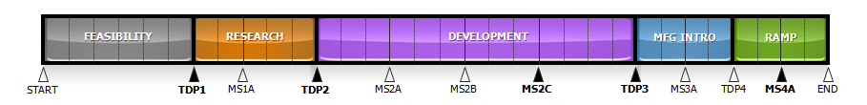
2.0 Program Milestones
# | Milestone | S15A
0 | Test Chip Tapeout “XP01” | Mar 03 ‘12
1 | Lead XP01 to probe | June 02 ‘12
2 | XF15 – structure mask tapeout | May 30 ‘12
3 | S15A data base release | Aug 31 ‘12
4 | S15A lead Si – 1.8 DPML | Nov 20 ‘12
5 | 20nm Tile functionality | Dec 30 ‘12
6 | 30% functionality demonstration - ES | Jun 28 ’13
7 | F4 30% yield | Aug 16 ‘13
8 | MFG intro - EFF | Sept 06 ’13
9 | >30% yield in Fab 2 | Dec 30 ’13
10 | Ship release | Jul 01 ‘14
11 | Qual release | Dec 31 ‘ 14
Milestones are a combination of historic
NAND cadence trends and aggressively
defined dates to hit top-down applications
Technode checkpoint dates to serve
as timeline assessment for schedule
confidence
TECHNODE CHECKPOINT Dates:
TDP1: WW26 2011 Go-no go
TDP2: WW35 2012 S15A timing
MS2B: WW03 2013 MFG strategy
TDP3: WW34 2013 EFF readiness
MS3A: WW26 2014 Ship release
TDP4: WW01 2015 S15A Qual
4/3/2012
Micron/Intel Confidential
9
Notes:
9

Slide 10
3.0 Process Development SOW

Slide 11
MOR definition
Current Litho mapping: 38 masking layers (7 - 193i, 9 – 193 dry, 12-248nm , 10 – I line) + 5 I-line alignment mark clears
Process Highlights
  Co salicided S/D and gate
  Dual oxide CMOS
  Poly fuses
  4 Levels of Cu metallization under array
  W wordline and bitline
  Dual deck with shared bitline architecture
  Al top metal with polyimide
Key contingencies
  Array etch and passivation schemes (liners, cleans, de-integrated etches)
  Array materials definition
  Alignment mark definition schemes
  Implant schemes for CMOS requirements
Link to MOR + contingency list

Slide 12
Process costs
Cost per wafer projection
Link to study details : This is an
unoptimized Rev 0 process flow.
Flow analysis to be updated
quarterly
The following metrics will be
Tracked thru this project:
Cost per wafer for a simulated
15K greenfield fab
15K greenfield start up costs
Cost of transition for a 15K
Fab equipped for 80s NAND
Cost of transition and greenfield projections

Slide 13
Moves Targets - Boise
Fab 4 will process XP01
Material at least thru the end
of calendar 2012.
Target 50-100 wafers per
week run rate on XP01
With S15A availability starts
Will transition from XP01
And ramp to 150 wafers/week
SxP moves / week
SxP outs per week
Priority slots and WIP
Allocations to match
Historic NAND levels

Slide 14
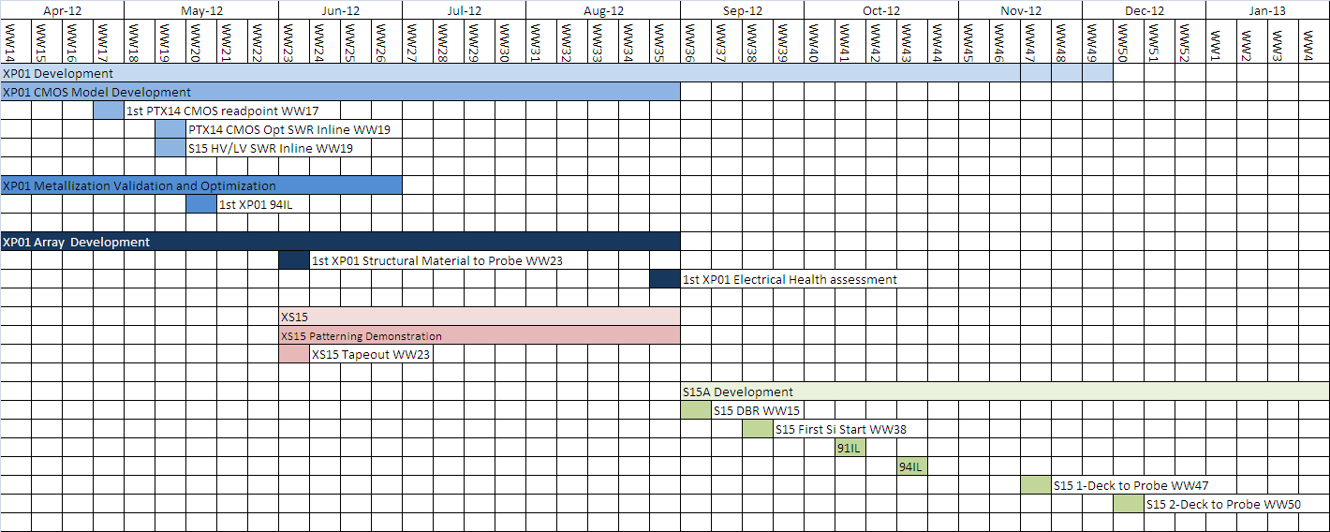
20nm REV 0 Build Strategy
XPO1 builds thru August with build plan in Q4 to be determined week by week
XS15 reticles defined to tape by end of May to enable look ahead pattern work
S15A cmos lots to get early review of CMOS/periphery functionality
S15A single deck flow to be enabled for potential troubleshooting
S15A lead silicon to target full double deck processing
Build strategy will be dynamically modified as project priorities require

Slide 15
SXP Technology
SOW for Agrate Activities

Slide 16
SXP activities in Agrate-F14 enabling the 20.5nm integration in Boise-F4
Focus on activities to anticipate the integration of the 20.5nm SXP technology:
  Sequence of materials (compositions and thicknesses) for 20.5nm
  WL and BL integration architecture demonstrated at 50nm
  2 decks integration compatibility
Materials for roadmap and support to the 20.5nm development

Slide 17
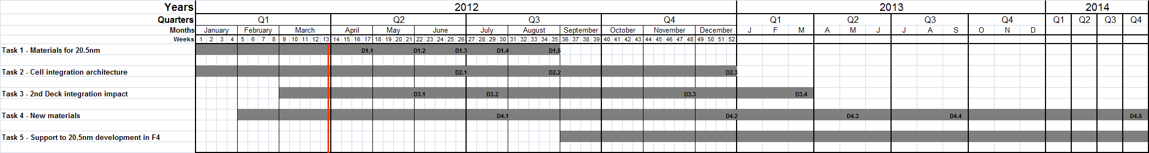
Agrate SOW proposal
Task 1 – Materials for the 20.5nm cell
Task 2 – Cell integration architecture
Task 3 – 2nd deck integration impact and characterization
Task 4 – New materials research
Task 5 – Support to 20.5nm development in F4

Slide 18
SOW Proposal (1/5)
Task 1 – Materials for the 20.5nm cell
  Goal: stack materials definition (BE, SD, ME, PM, TE) in terms of composition (C, SAG, IST’) and thicknesses for the 20.5nm SXP cell
    Metric: match the DTS1.2 in the intrinsic parameters
    Vehicle: cantilever, PTX14A Segmented Flow (SF), PTX14A Full Flow (FF)
    Connections: MOR/20nm process, RWB/DTS
    Timeline: March-August 2012
Deliverables
# | Description | ECD
D1.1 | Definition of minimum Carbon thickness (mechanical stability, barrier to diffusion) through intrinsic characterization | wk17/12
D1.2 | Cell stack (SD/PM) initial characterization with co-sputter | wk22/12
D1.3 | Cell stack (SD/PM) meeting DTS1.2 with single target SAG | wk26.12
D1.4 | Cell stack (SD/PM) to meet DTS1.2 and 20nm ME thickness electrical characterized | wk30/12
D1.5 | Cell stack (SD/PM) meeting key parameters of DTS1.2 | wk35/12

Slide 19
SOW Proposal (2/5)
Task 2 - Cell integration architecture
  Goal: WL and BL etch, sealing and filling with the morphology and integrity proven to be good for electrical performances
    Metric: cell functionality and yield progression
    Vehicle: PTX14A SF, PTX14A FF
    Connections: MOR/20nm process
    Timeline: March-Dec 2012
Deliverables
# | Description | ECD
D2.1 | Array without leakage (20% yield on MM structures ) | wk26/12
D2.2 | Cell intrinsic distribution (+/- 1 sigma) | wk35/12
D2.3 | Array funct. with DTS1.2 (10% yield - DB4 tile level -128x128) | wk52/12

Slide 20
SOW Proposal (3/5)
Task 3 - 2nd deck integration impact
  Goal: to prove the 1st deck functionality with the presence of 2nd deck; to integrate the 2nd deck to prove functionality; to characterize the new materials developed in Task 4 with the 2nd deck integration
    Metric: 1st deck same functionality w/ or w/o 2nd deck; same DTS for 1st deck; DTS for 1st and 2nd deck
    Vehicle: PTX14A FF and PTX14A FF with mask for 2nd deck
    Connections: MOR /20nm process, RWB/DTS
    Timeline: March 2012 – March 2013
Deliverables
# | Description | ECD
D3.1 | 2nd deck thermal budget impact on the 1st deck | wk22/12
D3.2 | 2nd deck dummy integration impact on 1st deck | wk29/12
D3.3 | First electrical characterization of 2nd deck | wk48/12
D3.4 | Second characterization with optimized flow | Mar/13

Slide 21
SOW Proposal (4/5)
Task 4 – New materials research
  Goal: continue the exploration of alternative materials and composition to improve cell performances and to sustain the scaling; integration method impact on new material (e.g. cleaning/sealing, etc..)
    Metric: better parameter than current DTS
    Vehicle: cantilever; PTX14A SF and FF
    Connections: RWB/DTS
    Timeline: March/12 – Q4/14
Deliverables
# | Description | ECD
D4.1 | PM3 (IGT system) and SD3 (STAG system) characterized on cantilever | wk30/12
D4.2 | PM3 and SD3 integration in full flow | wk52/12
D4.3 | PM4 and SD4 characterized on cantilever | May/13
D4.4 | Electrical characterization of 2nd deck with PM3/SD3 | Aug/13
D4.5 | PM and SD finalization for scaling | Q4/14

Slide 22
SOW Proposal (5/5)
Task 5 – Support to the 20.5nm development in F4
  Goal: sustain with electrical characterization and modeling the 300mm process
    Timeline: exit from path-finding on
Activities
# | Description | ECD
A5.1 | Definiton and evaluation of experiments
A5.2 | Electrical characterization on the F4 silicon
A5.3 | TCAD of specific trials
A5.4 | Modeling of cell behaviors

Slide 23
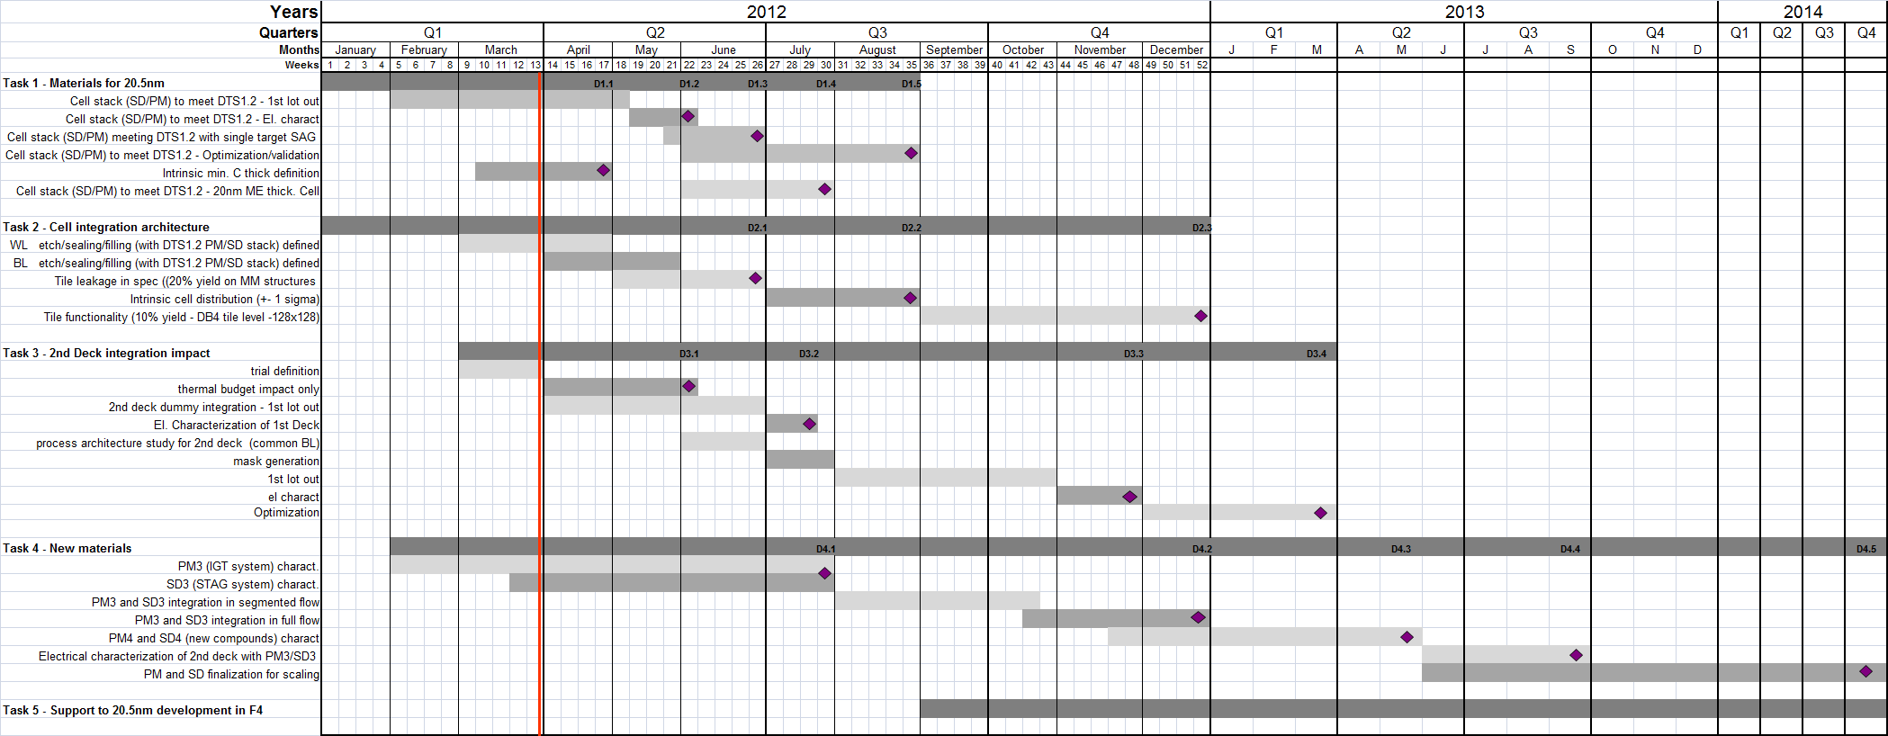
SOW proposal Gantt chart

Slide 24
4.0 Design SOW

Slide 25
Contents
Strategy
Key Features
Architecture
Milestones
Development & Resource Plan
MLC Architecture New Capabilities
Risk Areas
Silicon & PE Support
Stepping Support
Key Documents

Slide 26
Strategy
128Gb design capable of meeting full datasheet at PRQ while providing flexibility for silicon start-up
DDR4 electricals with SXP specific physicals & protocol
Priority – design decision making tree thru Alpha chip tapeout
    Schedule
      Energy
        Performance & Cost
Tape-Out schedule August 2012

Slide 27
Key Specifications / Features
Feature | Spec
Vcc / Vddq | 1.2v ±5%
Vhh | 3.3v ±10%
Vpp | 4.4 ±5%
Vnn | -4.1 ±5%
I/O Performance | 1600MT/s/pin (DDR)
Read Latency | 80ns
Write Latency | 8 tCK
Write Completion | 475ns
Sustained Read Throughput | 1600MT/s
Sustained Write Throughput | 550MB/s
Addressable Data Size | 16B
Feature | Spec
Read Power / Energy | 576mW / 45pJ/b
Write Power / Energy | 400mW / 91pJ/b
Idle Power | 30mW
Fast Standby / Exit Time | 1mW / 30ns
Slow Standby / Exit Time | 400uW / 10us
Powerdown / Exit Time | 100uW / 1ms
Feature | Description
Thermal Alert | Provides an asynchronous over temperature indicator pin
CS# Reduction | Supports daisy chain select logic with programmable ID assignment
Calibration | Automatic internal calibration of the output drivers and on-die termination values
Write Cycle Binning | Adjusts the reset pulse start current as a function of the write cycle bin indicator
Adjustable VDM | Adjusts the BL to WL voltage to 1 of 4 trimmable values
Interface | x8 Data IO, DDR4 electricals, Dedicated Command-Address bus, Differential bidirectional data strobe (DQS/DQS#), Differential clock input (CK/CK#), SXP Protocol

Slide 28
Key Specifications / Features - Status
Feature | Spec
Vcc / Vddq | 1.2v ±5%
Vhh | 3.3v ±10%
Vpp | 4.4 ±5%
Vnn | -4.1 ±5%
I/O Performance | 1600MT/s/pin (DDR)
Read Latency | 80ns
Write Latency | 8 tCK
Write Completion | 475ns
Sustained Read Throughput | 1600MT/s
Sustained Write Throughput | 550MB/s
Addressable Data Size | 16B
Feature | Spec
Read Power / Energy | 576mW / 45pJ/b
Write Power / Energy | 400mW / 91pJ/b
Idle Power | 30mW
Fast Standby / Exit Time | 1mW / 30ns
Slow Standby / Exit Time | 400uW / 10us
Powerdown / Exit Time | 100uW / 1ms
Feature | Start Up Plan | Long Term Plan
I/O Performance | Capable of operating at lower frequency while LVT development continues | 1600MT/s/pin (DDR)
Write Completion / Throughput | PCU designed to provide capability for “pulse and verify” reset algo | Single pulse concurrent reset 475ns write completion 550MB/s sustained write throughput

Slide 29
Key Specifications / Features - Status
Feature | Spec
Vcc / Vddq | 1.2v ±5%
Vhh | 3.3v ±10%
Vpp | 4.4 ±5%
Vnn | -4.1 ±5%
I/O Performance | 1600MT/s/pin (DDR)
Read Latency | 80ns
Write Latency | 8 tCK
Write Completion | 475ns
Sustained Read Throughput | 1600MT/s
Sustained Write Throughput | 550MB/s
Addressable Data Size | 16B
Feature | Spec
Read Power / Energy | 576mW / 45pJ/b
Write Power / Energy | 400mW / 91pJ/b
Idle Power | 30mW
Fast Standby / Exit Time | 1mW / 30ns
Slow Standby / Exit Time | 400uW / 10us
Powerdown / Exit Time | 100uW / 1ms
Freezing S15A0 architecture. Pursue long term resolution to intercept Q2’14 PRQ.
Feature | Spec | Current Value | Action Plan
Read Latency | 80ns | 94ns | Known optimization opportunities with energy cost.
Energy | Rd: 45 pJ/b Wr: 91 pJ/b | 61pJ/b 134pJ/b | Stick level optimization opportunity identified with diesize cost. With Sequential Addressing: Rd=47pJ/b & Wr = 120pJ/b.
Idle Power | 30mW | 110mW | Dominated by LV transistor leakage in address path (80mW).
Fast Standby | 1mW / 30ns | 9mW / 120ns | Dominated by 10 regulators that need to be maintained on during mode.

Slide 30
Architecture
Feature / Spec | S15A
Density | 128Gbit
Die Size | <202mm2
Organization / Concurrency | 16 independent 8Gb partitions capable of read while write
Sticks / Partition (same as Tiles / Slice) | 128
Tiles / Stick (same as Slices / Partition) | 4
# of tiles / partition | 512
Redundanct Repairs | 544 (32 row repair solutions per partition; 2 column repair solutions per partition)
Tile Size | 16Mbit
Columns / Tile | 2Kbit
Rows / Tile / Deck | 4Kbit (½ above BL driver & ½ below)
Cell Structure | WL = Top (AM4) / Bot (AM1) BL = Center (AM2 & AM3)
WL Driver | Edge / Under Tile
BL Driver | Center / Outside Tile
Periphery | Center (perpendicular to Pads)
Pads | Single sided

Slide 31
Milestones
Milestone | Commit
Conceptual Design Review | March 26-27, 2012
Collateral Delivery | April 4, 2012
Rev 2 | June 1, 2012
Final Design Review | July, 2012
Rev 3 | July 27, 2012
Database Ready (DBR) | August 31, 2012

Slide 32
Development & Resource Plan
Design Lead: Matt Goldman
Section Leads:
  HV Analog: Martin Szwarc
  IO / Data path: Mike Allen
  Core / Array: Owen Jungroth
  Logic: Rezaul Haque
    Layout: Julie Picarello
    DA: Sean McDermott
    Architect: Rajesh Sundaram
    TestModes: Manjinder Bains
Function | Q1’12 | Q2’12 | Q3’12 | Q4’12
Analog | I: 6 | I: 6 | I: 6 | I: 6
Core | I: 10 M: 2 | I: 10 M: 2 | I: 10 M: 2 | I: 10 M: 2
IO | I: 6 | I: 6 | I: 6 | I: 6
Logic | I: 13 M: 4 | I: 13 M: 4 | I: 13 M: 4 | I: 13 M: 4
Layout | I: 27 | I: 27 | I: 27 | I: 8
Notes:
Modeling supported by San Jose Modeling team.
Resource plan is Estimated. Final budget based on JDP Plan’12.

Slide 33
Design Environment & Collateral
Item | Status
compLib | Available for use
pcell | Available for use
stdPCMS80A | Available for use
stdcell_Lib | Targeting release ww13
Fuse Collateral | Espec due April 4th
ESD Collateral | TBD
Design rule | Currently using rev0.65
DRC/LVS | Available for use
Espec | Espec due April 4th
Cell model | Primitive Collateral due April 4th
Device model | Primitive Collateral due April 4th
Interconnection model | Primitive Collateral due April 4th
StarRC | Available for use
AutoP&R w/ PowerGating | Capability development in progress
UVM environment | Available for use
Risk / Challenge: Developing final silicon to match paper based models used for tape-out.
4/3/2012
Micron/Intel Confidential
33

Slide 34
Stepping Support
Design steppings / modifications will be supported until the target device performance and manufacturing stability is met or both parties agree that no additional changes will be made

Slide 35
Back-up

Slide 36
Design Revision Definitions
Rev 0 – Starting set of schematics
Rev 1 – Sheet level implementation of all DDS features (design and test mode)
Rev 2 – Circuits ready for Layout
  Requires sheet level performance sizing complete
Rev 3 – Fullchip functional and performance validation of features, specifications and test modes
DBR – Database Ready

Slide 37
5.0 - S15A JDP Product SOW

Slide 38
Product Schedule
Milestone | Target Date
F4 Tape Out | August 31, 2012
F4 First Silicon | November 15, 2012
First Wafers to Assembly | December 15, 2012
Engineering Samples | June 28, 2013
F2 Ship Release | July 1, 2014
F2 Qualification Samples | November 24, 2014
F2 Qualification Release | December 31, 2014

Slide 39
Product Goals – Qualification
Key Specifications | Values
Operating Voltages | Vpp=4.4V; Vnn=-4.1V
Operating Temperature | 0 – 85°C (Tj)
Read Power / Energy | 576mW / 45pJ/b
Write Power / Energy | 400mW / 91pJ/b
tCK | 1.25ns
Read Latency | 80ns¹
Sustained Read Throughput | 1600MB/s¹
Sustained Write Throughput | 550MB/s¹
Maximum Write Cycles | 1E7
Selected Cell Read Disturb | 1E9
Retention | 1 yr. @ 55°C
RBER | 1E-5
Quality | 500 DPM
1. Timings referenced to 1.25ns tCK

Slide 40
Product Goals – Ship Release
Key Specifications | Values
Operating Voltages | Vpp=4.4+0.25V; Vnn=-4.1-0.25V
Operating Temperature | 0 – 85°C (Tj)
Read Power / Energy | 768mW / 60pJ/b
Write Power / Energy | 500mW / 115pJ/b
tCK | 2.5ns
Read Latency | 120ns¹
Sustained Read Throughput | 800MB/s¹
Sustained Write Throughput | 250MB/s¹
Maximum Write Cycles | 5E5
Selected Cell Read Disturb | 1E6
Retention | 6 mo. @ 55°C
RBER | 3E-4
Quality | 5000 DPM
1. Timings referenced to 2.5ns tCK

Slide 41
Development & Manufacturing Strategy
Initial tape-out and technology development will occur in Boise Fab 4.
No Product Qualification or Ship Release from F4.
Technology development support for F4 will include package builds, backend test development, and look-ahead qualification runs.

Slide 42
Wafer Test Strategy
JDP Probe teams will jointly develop all wafer test capability required to support the technology development and the full product specification. The required test flows are defined by the Product Engineering team. Flows may include:
  Wafer Test Flow
  Wafer Speed Binning Flow
  WLR / ICF / ECF Flows
JDP Probe teams have jointly identified the Verigy V5400 as the probe platform for S15A.
JDP and IMFT Probe teams will jointly develop all H/W and S/W required to support the wafer test flows.

Slide 43
Wafer Test Resourcing
Intel and Micron Probe teams will provide resources to support S15A wafer test development.
Intel will serve as the development lead for the primary wafer test flow.
Intel will serve as the development lead for the wafer level reliability flow(s).
2012 Probe HC Allocation
 | CQ1’12 | CQ2’12 | CQ3’12 | CQ4’12
Intel | 2 | 3 | 3 | 3
Micron | 0 | 1 | 3 | 3
IMFT | 0 | 0 | 0 | 0

Slide 44
Package Test Strategy
JDP Test teams will jointly develop all package test capability required to support the technology development and the full product specification. Required test flows are defined by the Product Engineering team. Flows may include:
  Hot Sort
  Cold Final
  Burn-in
JDP teams will jointly identify package test platforms which meet the technology development and product requirements.
JDP Test teams will jointly develop all H/W and S/W required to support the package test flows.

Slide 45
Package Test Resourcing
Both Intel and Micron Test teams will provide resources to support S15A package test development.
Micron Test will serve as the development lead for ATE test flow development.
Micron Test will serve as the development lead for Burn-In flow development.
2012 Test HC Allocation
 | CQ1’12 | CQ2’12 | CQ3’12 | CQ4’12
Intel | 0 | 0 | 2 | 2
Micron | 0 | 0 | 2 | 2

Slide 46
CMOS & Array Reliability
JDP Reliability teams will jointly support development of volume and bench level reliability data collection to enable technology and Product development.
JDP Reliability teams will jointly develop wafer and package test reliability flows and development line sampling plans for both intrinsic and extrinsic CMOS and array reliability issues.

Slide 47
Reliability Resourcing
JDP Reliability teams will each supply resources to support CMOS and array reliability testing and analysis.
Intel Reliability will serve as the lead on defining array reliability metrics and measurement methodologies.
Micron Reliability will serve as the lead on defining ESD, CMOS, and interconnect reliability metrics and measurement methodologies.
2012 Reliability HC Allocation
 | CQ1’12 | CQ2’12 | CQ3’12 | CQ4’12
Intel | 0 | 1 | 1 | 2
Micron | 0 | 3 | 4 | 5

Slide 48
Product Development Strategy
JDP PE teams will jointly support product design validation, characterization, and debug.
JDP PE teams will jointly support definition and implementation of all wafer and package test flows.
JDP PE teams will jointly develop all H/W and S/W capabilities needed to support:
  µProbe / Wafer debug and EFA
  Interface Validation/Characterization
  Array Characterization
  Package EFA
JDP PE teams will jointly support product and test flow optimization to enable technology development, product qualification, and HVM.

Slide 49
Product Development Resourcing
Intel PE will serve as the S15A Product Development lead.
Micron PE provide primary H/W and S/W development resources for high speed interface characterization.
Micron PE will selectively support other key areas of product development.
2012 PE HC Allocation
 | CQ1’12 | CQ2’12 | CQ3’12 | CQ4’12
Intel | 10 | 11 | 15 | 17
Micron | 3 | 3 | 4 | 6

Slide 50
Qualification Strategy
JDP QA teams will jointly define the test flows needed for qualification. Qualification flow definition will be based on JEDEC standards adapted as needed for SXP.
JDP QA teams will support look-ahead qualification runs to enable technology development.
JDP will support silicon and package qualification which represents the envelope of the product requirements.

Slide 51
QA Resourcing
Intel QA will serve as the lead on flow definitions and execution of the product Qualification.
Micron QA will serve as the lead for ESD and Latchup Product Qualification.
Execution of the Qualification flows will be divided between Boise and Folsom to efficiently utilize existing JDP resources.
2012 QA HC Allocation
 | CQ1’12 | CQ2’12 | CQ3’12 | CQ4’12
Intel | 0 | 0 | 1 | 1
Micron | 0 | 0 | 0 | 0

Slide 52
4.0 Package SOW

Slide 53
Packaging & Assembly Strategy
JDP Packaging teams will proceed with a path-finding effort to define a package design which meets the component and application level requirements (Electrical, Thermal, Mechanical, and Ecological). Package path-finding exit should be achieved by September 28, 2012.
At the close of the path-finding effort the JDP Packaging teams will:
  Identify packaging technologies (e.g. wire-bond, etc..), configurations (ball-out, stacking, etc..), BOM, and assembly process.
  Identify gaps to meeting product requirements.
  Define a Package Development SOW which includes a committed schedule for package development and execution.

Slide 54
Package Attributes
Specifications | Values
Die Characteristics
Operating Voltages | Vcc/Vddq = 1.2V ±5%; Vhh = 3.3V ±10%; Vpp=4.4V ±5%; Vnn=-4.1V ±5%
Operating Temperature | 0 – 85°C (Tj)
Power | 400-600mW active per die
I/O Interface | DDR4 Electricals
tCK / Data Rate | 1.25ns / 1600MT/s/pin
Package Characteristics
Die Dimensions | 13x15mm
Package Dimensions | 17x17mm
Stack Height Configurations | SDP, DDP, QDP, ODP
Max. # Channels | 2
ODP Z-Height Range | 1.0 - 1.5mm
Theta-JA | 14-17 °C/W¹
Theta-JB | 6-8 °C/W¹
Theta-JC | 1.5-2 °C/W²
Mechanical Reliability | TBD
Depending on Board and Package BOM
Depending on Package BOM

Slide 55
Packaging Risks & Future Considerations
Risks:
  High speed signal integrity in 4 and 8 die stacks
  Thermal performance in 4 and 8 die stacks
  Unforeseen silicon to package integration issues
Future Considerations – To be included in a later SOW after package design path-finding is complete
  Package cost targets
  Assembly success criteria (process, yield, etc..)
  Assembly process/materials characterization plans
  Package PFA support for qualification
  Intel Assembly team early involvement model
  HVM assembly

Slide 56
Packaging & Assembly Resourcing
JDP Packaging teams will jointly support all areas of package design and analysis.
Intel will serve as the lead on package design and analysis.
Micron will serve as the lead on silicon to package integration, Assembly process definition and manufacturing.
2012 Package/Assembly HC Allocation
 | CQ1’12 | CQ2’12 | CQ3’12 | CQ4’12
Intel | 2 | 2 | 2 | 3.5
Micron | 0 | 4 | 4 | 5

Slide 57
5.0 SOW Deliverable

Slide 58
SOW deliverables
Qualifiable process as defined in the 10 series SxP Model of Record.
Array and cell capability as defined in the DTS
Process and design performance to hit the device specs as stated in the design and product SOWs
Package technology to enable the required system performance

Slide 59
7.0 Development Budget

Slide 60
Budget Planning
This SOW project scope activities for 2012 are consistent with the 2012 SXP JDP budget.
Budgets for subsequent years of this SOW will be adopted on a yearly basis, as part of the overall SXP JDP budget.
4/3/2012
Micron/Intel Confidential

Slide 61
Back up

