Slide 1
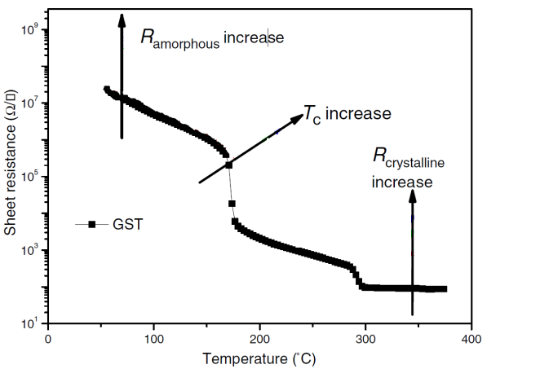
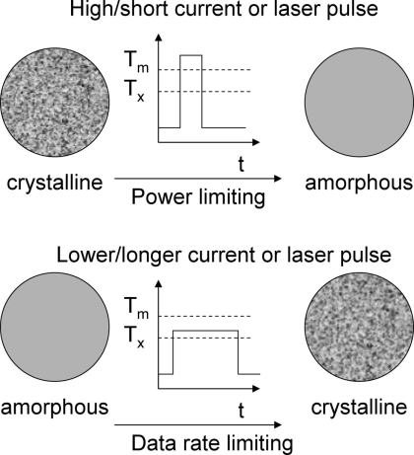
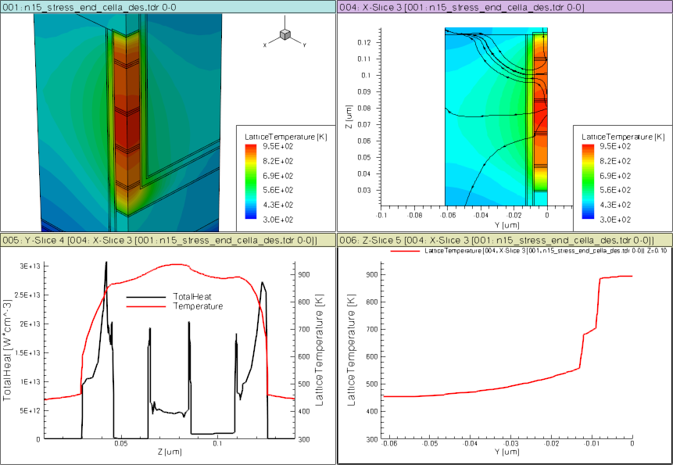
SXP Memory: Phase Change Model
(GST example)
E
Te
V
CB
E_{c}
Crystalline
E_{v}
E_{f}
FCC
VB
10% structural vacancies result in localized states near LP band
E
Te
CB
E_{c}
SD
PM
Amorphous
E_{f}
BE
ME
TE
E_{v}
VB
Over- and under-coordinated Tellurium lead to defects/traps

Slide 2
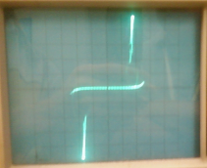
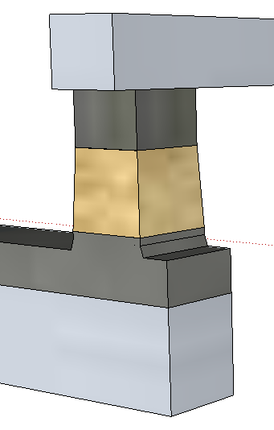
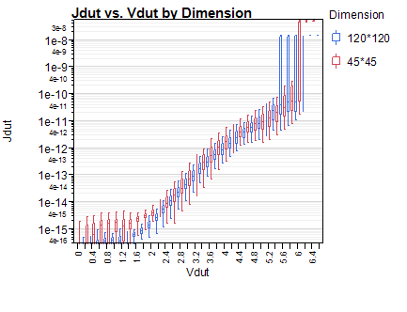
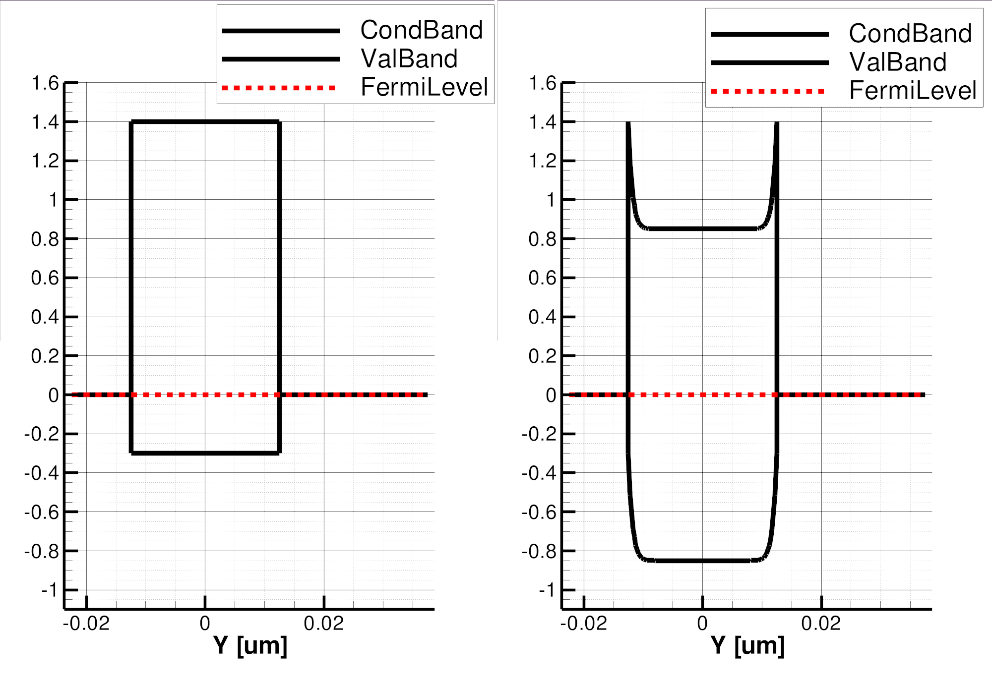
SXP Selector: Ovonics Threshold Switch Model
Near Threshold
On-state
BE
BE
TE
TE
Top
Electrode
64
J [A/nm²]
(120nm)²
Selector
J [MA/cm²]
(45nm)²
48
Bottom
Electrode
32
Full-STACK
Electrode only
16
φ_{B}=.85eV
3.0eV
4.4eV
V [Volts]
V [Volts]
1.7
1.7eV
E_{F}
BE
TE
BE
BE
SubThreshold
PF conduction
Threshold,
(positive feedback)
Snapback Regime
TE
TE

