Slide 1
SxP Device Physics
Phase Change
Threshold Switching
Structure and band diagram to illustrate the origin of conductivity of a chalcogenide material.
Evidence of phase change from thermal hysteresis.
Power delivery with pulse to change phase
Physics and model of phase change in SxP technology (electrode is the heater)
Structure and Band diagram of a SD devices, electrode included.
Subthreshold conduction is a Poole-Frankel emission process
Space charge injection delocalizes, the mobility gap decreases and carriers multiply at cathode as device biased in near threshold.
Carrier multiplication at both electrodes is the positive feedback mechanism leading into threshold, snapback as shown in negative differential resistance regime.
On-state is due to carrier injection (tunneling) from both electrodes. Injected carrier recombine in the bulk or drift through to other electrodes.

Slide 2
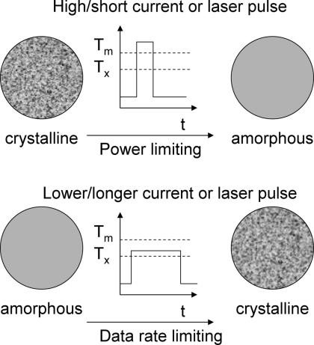
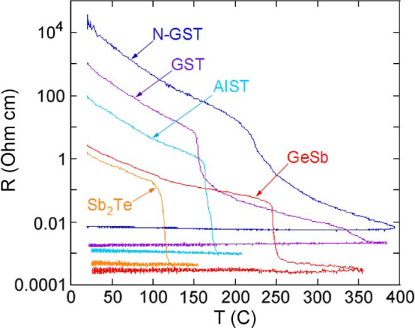
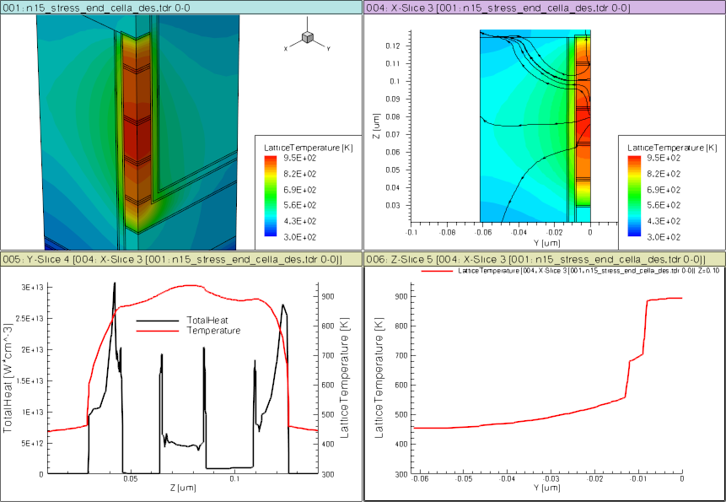
E
CB
E_{c}
Acceptor-like
localized states
Crystalline
E_{v}
E_{f}
VB
LP_{Te}
10% structural vacancies result in localized states near LP band
E
CB
Amorphous
E_{c}
Donor( C₃⁺ )
SD
PM
E_{f}
Acceptor ( C₁⁻ )
BE
ME
TE
E_{v}
VB
LP_{Te} ( C₂⁰ )
Over- and under-coordinated Tellurium lead to defects/traps

Slide 3
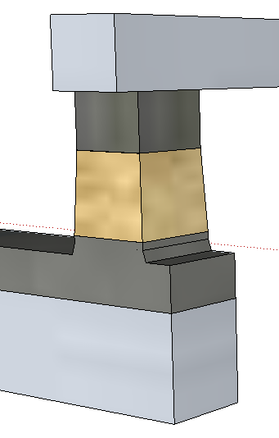
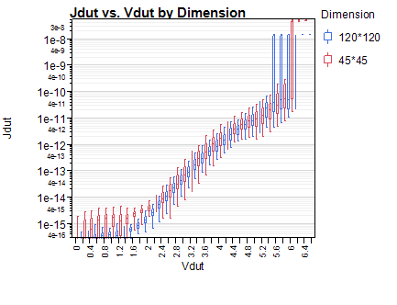
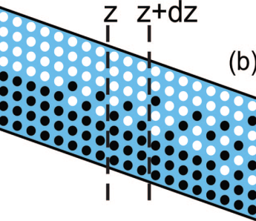

Neal Threshold
Top
Electrode
BE
(120nm)²
J [A/nm²]
TE
Bottom
Electrode
(45nm)²
BE
SubThreshold
PFE conduction
TE
BE
TE
V [Volts]

Slide 4
On-state
(4)
(1)
(2)
Top
Electrode
(3)
64
BE
(2^{R})
(2^{R})
(4)
20s/SD2’/60s
(3)
J [MA/cm²]
40s/SD2’/40s
(2)
Bottom
Electrode
48
30s/SD2’/30s
(1)
TE
50² nm² Cell
32
(4e)
BE
(5)
16
(4^{h})
(3)
(6)
(2)
(1)
(7e)
BE
TE
TE
V [Volts]
Threshold,
Snapback, NDR Regime
(7^{h})

Slide 5
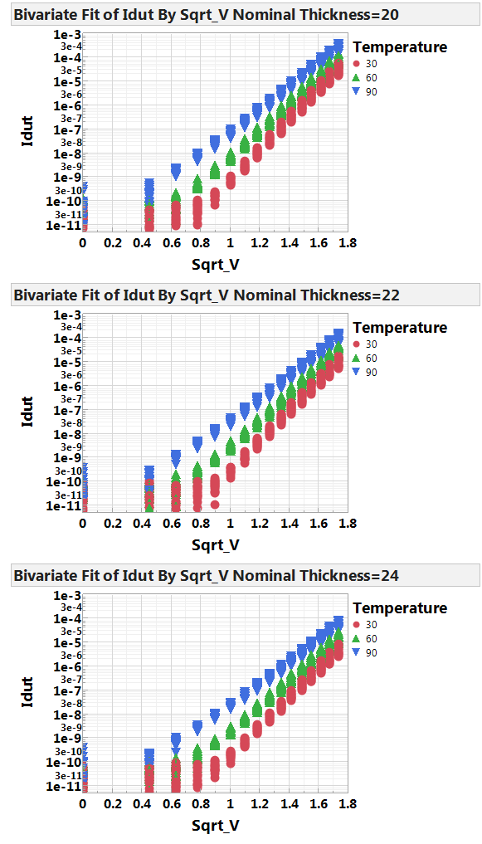
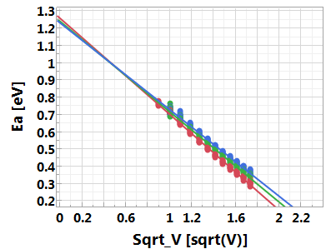

Sub-threshold I-V is a Poole-Frankel Emission
(120nm)²
nm
nm
nm
J [A/nm²]
(45nm)²
V [Volts]
Sub Threshold: Experimental validation of trap hopping conduction behavior; E_{A} matches ½ of optical bandgap
Near threshold: Due to space charge injection exponentially as the Poole–Frenkel effect delocalizes, tail states increases; the mobility gap decreases.

Slide 6
Threshold Switching is a current density triggering event: Refute prior bulk model of filamentation subject to electron-phonon interaction or band to band tunneling
15nm x 15nm Cell
23nm x 30nm cell
97uA
43MA/cm²
110uA
125uA
55MA/cm²
110uA
33MA/cm²
38MA/cm²
43MA/cm²
V_{TH} [Volts]
Threshold Point Characteristics
per Cycling Effects
J_{TH} [A/cm²]
Other evidences of threshold switching an current density triggering but not a critical field event 1) V_{TH} is linear scalable but E_{TH} is not a constant per thickness experiment; 2) J_{TH} is constant from 25℃ to 120℃ (with subVt conductive E_{A}=~1eV); 3) J_{TH} depends on electrode (Mo vs. C on αPM2 with identical SubVt I-V)
Delocalized carriers multiplied
near interface in Electrode

Slide 7
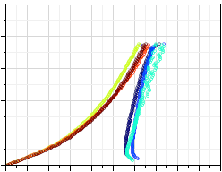
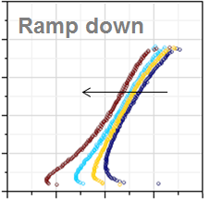
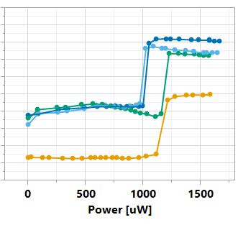
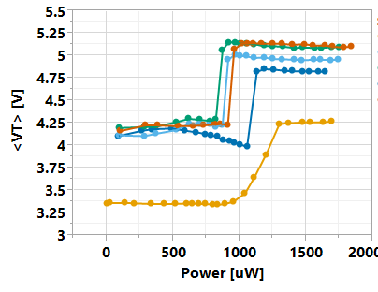
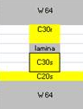
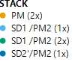

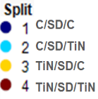
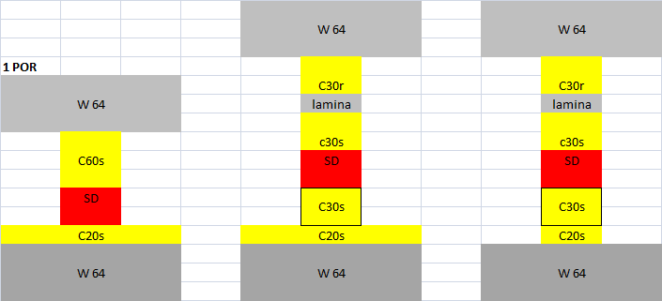

On-State and Speculative Models Early Phase of Model Development, with a focus on Electrode/Bulk Interaction
Electrode only
NDR: ∆V_{T,SD} ↘ as J↗
Various Electrodes (𝛒)
J [MA/cm²]
J [MA/cm²]
20
Electrode + SD
20
12
12
Melting Temp_{PM}
4
4
.5
1
1.5
V[Volts]
1.2
1.4
V[Volts]
Negative Differential Resistance Regime: High potential carriers leaving SD mobility edge falling on electrode multiply at Interface; EHPs are generated and E-field push the charged particles as a positive feedback mechanism; The excess carriers fill the traps forming a sharp and narrow tunneling barrier at both interfaces, collapse the voltage cross the SD bulk; the current controlled S-type NDR leads dual carrier conductions in on-state; Energy dissipation similar to Joule-heating effects (evidence on melting of PM) Still need to validate the evidences on E-H recombination by Vezzoli et.al. [JAP 45 (1974)]
Experimental evidence of sustainable current density > 200MA/cm² for > 10sec using un-confined structures (intrinsic)

