Slide 1
SD / Electrode Schottky barrier
Modeling and Silicon data overview
Agrate TCAD team wk5-2014

Slide 2
Outline
Metal/SD1/Metal band structure
Dielectric like → fully depleted
Semiconductor → large trap density in the energy gap
CV check (Dielectric vs Semiconductor)
Schottky SD/Metal model
Room Temp IV fitting
Carbon work-function?
CAP vs XPS data (F14)
LOT_ID | Wafer | Thickness | Alloy | Io_PF_1E3cyc | STS_PF_1E3cyc
CLVB212 | 2 | 35nm | C/SD1/C | 2.67E-18 | 9.83
CLVB194 | 17 | 35nm | TiN/SD1/C | 3.22E-17 | 9.04
CLVB194 | 7 | 35nm | TiN/SD1/TiN/C | 8.08E-14 | 5.86
CLV EXP IV DATA (C vs TiN)

Slide 3
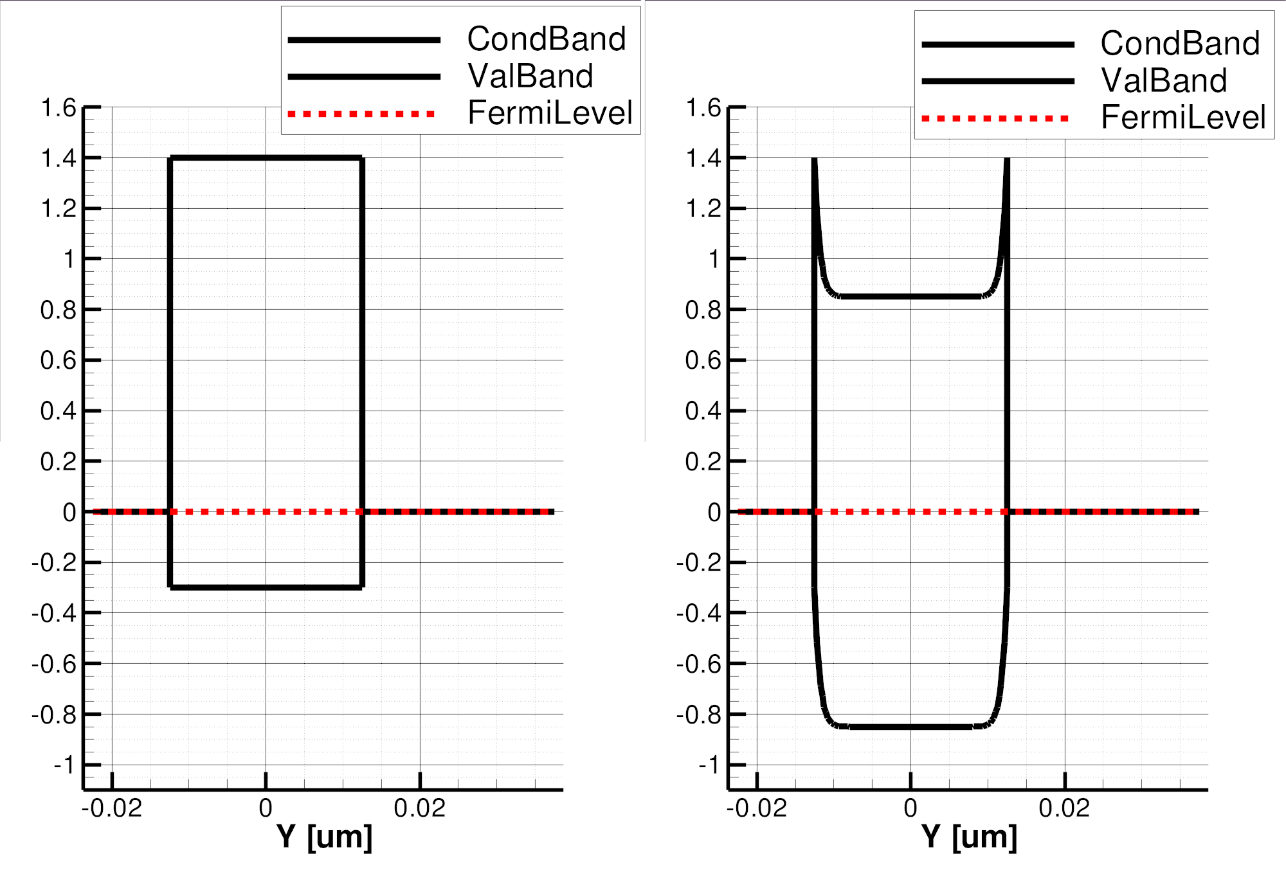
Metal/SD(Ptype)/Metal band structure 1
3.0
3.0
E_{barrier}= 0.3 eV
E_{barrier}= 0.85 eV
4.4
1.7
4.4
SD
stand-alone
1.7
Depleted region
Acceptor/Donor traps placed uniformly in the gap
(conc=1e21 cm⁻³)
E
SD
(fully-depleted)
E
E
SD
E
Fermi level in SD held by the electrode work-function
Hole accumulation in the whole SD layer (if electrode wf is larger than SD one)
SD works as dielectric
SD Fermi level pinned in the middle of the gap by the traps in the energy gap
Hole accumulation only close to the electrodes interface
E_{barrier} does not depend on electrode material

Slide 4
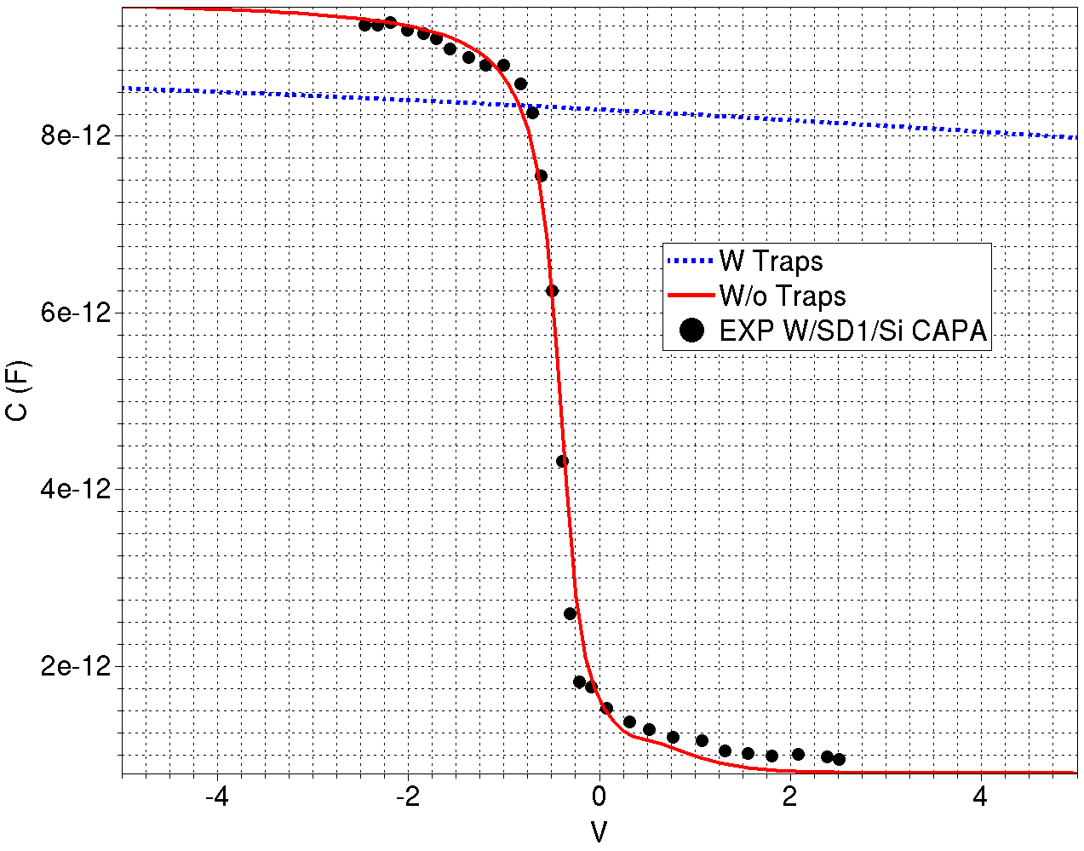
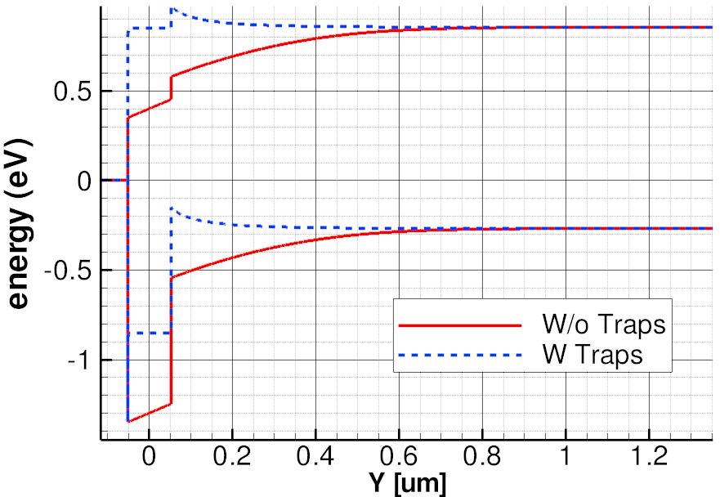
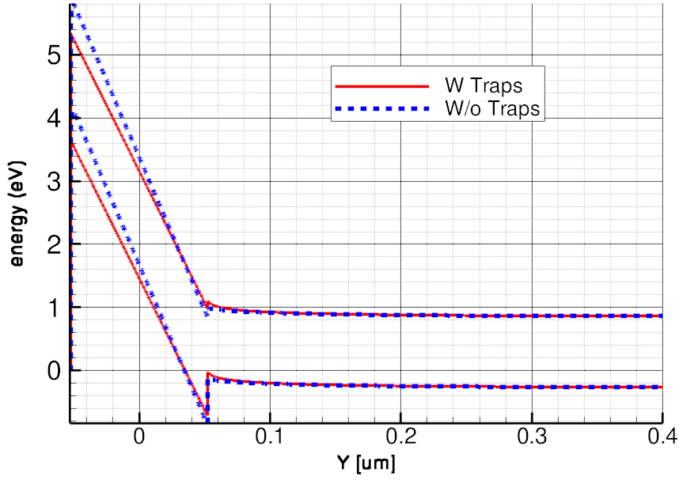
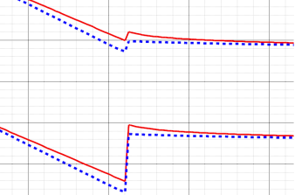
Which scenario? ➔ W/SD1/Si (P⁻) CV
W (Metal)
Φ [eV] | 4.55
SD1 (Semiconductor)
Eg [eV]* | 1.7
Χ [eV]* | 3.0
ε [1] | 10.5
* Do not toggle the CV curve → none info can be extracted from CV fitting
- 5V
0V
Weaker hole accumulation @ Si/SD interface with traps
CAPACITOR data compatible only with no traps case

Slide 5
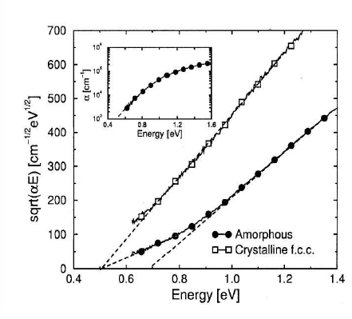
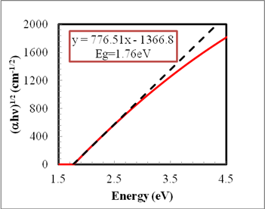
Optical spectra
GST
DOS
cond
val
E_{G}
E_{T}
No states here
Absorption optical spectra in agreement with the no traps scenario
GST data shows large traps concentration close to the bands (true also for SD?)
Need low energy – hi resolution optical spectra on SD1 sample
SD1
L. Laurin switching modeling 2010
P. Fantini EPCOS 2012

Slide 6
Schottky model
Assumptions
SD slightly Ptype semiconductor (E_{G}=1.7)
No traps in the middle of the gap of SD
Large traps density close to the valence bands (PF conduction)
Electrode modeled as metal material (no energy gap)
SD Fermi level held by electrode work-function (SD fully depleted)
TiN wf deeper than C one (4.7 vs 4.4 eV → F4 data)*
Conduction Band
E
SD
E
C wf
TiN wf
E_{barrier}
E_{A} C
E_{A} TiN
Trap band (PF)
E_{T}^{PF}
Valence Band
* Not in agreement with F14 and lit data → C wf ~ 5.1 eV, TiN wf ~ 4.7 eV

Slide 7
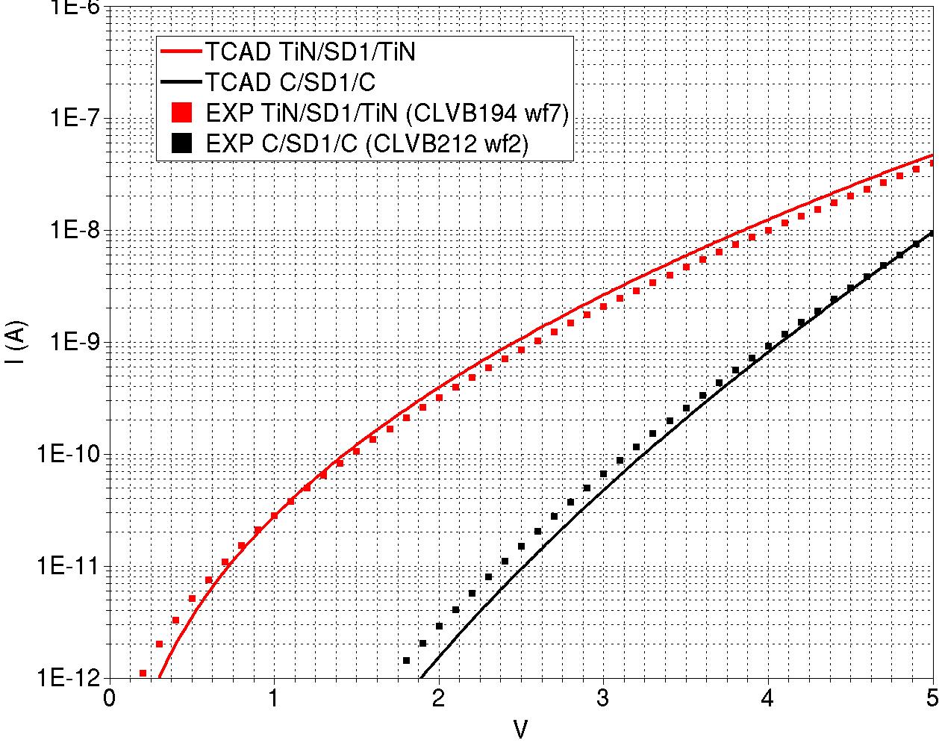
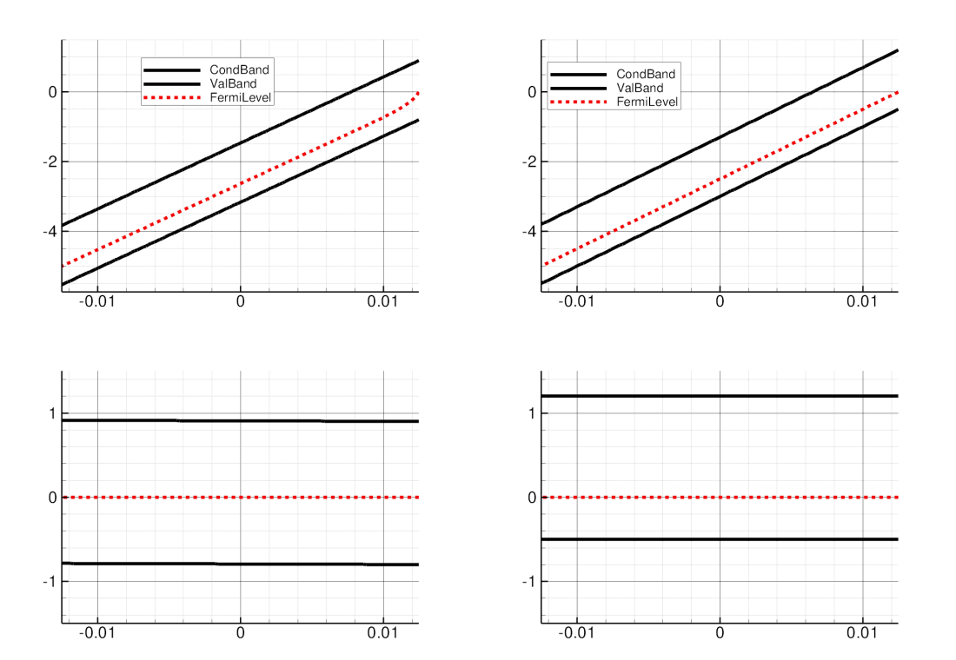
CLV ST IV fitting
1D mesh
C electrode
TiN electrode
1e3 cycled
Trap band (PF)
Trap band (PF)
E_{barrier}
E_{barrier}
E_{T}^{PF}
Trap band (PF)
E_{T}^{PF}
Trap band (PF)
SD1 (semiconductor)
Eg [eV] | 1.7
Χ [eV] | 3.0
E_{T}^{PF} [eV] | 0.3
ε∞ (PF)[1] | 7.8
Model params
C (Metal)
Φ [eV] | 4.4
ε∞ (schottky)[1] | 3.78
TiN (Metal)
Φ [eV] | 4.7
ε∞ (schottky)[1] | ∞*
*No barrier lowering @ SD/TiN interface (its contribute should be negligible since the highest barrier is the SD bulk traps one)

Slide 8
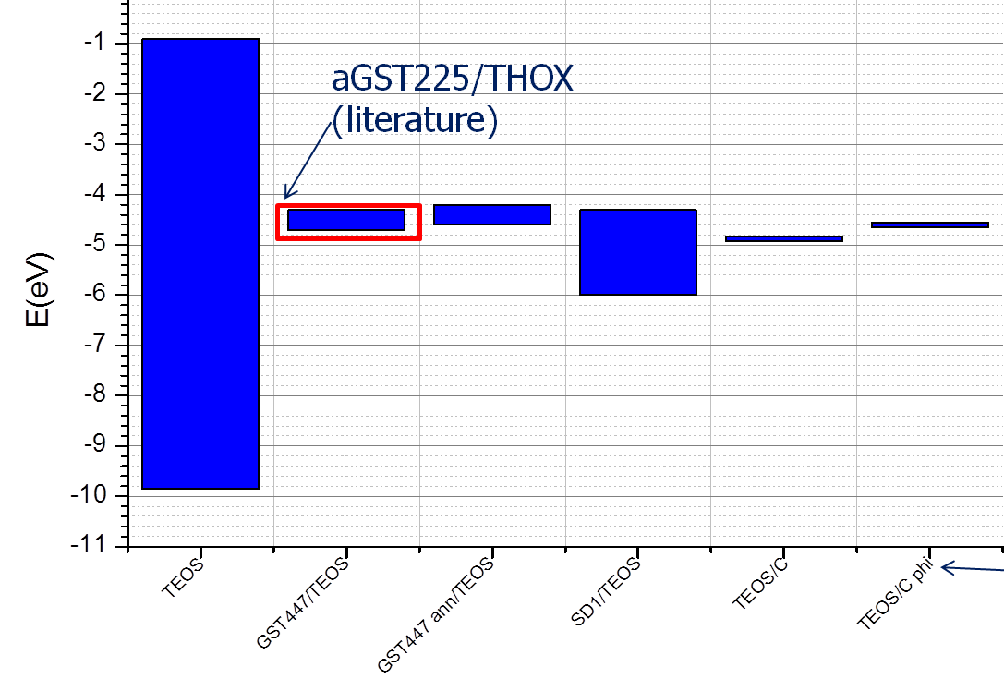
Carbon Work-Function
C/SD/Si
C/SD/Si CAP →
W+C/SiO₂/Si CAP →
XPS (wrt TEOS) →
CLV CAPACITOR DATA
CLV CAPACITOR DATA 1
XPS data

Slide 9
Schottky model: conclusions
Good agreement between TCAD and EXP IV using the same model parameters for SD1 material (only electrode ones were changed)
Electrode material can toggle the activation energy of conduction
TiN/SD1/TiN STS handled by SD1 bulk PF barrier lowering while C/SD1/C STS by the C/SD1 schottky one
Not in agreement with F14 and lit. material params (C wf deeper than TiN one)
Not able to explain why the post bake carbon sample comes back to the virgin state while the TiN one not
EXP check: Electrode material with deeper work-function should minimize the interface barrier (and thus its contribute to the ST conduction)

Slide 10
Bonus slides

Slide 11
SD Optical characterization

Slide 12
SD1 POR Optical Characterization
Experimental
25,50,75nm on 100Å oxide and silicon
KT F5 (OXMEAS1)
Wider but noisier in IR region
KT SpectraFX (OXMEAS11)
Low rough./native contrib.
Low confidence on quantification: <7Å
Consistent with low oxidation (XPS)
Models
Tauc-Lorentz (4 parms , off-line model)
Lorentz 2xHO (7 parms., in-line/off-line)
Eg=1.77±.01eV (σ 13pts/6wfs)

Slide 13
SD0 – SD1 comparison
SD1 has lower n and k
Higher Eg
1.77eV vs ~1.2eV
Follow up
New alloys characterization
2 thicknesses on Si
Capping
Inline monitor of SD1
SD0
SD1

Slide 14
SD CAPACITOR DATA
CLV CAPACITOR DATA (PFantini)
CLV CAPACITOR DATA 1 (PFantini)

Slide 15
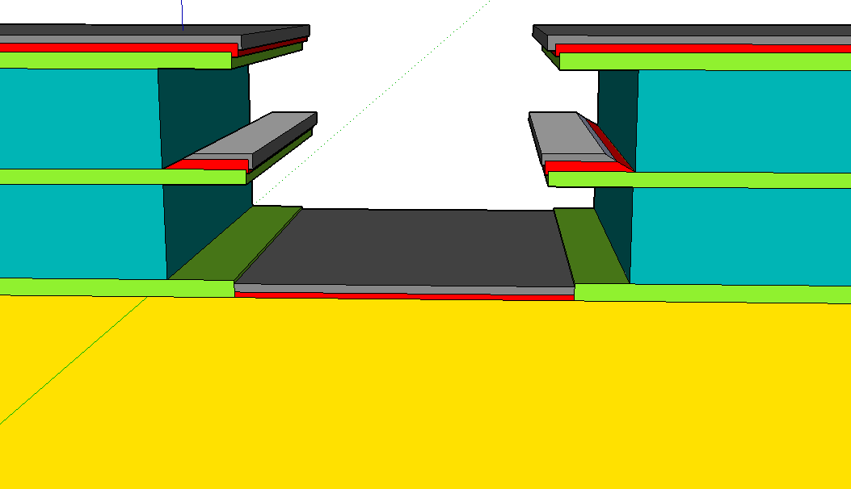
W/SD/Si capacitor
CLV-Capacitor with PAD mask
Native P-type Si substrate

Slide 16
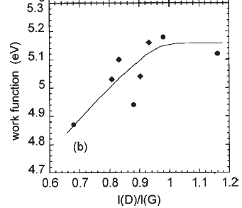
C/SD/Si capacitor
Si/SD/C
JAP 90, 2024 (2001)
α-C with higher and higher amount of sp² (up to 70%)
WF measured via field-emission
W
Non-quasi-static effects are expected for the Carbon film resistance
The ‘effective area’ explored decreases with frequency
We are improving the structure terminating the Carbon electrode with a Tungsten layer that should drive the signal on the entire capacitor area

