Slide 1
Common VDM – Next Rev ?

Slide 2
Binning / Strategy
Trending Register | Bin | Sigma | Drift Coverage | Forgiveness
Nevil | WF:* | 2 | >=8 | 8
Sanjay | WF:* | >=2 | 10 | 8
Russ | WF:* | >=2.5 | 10 | 7 ?
Al | WF:* | 3 | >=10 | 6 ?
1usec
10Ksec
1usec
10dec
Xσ/3σ
E2
E3
VDM1
Problem Statement:
Systematic defect can be covered by AO.
Random defects cannot be covered by AO
Strategy for probe
Move to “Sanjay” Category
Select VDM based on 10 decade drift margin at probe
Probe Test Set at 10sec VDM and Reset at 25usec VDM
Create a trend register or add bin for visibility/selecting units for probe
RBER Trend : 1usec,10sec and predict 10K sec rber
Drift Trend
Request custom crunch based on Sanjay’s AO script

Slide 3
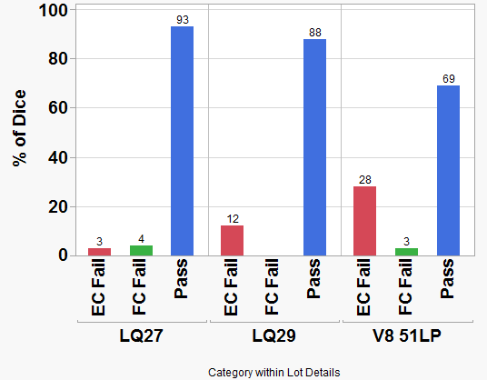
Die Loss from Yielding Dice
76 dice
413 dice
835 dice
LQ27 and LQ29 show about 7-12% die loss from WF:*
V8 51LP lot, shows about 30% die loss at WF:*

Slide 4
Proposal for VDM1 at probe
E2
E3
10sec
1E4sec
1usec
Current VDM1
1usec
1E8sec
VDM1
VDM2
VDM3
RBER
predict
Si
2sigma
VTH
Drift
200mv
VDMx
400mv
VDM1 = Best RBER(10sec E2 / 1usec E3) + drift ( 3 dec)
Dynamic Drift => Probe collect E2 at 1sec and 10sec
7 decade [1usec – 10sec] + 3 decade [calculated based on 1sec to 10sec by die]
Limit BER at VDM1 to 3σ
Increase drift coverage
Trend : RBER and MAX_DRIFT_COVERAGE
VDM2 = (VDM1 + VDM3 ) / 2
VDM3 = VDM1 + (4dec * 100mv E3 drift), only allow to Max 7v

Slide 5
Previous to Proposed
2σ
1usec
100sec
1usec
1usec
10Ksec
1usec
8dec
10dec
-2σ
E2
E3
xσ
E2
E3
VDM1
VDM1
Current Method
Anchored on 2sigma
No trending for Drift (assumed 8dec)
Die may fail EC at probe if drift > E2 Margin
Rber Trending
10sec
True window Trending
Testing : EC = VDM1-50mv, FC = VDM1 – 100mv
Proposed Method
Anchored on 10decades of drift
Drift trending based on 2sigma
RBER Trending (limited to 3s)
1usec, 10sec
True window trending
Testing : EC = VDMx, FC = VDM1 – 100mv

Slide 6
Validation Plans
Sanjay’s Crunch
Predict RBER needed with AO and C7 enabled (LQ29)
WCF Runs
Check for the longer drift times
Check for endurance requirements for 1k cycles
Sigma
Burn Run
Validate full dice testing at longer times
Probe Run
Validate > 10sec at probe

Slide 7
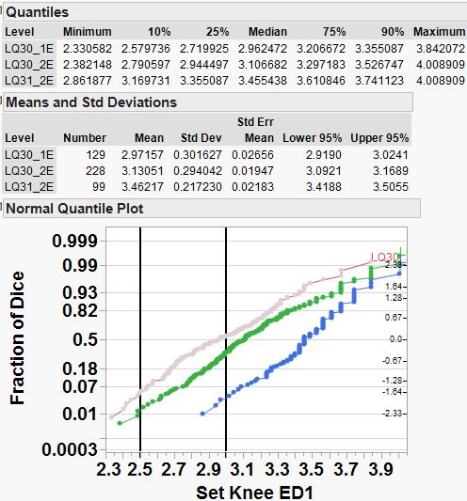
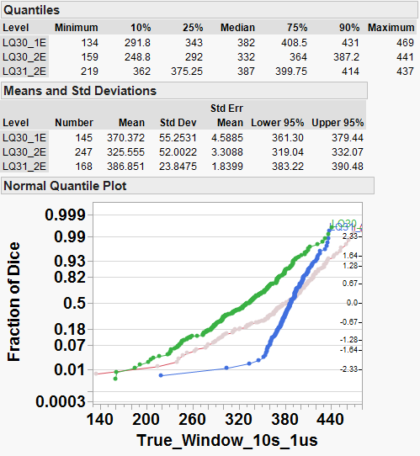
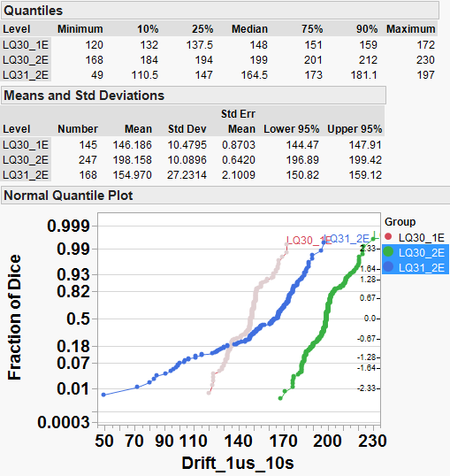
V4 Vs V10 comparisons
SD V10 => LQ30 – 2E and LQ31 – 2E
Median SET Knee improvement by 0.3sigma, True Window (2sigma) improved by 50mv, driven by drift improvements
Better Set knee and True Window

Slide 8
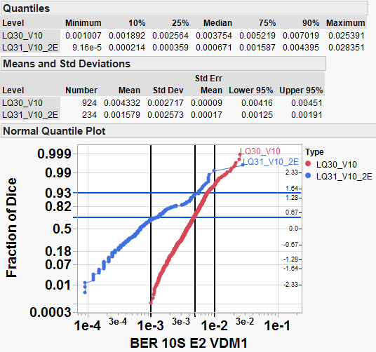
Forgiveness tightening
Comparing LQ30 Vs LQ31 V10
1E-3 we see about 30% yield hit at bin EC

Slide 9
backup

Slide 10
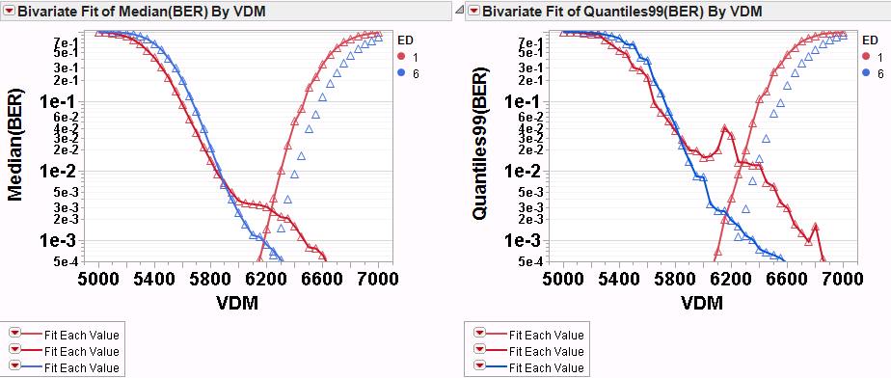
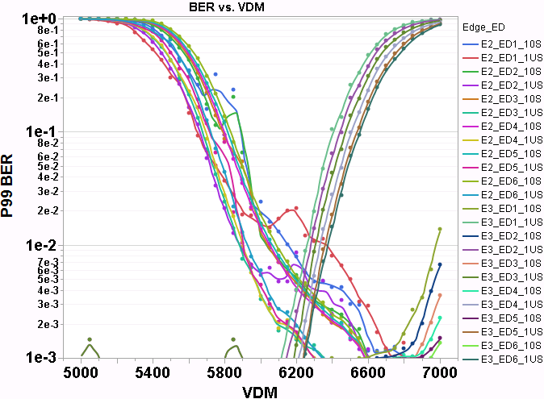
Median by ED Vs 99% by ED
9108202:24:P11:04:12
Using Worst 1% of all 2.5k unit will select wrong VDM (based on new method)
Method should be
Median RBER by ED Groups
Select Worst ED ? ←because this will minimize the failing rate of blocks and will give correct signature to quantify for FAB

