Slide 2
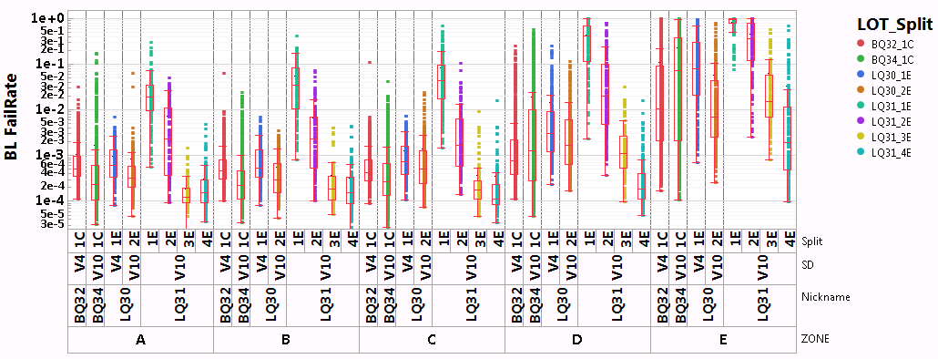
BLBL
Goal: 1E-3

Slide 3
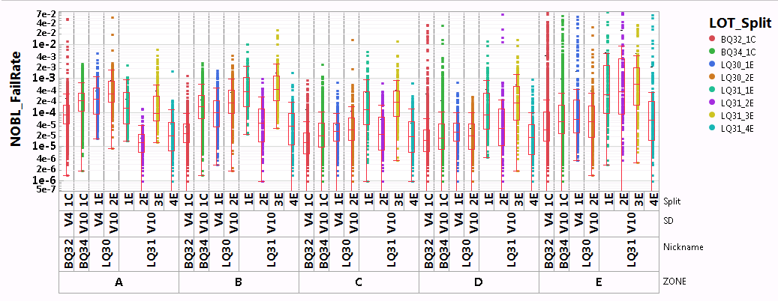
NOBL
Goal: 3E-4

Slide 4
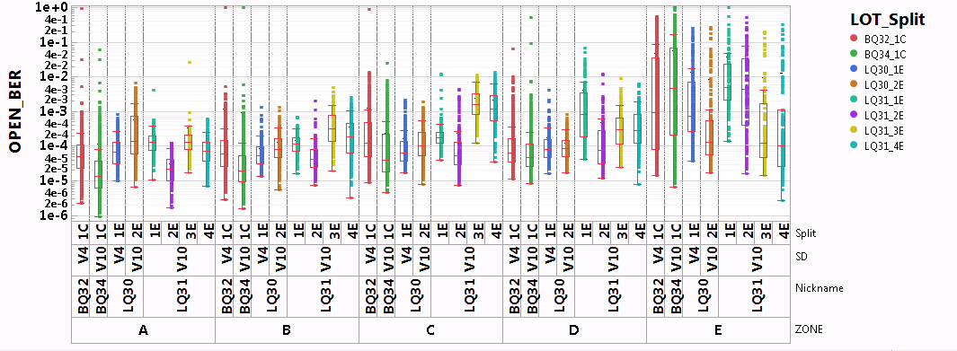
OPENs
Goal: 1E-5

Slide 5
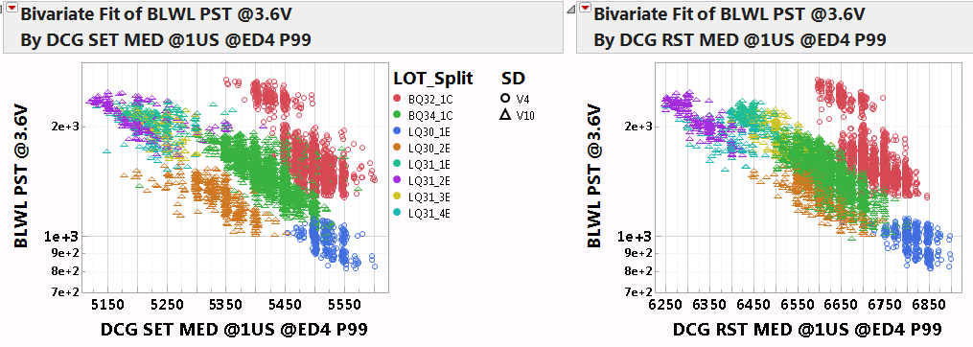
Leakge vs VT
There is a shift related to CSOD/C7/other?

Slide 6
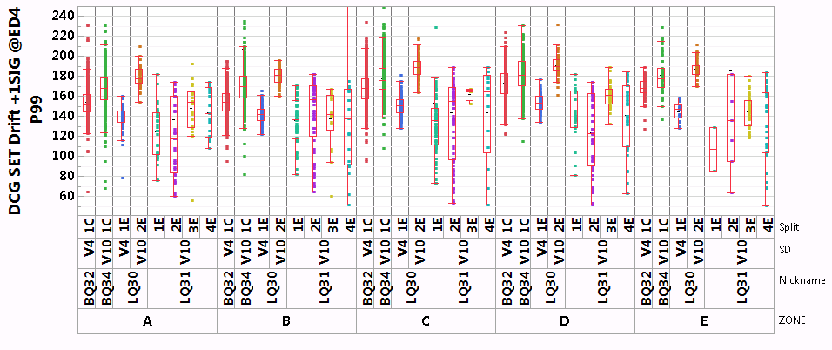
Drift 1us-10s
Need to update with WLR drift 1us-10min, including t0 and slope
Goal: 1us-10min → 80mV

Slide 7
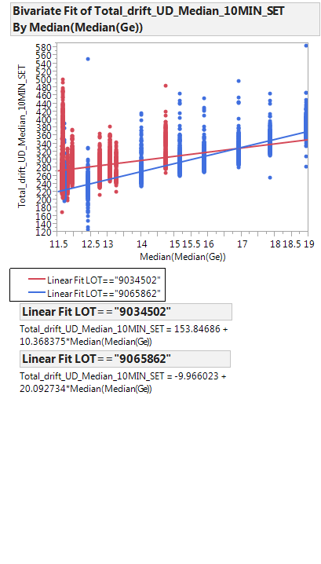
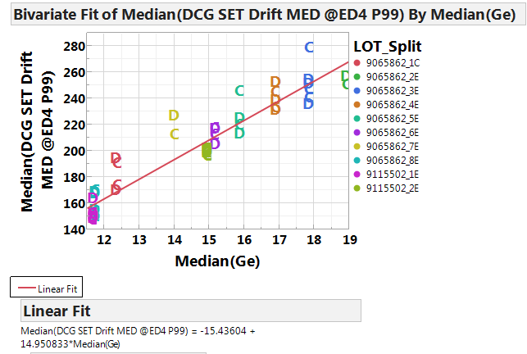
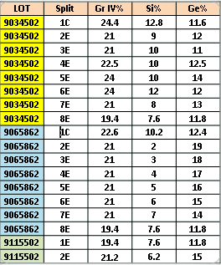
Median Drift @ED4 @RT
1us-10min
1us-10s
Feng
Each point is die
LQ30 2E
BQ34
LQ31 2E
Goal (estimated): ~80mV
Each point is median by zone
Drift increases with Ge% within A2* lot. 15-20mV/Ge%
Based on V4/V10 data on LQ30, toggle driven by t0 rather than drift slope (Unbiased drift slope ~75mV @90C). Lower Ge% will help but not meet goal.
Lot to lot/Wf to Wf variation within V10 significant → Further segmentation WIP

Slide 8
SET VT Sigma
Need to add variability plot

Slide 9
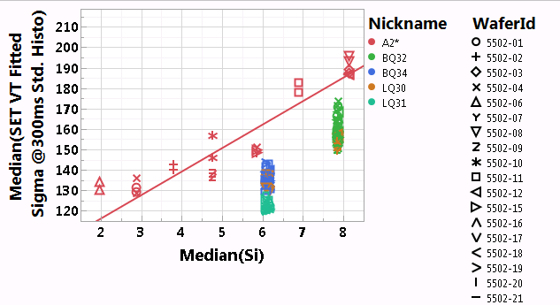
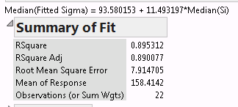
SET VT Sigma
Data measured with std. histo @300ms wait-time
Need to update with 1us data
SET VT Sigma driven by Si%. ~11.5mV/at% [fit within A2* splits]
Significant lot to lot variation. Segmentation WIP.

Slide 10
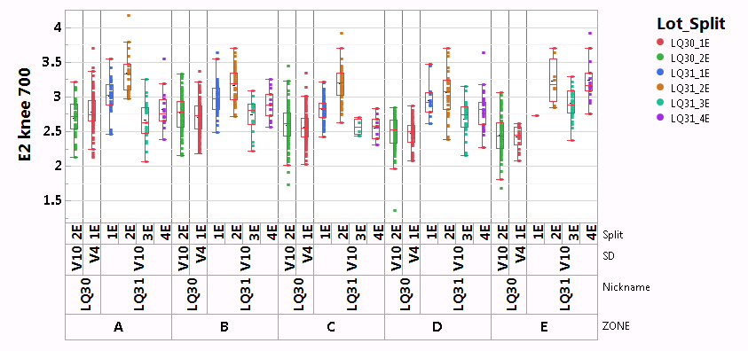
E2 Knee

