Slide 1
SDδ Rev6 SET VT Sigma RARMR
Koushik

Slide 2
Summary
Rev 6.3 SET Vt sigma@1us @ED4 @RT 1.3X-1.5X higher than DTS goal
Within bit to bit, known major components –
  51 CD/Process: ~105mV RSS
    Need to segment 51 BEC/W Etch, Clean/Seal
  As-dep Si%: ~11mV/Si%
    Susceptibility to oxidation/other process interaction
Goal | Stack | @ED4, @1us, @RT, ±2σ
 |  | total | Bounce | B2b
 |  | mV | mV | mV
SVC’ <120 Qual <105 | 6.3 V10 LQ31 | 130 | TBD | TBD
 | 6.3 V4 LQ30 | 150 | 75 | 130

Slide 3
SD Vt Sigma RARMR
Issue/Owner | Components of bit-to-bit Vt σ & Strategy | Results/Next Steps/ECDs
Problem Statement: Rev 6.3 robust SET Vt sigma@1us @ED4 @RT 1.3X-1.5X higher than DTS goal Problem Characterization: Impact Description: limiting RWB balance; Detect: Electrical – Probe DCG SET distribution. L0: XRF as-dep composition on monitor wafers Inline – XRR thickness, SEM CD/LWR/SpWR, limited XRF monitors Contain/Mitigate: lower SD Thickness Owners: Team leader - Koushik Coach – Sanjay core members Lee, Umesh, Sachin Phase: Segmentation – Building components of variation with existing and new SWRs. Material stability and reactivity are top suspects in SD-delta degradation. SWRs and L1D data most likely fastest path to enable segmentation. [Need to understand interaction with drift] Risk: High | A] Process Integration [including geometry] 51/55 SD CD/LWR Variation: Extent of Etch/Clean/Seal interaction vary with SD CD BEC/W Etch effect: C/W etch chemistries altering SD composition Clean/Seal effect: Clean/Seal altering SD composition Local thickness/roughness variation: bit to bit or within bit thickness variation affecting VT/bounce B] As-dep Composition 5. Si content: Higher Si% gives higher VT sigma due to higher oxidation/process interaction susceptibility D] Electrical Measurement Effect 6. Effect from SET/RST PW/PA/pulse shape: pulse application glitches or SD memory effect differences B] Intrinsic 7. Mean thickness: Variation of threshold switching path bit to bit 8. Bounce : VT variability with repetition on same bit [current bounce values might include both intrinsic and process integration components] Strategy: 1> Line trend analysis to identify and segment sigma/bounce signals (focus V4/V10) 2> Good vs Bad Die segmentation EFA/PFA to build components of VT variation 3> L1D/L3 SWRs to segment process effects 4> Material exploration with lower Si% AND lower Ge% | Results: 6.2 V4 PFA showing ~107mV/nm VT dependence on 51 CD LQ30/LQ31 showing 3-4mV/A sigma dependence on 51 LWR L1D results showing significant SD material loss post 51 W Etch L1D results showing significant SD element loss post W-etch Campaign A2* showing sigma variation ~7mV/Si% V8 thickness skew show ~5mV/nm sigma to thickness dependence Bench measurements showing ~75mV bounce @1us on 6.2 V4 Next Steps / ECD: LQ31 EFA on good/bad dies to segment bit to bit & bounce + other segmentation (Ihold/VTI) – WW25 Line trend analysis on V4/V10 lots for sigma (updated probe metric) and bounce – WW25 LQ31 PFA for VT to geometry/composition correlation – WW26.1 L1D Experiments on SD protection during BEC/W Etch - <details ECD from Sachin> LWR improvement l(9079062.003) - WW25 V4 51/55 CD skew (9082852.003 )– WW26 V4/V10 thickness skew (9085432.003)– WW26 Help Needed: Inline & EOL visibility in Si% variation [TEM lab/PI] Refine sigma registers [Probe]
Goal | Stack | @ED4, @1us, @RT, ±2σ
 |  | total | Bounce | B2b
 |  | mV | mV | mV
SVC’ <120 Qual <105 | 6.3 V10 LQ31 | 130 | TBD | TBD
 | 6.3 V4 LQ30 | 150 | 75 | 130

Slide 4
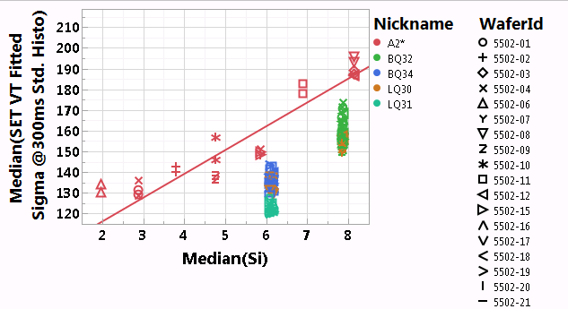
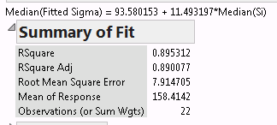
SET VT Sigma
Data measured with DCG std. histo @10s wait-time
Will update with 1us data
SET VT Sigma driven by Si% within A2*. ~11mV/at%
Significant lot to lot variations. Need segmentation -
  51 process effects/CD
  Qtime effects
  Others?

Slide 5
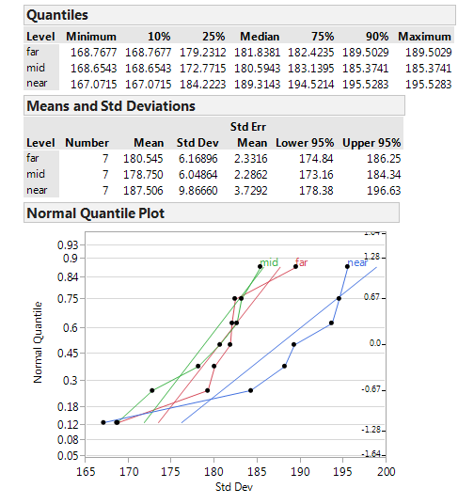
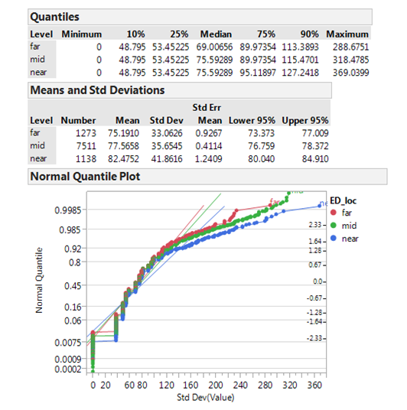
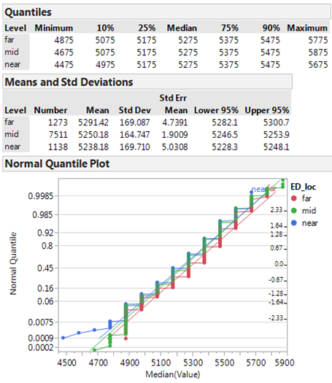
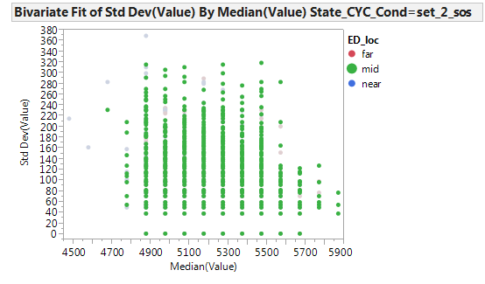
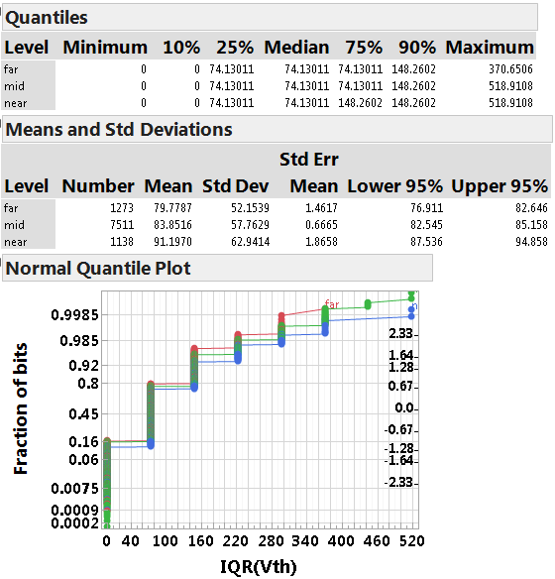
NPT SET Bounce Bench @1E3
LQ25 V4
Lee
Total VT Sigma
Bounce [7 repeats]
Bit to Bit [7 repeats]
Fraction of repeats
Fraction of bits
Fraction of bits
Bit 2 Bit | Bounce Median | RSS of B2B & Bounce Med | Median Sigma from 7 repeats
mV | mV | mV | mV
169 | 69 | 183 | 182
165 | 75 | 181 | 181
170 | 75 | 186 | 189
Note: Bounce includes both read & program variation

Slide 6
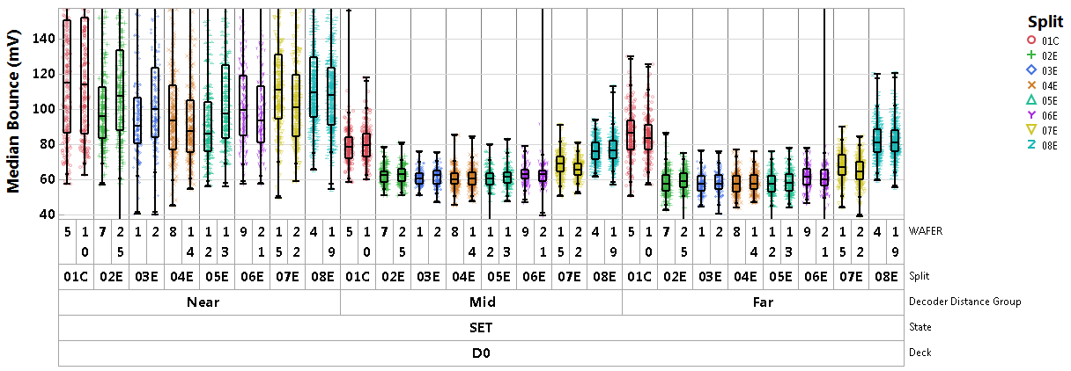
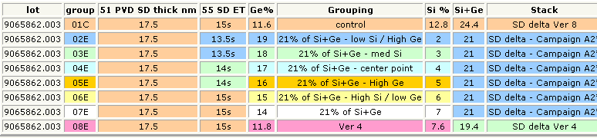
Bounce A2* [WLR]
9 repeats using std histo. Each point is median by die. Data from zones A,B,C
V4
~20mV bounce reduction with as-dep Si <=6%
Need to confirm quantification @1us

Slide 7
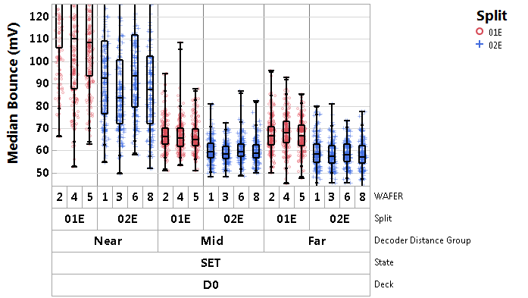

Bounce LQ30 [WLR]
9 repeats using std histo. Each point is median by die. Data from zones A,B,C
V4 bounce significantly lower than previous typical values (65mV this lot vs ~80mV previous)
V10 is ~60mV [~5mV lower than V4]
Need to check 1us data
Need to segment Near cells

Slide 8
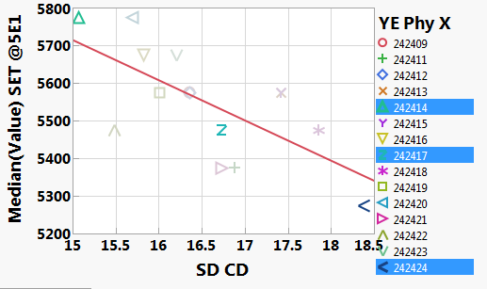



SET VT vs 51 SD CD
Median(Value) SET @5E1 | YE Phy X
5775 | 242414
5475 | 242417
5275 | 242424

Slide 9
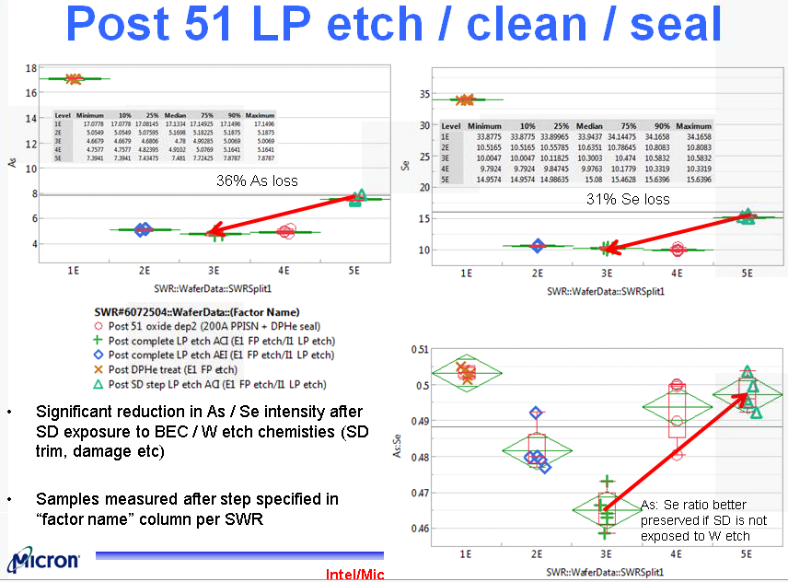
51 LP Etch/Clean/Seal Segmentation
Kolya/Sachin

Slide 10
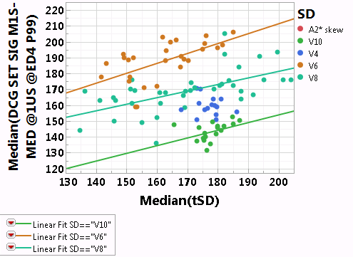
SET VT Sigma vs Thickness
SD | Slope [mV/nm] | Rsq of fit
V6 | 6±2 | 0.35
V8 | 4±1 | 0.35
V10 | 5±2.5 | 0.20
V4 | No fit | No fit
Considering wafers with XRR thickness measurement
V10 data from LQ30, LQ31, BQ34
V4 data from LQ30, BQ32 → No clear thickness trend [chcekced additional lots too, but do not see clear trend → need thickness skew]

Slide 11
Bonus

Slide 12
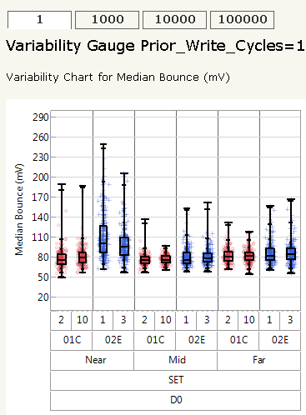
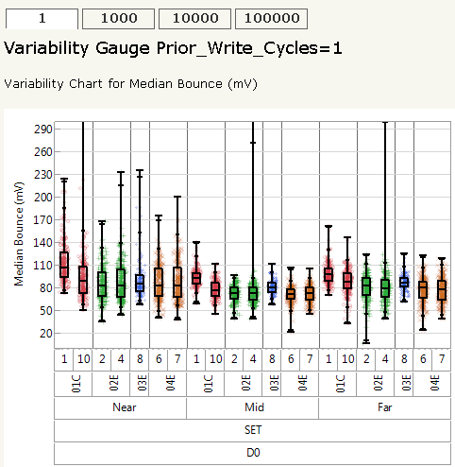
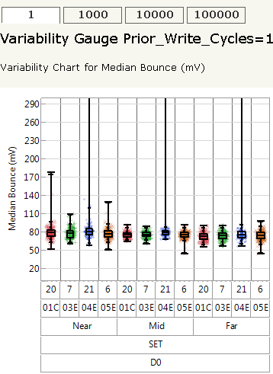
SET VT Bounce Median [WLR]
9 repeats using std histo.
Each point is median by die. Data from zones A,B,C
LQ27, SD V4
LQ26, SD V6 & V8
BQ28 – SD1
No significant differences. Distribution tighter on 5.Z.
Need systematic trend building & correlation to SET VT Sigma

Slide 13
Interlaced @1us vs Std Histo @300ms bounce by ED location: RESET
Lee

Slide 14
Interlaced @1us vs Std Histo @300ms bounce by ED location: RESET
Lee

Slide 15
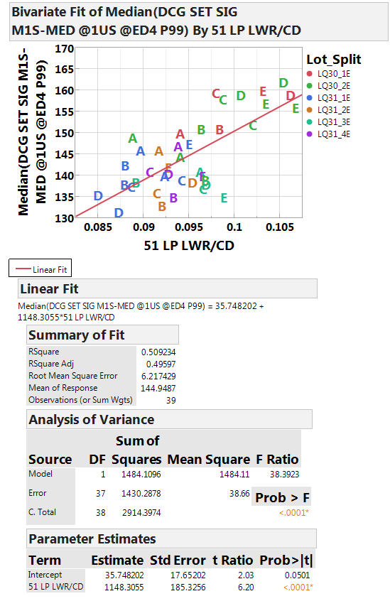
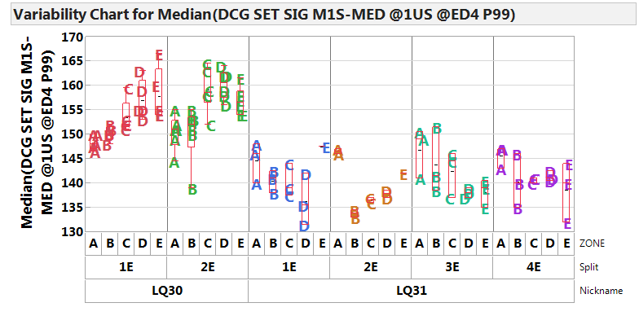
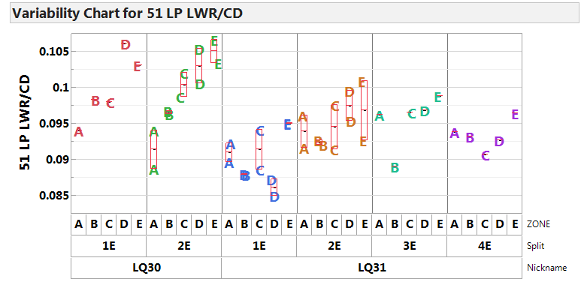
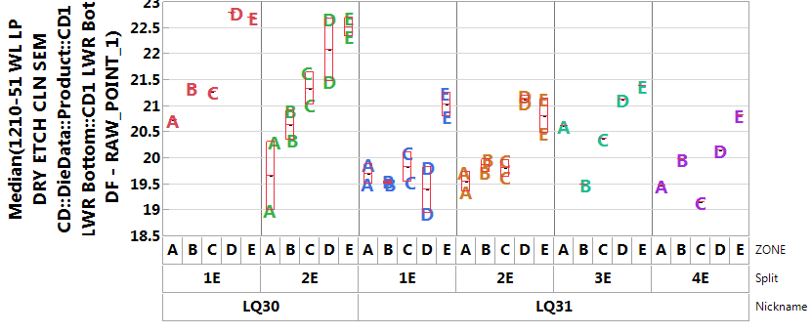
Zone Trend

