Slide 1
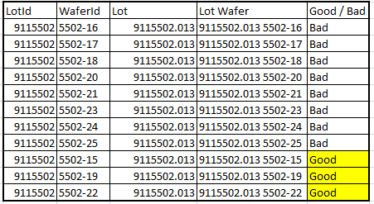
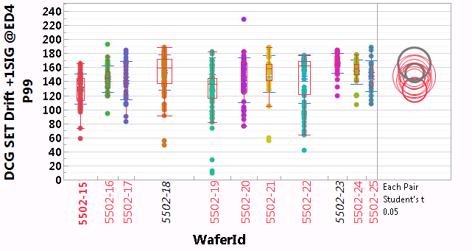
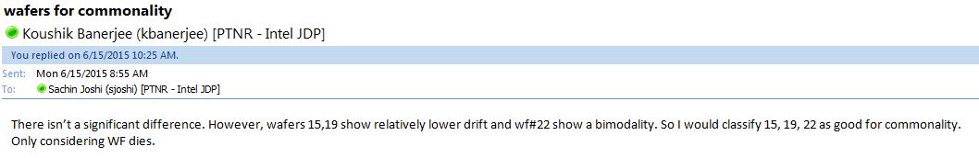
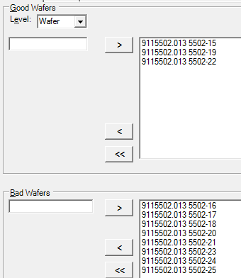
Update: Wafer level commons

Slide 2
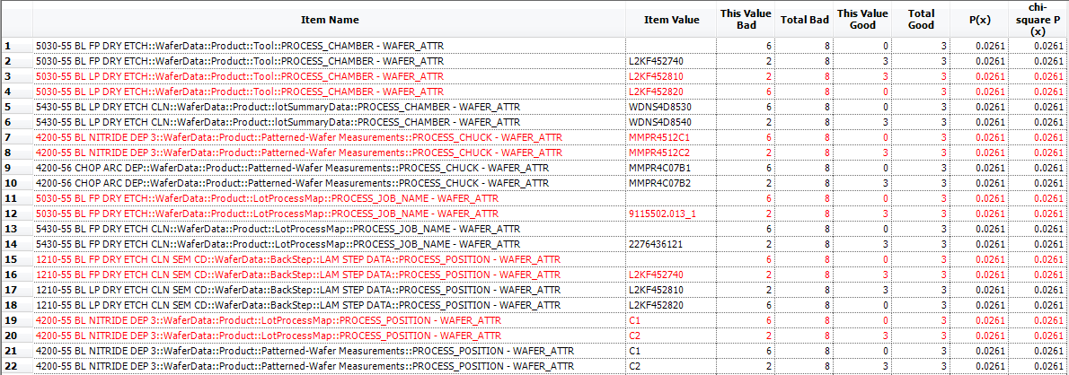
Wafer level commons
Nothing 100% conclusive yet.
Several items show a commonality where 3 good wafers + 2 bad wafers ran on the same chamber / tool and 6 of the bad wafers ran on a different chamber / tool.
If we can possibly reassign the two “bad” wafers as actually being good, there may be something in the 55 FP etch / clean loop but not yet a slam dunk.
Physical model = ?

Slide 3
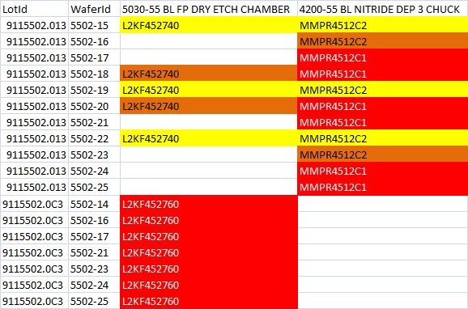
Good / bad wafers
Wafers 15, 19, 22 are considered “good”
Wafers in red and orange are “bad”
Follow up:
Confirm whether wafers 18 / 20 or 16 / 23 are really “bad”? May be some opportunity here if orange wafers are actually “good” but not otherwise.

Slide 4
Previous commons

Slide 5
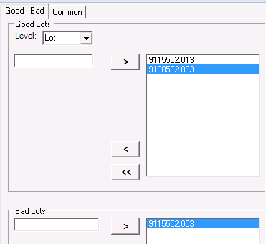
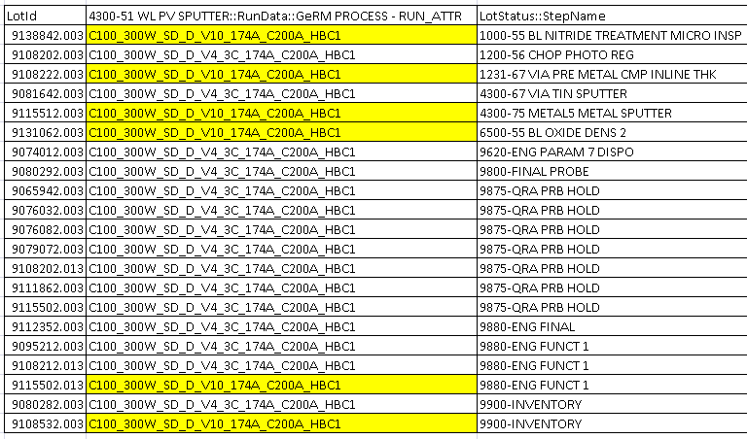
Commons analysis - V10 lots

Slide 6
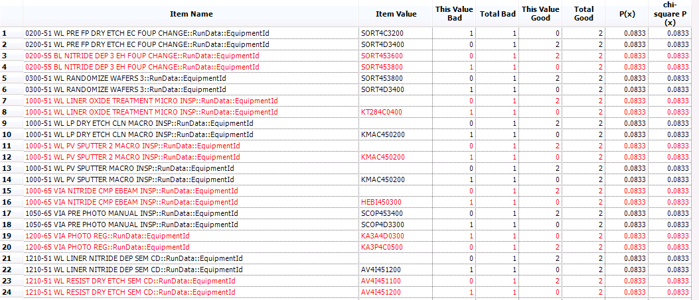

Slide 7
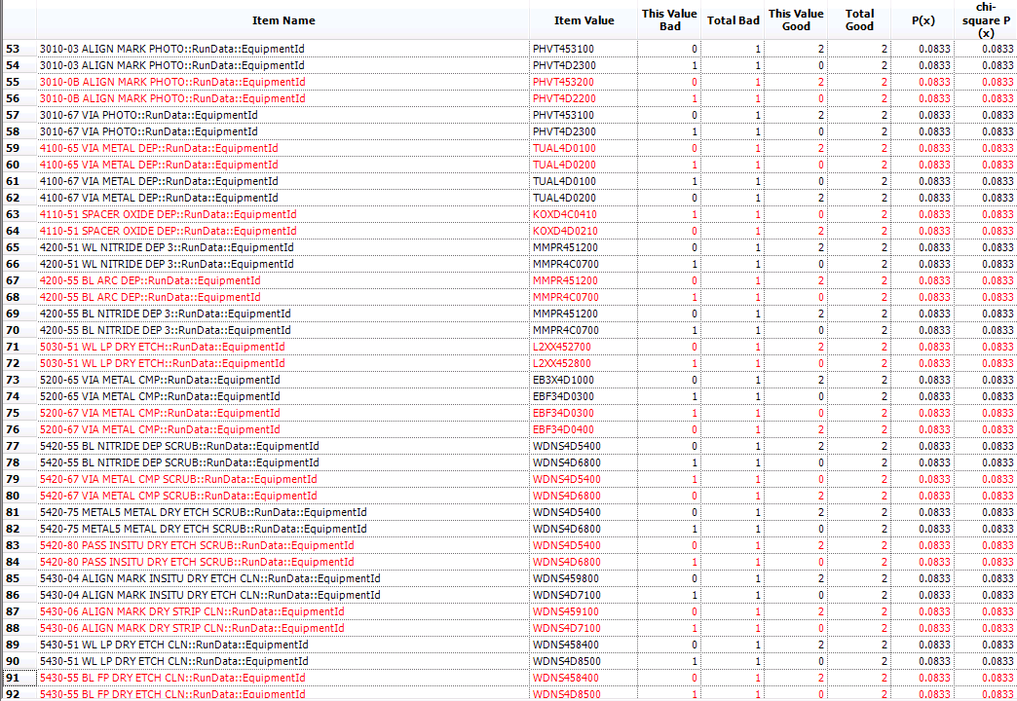

Slide 8
Next steps
Two options:
Identify more SD V4 “good” / “bad” lots with similar (rev 6.2) process that can be used for commons analysis
Wait for more data on SD V10 material / prioritize thru drift measurement.

