Slide 1
SxP Device Physics
Phase Change
Threshold Switching
Structure and band diagram to illustrate the origin of conductivity of a chalcogenide material.
Evidence of phase change from thermal hysteresis.
Power delivery with pulse to change phase
Physics and model of phase change in SxP technology (electrode is the heater)
Structure and Band diagram of a SD devices, electrode included.
Subthreshold conduction is a Poole-Frankel emission process
Space charge injection delocalizes, the mobility gap decreases and carriers multiply at cathode as device biased in near threshold.
Carrier multiplication at both electrodes is the positive feedback mechanism leading into threshold, snapback as shown in negative differential resistance regime.
On-state is due to carrier injection (tunneling) from both electrodes. Injected carrier recombine in the bulk or drift through to other electrodes.

Slide 2
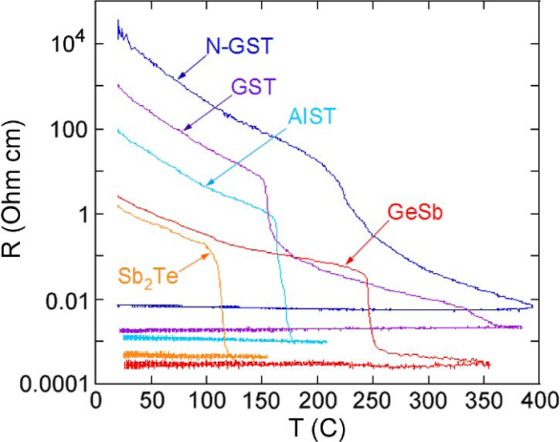
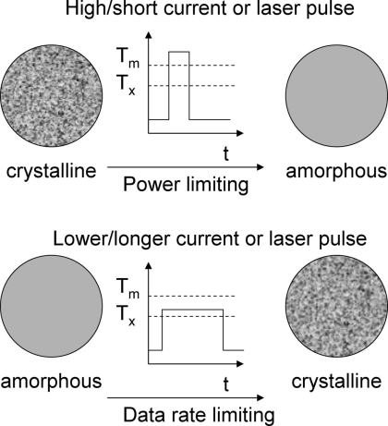
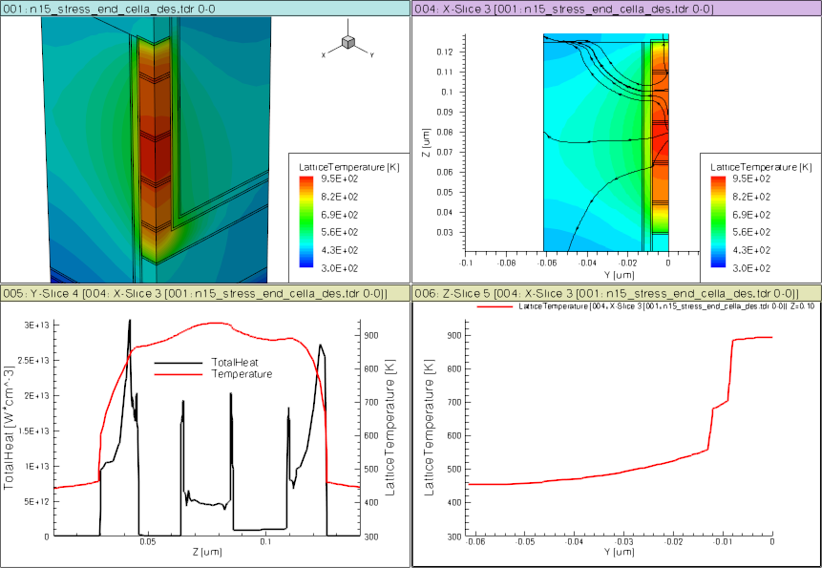
E
CB
E_{c}
Acceptor-like
localized states
Crystalline
E_{v}
VB
E_{f}
LP_{Te}
10% structural vacancies result in localized states near LP band
E
CB
Amorphous
E_{c}
Donor( C₃⁺ )
SD
PM
E_{f}
Acceptor ( C₁⁻ )
BE
ME
TE
E_{v}
VB
LP_{Te} ( C₂⁰ )
Over- and under-coordinated Tellurium lead to defects/traps

Slide 3
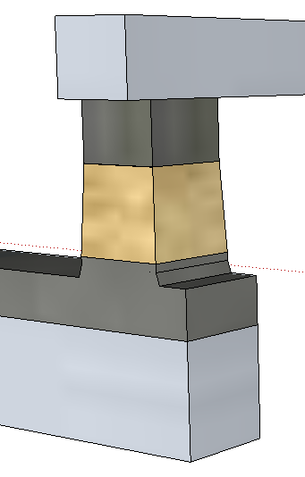
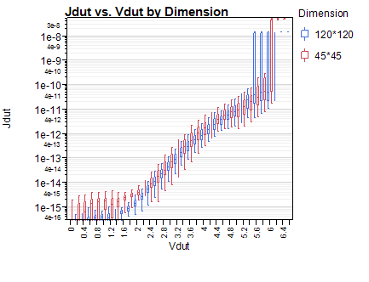
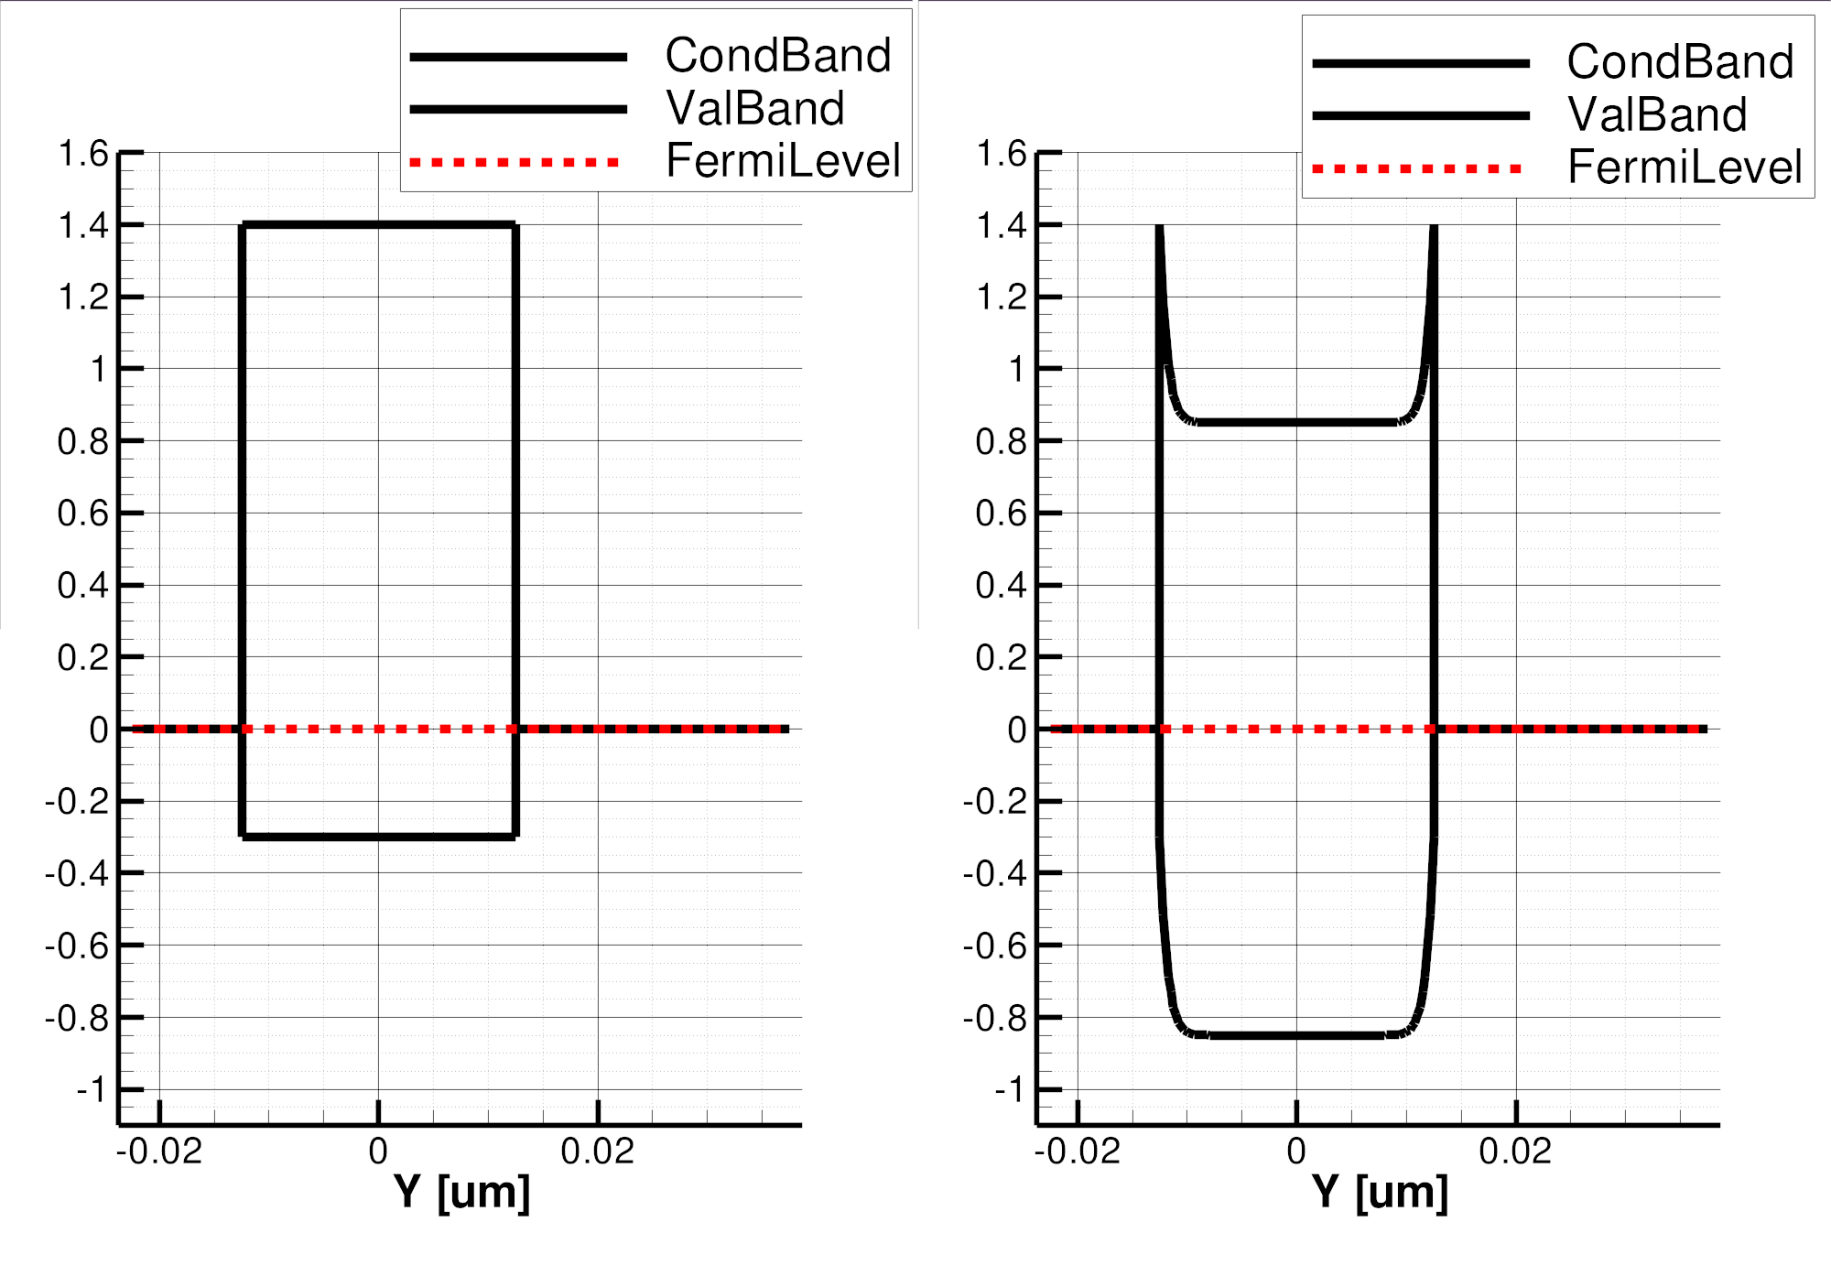
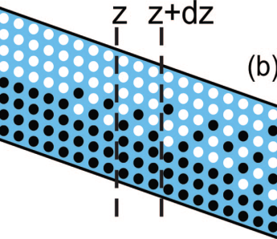
Neal Threshold
On-state
(4)
(1)
(2)
(3)
BE
BE
(2^{R})
(2^{R})
(4)
Top
Electrode
(3)
(2)
TE
(1)
TE
64
20s/SD2’/60s
J [A/nm²]
(120nm)²
J [MA/cm²]
40s/SD2’/40s
Bottom
Electrode
(45nm)²
48
30s/SD2’/30s
50² nm² Cell
32
16
φ_{B}=.85eV
3.0eV
4.4eV
V [Volts]
V [Volts]
1.7
(4e)
1.7eV
E_{F}
BE
TE
BE
BE
(5)
(4^{h})
SubThreshold
PFE conduction
(3)
(6)
TE
Threshold,
(positive feedback)
Snapback, NDR Regime
(2)
(1)
(7e)
TE
(7^{h})

Slide 4
3.0
E_{barrier}= 0.85 eV
4.4
1.7
Depleted region
Acceptor/Donor traps placed uniformly in the gap
(conc=1e21 cm⁻³)
E
SD
E

Slide 5

φ_{B}=.85eV
3.0eV
4.4eV
1.7
1.7eV
E_{F}
BE
TE
BE
TE
SD

