Slide 1
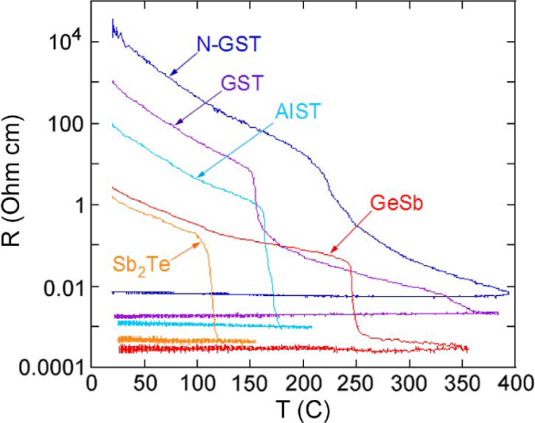
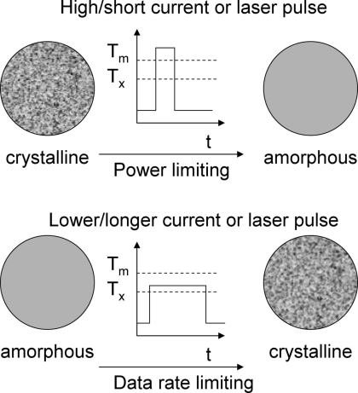
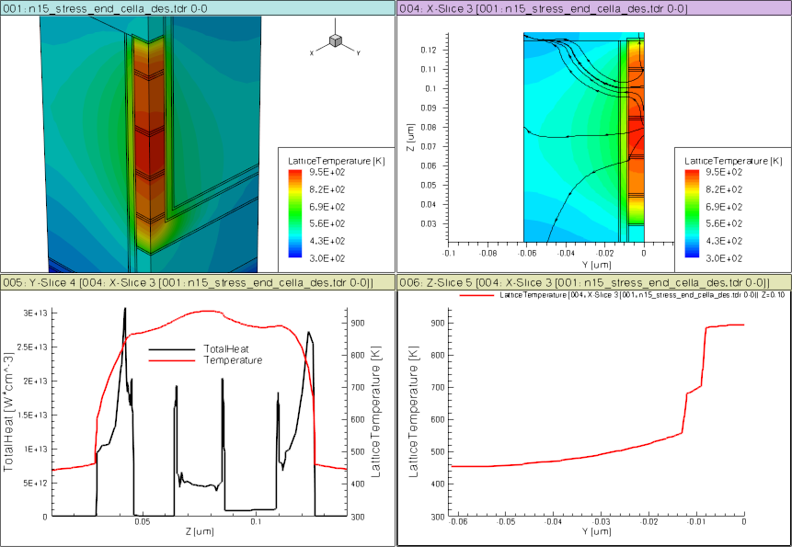
E
CB
E_{c}
Crystalline
E_{v}
E_{f}
VB
10% structural vacancies result in localized states near LP band
E
CB
E_{c}
SD
PM
Amorphous
E_{f}
BE
ME
TE
E_{v}
VB
Over- and under-coordinated Tellurium lead to defects/traps

Slide 2
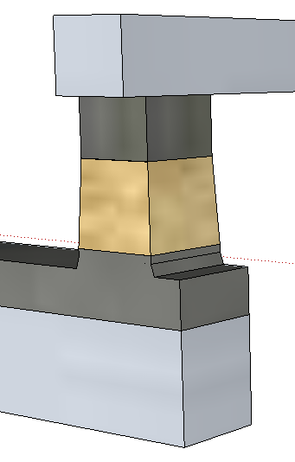
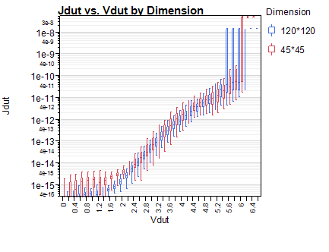
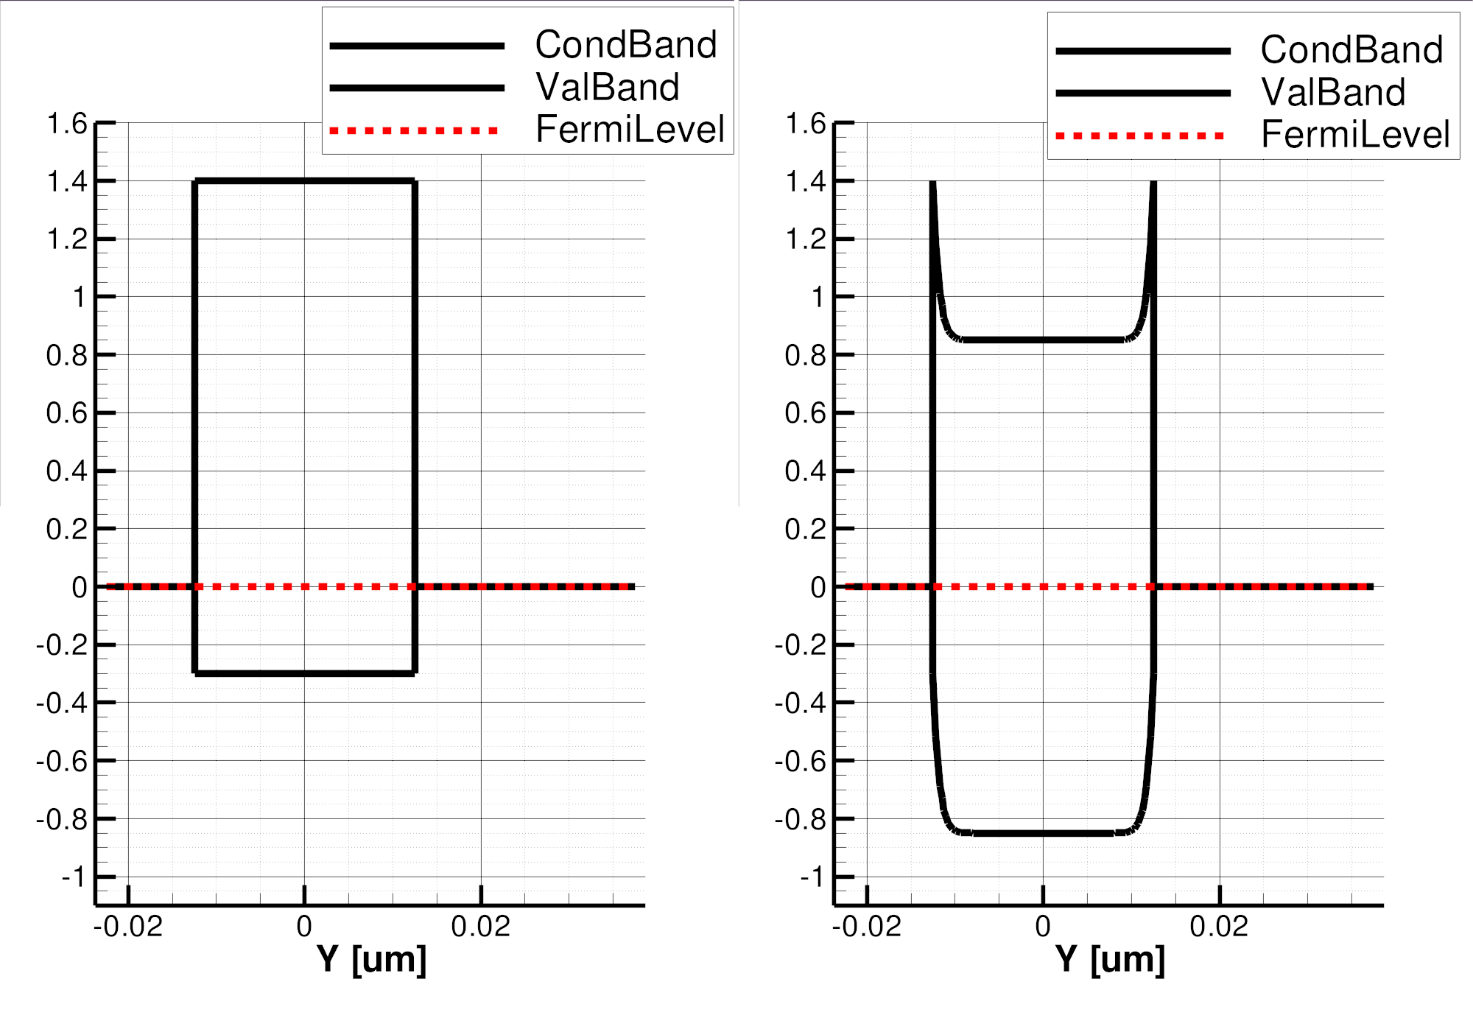
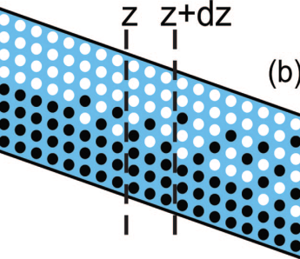
Neal Threshold
On-state
(4)
(1)
(2)
(3)
BE
BE
(2^{R})
(2^{R})
(4)
Top
Electrode
(3)
(2)
TE
(1)
TE
64
20s/SD2’/60s
J [A/nm²]
(120nm)²
J [MA/cm²]
40s/SD2’/40s
Bottom
Electrode
(45nm)²
48
30s/SD2’/30s
50² nm² Cell
32
16
φ_{B}=.85eV
3.0eV
4.4eV
V [Volts]
V [Volts]
1.7
(4e)
1.7eV
E_{F}
BE
TE
BE
BE
(5)
(4^{h})
SubThreshold
PFE conduction
(3)
(6)
TE
Threshold,
(positive feedback)
Snapback, NDR Regime
(2)
(1)
(7e)
TE
(7^{h})

Slide 3
3.0
E_{barrier}= 0.85 eV
4.4
1.7
Depleted region
Acceptor/Donor traps placed uniformly in the gap
(conc=1e21 cm⁻³)
E
SD
E

Slide 4
E
CB
E_{c}
Crystalline
E_{v}
VB
E_{f}
10% structural vacancies result in localized states near LP band
E
CB
Amorphous
E_{c}
E_{f}
E_{v}
VB
Over- and under-coordinated Tellurium lead to defects/traps

