Slide 1
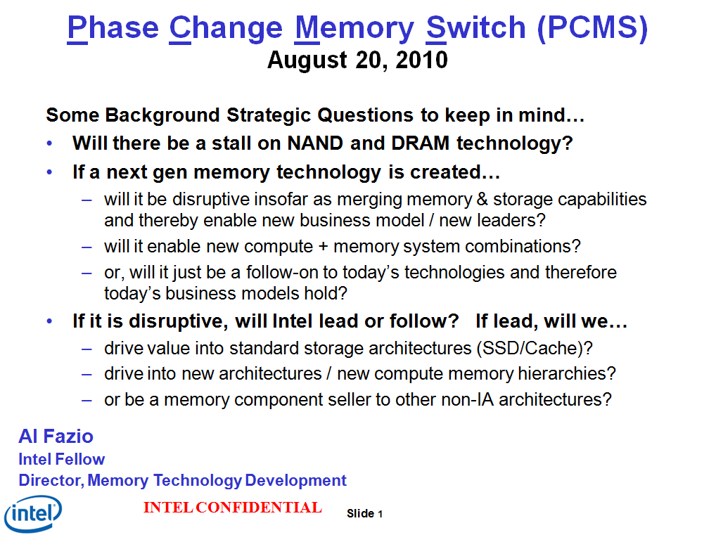
SXP Technology Update
Al Fazio
August 28, 2014
What’s Happened Since:
We last discussed 4 years ago …
DRAM scaling slowing
NAND 2D → 3D
SXP technology in pre-production phase (initial volume ramp in ‘15)
Stand alone storage and IA Platforms in-flight to exploit the disruption

Slide 2
Outline
Overview
SXP Technology Primer
Competitive Analysis
Technology Status
Intel System Architectures with SXP

Slide 3

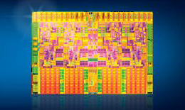
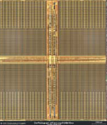
SXP combines storage + memory semantics
Wordlines
Storage Device
SXP = Desirable Memory Attributes:
  Cross-point Cell/Array:
    Area = 4*λ²
  Stackable above CMOS
    Area = 4*λ²/N.
  Selector and memory “matched” non-linear I-Vs
Selector Device
Bitlines
SXP Combines Storage & Memory = performance/power/$ + new usages
On CPU Embedded Memory (SRAM cache)
Off Package Memory (DRAM)
NVM Storage (SSD)
Storage (HDD)
Latency | 1x | ~=20x | ~=20,000x | ~=10,000,000x
$$/bit | 1x | ~=0.075x | ~=0.005x | ~=0.0005x
SXP Combines 1. NVM 2. Low Cost 3. High Performance; Scalable to future Generations

Slide 4
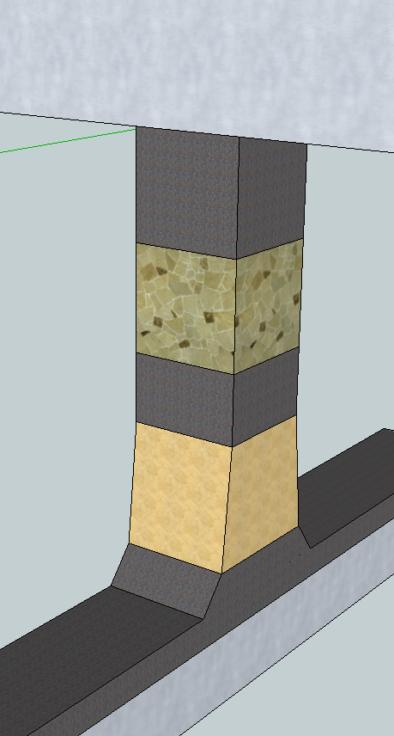
Summary
SXP on cusp of die functionality / yield ramp
  Confidence technology works and remaining issues are solvable
SXP uniquely combines
  1. NVM
  2. Near DRAM performance
  3. Near NAND cost (capacity)
SXP appears >year+ lead on industry
  Better fundamentals vs. RRAMs (MemRistor)
  No sign of similar approach in industry
  Minimum 3 generation scaling roadmap established
IA platforms (Data Center, Client) readying proprietary architectures/busses to exploit SXP uniqueness
  Storage, Large Memory, Combo Storage + Memory: Persistent Memory
  Each with significant performance / cost advantages
BL
TE
PM
ME
SD
BE
WL

Slide 5
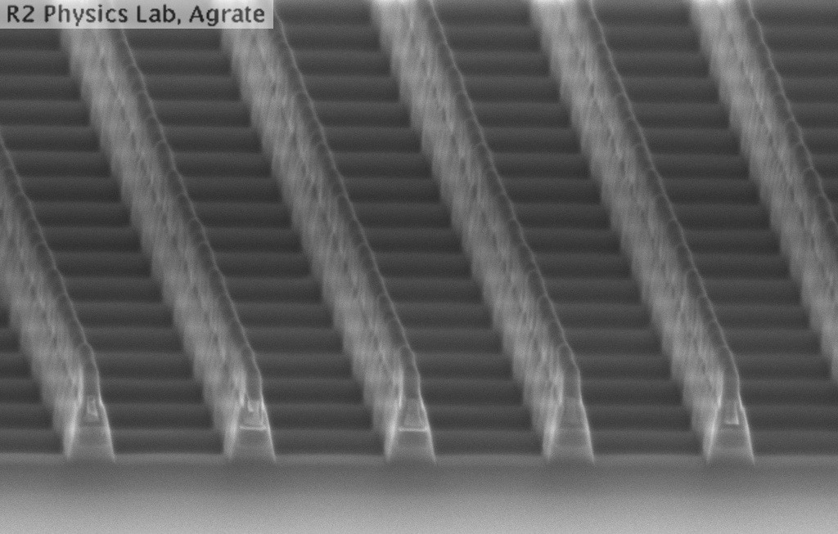
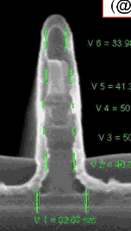
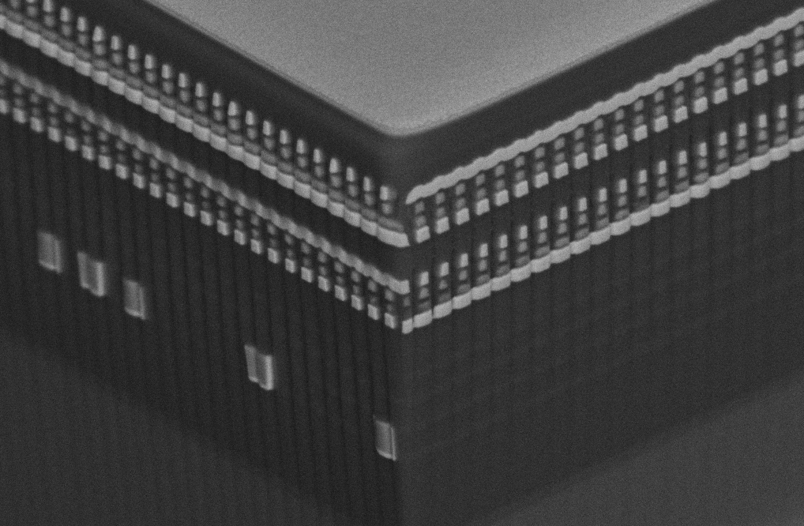
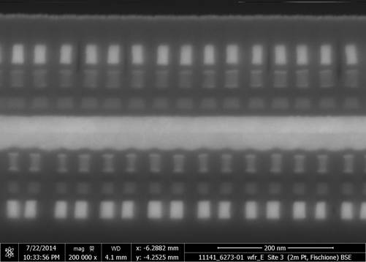
What’s Changed since 2010?
Changed The Name: SXP
  Phase Change Memory Switch (PCMS) said what we were building
  SXP is a project name with no technology meaning
Changed tech node, architecture, # decks & development location:
2009: 180nm ½ Pitch, 6 Mask, Damascene Cell
Santa Clara, CA
2010-11: 100nm feature, Self-Aligned, Subtractive Cell Agrate, Italy
X-section along ROW
W
C
OTS
OTS
PCM
Mid Electrodes
PCM
2012-13: 50nm ½ Pitch, Dual Deck, Self Aligned Subtractive Cell Agrate, Italy
2014: 20nm ½ Pitch Dual Deck Self Aligned Subtractive Cell Boise, ID

Slide 6
Outline
Overview
SXP Technology Primer
Competitive Analysis
Technology Status
Intel System Architectures with SXP

Slide 7
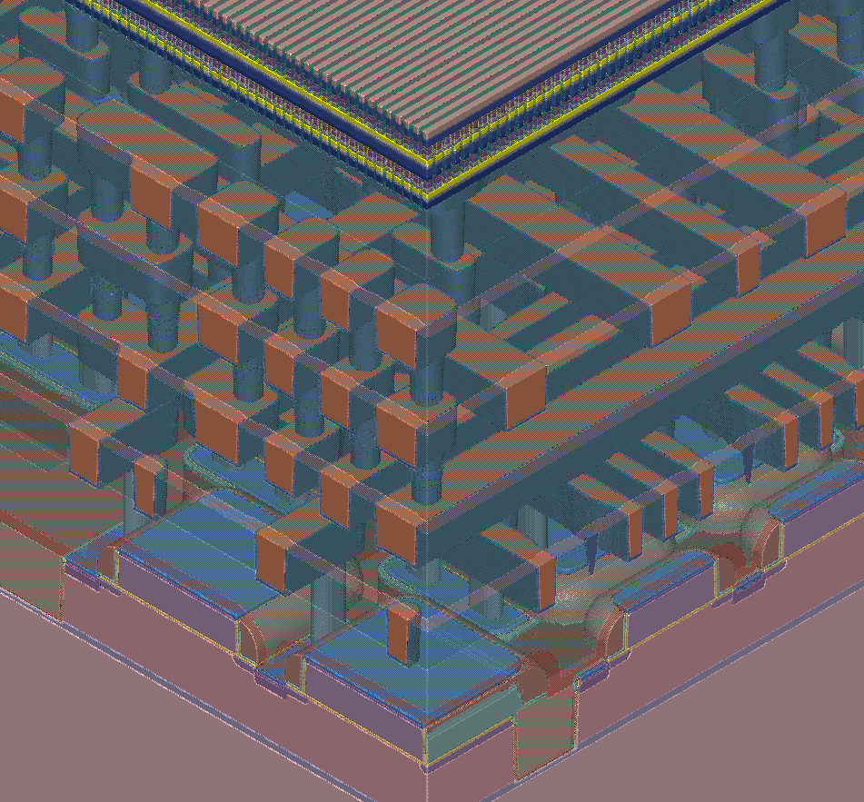
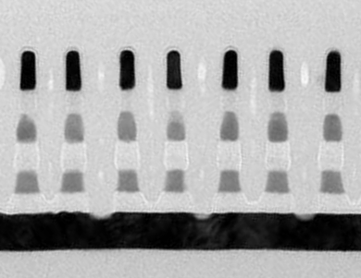
SXP: CMOS Under Array
1. Memory above Si substrate → CMOS “periphery” underneath the array → reduces die size:
Circuits under array: “pitch cells” (sense amplifiers, address decoders, etc.)
Other circuits still located in “periphery” (power supplies, I/O circuits, fuses, etc.)
8 Day Thru-put
Array Decks
Process in Boise TD Fab
BL (4)
3
2. Facilitates modular process & faster info-turn for TD:
CMOS testable at Metal1 electrical-test
S15 Product testable for all periphery (wafer/package) w/ & w/out an array
Fab/test array: 1st, 2nd or both decks
Cell: Isolation Selector only (1’s only) or Full Cell Stack (1’s & 0’s)
Backend Array = Fast TD info turns
2
WL (1)
Each SXP Memory Cell Consists of:
Wordline
Selector Device
Storage Device
Bitline
Electrodes
Interconnects
3. CMOS Base:
~½ Process Steps
4 Layer Copper
All dry litho
CMOS: LV logic (1.2V) + 110A HV (5.5V)
CMOS & Interconnects developed & transferred to IMFT (Utah) Mfg fab, provides base wafers to TD
Digital CMOS Die Yield | S15
Median Wafer | 82.5%
Best Wafer | 96.5%
CMOS Transistors
(under arrays)
Substrate

Slide 8
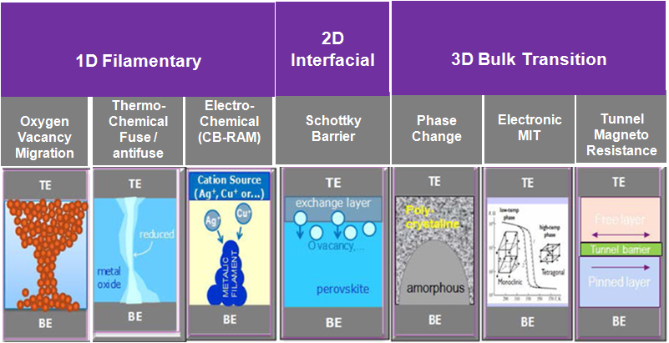
Options for Cross-Point (Xpt) RRAM Memory Materials
Classification courtesy IMEC
Industry focus: Poor Variability (& retention issues)
Research level, but poor scaling
Basis for SXP
ΔR ~1e3 – 1e4x
Research as switch: NbO₂, VO₂
eRAM option ΔR too low for Xpt (~2x)

Slide 9
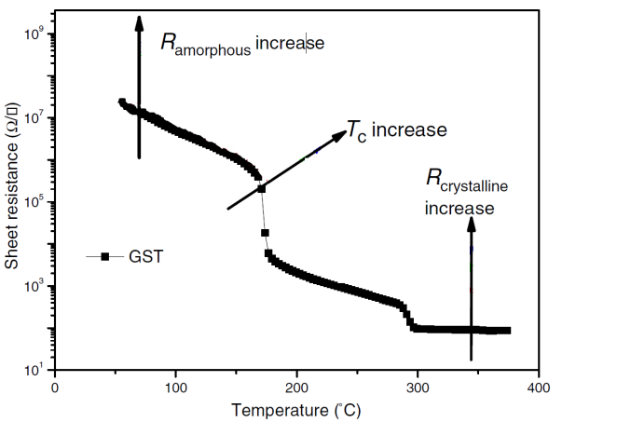
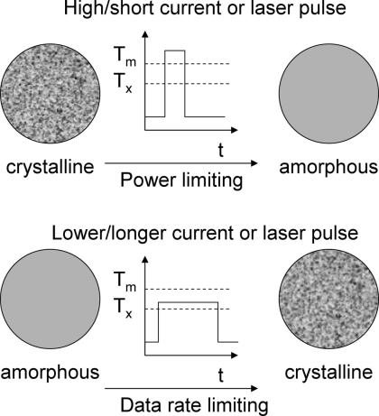
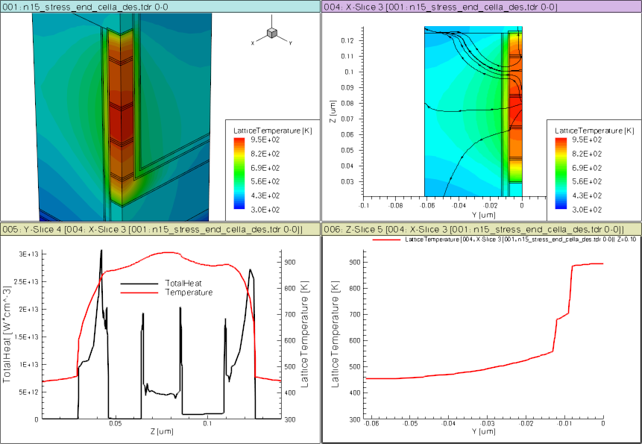
SXP Memory: Phase Change Model
(GST example)
E
Te
V
CB
E_{c}
Crystalline
E_{v}
E_{f}
FCC
VB
10% structural vacancies result in localized states near LP band
E
Te
CB
E_{c}
SD
PM
Amorphous
E_{f}
BE
ME
TE
E_{v}
VB
Over- and under-coordinated Tellurium lead to defects/traps

Slide 10
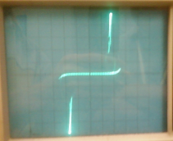
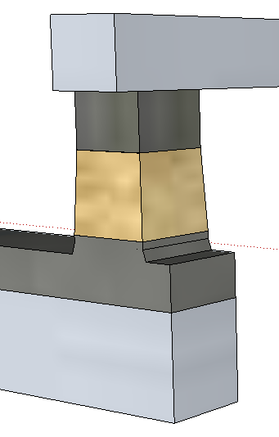
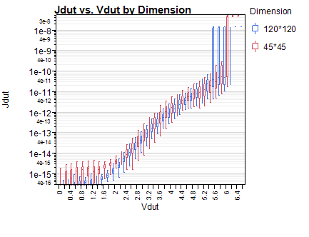
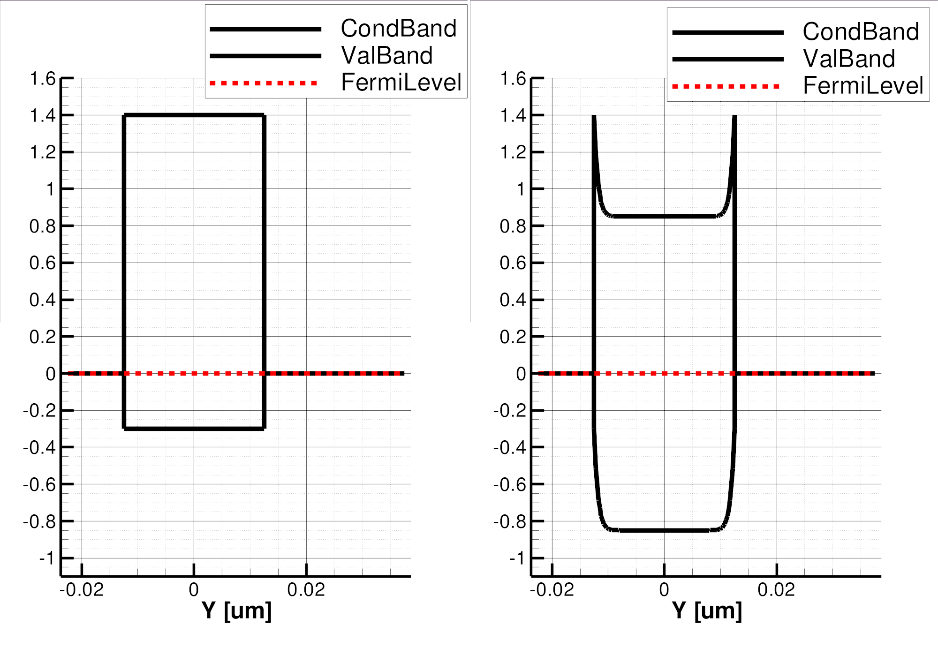
SXP Selector: Ovonics Threshold Switch Model
Near Threshold
On-state
BE
BE
TE
TE
Top
Electrode
64
J [A/nm²]
(120nm)²
Selector
J [MA/cm²]
(45nm)²
48
Bottom
Electrode
32
Full-STACK
Electrode only
16
φ_{B}=.85eV
3.0eV
4.4eV
V [Volts]
V [Volts]
1.7
1.7eV
E_{F}
BE
TE
BE
BE
SubThreshold
PF conduction
Threshold,
(positive feedback)
Snapback Regime
TE
TE

Slide 11
SXP = Selector (SD) + Memory (PM)
SXP is the series combination of SD and PM
SD adds an offset to the programmed V_{th} of the PM element
  SET SXP: V_{th} = V_{th,SD} + ~0
  RESET SXP: V_{th} ≤ V_{th,SD} + V_{th,PM}
    Note: RESET V_{th} is not quite sum of individual V_{th}’s – whichever element has lower I_{th} will trigger its counterpart prematurely
Bitline
RESET V_{th}
Storage
Cell (PM)
V_{th,PM}
V_{th,SXP}
Selector
Device (SD)
V_{th,SD}
SET V_{th}
Wordline

Slide 12
Outline
Overview
SXP Technology Primer
Competitive Analysis
Technology Status
Intel System Architectures with SXP

Slide 13
Options for Cross-Point (Xpt) RRAM Memory Materials
Classification courtesy IMEC
Industry focus: Poor Variability (& retention issues)
Research level, but poor scaling
Basis for SXP
ΔR ~1e3 – 1e4x
Research as switch: NbO₂, VO₂
eRAM option ΔR too low for Xpt (~2x)

Slide 14
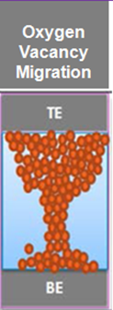
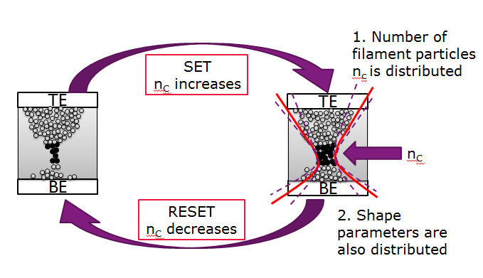
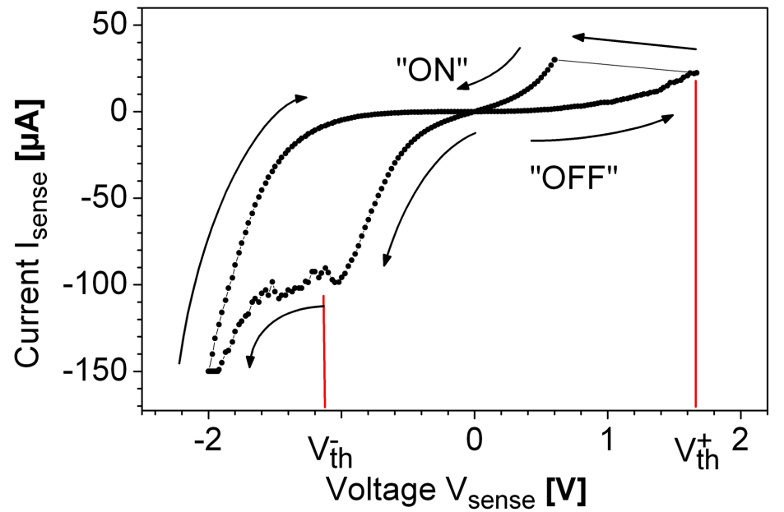
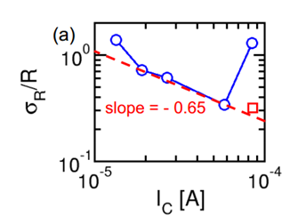
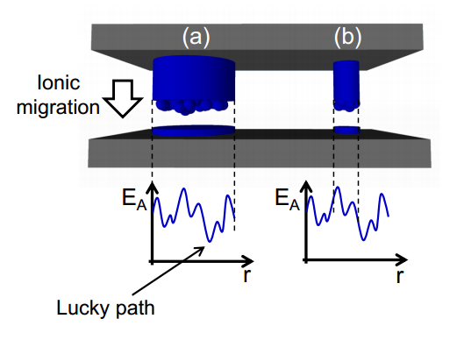
MemRistor: Fundamental Variability Limitation
Fine current control = Slow
Typical RRAM IV Sweep
LRS: different defect clustering cycle to cycle
HRS: Nc <10
HfO₂/Hf
w/o SET Failures
Data & images courtesy IMEC and Politecnico di Milano

Slide 15
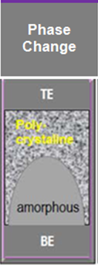
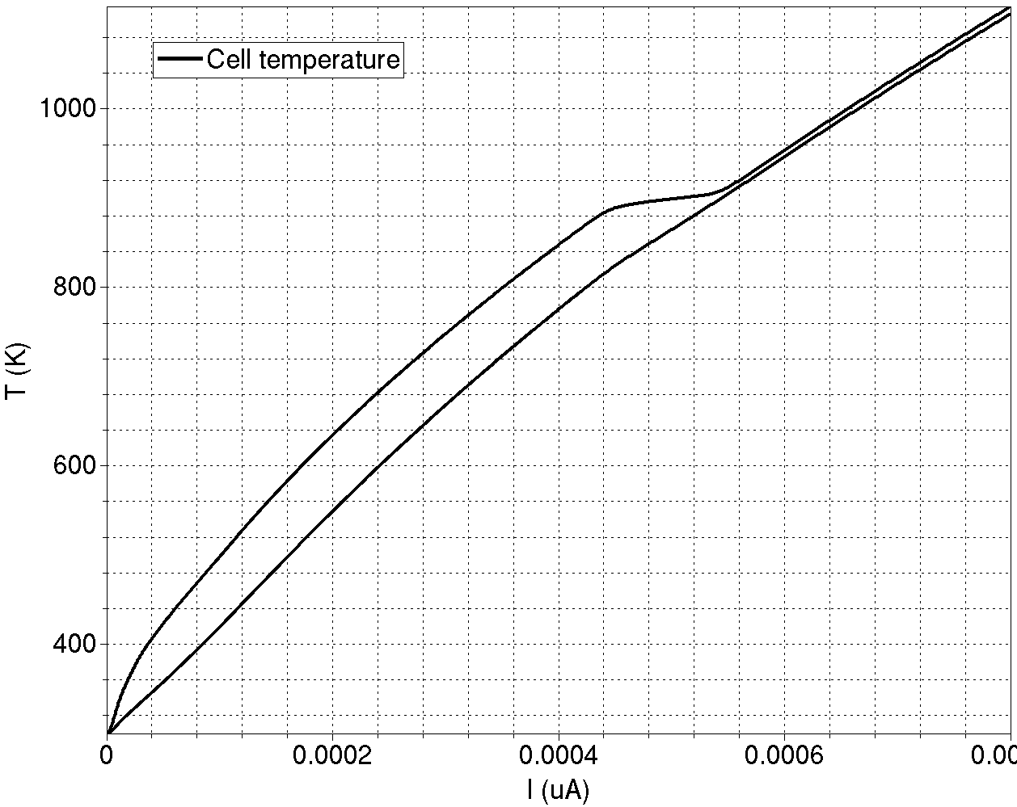
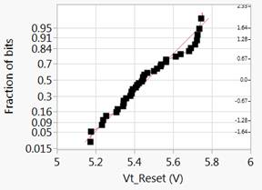
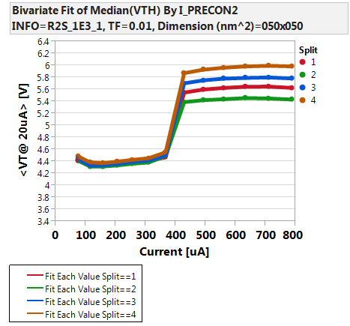
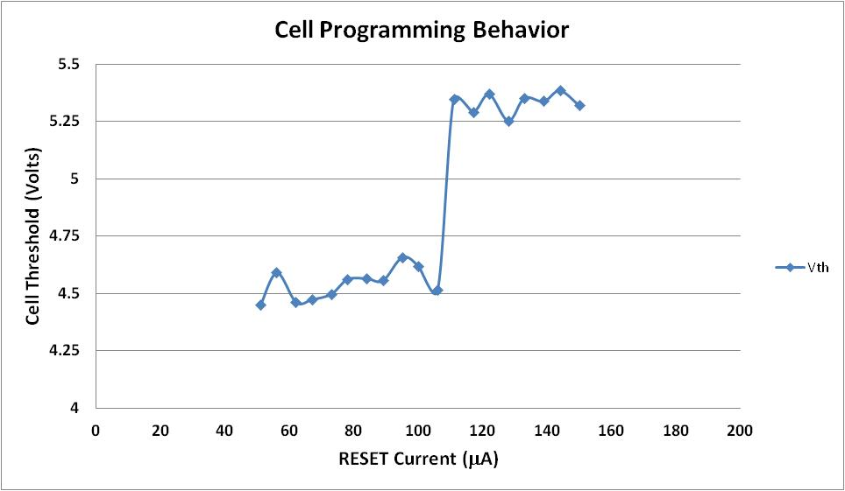
SXP Phase Change = Scalable & Tight Vt Capability
Reset sigma within 1.3x Production Target
Molten
Max temp in the PM
Min temp in the PM
50nm SXP Cell
20nm SXP Cell
Lower Vt than 50nm due to thickness scaling
Increasing Thickness
Current Scaling by Area
Abrupt set to reset transition: resistivity drops abruptly @ melting
Flat temperature profile in the PM after melting

Slide 16
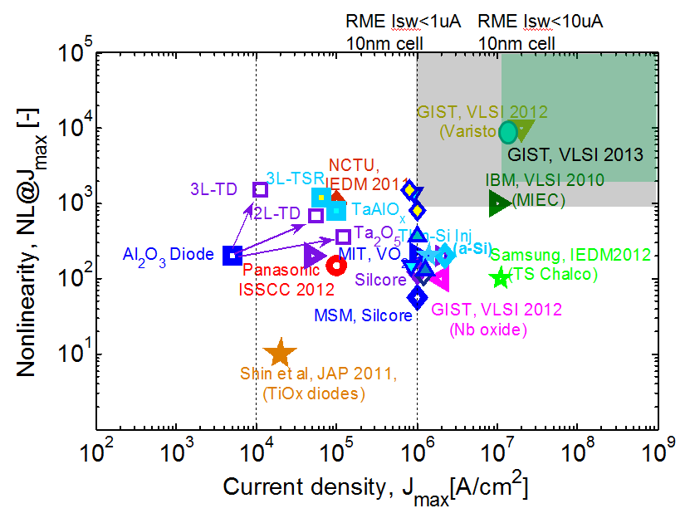
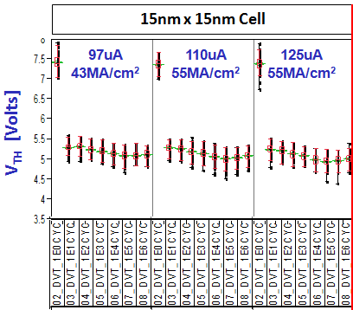
Selector Benchmarking
OTS Best in Class (we think OTS snapback IV is NOT compatible with Oxide RRAM)
No known selector compatible w/ high RRAM current required for low Vt variability
OTS Nonlinearity
OTS Cycling Stability; Scaled Cell; High Current Density
Selector Benchmarking:
Benchmark data courtesy IMEC

Slide 17
SXP: Substantial Competitive Lead Potential
Memory-Storage Technology Options and Vector Scoring
Post DRAM/Post NAND Competitor Strategies
1
2
SXP uniquely combines
  NVM
  Low cost (stackable memory-selector pair)
  High Performance: latency 10³X below NAND
Competition
  Research phase, largely oxide RRAMs (MemRistor)
  No stackable selector pair yet ID’d
  If solution is found: timeline 2017+ (Hynix/HP)
IP challenges to entry for comp to follow SXP
  Product interface license
  PVD Target Exclusivity with supplier
  Ovonyx license to selector material
  SXP heterogeneous stack integration not reverse engineer-able
1
Hynix is HP’s development source for MemRistor
Hynix’s comments and roadmaps on RRAM consistent with our assessment (contrary to HP’s comments)
Hynix Roadmap: 16Gb-32Gb in ‘17 (SXP = 256Gbit @ same time)
Hynix private comments more pessimistic about viability / timing
2
Notes:
Most of the new memory technology candidates are non-volatile to some extent. Most are targeted at replacing one of the existing technologies. There is usually a significant trade off in cost (density) versus performance. SXP is unique in that these trade offs are much lower.
3D NAND is a direct replacement for 2D NAND with similar performance profiles at lower cost. How much lower cost depends on the implementation.
There are a number of Resistive RAM technologies in research with HP’s Memristor being the most talked about. Our competitive analysis indicates that there are still some significant problems to be solved for the memory cell of these Oxide Resistive RAMs. In addition the memory product would need to invent a new, high density selector device (ours is not appropriate for this technology.) The earliest we would expect a product from this technology is 2017.
Spin Transfer Torque Memory is similar speed to DRAM as well as Density. STTM is the most popular candidate for DRAM replacement as it has the right performance and endurance characteristics and cost similar to DRAM. This makes it interesting for DRAM replacement, but not a likely competitor to SXP.
The bottom line is that we expect to have a 6-8 quarter lead to start on the technology. We will also have a significant lead on the learning how to drive the evolution of the technology for broader use.

Slide 18
Outline
Overview
SXP Technology Primer
Competitive Analysis
Technology Status
Intel System Architectures with SXP

Slide 19
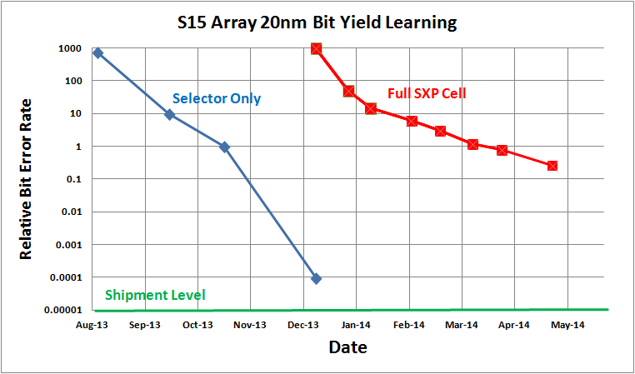
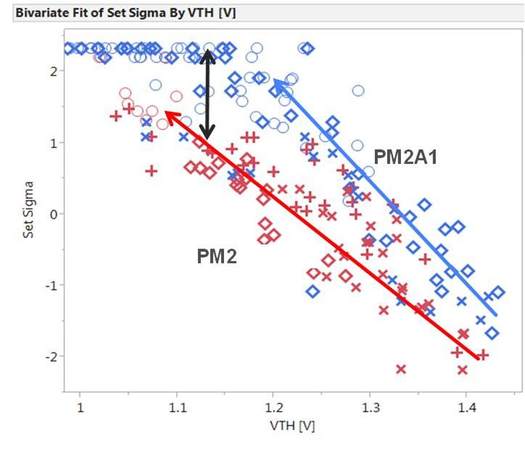
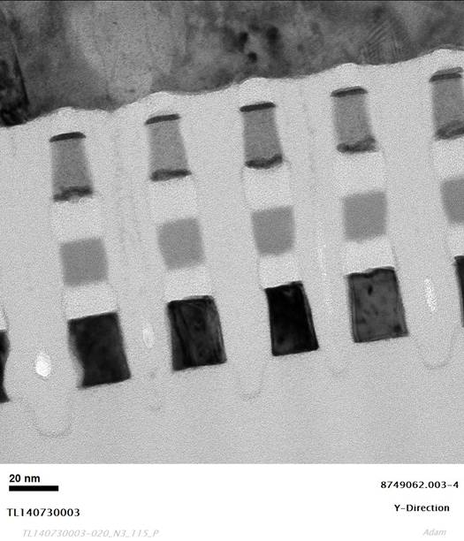
Focus moved: 20nm bit Functionality → 128Gbit Die Yield
Selector scaling & yield has gone well (biggest unknown at start)
Full Cell (selector + memory) has been the challenge
Modified Memory Composition → Better Performance
Level where we are confident “it works”
Better
Better SET-ABILITY →
Shallow slope: required process flow, steps and integration invention to solve memory & selector cross contamination / structural integrity
Improved SET to RESET ΔVT →
Memory Elements cross contaminate Selector
Selector Elements cross contaminate Memory
Structural integrity: Line/space CD’s; Seal/fill adhesion / step coverage
Focus on 1 deck: Invent process flow steps (e.g. etch, cleans, seal films) & integration to prevent memory & selector cross contamination / Structural Integrity
Dual deck not showing unique issues

Slide 20
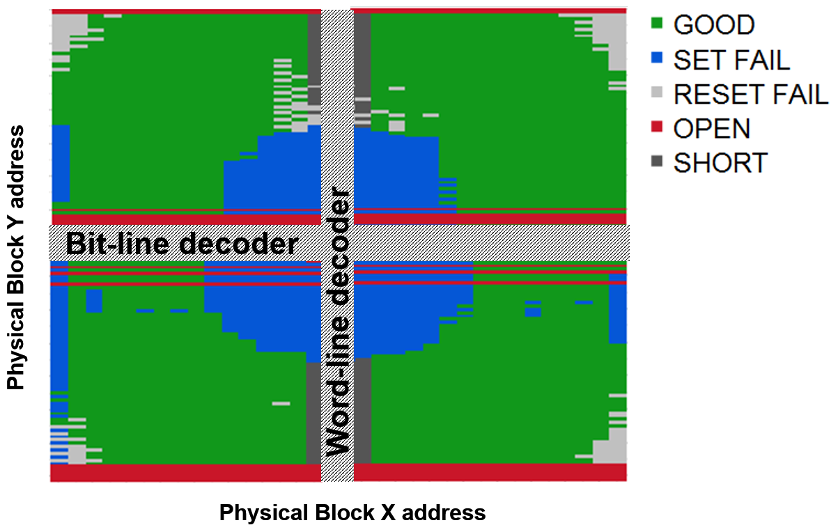
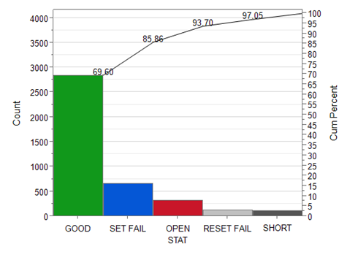
High level of functionality: on cusp of die level yield
Yield Pareto of key limiters
Clean up residual cross-contamination / structural integrity
Die Map of 8K Cumulative Tiles
Improving Distributions for Better Performance
Improving Edge of Tile Systematic issues (e.g. Polish, litho termination, etc)

Slide 21
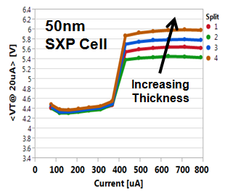
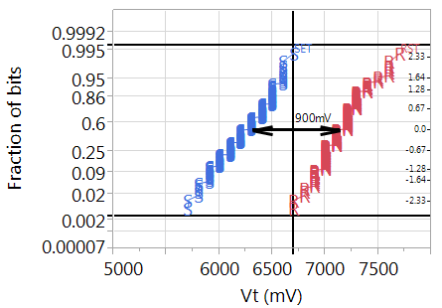
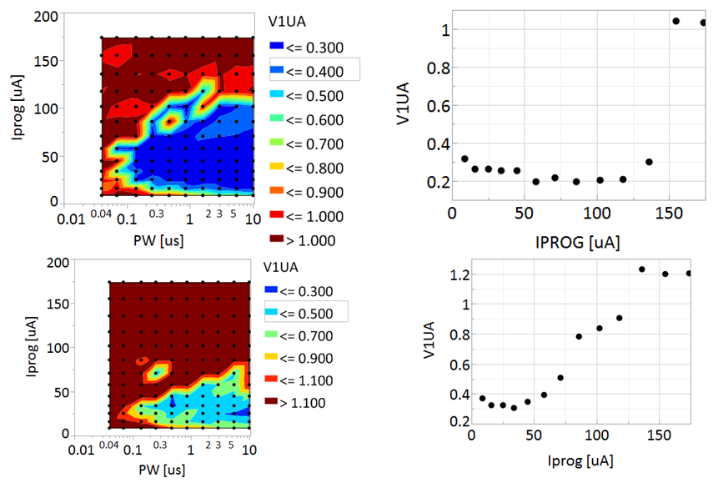
Present Focus: Improved performance/yield distributions → Better Performance
SET / RESET Distributions
Improved window with +thickness (~14nm planned → +420mV)
Good Fast SET
Good Vt vs I Behavior
Poor Slow SET
Poor Vt vs I Behavior (variety of process improvements in flight)

Slide 22
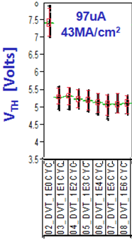
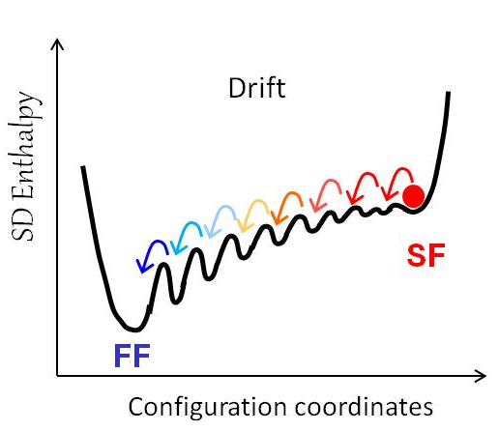
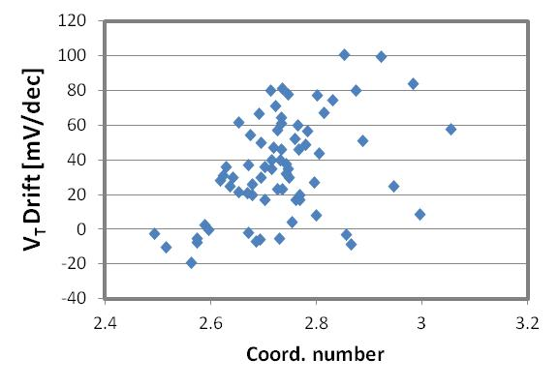
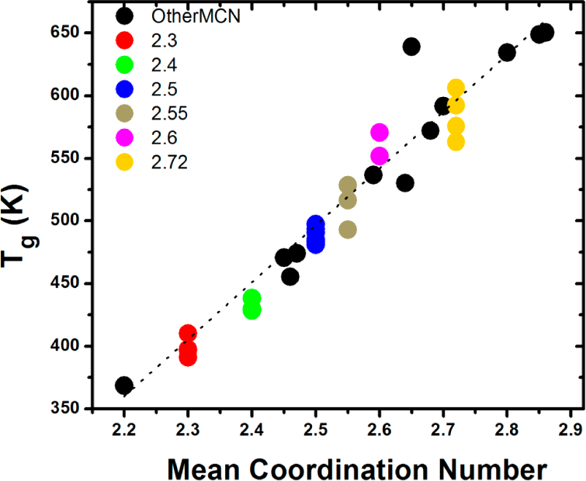
Resolution Underway for Vt Drift
“First Fire” (FF)
Drift Energy Diagram
“Second Fire” (SF)
P. Lucas, et al. J. Phys. Chem. B 118, 1436 (2014).
Old SD
New SD
Correlation between Drift and CN
Low CN → Low T_{g} → Lower Thermal Budget

Slide 23
Future Technology Roadmap
2nd Generation is large re-use of 1st Generation:
  2 decks → 4 decks @ same pitch / dimension as Gen 1
  256Gbit Product
  Rapid Technology Transition: Gen 1 production = 2015; Gen 2 = 2016
WL
BL
WL
WL
WL
PM
PM
PM
SD
SD
SD
BL
BL
WL
WL
WL
PM
PM
PM
SD
SD
SD
PM
PM
PM
WL
WL
WL
SD
SD
SD
WL
WL
WL
BL
PM
PM
PM
BL
SD
SD
SD
PM
PM
PM
BL
SD
SD
SD
BL
WL
WL
WL
PM
PM
PM
SD
SD
SD
Isolation
WL
WL
WL
1 BL Sockets
2 WL Sockets
Isolation
2 BL Sockets
2 WL Sockets
S15: 2 Decks 128Gbit
S26 4-Decks 256Gbit
3rd Generation is litho node change (14nm ½ pitch):
  4 decks, 512Gbit Product
  Materials and Process Integration Path-finding to launch Q4‘14
  Gen 3 Production = End of Year ‘17

Slide 24
Outline
Overview
SXP Technology Primer
Competitive Analysis
Technology Status
Intel System Architectures with SXP

Slide 25
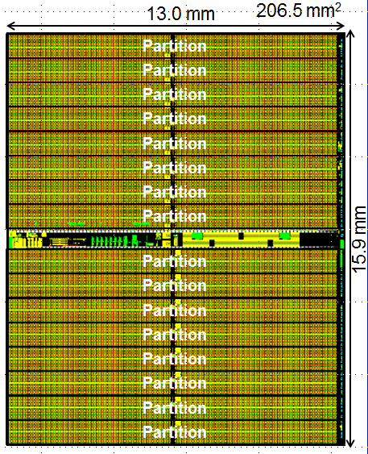
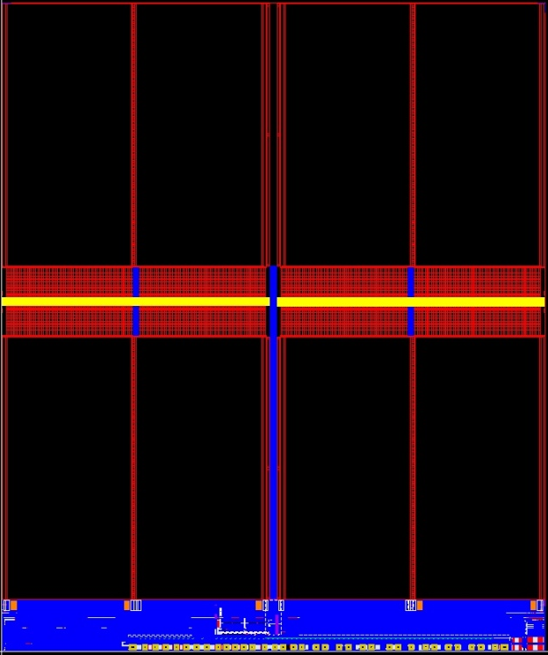
Memory Product Comparison
NAND 128Gb Dual Plane / 32kB Page
SXP 128Gb / 16B Access
DRAM – 4-8Gb / 1-2kB
13.00mm
Bank15
Selected Wordline
All 32kB BLs active
16B tiles active
Bitline
1kB-2kB/WL
Periphery
15.59mm
Data Cache
16kB Page
Data Cache
16kB Page
Periphery
Bank1
Bank0
For Illustration Purposes
Periphery
 | NAND (L85A) | SXP (S15) | DRAM
Access | 32kB cells w/in 1 block (dual plane) | 16Bytes: 1 cell in each of 16B tiles | 1k/2k cells across 1 bank
Parallelism | None (1 read or 1 write) | 16 independent partitions | 16 independent banks
Vwl /Vbl | >20V (high impedance) / 1V | -3.25V/+3.25V (set select), 0.6V (Vhold) | 2.5V (internal) / 1.2V
Endurance | ~1e3 to ~1e4 Write Cycles | ~1e7 Write Cycles | Unlimited Write Cycles
Read/Write Bandwidth | 400MT/s (IO Limited) / 22MB/s | 1600MT/s (IO Limited) / 550MB/s | 1600-3200MT/s for both (IO Limited)
Read/Write Latency | 50μs / 1500μs | 100ns / 465ns | 30ns / 30ns

Slide 26
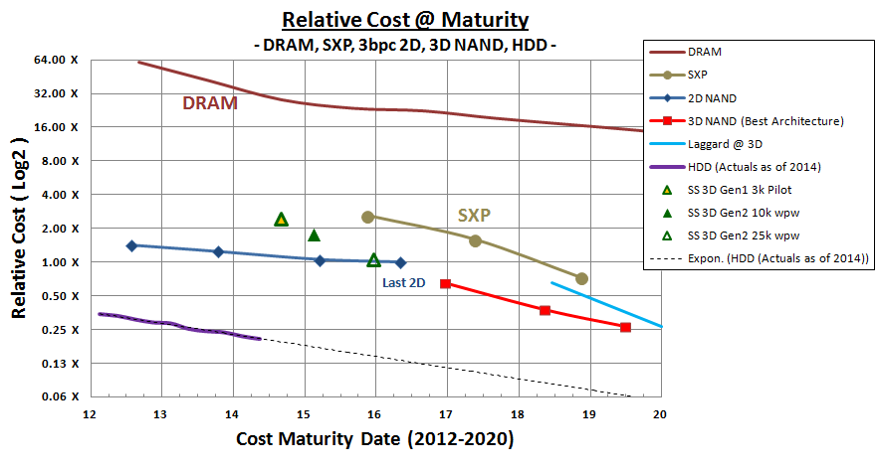
Relative Cost Comparison

Slide 27

Storage/Memory Progression
HDD latencies, 1,000,000x slower than DRAM, meant that we needed ~100% DRAM hit rates
SSDs, >100x faster than HDD, with the same amount of system DRAM, results in much more responsive systems
SXP SSDs allows reduced DRAM footprint
  SXP storage has power, cost, performance advantages
2LM allows for a small amount of DDR
  Cuts $$ out of BOM cost
  Frees up several square inches of board space
  Cuts memory idle power to nearly 0, reduces active power
  Provides SKUs that increase performance
< Power
> Bandwidth
< Latency
DRAM BOM $ / 2
(4 device min)
DRAM BOM $ / 8
(1 device min)
SXP
2LM
Improved
form
Factor
SXP
SSD
< Power
>Performance
2LM
SXP
SSD
SSD
SSD/SXP
2LMD
HDD
Latencyeffective = (Ldram * dram_hit) + (Lstorage * (1 – dram_hit))

Slide 28
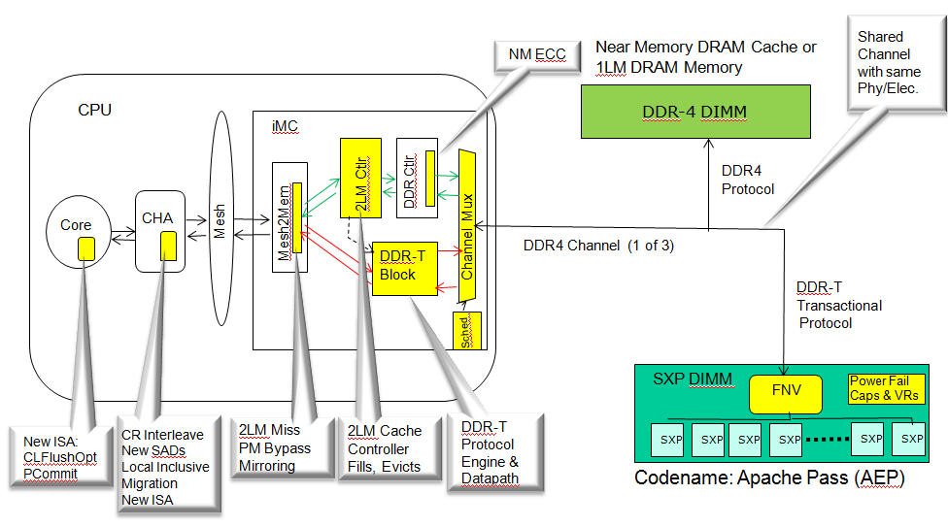
Memory and Storage Hierarchy with SXP
Memory Hierarchy
Intel Unique Memory Controller Links to SXP
Interfaces
Processor
Relative Latencies
On Core CPU
L1/2 Cache
~1 ns
On Die
L3 Cache
~10 ns
Memory
Bus
Attach
DDR DRAM
~30 ns
SXP
~200 ns
SSD
NVMe SXP
NVMe NAND
SATA/SAS NAND
~ 6,000 ns ( 6 us)
~ 90,000 ns ( 90 us)
~100,000 ns (100 us)
FNV = Transactional Memory Controller on DIMM; Manages SXP Media Management
SAS, SATA
HDD
~10,000,000 ns (10 ms)
Intel Unique: Create Transactional Bus for media management (low cost) = Low Latency (200nSec) & Memory Use. Others relegated to slow (6μSec) Storage Use
Notes:
The memory and storage hierarchy is a series of trade offs on density vs cost that drive a hierarchical approach to meet performance and affordability goals.
Memory technology candidates that are alternatives to DRAM and NAND have been around for some time, but the evolutionary advancement of these incumbent technologies (DRAM/NAND) have sustained the leadership position for the volume memory market segments. DRAM provides very high performance and endurance at a high cost (~8X) relative to NAND. NAND provides low cost and Non-volatility but with longer access times (~1000X) than DRAM.
SXP is unique and disruptive in that it has cost similar to NAND and performance similar to DRAM. Another way to look at it is that it is much faster (1000x) than NAND or much higher density (8x) than DRAM. It is not a direct replacement for either in all cases. Our view is that it is likely to be a new level in the memory hierarchy (2LM.)

Slide 29

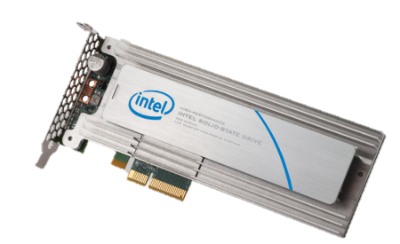
SXP in Server 2016: “Crystal Ridge” Concept*
Flexible, Usage Specific Partitions
NVM Memory:
Closer to DRAM latency
Cache Line Size Access
Volatile and Persistent Memory usage
Block access
High BW
Usage Flexibility
Modular/Scalable
NVM Pool
Apache Pass (AEP)
Volatile
Memory
Persistent
Memory
Fast SSD
Block Access
DRAM
Or
DRAM Cache
Native Support for
Persistent Memory in IA
Cold Stream
CPU
Next Generation
PCIe – NVMe SSDs
*In planning – subject to change

Slide 30
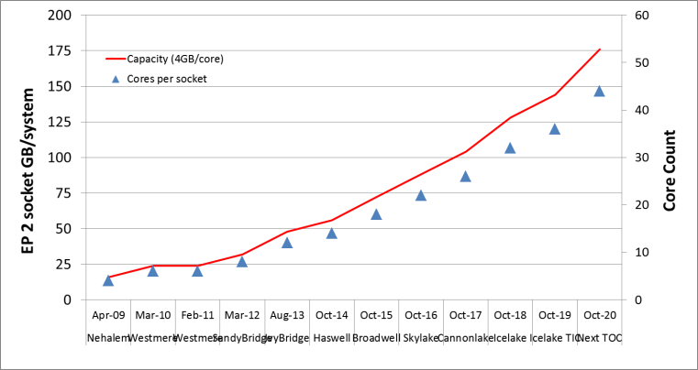
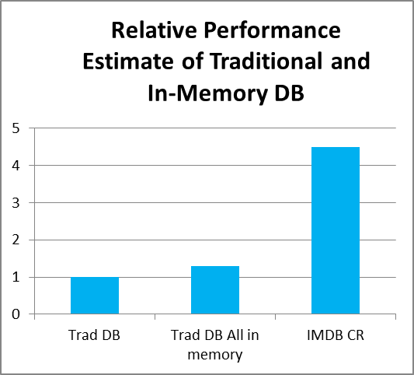

SXP High Capacity: Solution to Cost & Performance
TB’s of SXP memory changes SW architecture paradigm
Decision support & Bigdata
Databases doubling every 1.5-2yrs
Median size: 300GB – 3TB
HPC: Larger Memory → Less Comms
Compute Node
Compute Node
Compute Node
Performance
. . .
4X+
Re-Think SW
25%+
Communication Overhead Node to Node
Perf/node→
DB in memory
# Nodes →
DB in SAN cached in memory (CR/DRAM)
DB in SAN, cached in SSD/DRAM

Slide 31
Summary
SXP on cusp of die functionality / yield ramp
  Confidence technology works and remaining issues are solvable
SXP uniquely combines
  1. NVM
  2. Near DRAM performance
  3. Near NAND cost (capacity)
SXP appears >year+ lead on industry
  Better fundamentals vs. RRAMs (MemRistor)
  No sign of similar approach in industry
  Minimum 3 generation scaling roadmap established
IA platforms (Data Center, Client) readying proprietary architectures/busses to exploit SXP uniqueness
  Storage, Large Memory, Combo Storage + Memory: Persistent Memory
  Each with significant performance / cost advantages
BL
TE
PM
ME
SD
BE
WL

Slide 32
Backup

Slide 33
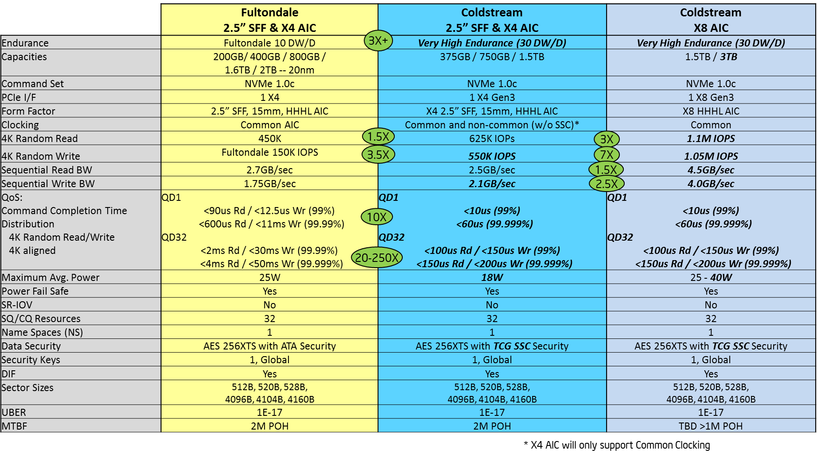


SXP Data Center SSD: Coldstream
Fully Integrated NVM Express 1.0C Controller
  Ultra low latency
  Symmetrical read/write IOPS performance
  Best QOS
  Power Fail Write Cache
  End-to-End Datapath Protection
  Endurance Management
  Power and Thermal Throttling
  Support for OEM Specific Management Features

Slide 34

SXP in Client 2016: 2LM Value Prop
1LM Platform
DRAM
LPDDR4
SoC
PCIe
NAND SSD
Main Memory
& Storage
2LM Platform
WIO2
FMI
SoC
SXP-NVM Module
With 2LM/SXP-NVM module:
  Achieves very large memory capacity
  Higher effective memory bandwidth
  Lower active power (WIO) and idle power (turn off WIO)
  Create systems with fungible memory and storage
  Boost SSD responsiveness with fast SXP-NVM
  Possibly use less board area and simplify layout

Slide 35
Persistent Memory Software Touch Points
(Dependent on How Software uses it)
Application
Application
Application
Application
Application
Libraries
Libraries
Libraries
Libraries
Libraries
User mode
User mode
User mode
User mode
User mode
Kernel mode
Kernel mode
Kernel mode
Kernel mode
Kernel mode
I/O Subsystem
I/O Subsystem
I/O Subsystem
Direct Memory
Access
Direct Memory
Access
File system
File system
PM Aware File System
Disk Storage Drivers
Disk Storage Drivers
Disk Block Driver
PM Block Driver
Hardware
Hardware
Hardware
Hardware
Hardware
Disk
PM
PM
PM
PM
Legacy system
Changes limited to block driver
No changes in OS & Apps
Implementation of PM aware file-system
No changes to Apps
Implementation of OS libraries utilizing “Direct access to PM”
No changes in Apps
Applications rewritten to use “Direct access to PM”
More opportunity to the right, but more enabling required
Initial hardware support the same
Notes:
Key message – for the items on the right, hardware is the same that supports various implementation profiles
Scope of changes –
Segmentation strategy based on touch points is outside of scope.

Slide 36
TB’s of CR memory changes SW arch paradigm
Traditional DB – Stack Optimized for IO
IMDB – Stack Optimized for Memory
  Limited by DRAM capacity; High capacity very costly
  32GB vol DIMM in 2016/17
    768 GB of EP2S system capacity
  128/256GB DIMM is ultra ultra premium in 2016/2017
    3/6TBof EP2S system capacity
  4X+ system perf w.r.t. to Traditional DB
CR is game changer
  CR is ~1/3 the $/GB cost w.r.t. Vol DRAM
  CR is significantly lower cost w.r.t. ultra premium DIMMs
  Enable 7.5/21TB EP2S capacity for 2016/17
  Enable up to 84TB with EX4S for CNX
Key observation about IMDB performance
  MS Hekaton 5-50x on same hardware over MS SQL server.
  VoltDB 45x faster than Oracle on TPC-C.
  Oracle Exalytics IMDB— ~5x response time improvement
  IBM SolidDB —10x acceleration over DB2
Performance
4X+
Re-Think SW
25%+
DB in memory
DB in SAN
cached in memory (CR/DRAM)
DB in SAN, cached in SSD/DRAM
SW innovation can drives significant performance improvement
(Re-think how data sets are placed in Memory Vs SSD/HDD/SAN)

Slide 37



Read Disturb
POR FFR
RESET V_{th}
~50% die w/o RD
SET V_{th}
10ns SSR
R5.Y3
NN cells
>90% die w/o RD
~700mV RD
<100mV RD

