Slide 1
SD1 Virgin Conduction Activation Energy vs Thickness
Koushik

Slide 2
Data
S15A 8636312 (PPISN4C Seal, HBC1 Electrode)
Splits → Wafers tested
  07C (SD1, nominal 22nm) → 19,24
  08E (SD1, nominal 20nm)→ 7,25
  09E (SD1, nominal 24nm) → 6,23
2kx4k Mongo-mono structure measured on 11 dies xWafer
90C, 60C, 30C
  IV sweep 0V-3V in 0.2V steps

Slide 3
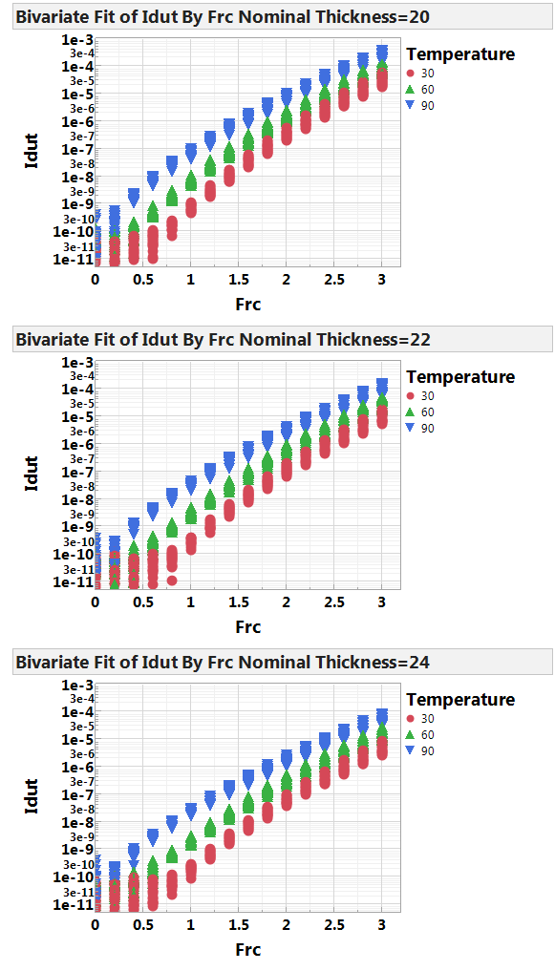
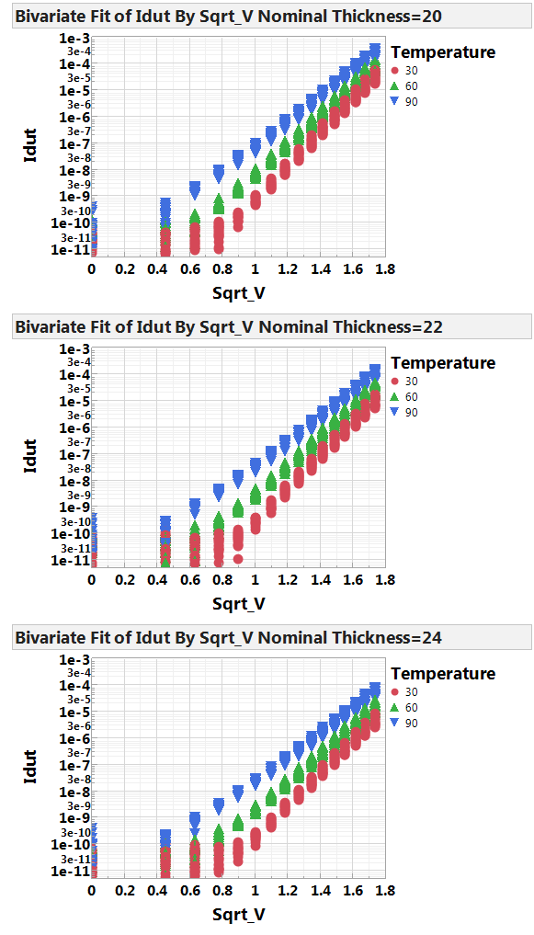
Temperature Comparison

Slide 4
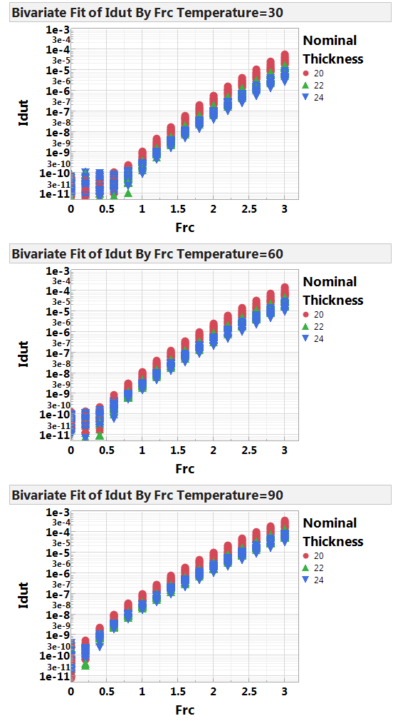
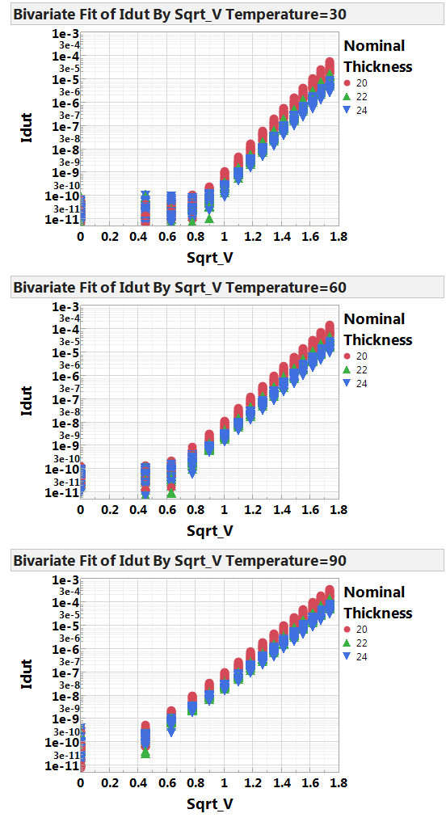
Thickness Comparison

Slide 5
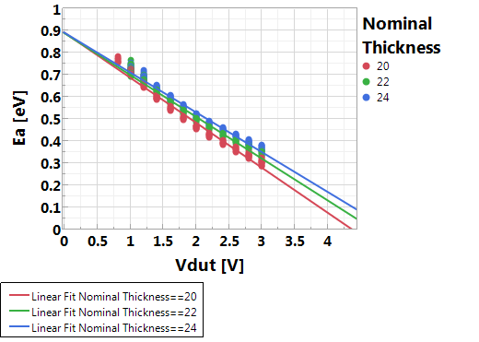
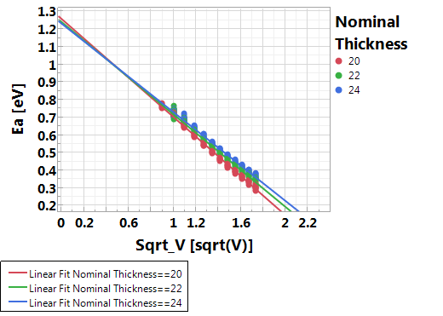
Ea bias Dependence
Fit | Nominal Thickness | Estimate Intercept | Estimate Slope | Std Error Intercept | Std Error Slope | t Ratio Intercept | t Ratio Slope | Observations (or Sum Wgts) | Root Mean Square Error | RSquare | RSquare Adj
Poole (vs V) | 20 | 0.89 | -0.20 | 0.004 | 0.002 | 225.75 | -107.01 | 248 | 0.019 | 0.979 | 0.979
 | 22 | 0.89 | -0.19 | 0.004 | 0.002 | 235 | -105.13 | 240 | 0.017 | 0.979 | 0.979
 | 24 | 0.89 | -0.18 | 0.003 | 0.002 | 255.74 | -110.1 | 232 | 0.015 | 0.981 | 0.981
Poole-Frenkel (vs sqrtV) | 20 | 1.26 | -0.56 | 0.004 | 0.003 | 326 | -202.270 | 248.000 | 0.019 | 0.979 | 0.979
 | 22 | 1.24 | -0.52 | 0.004 | 0.003 | 286 | -171.040 | 240.000 | 0.017 | 0.979 | 0.979
 | 24 | 1.23 | -0.50 | 0.005 | 0.003 | 273.12 | -159.180 | 232.000 | 0.015 | 0.981 | 0.981

Slide 6
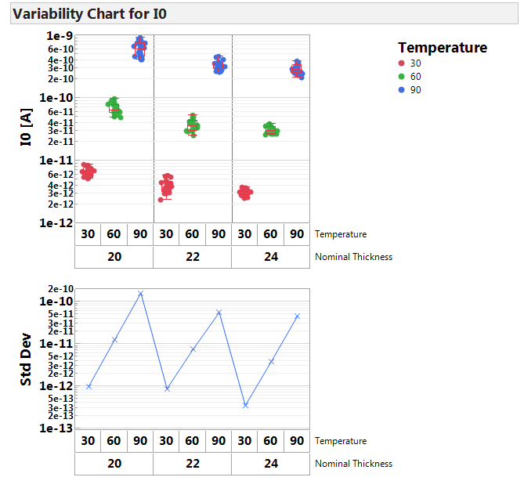
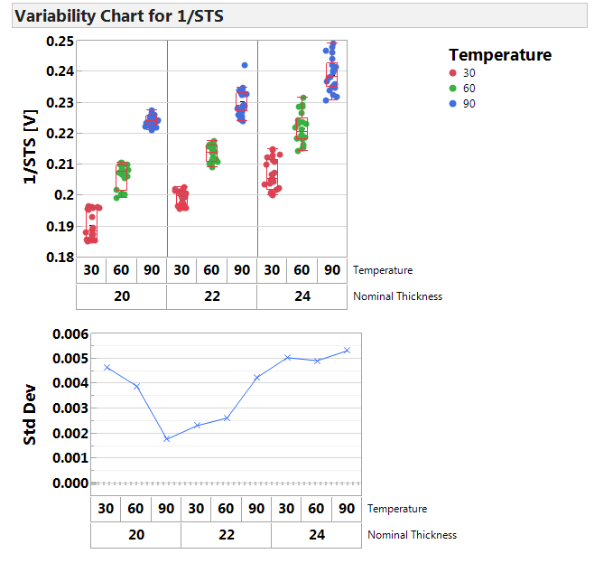
Poole Fit (logI vs V)

Slide 7
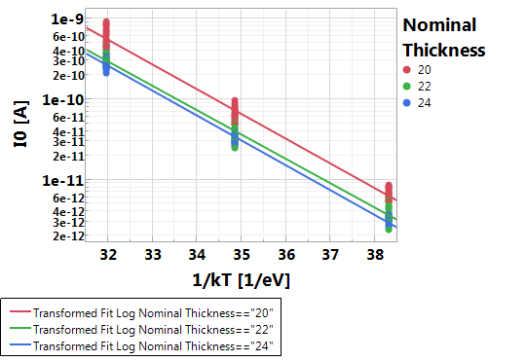
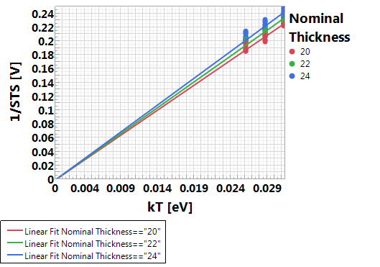
Poole Fit (logI vs V)
Log(I0) vs 1/kT fit
Nominal Thickness | Estimate Intercept | Estimate Slope | Std Error Intercept | Std Error Slope | t Ratio Intercept | t Ratio Slope
20 | 1.37 | -0.71 | 0.366 | 0.010 | 3.76 | -68.15
22 | 0.39 | -0.70 | 0.361 | 0.010 | 1.07 | -67.95
24 | 0.75 | -0.71 | 0.268 | 0.008 | 2.8 | -93.39
1/STS vs kT fit
Nominal Thickness | Estimate Slope | Std Error Slope | t Ratio Slope
20 | 7.208 | 0.017 | 425.83
22 | 7.464 | 0.019 | 390.17
24 | 7.743 | 0.025 | 303.81

Slide 8
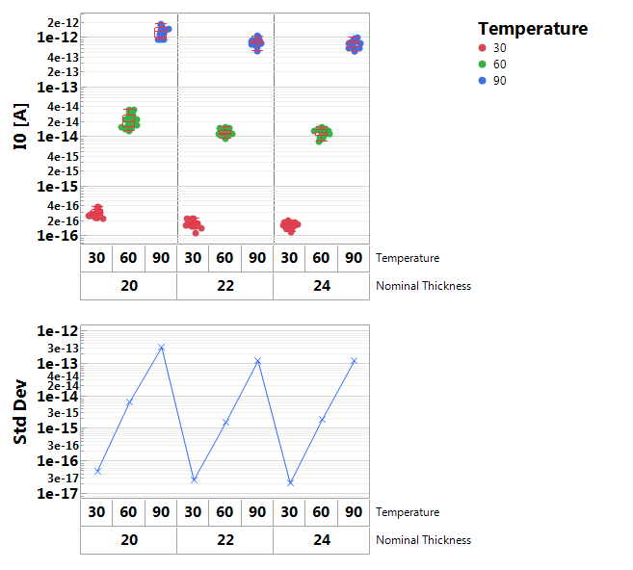
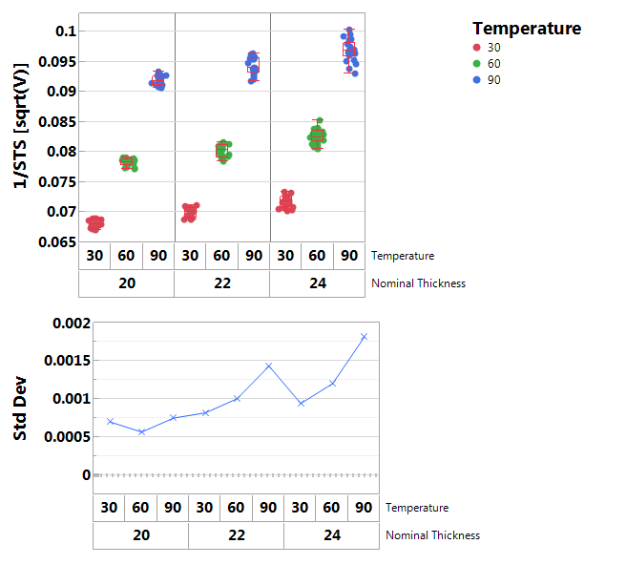
Poole-Frenkel Fit (logI vs sqrt(V))

Slide 9
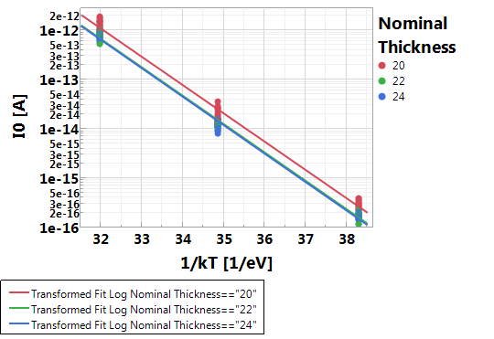
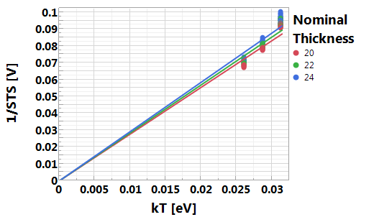
Poole-Frenkel Fit (logI vs sqrt(V))
Not correct model
Log(I0) vs 1/kT fit
Nominal Thickness | Estimate Intercept | Estimate Slope | Std Error Intercept | Std Error Slope
20 | 14.739 | -1.321 | 0.4825118 | 0.013732964
22 | 14.373 | -1.325 | 0.382879711 | 0.010897295
24 | 14.459 | -1.329 | 0.362385324 | 0.010313996
1/STS vs kT fit
Nominal Thickness | Estimate Slope | Std Error Slope | t Ratio Slope
20 | 2.776338996 | 0.017229793 | 161.14
22 | 2.848607913 | 0.018036746 | 157.93
24 | 2.927543823 | 0.0187728 | 155.95

