Slide 1
Polarity measurements using 2xNMOS single cell devices in S15B
Christina P., Koushik, Stephen
10/17/2014

Slide 2
Test Plan
Start measurements on SD1 and then SDδVer4
  8755582_Wfr 5 (split1_SD1), and
  8755582_10 (split4_SDδRev2).
2xNMOS Module: MOD113AT
Ramp Vth detection will be used with shortest Ramp rate=1V/us or 1V/10us.
Test details:
    Exp#1: Effect of FRW Vs REV and Sequence
  Exp#2:
    Vary Iclamp
    Vary precondition PA=25uA to 150uA
    Vary Wait time=1ms to 1sec
    Vary RC: BRC structure (this is 1xNMOS).

Slide 3
Status
Set Up AC05: No documentation was available. ➔ Done
Verify code (create station for AC05 & update pad assignment) ➔ Done
Set backs due to incorrect connection of pad1 on the switch matrix. In addition, pad4 and 11 were shorted at the matrix using triax to BNC connectors (without grounded shield), which is forbidden for SPA operation (SPA is not controlled as expected). ➔ Pad 4 and pad11 are now connected at the switch matrix, and shorted together at operation (as needed).

Slide 4
Test Flow
Lot_wfr: 3000673 W4 (SD1)
Four group of devices:
  FF/SF FRW with Iclamp= 60uA & Ramp Rate=1V/us
    dies: [0,-1;2,-1;-1,-2;1,-2] , file: 60uA1FRWa
  FF/SF REV with Iclamp= 60uA & Ramp Rate=1V/us
    dies: [-1,-1;1,-1;0,-2;2,-2] , file: 60uA1REVa
  FF/SF FRW with Iclamp= 60uA & Ramp Rate=1V/10us
    dies: [-2,-1;-2,-3;0,-3;2,-3] , file: 60uA10FRWa
  FF/SF REV with Iclamp= 60uA & Ramp Rate=1V/10us
    dies: [-2,-2;-3,-3;-1,-3;1,-3] , file: 60uA10REVa

Slide 5
Pad Connections for S15B_2xNMOS
FRW
2
BLpulser
2
9
SMU1
4
11
11
12
SMU1
12
SMU3
DNW=7 globally SMU2
Pad | Desc | Device ID
1 | Cascode | All
2 | BL-Dev1 | All
3 | PW_BOT_D1 | All
4 | Top_Gate_dev2 | All
5 | DBL | 1
6 | Gate | All
7 | DNW | 2
8 | Source | All
9 | Top Gate | All
10 | DWL | All
11 | PW_top | 1
12 | Top Cascode | 5
13 | PSUB | 2
14 | Gate-2 | All
15 | PW_BOT_D2 | 1
16 | Source-2 | All
Gate pulser
1
1
1
3
3
15
SMU4
6
6
SMU2
14
8
8
16
scope2
SMU1=9.5V
SMU2=6.5V
SMU3=3V
SMU4=0V
Des BL=5
Des WL=10
SMU3
Are the tr different? yes
Pad 4 is connected to pad11

Slide 6
Pad Connections for S15B_2xNMOS
REV
scope2
2
2
SMU2
4
9
11
Gate pulser
11
12
12
SMU4
DNW=7 globally SMU2
Pad | Desc | Device ID
1 | Cascode | All
2 | BL-Dev1 | All
3 | PW_BOT_D1 | All
4 | Top_Gate_dev2 | All
5 | DBL | 1
6 | Gate | All
7 | DNW | 2
8 | Source | All
9 | Top Gate | All
10 | DWL | All
11 | PW_top | 1
12 | Top Cascode | 5
13 | PSUB | 2
14 | Gate-2 | All
15 | PW_BOT_D2 | 1
16 | Source-2 | All
1
1
1
SMU1
3
3
15
SMU3
6
SMU1
6
14
8
8
16
BLpulser
Des BL=5
Des WL=10
SMU1=9.5V
SMU2=6.5V
SMU3=3V
SMU4=0V
SMU3
Pad 4 is connected to pad11

Slide 7
VT_FF & VT_SF
VTH_FF slightly lower when measured with slower ramp rate, as expected.
VT_SF slightly lower when device is biased in REV polarity.
➔ Vform is higher in REV polarity by 300-400mV.

Slide 8
60uA with Ramp=1V/1us
Filter out cells when Iclamp<40uA.
2 different Vth levels are observed in FRW and REV direction.
Vth in REV direction is slightly lower.

Slide 9
60uA with Ramp=1V/10us
Filter out cells when Iclamp<40uA.
2 different Vth levels are observed in FRW and REV direction. Vth in REV direction is slightly lower.

Slide 10
Bits without differences in Vth Vs polarity
A small number of bits does not show 2 difference Vth levels in FRW and REV direction (excluding first pulse effect).
The last bit (in this slide) shows a reduction in the Vt difference as the device is cycled.
Follow Up: Cycle more the devices to see if delta Vth will decrease.

Slide 11
Effect of polarity reversal
FF/SF in FRW
FF/SF in REV
VT shift is larger (~200mV) from FRW to REV polarity.
VT shift is larger (~200mV) from REV to FRW polarity.
Vth shift depends on FF/SF polarity used!!

Slide 12
Follow Up
Understand origin of Vth dependence on polarity. Could we eliminate the 2 Vth levels if devices are cycled further?

Slide 13
Delta Vth_post direction reversal

Slide 15
VT_FF, SF & Vform

Slide 16
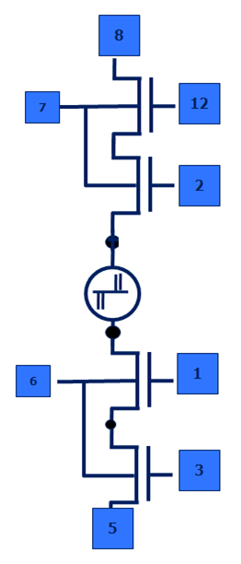
2xNMOS – ISO cell test method
Main limitation:
CMOS cannot handle more than 6-6.5V of gate voltage
NMOS will have Vt drop when trying to pass 6.5V
  Max voltage at LBL<5V
To circumvent, apply V_{offset} at top PW (5)
  Gate, (4),(2) can go now to 6.5+ V_{offset}
  LBL can go to ~5+Voffset
Ideally V_{offset} can be large enough to pass ~10V to LBL
  However there is a protection diode to substrate at 4,2 and if I applied >9V of gate (4),(2), either broke diode or turned on parasitic device
Max LBL with V_{offset} ~7V-7.5V
6
BITLINE
Is this an issue for S15B CMOS??
5
4
2
Des BL=10
Des WL=16
LBL
DNW=9
Pad assignment for S15A_2xNMOS structure!!!
7
1
Courtesy Arjun K.
3
8
WORDLINE

Slide 17
Arjun’s experiment in PTX
4 Groups of bits:
FF-SF_FRW
FF/SF-FRW after 10min FRW stress @ 70%VT_FF
FF-SF_REV
FF/SF-FRW after 10min REV stress @ 70%VT_FF
Measure VT 8 times in FRW and 8 times in REV for each group; Repeat 5 times.
Repeat experiment in 20nm S15B cells. Do we see the same behavior?

Slide 18
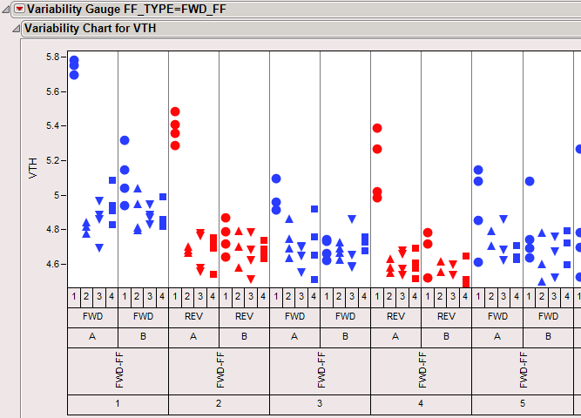
Changing Polarity: First Fire type: FWD no stress
FORWARD
REVERSE
Stopped and set matrix connections

