Slide 1
PTX-A364: Sub-threshold leakage vs. Temperature
Dany, Stephen, Koushik

Slide 2
PTX-A364: Leakage vs. Temperature Summary
Summary
For PTX14 IG88, leakage of single cells is under noise floor. Subthreshold leakage for all bits on a single module are measured in parallel to increase the signal.
When selecting one bit, the deselected bits leakage dominates the measurement. The deselected bits leakage floor also changes with temperature, and higher temperatures show higher leakage from the deselected cells. The deselected bits leakage continues to dominate at higher temperature, even though the selected cell leakage has also increased at higher temperatures.
Hence, measurements where all bits are selected are used for characterization. Under those measurements, all bits are contributing to leakage, and none of the bits are deselected.
Based on data collected between 0C to 105C for virgin and 1e3 cycles:
Data is fitted for EA according to Poole conduction model and Poole-Frankel conduction model.
Split 1 showing largest drop in E_{A} after cycling
Split 2 SD-zeta 19nm showing nearly overlaid data after cycling. E_{A0} extraction showing differences post-cycling, but mostly due to E_{A} data extracted within 2.2V-2.5V region; higher biases showing nearly no difference in E_{A}.
Split 5 data (SD-zeta 25nm) very noisy due to lower SD leakage. Higher bias data required for further validation of extracted data.
E_{A0} overall higher for SD1 than SD-zeta 19nm.

Slide 3
Leakage vs. Temperature Experimental Flow
Splits / Wafers tested:
PTX-A364, Split 1 (W24), Split 2 (W23), Split 5 (W6)
Structures tested:
73O00050050M & 73N00050050M (IG88, 50x50) ➔ same measurement, for statistics only.
Flow:
On virgin bits, for each temperature (105C, 85C, 55C, 25C, 0C):
Start at the higher temperature
Measure DC IV in 1V – 3V range for 10 individual bits (segmentation only)
Measure DC IV in 1V – 3V range for all bits in parallel (cumulative leakage), repeat the I-V 10 times
Cycling (25C):
First Fire / Second Fire (clamp at 100uA)
1e3 cycles, RESET only, 110uA PA, 100ns PW.
Bake wafers: 30 min at 120C
After cycling (e.g. post-1e3 cycles), for each temperature (105C, 85C, 55C, 25C, 0C):
Measure DC IV in 1V – 3V range for 10 individual bits (segmentation only)
Measure DC IV in 1V – 3V range for all bits in parallel (cumulative leakage), repeat the I-V 10 times

Slide 4
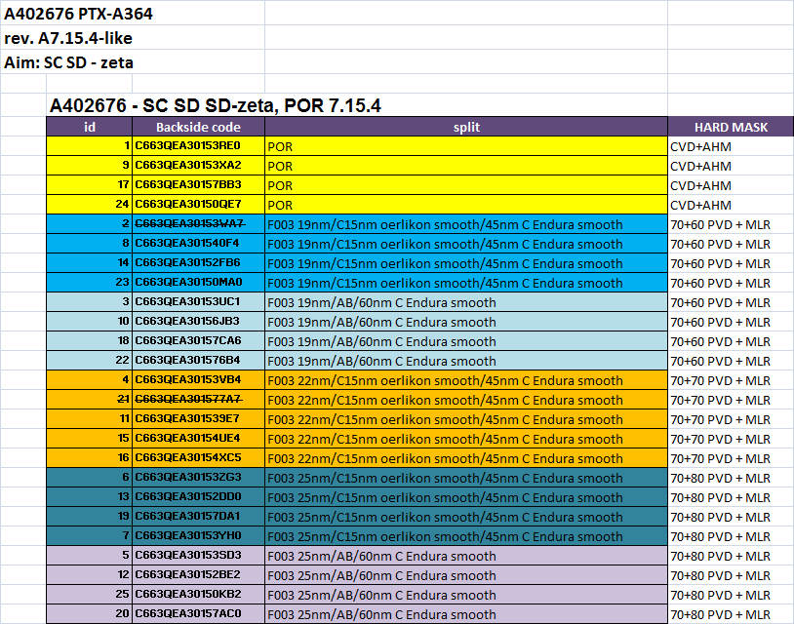
Split Table

Slide 5
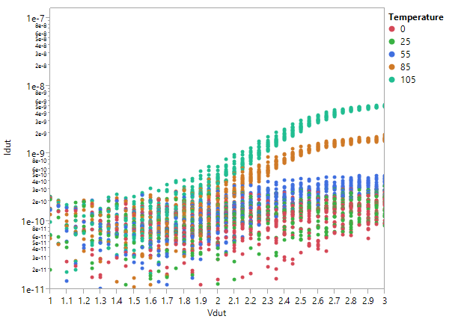
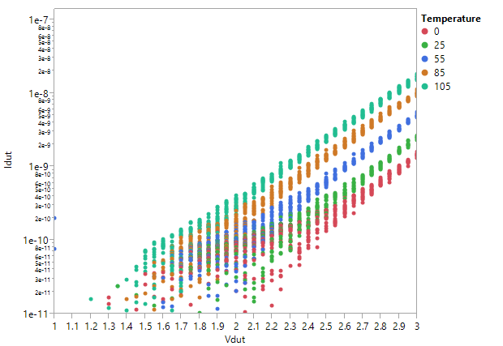
Methodology: Measuring all cells in parallel in IG88
Virgin Cell IV
One cell measured (20 cells / temp)
19nm W23 (no/AB)
Virgin Cell IV
All 108 cells measured at once
10 repetitions, 2 spines
19nm W23 (no/AB)
Deselect
device
Leakage of one cell (others are deselected through deselect transistor, left) vs. when all cells are selected (right).
Leakage floor due to the deselected transistor is temperature dependent, and increases faster than the target cell leakage.
Clamp voltage set to 4V (~mA current) and well beyond any current limit for these experiments

Slide 6
Virgin Leakage
Split 1
SD1
virgin
Split 2
SD-zeta 19nm
virgin
Split 5
SD-zeta 25nm
virgin
Split 1
SD1
1e3
Split 2
SD-zeta 19nm
1e3
Split 5
SD-zeta 25nm
1e3
Data collected on Split 1, 2, 5 for virgin and 1e3 cycles.

Slide 7
Fitting of Idut vs. 1/kT curves
I vs. T
Bias = 3V
Virgin
I vs. T
Bias = 2.7V
Virgin
Split | SD | Intercept (A) | Slope (B = -Ea)
1 | SD1 19nm | -8.63 | -0.2597
2 | F003 19nm | -11.86 | -0.2028
5 | F003 25nm | -11.12 | -0.3019
Split | SD | Intercept (A) | Slope
1 | SD1 19nm | -8.80 | -0.2900
2 | F003 19nm | -12.86 | -0.2087
5 | F003 25nm | -16.65 | -0.1584
Ea is extracted from the slope of the linear fits for log(I) = A - Ea/kT at each voltage
Data points measured under 0.2nA are ignored.

Slide 8
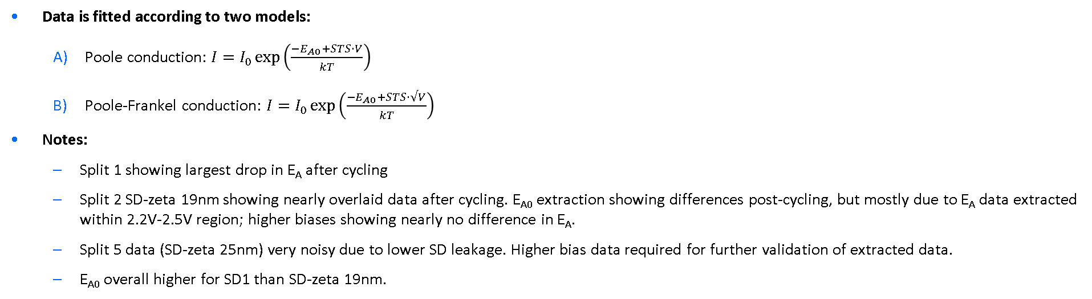
Ea extraction vs. Vdut
Split 1
SD1
Split 2
SD-zeta 19nm
Split 5
SD-zeta 25nm
virgin
1e3
1e3
virgin
1e3
virgin
Data is fitted according to two models:
Poole conduction: $I=I_{0}\exp\left(\frac{−E_{A0}+STS⋅V}{kT}\right)$
Poole-Frankel conduction: $I=I_{0}\exp\left(\frac{−E_{A0}+STS⋅√V}{kT}\right)$
Notes:
Split 1 showing largest drop in E_{A} after cycling
Split 2 SD-zeta 19nm showing nearly overlaid data after cycling. E_{A0} extraction showing differences post-cycling, but mostly due to E_{A} data extracted within 2.2V-2.5V region; higher biases showing nearly no difference in E_{A}.
Split 5 data (SD-zeta 25nm) very noisy due to lower SD leakage. Higher bias data required for further validation of extracted data.
E_{A0} overall higher for SD1 than SD-zeta 19nm.
A) Poole conduction
B) Poole-frankel conduction
Split | Cycle | EA0 | STS
1 | Virgin | 0.674 | -0.143
1 | 1e3 | 0.477 | -0.094
2 | Virgin | 0.346 | -0.049
2 | 1e3 | 0.249 | -0.015
5 | Virgin | 0.333 | -0.043
5 | 1e3 | 0.680 | -0.169
Split | Cycle | EA0 | STS
1 | Virgin | 1.032 | -0.453
1 | 1e3 | 0.696 | -0.287
2 | Virgin | 0.475 | -0.160
2 | 1e3 | 0.286 | -0.047
5 | Virgin | 0.447 | -0.141
5 | 1e3 | 1.129 | -0.550

Slide 9
Split 1 – Ea fit
Virgin leakage vs. temperature
1e3 cycles leakage vs. temperature
Virgin – Fit vs. Vdut
Virgin – Fit vs. sqrt(Vdut)
1e3 cycles – Fit vs. Vdut
1e3 cycles – Fit vs. sqrt(Vdut)
Ea = 0.6743033 - 0.143004*Vdut
Ea = 1.032482 - 0.4534796*sqrt(Vdut)
Ea = 0.4766904 - 0.0935454*Vdut
Ea = 0.6958805 - 0.2873885*sqrt(Vdut)

Slide 10
Split 2 – Ea fit
Virgin leakage vs. temperature
1e3 cycles leakage vs. temperature
Virgin – Fit vs. Vdut
Virgin – Fit vs. sqrt(Vdut)
1e3 cycles – Fit vs. Vdut
1e3 cycles – Fit vs. sqrt(Vdut)
Ea = 0.3456015 - 0.0491194*Vdut
Ea = 0.4751746 - 0.1597386*sqrt(Vdut)
Ea = 0.2493545 - 0.0147523*Vdut
Ea = 0.2860725 - 0.0466108*sqrt(Vdut)

Slide 11
Split 5 – Ea fit
Virgin leakage vs. temperature
1e3 cycles leakage vs. temperature
Virgin – Fit vs. Vdut
Virgin – Fit vs. sqrt(Vdut)
1e3 cycles – Fit vs. Vdut
1e3 cycles – Fit vs. sqrt(Vdut)
Ea = 0.33269 - 0.0430359*Vdut
Ea = 0.4474144 - 0.1406066*sqrt(Vdut)
Ea = 0.6802178 - 0.1685779*Vdut
Ea = 1.12873 - 0.5504027*sqrt(Vdut)

