Slide 1
SD1 Forming
Risk Assessment & Management Plan
2/26/2013
Collaborators:
Project Owner: Fabio (PaoloF, DerChang)
Device: Christina, DavideM*, Enzo§, Feng, Karthik, Koushik¤, Mattia
Integration: Lorenzo
                §: Etest/Probe coordinator
                *: Array charx coordinator
                ¤: Cell charx coordinator
                (Collaborators are assignment based,
                Supervised by Fabio, DerChang and Lorenzo)

Slide 2
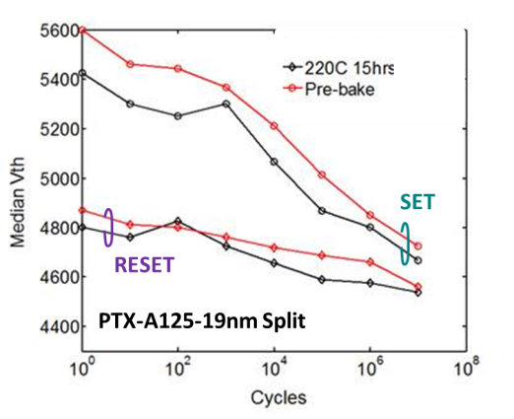
Single Pulse Forming
1
WW9.2 2/26/2013
3
Goal vs. Gap
Empirical Model
Supporting Material
Goal: Single Pulse to form a stable Vt of SD device
Gap:
  No unified forming procedure for Array, CLV and DITP
  Continuous Vt reduction after “BKM” forming; (>0.3V @1E7 cycle)
  Negative memory effect (1V of more); reduces after bit is cycled
Formed behavior changed
1) after Oerlikon maintenance (Q3/12) 2) Geometric confinement
Forming changes SD bulk conduction
Insufficient forming results in memory effects, this memory effect manifests interface and/or its boarder dependence
Forming is typically a bake reversible process.
1. SF I-V indep. of area before tool change vs. J-V after tool change
2. 2D confined SD improves I-V dist.
V_{form} , ρ, σ, scales with SD thickness
1. Forming pulse vs. Vt stability
2. Memory effects correlated to electrode but less dependent on SD bulk
Limited data yet true for SD0 vs. SD1, electrode process but not for A67?
Owners & Status
Resolution Strategy & Containment
Plan and ECD
Owner: Fabio
Process effects and segmentation using existing silicon
SD1 Interface/electrode DOE with PM learning (SDx baseline will use SD1 POR)
Establish device attributes (success criteria) of ‘formed’ devices and forming procedure (as a requirement)
Establish forming procedure as a containment to stabilize Vt and to reduce memory effects for full stack and array learning
Scrub split on “Oerlikon maintenance” and 2D confinement / ECD WW09
2D decision WW13, Carbon surface treatment WW17, W interface WW19
Forming/seasoning characterization on pre-Oer-maintenance A45, A67 and 2D confined A131 / ECD WW10
Develop forming procedure at probe and etest for process yield learning, material/electrode characterization and reliability assessment /ECD WW11

Slide 3
Observations
Anecdotal model development

Slide 4
Observations – Process effects
FF IV ∝ area but SF IV is area independent
  True for SD0 (PT180-D2)
  True for old SD1 [Oerlikon RT stack before maintenance], A45, A67
  SF IV is area dependent in newer lots, after Ore maintenance, [both Oerlikon & Endura dep] though the dependency might vary. Lot A65 split 1 is done before Ore maintenance still need to get data from Enzo.
  quantification of forming voltage, slope change and resistance change
Memory Effect – independent of process variations
  Test structure dependence – for both SD0 and SD1, window is positive in CLV and negative in PTX14 (test structure is also coupled with test mechanism)
  SD1 memory window is present in all lots and reduces with cycling (based on DITP Pass 4 testing and IG88 characterization, PTX14 1X1 and 128X128 probe and engineering charx)
  Memory effect quantification per process conditions is in foil xxx
    Are they size dependent, how about thickness, carbon, process conditions.
  Memory effect characterization specifics are using A110 (foil yyy)
Recovery of virgin state with bake on A67, A65, A110
  SD0: Observed in D2 PT180, both Vt and subVt
  SD1: FF Vt recovered in A65/A110 array @220,15hr. Not observed in A67 single-cell (old lot) @220C, 42hr.

Slide 5
Observations – Single Pulsing effects
Single Square pulse Forming (different forming pulses are used on different devices having ~ VT FF; VT SF is recorded)
  A125 in array split 3 16nm PA=500uA, PW=100ns~5use show Vt increase slightly; sub 100mV; A110 16nm increase 0.4V; A110 25nm increase 1V.
  A110 in array 16nm
    Square pulse, PW=100nsec PA =100-500uA, applies to virgin bit: VT detect (analog to “SF”) shows slightly up ticking behavior @ higher PA (+ 200mV Δ VT @ 500uA);
  A110 in IG88 22nm show similar trend with saturation at 100usec

Slide 6
Observations – pulse seasoning effects
Long Pulse width forming on A110 wafer 2, split 2?
    A110 forming is done with Vt-detect on FAT; cylcing is done with 500uA, 100ns square pulse
      Vt continue drop from virgin to 1E7 with memory effects
    A110 forming is done with 1K pulses @ 10usec/500uA (or 10msec/500uA equivalent or 1E5 of 100nsec cycles); cycling is done with 500uA, 100ns square pulse
      Vt do not change from SF to 1E5. drop 200mV @ 1E6 and 1E7
      No memory effects
    A110 forming is done with 100 pulses @ 10usec/700uA (or 1msec/700uA equivalent or 1E4 of 100nsec cycles); cycling is done with 500uA, 100ns square pulse
      Vt do not change from SF to 1E6. drop 100mV @ 1E7
      Positive memory effect drops from 200mV to near 0mV as it cycles

Slide 7
Observations –Pulse trailing edge effects
Memory effects: VT dependence on set/reset PA, PW, t_fall (repeatable on the same device) need silicon process info
  Based on A110 16nm and A145 ? Use Plateau Amplitude of 500uA/500nsec trailing edge @ 1usec or longer exhibits higher Vt, upto 800mV @ TF=5usec ➔ how is it manifest to PA/PW on Vt contour experiment? Data is available, need analysis
  But it does not exhibit the same behavior on IG88? (different forming condition Vt detect on Array and ramp/clamp threshold for IG88; smaller, -200mV, VT memory window)
  Electrical Ramp down are different between IG88 (nMOST current clamp Vg ramp down) and array (pMOST current mirror SCD)

Slide 8
Supporting Data for
Observations – Process effects

Slide 9
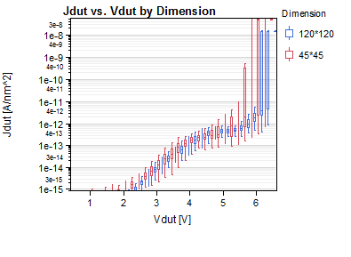
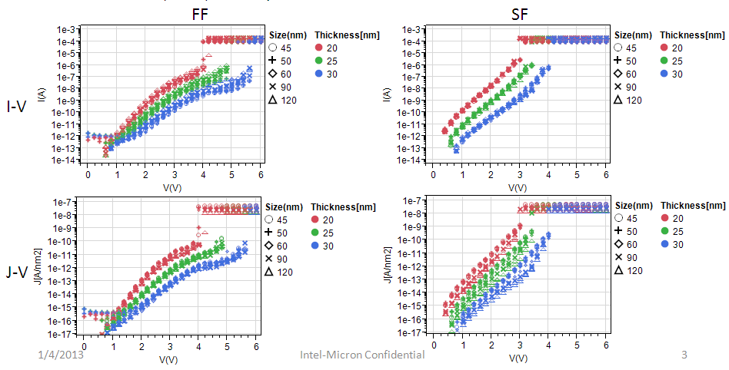
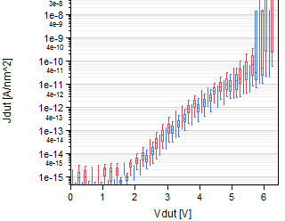
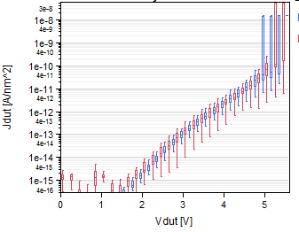
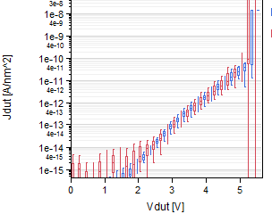
FF J-V
All process splits show virgin IV ∝ area
i.e. JV overlap for different CDs
Oerlikon RT Dep. before maintenance, Mask#1
SD0 (D2 PT180)
SD1 (A45) - 30nm
SD1 (A67)
Oerlikon RT Dep.
after maintenance,Mask#1
Oerlikon 200C Dep.
after maintenance,Mask#3
Endura RT Dep.
Mask#3
SD1 (A65) – 25nm
SD1 (A125) – 19nm
SD1 (A110) – 19nm

Slide 10
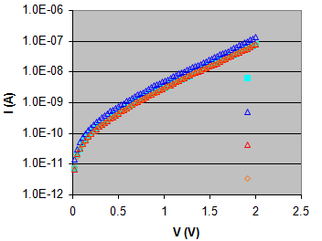
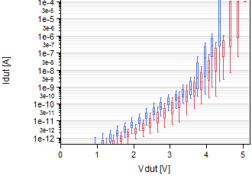
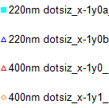
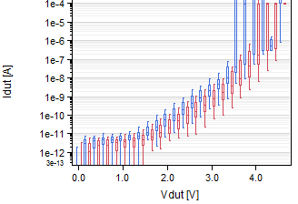
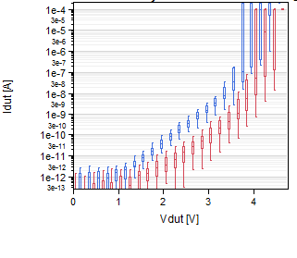
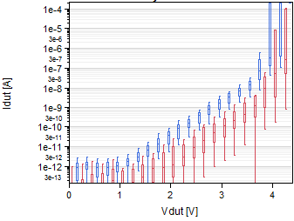
SF IV
Oerlikon RT Dep. before maintenance, Mask#1
SD0 (D2 PT180)
SD1 (A45) - 30nm
SD1 (A67)
SF IV is area-independent for SD0 and few SD1 lots (A45, A67- Oerlikon before maintenance)
Oerlikon RT Dep.
after maintenance,Mask#1
Oerlikon 200C Dep.
after maintenance,Mask#3
Endura RT Dep.
Mask#3
SD1 (A65) – 25nm
SD1 (A125) – 19nm
SD1 (A110) – 19nm
SF IV scales with area for SD1 lots (Oerlikon after maintenance and Endura)

Slide 11
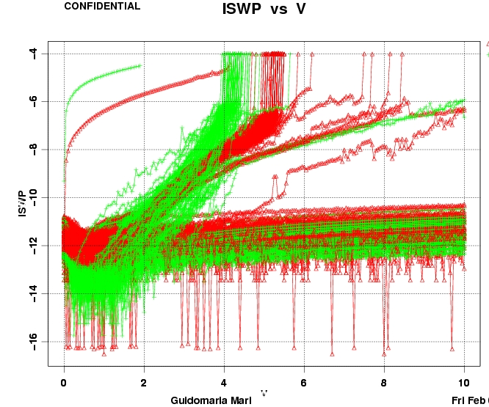
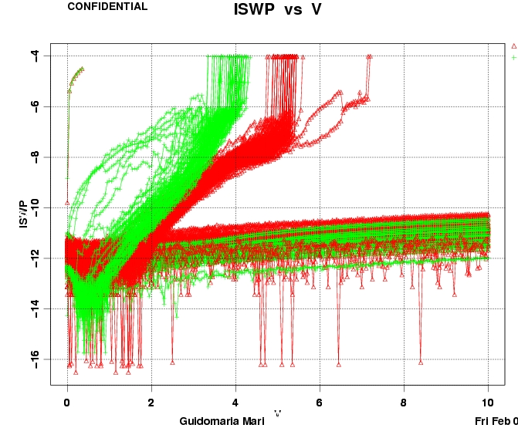
1D vs 2D SD1 FF/SF IV [PTXA131]
1D Confinement
2D Confinement
Crossover of FF & SF IV
(similar to A125, A110)
No crossover
(similar to A45, A67, A65)
Data from L3 testing, 50×50 1xnmos devices

Slide 12
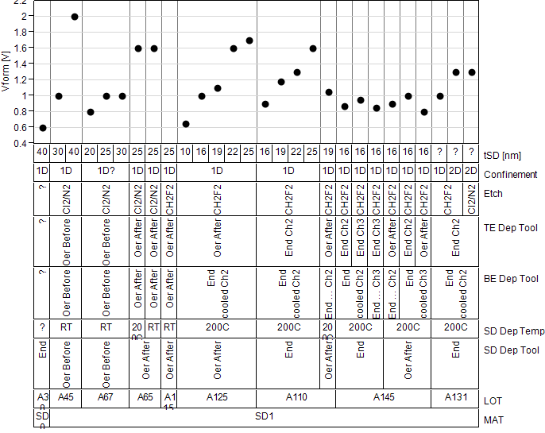
DC Vform vs Process Variation
Before Oerlikon maintenance
Increases with thickness
Vform for 2D is higher than 1D
SD0 (Vform lower than SD1)

Slide 13
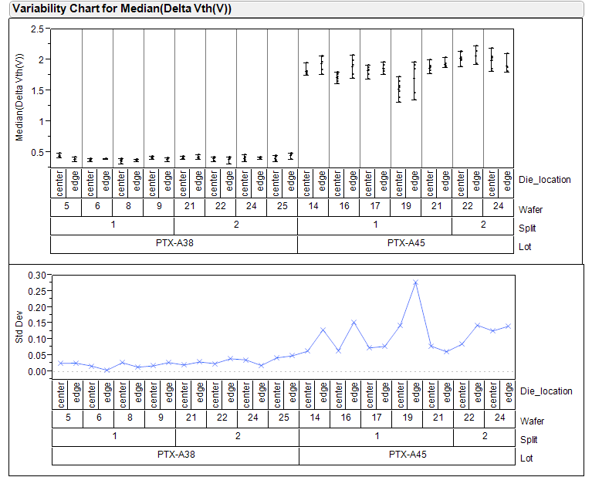
Vform Median

Slide 14
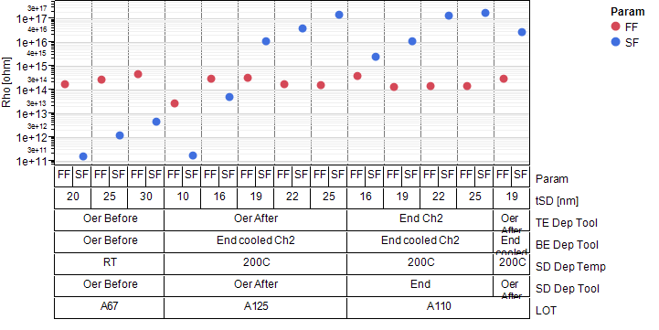
FF/SF ρ vs Process Variation
FF ρ → similar (order of 1e14) across splits
SF ρ →
  A67 & A125 (10nm,16nm) → lower than FF (i.e. SF leakier @low field). Exponential variation with thickness.
  A125 (19nm-25nm) & A110 → higher than FF (i.e. SF less leakier @low field). Also exponential variation with thickness.

Slide 15
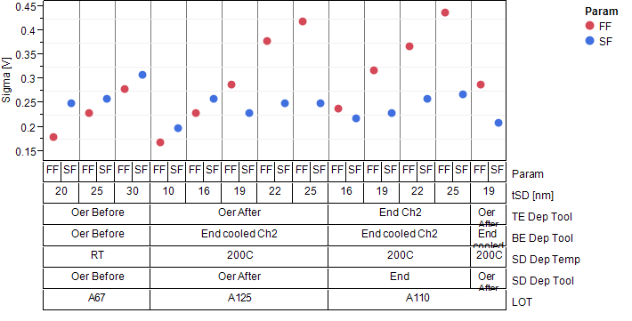
FF/SF σ vs Process Variation
FF σ → Linear increase with thickness in all lots [Slope: A67 0.01V/nm, A125 0.018V/nm, A110 0.022V/nm]
SF σ → No clear trend with thickness
  A67 & A125 (10nm,16nm) → higher than FF (i.e. SF IV less steep)
  A125 (19nm-25nm) & A110 → lower than FF (i.e. SF IV steeper than FF)

Slide 16
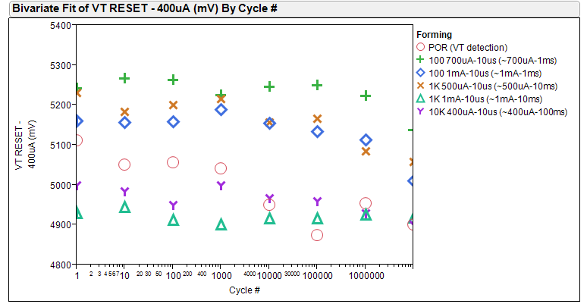
VT Reset vs Cycle vs Forming – 1x1
PTX-A110; split 2; 16nm

Slide 17
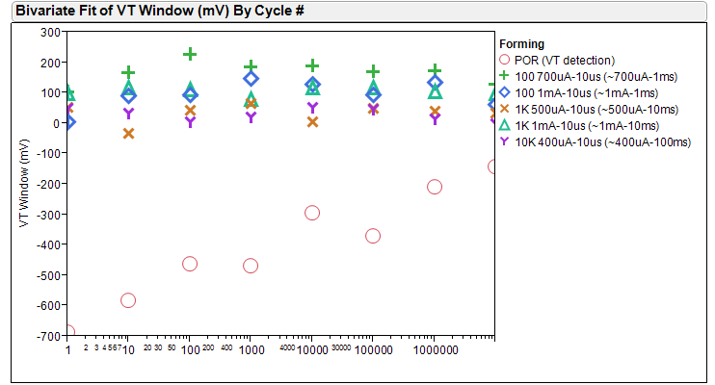
Memory Window vs Cycle vs Forming – 1x1
PTX-A110; split 2; 16nm

Slide 18
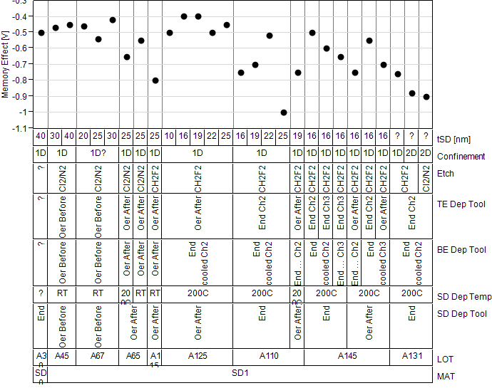
Memory Effect vs Process Variation
Before Oerlikon maintenance
Electrodes affects memory window [See next slide]
Higher Memory Effect
(negative)
Higher for 2D than 1D
No clear thickness dependence

Slide 19
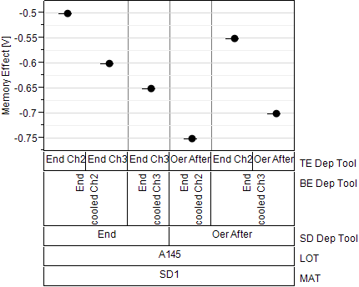
Memory Effect vs Electrode (PTXA145)
TE modulates the memory effect the most (Endura Ch2 minimum), for both Oerlikon and Endura dep.
Higher Memory Effect
(negative)
BE also modulates memory effect. However the trend is different for Endura and Oerlikon dep.

Slide 20
Memory Effect Characterization
Data for POR L4 testing
AC First Fire and Second Fire using Vt detect (10V/10µs ramp, I_{clamp}=100µA)
S2R VT-I starting with a SET (TR=1µs, PW=3µs, TF=12µs, PA=300µA) pulse followed by increasing amplitude of RESET pulses (TR=100ns, PW=500ns, TF=10ns, PA=100µA-800µA) and AC Vt detects

Slide 21
Recovery of Virgin State in SD0 (D2-PT180)
Graph 1) J Vs. V for Virgin State: Scales with the device area
Graph1
1.0E-06
Graph2
1.0E-07
1.0E-08
220nm dotsiz_x-1y0a_1mA_BA
I (A)
1.0E-09
220nm dotsiz_x-1y0b_1mA_BA
1.0E-10
400nm dotsiz_x-1y0_1mA_BA
1.0E-11
400nm dotsiz_x-1y1_1mA_BA
1.0E-12
0
0.5
1
1.5
2
2.5
Graph 2) 220nm and 400nm devices programmed with 1mA/20us pulses. Their sub-threshold IVs were measured. Devices do not scale with the area.
Graph 3) The same devices measured after 17 hours annealing at 200C in ambient. We plot J Vs. V, and we see that devices do scale with the area, again!! 220nm devices did not recover fully.
V (V)
Graph3
Christina, Stephen

Slide 22
Recovery of Virgin Vt in A65
Solid marks:
Pre Bake
Open marks:
After Bake 1hr @250C
Die #1
Die #2
FF after bake is 50~100mV lower than FF pre bake
SF pre and after bake match
Die #3
Die #4
Mattia

Slide 23
Recovery of Virgin Vt [PTXA110]
Solid blue and red:
First and second Fire
Open blue and red:
First and second read after bake (250C, 1hr)
Mattia

Slide 24
Recovery of Virgin Vt & Memory Effect (A125, A65) with bake
Cycling:
RESET-only cycling.
PA = 420uA ;
PW = 100ns ;
Pre-bake: SET
Pre-bake: SET
Post-bake: SET
Post-bake: SET
Pre-bake: RESET
Pre-bake: RESET
Post-bake: RESET
Feng
Post-bake: RESET
PTX-A125 /SD1_only / W12/ 1 by 1 tile
PTX-A65-SD1only\W20\X17Y5
Both Vt and memory effect recovered with 220C, 15hrs bake after 1E7 cycles

Slide 25
Non-recovery of Virgin State in SD1 (A67)
SD Thickness 25nm
SD Thickness 30nm
Pre-bake IV
Pre-bake IV
Virgin IV
Virgin IV
Post-bake IV
Post-bake IV
Christina
Virgin state was not recovered after bake [24 h @ 200 C, 98 h @ 200 C, and 42 h @ 220 C]
Vt increases and leakage reduces compared to pre-bake condition

Slide 26
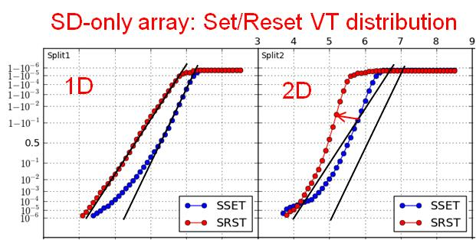
SXP Cell Integration – SD Electrodes Status
    C/SD/C interfaces learning
      BE & ME Carbon need to be flat to prevent X-migration
      the only trial able to improve the forming / memory effect issue is the 2D patterning of SD1
    Running experiments
      (*) W is so far the only alternative electrode tried; due to integration complexity, other metal will be considered only based on advantages coming from CLV
SD Step | Aim / trial | LOT | ECD
Ar-poor Carbon | Best C adhesion at both SD interfaces | A175, SD | W10
2D confined | 2D confined on full stack to confirm forming uniformity SD-only – 2D confined SD, with thickness skew | A181, FF tbd | W11 tbd
Carbon treatments | Thermal degas 200C-400C on C electrode and SD anneal Carbon SSE treatment or implantation | A191, SD | W14
W electrode (*) | SD1-only C/W/SD1/C or C/SD1/W/C | A192, SD | W17

Slide 27
Electrodes Check Point
    Potential Process Change Check points:
      Moving to 2D/2D architecture, with SD patterning also at BL wk.13
      Carbon surface treatment (SSE, anneal, degas, implant,...)
        on PM wk.14
        on SD wk.17
      Adding thin W layers at key interfaces to mitigate the effects of Carbon
      (Carbon can not be removed) on PM wk.16
      on SD wk.19
      Note: Under development thin PVD W layer ~3nm
      to minimize impact on AR and patterning

