Slide 1
SD1 Forming
Risk Assessment & Management Plan
2/26/2013
Collaborators:
Project Owner: Fabio (PaoloF, DerChang)
Device: Christina, DavideM*, Enzo§, Feng, Karthik, Koushik¤, Mattia
Integration: Lorenzo
                §: Etest/Probe coordinator
                *: Array charx coordinator
                ¤: Cell charx coordinator
                (Collaborators are assignment based,
                Supervised by Fabio, DerChang and Lorenzo)

Slide 2
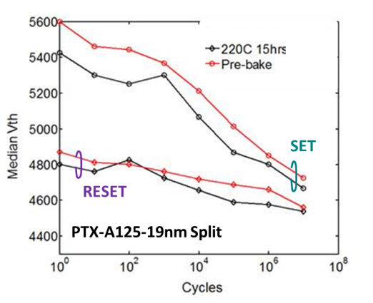
Single Pulse Forming
1
WW9.2 2/26/2013
3
Goal vs. Gap
Empirical Model
Supporting Material
Goal: Single Pulse to form a stable Vt of SD device
Gap:
  No unified forming procedure for Array, CLV and DITP
  Continuous Vt reduction after “BKM” forming; (>0.3V @1E7 cycle)
  Negative memory effect (1V of more); reduces after bit is cycled
Formed behavior changed
1) after Oerlikon maintenance (Q3/12) 2) Geometric confinement
Forming changes SD bulk conduction
Insufficient forming results in memory effects, this memory effect manifests interface and/or its boarder dependence
Forming is typically a bake reversible process.
1. SF I-V indep. of area before tool change vs. J-V after tool change
2. 2D confined SD improves I-V dist.
V_{form} , ρ, σ, scales with SD thickness
1. Forming pulse vs. Vt stability
2. Memory effects correlated to electrode but less dependent on SD bulk
Limited data yet true for SD0 vs. SD1, electrode process but not for A67?
Owners & Status
Resolution Strategy & Containment
Plan and ECD
Owner: Fabio
Process effects and segmentation using existing silicon
SD1 Interface/electrode DOE with PM learning (SDx baseline will use SD1 POR)
Establish device attributes (success criteria) of ‘formed’ devices and forming procedure (as a requirement)
Establish forming procedure as a containment to stabilize Vt and to reduce memory effects for full stack and array learning
Scrub split on “Oerlikon maintenance” and 2D confinement / ECD WW09
2D decision WW13, Carbon surface treatment WW17, W interface WW19
Forming/seasoning characterization on pre-Oer-maintenance A45, A67 and 2D confined A131 / ECD WW10
Develop forming procedure at probe and etest for process yield learning, material/electrode characterization and reliability assessment /ECD WW11

Slide 3
Recovery of Virgin Vt & Memory Effect (A125, A65) with bake
Cycling:
RESET-only cycling.
PA = 420uA ;
PW = 100ns ;
Pre-bake: SET
Pre-bake: SET
Post-bake: SET
Post-bake: SET
Pre-bake: RESET
Pre-bake: RESET
Post-bake: RESET
Feng
Post-bake: RESET
PTX-A125 /SD1_only / W12/ 1 by 1 tile
PTX-A65-SD1only\W20\X17Y5
Both Vt and memory effect recovered with 220C, 15hrs bake after 1E7 cycles

Slide 4
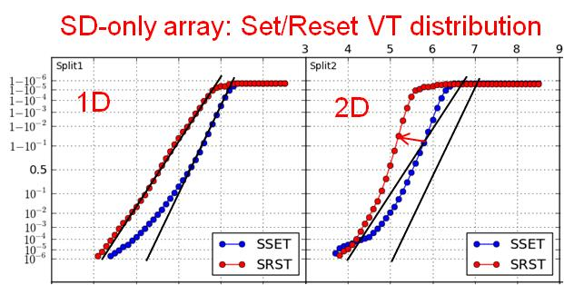
SXP Cell Integration – SD Electrodes Status
    C/SD/C interfaces learning
      BE & ME Carbon need to be flat to prevent X-migration
      the only trial able to improve the forming / memory effect issue is the 2D patterning of SD1
    Running experiments
      (*) W is so far the only alternative electrode tried; due to integration complexity, other metal will be considered only based on advantages coming from CLV
SD Step | Aim / trial | LOT | ECD
Ar-poor Carbon | Best C adhesion at both SD interfaces | A175, SD | W10
2D confined | 2D confined on full stack to confirm forming uniformity SD-only – 2D confined SD, with thickness skew | A181, FF tbd | W11 tbd
Carbon treatments | Thermal degas 200C-400C on C electrode and SD anneal Carbon SSE treatment or implantation | A191, SD | W14
W electrode (*) | SD1-only C/W/SD1/C or C/SD1/W/C | A192, SD | W17

Slide 5
Electrodes Check Point
    Potential Process Change Check points:
      Moving to 2D/2D architecture, with SD patterning also at BL wk.13
      Carbon surface treatment (SSE, anneal, degas, implant,...)
        on PM wk.14
        on SD wk.17
      Adding thin W layers at key interfaces to mitigate the effects of Carbon
      (Carbon can not be removed) on PM wk.16
      on SD wk.19
      Note: Under development thin PVD W layer ~3nm
      to minimize impact on AR and patterning

