Slide 1
Current Status
Critical Paths to be considered for Bow Falls

Slide 2
Current Status

Slide 3
BiSM Silicon Empiricals
Last silicon Rev 6.6, In doped SAG and DOE, in June/2018.
Yield learning curves with 100s of wafers (one lot every 2 weeks)
Rev 6.6 SD.k2 BKM process demonstrated PG1 structure yield (S26 live die):
>75% 1D & >40% 2D (on par with full stack at the same time frame)
1st & 2nd cut profile meets MTS; SWA @ 87.5° & 88.5° correspondingly.
Parametric and reliability sampling – 8 lots, 40 wafers, 5 die per wafer.
PG4 capable RWB (SR71 based, limited by array size 3.3σ)
PG1 capable of endurance; good/upper quartile die passing 2M cycles FW
No ULR performed

Slide 4
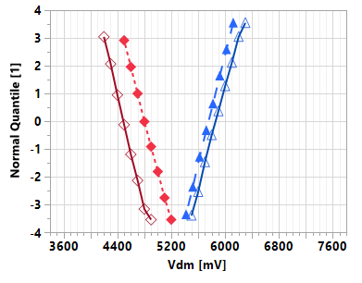
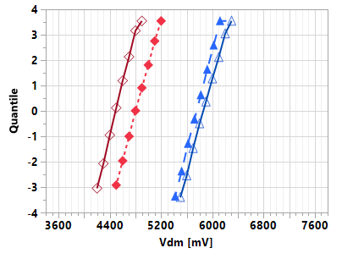
SLC RWB @ 41nm Pitch
Metric | Unit | Full Stack^ | BiSM^
ΔV_{T} @ 1μs ( = RST-SET ) | mV | 1140 | 1380
E2 Consumers
σ_{Vt} | mV | 95 | 100
Drift: 1μs-10s (3s-48h) | mV | 260 (320) | 330 (220)
GB (WE,RD,BD) | mV | - | -
E3 Consumers
σ_{Vt} | mV | 100 | 105
Drift: 1μs-10s (3s-48h) | mV | 630 (>1100) | 590 (1050)
GB (WE,RD,BD) | mV | 100 | 100
Array Op.
x-tile | mV | 30 | 30
Leakage: SET (RST) | mV | 5nA (2nA) | 5nA (0.2nA)
E1 | mV | 4030 | 4040
E4 | mV | 7600 | 7500
Full Stack op. (unipolar)
BiSM op. (bipolar)
RST
SET
Pulse Amplitude
RST
SET
time
time
1μs
10k FW
10s
RWB
E2
E3
RBER goal
^ 10s Qual SORT for full-stack, while non-opt. TBD for BiSM
V_{inh}

Slide 5
BiSM vs. Full Stack @ 41P

Slide 6
Process Technology
Metric | Full Stack |  |  |  |  |  |  |  |  | BiSM |  |  |  |  | Scaling Challenge
Periphery | LVT, HVT + 5~6 interconnect
Cell Stack | BE | SD | ME1 | ME2 |  | PM |  | TE |  |  | BE | SD | TE
Array Metals | W, 30nm First Cut, 30/40 nm 2nd Cut |  |  |  |  |  |  |  |  | ½ or more metal thickness reduction possible (>50% I_{pgm}/I_{lkg} reduction)
Patterning | Partial etch and Liner are required |  |  |  |  |  |  |  |  | Single etch, no liner required; lower AR, lower scope for hard-mask
Seal | Nitride seal required |  |  |  |  |  |  |  |  | Required, lower AR, more options
Gap fill | No air gap, 1st/2nd R_{θ} tuning for TD |  |  |  |  |  |  |  |  | No air gap, no visible TD issue
CMP | Similar challenges as nodes scale, socket size scaling limitations may impact
Ambient | Required
On Pitch Via | Scaling challenges expected at 28 pitch and below for via resistance

Slide 7
Set State
Metric | 41nm Pitch Full Stack | 41nm Pitch BiSM | Scaling Challenge
V_{T} | Tunable by SD MTS (thickness, alloy, transfer function)
MLC feasibility | Lower tuneability by waveform | More flexibility (without PM)
σ_{Vt} | SD MTS + cross contaminations | SD MTS
Drift | SD structure relaxation
Evolution_{Vt} | SD + PM WE, higher V_{T} turn-around | SD WE at lower power
Leakage | SD MTS + cross contaminations | SD MTS
E1 | SD WE + cross contamination | SD WE
E2 | SD WE + PM set-ability + RD | SD WE

Slide 8
Reset State
Metric | Full Stack | BiSM | Scaling Challenge
V_{T} | Tunable by PM material & thickness | Tunable by SD material
MLC feasibility | Tunable by waveform | Tunable by waveform
σ_{Vt} | (SD + PM) MTS + cross contamination | SD MTS
Drift | SD + PM structure relaxation | SD structure relaxation
Evolution_{Vt} | SD + PM WE | SD WE at lower power
Leakage | SD intrinsic (low α-PM contribution) | SD intrinsic subVt shift right
E3 | SD + PM WE + TD | SD WE + RD
E4 | SD + PM WE + PM drift + Leakage | SD WE

Slide 9
Set Operation
Metric | Full Stack | BiSM | Scaling Challenge
Mechanism | Crystallization: Nucleation/Growth | Mass transport @ T_{G} (Segregation)
I_{Program} | 25uA + 60uA (ambipolar) | 50uA (polarity dependent)
t_{pulse} | 130ns+70ns | 50ns
V_{Selection} | E4 | E4
Spike Miti. | Needed for PM endurance | No

Slide 10
Reset Operation
Metric | Full Stack | BiSM | Scaling Challenge
Mechanism | Vitrification (Glass) | Mass Transport @ T_{G} (Segregation)
I_{Program} | 110uA (ambipolar) | 50uA (polarity dependent)
t_{pulse} | 5ns | 50ns
V_{Selection} | E2 | ”E4”
Spike Miti. | Needed for PM endurance | No

Slide 11
Read Operation
Metric | Full Stack | BiSM | Scaling Challenge
Mechanism | Demarcation Read/Set Back/Termination | Demarcation Read(/termination?)
I_{read} | 25uA/60uA/25uA | 25uA or higher (/25uA)
t_{pulse} | 35ns/35ns/30ns | 35ns(/35ns)
V_{Selection} | E2 | E2
Spike Miti. | Needed to PM RD | No

Slide 12
Reliability
Metric | Full Stack | BiSM | Scaling Challenge
WE (Write End.) | Limiter: E2 (PM turn-around) Tuning: (SD + PM) MTS, waveform | Limiter: Extrinsic E1/E4 Tuning: SD MTS (SD ‘health’)
Array init. (Seasoning) | SD stabilization (low PM contribution) Tuning: SD MTS (SD ‘health’) | SD stabilization Tuning: SD MTS (SD ‘health’)
WD (Write dist.) | PM proximity disturb + (SD+PM) BD Tuning: Stack MTS, waveform | SD BD (‘reverse’ dominating) Tuning: SD MTS
RE (Read End.) | SD WE + (PM+SD) disturb Tuning: (PM + SD) MTS, waveform | SD WE Tuning: SD MTS
RD (Read Dist.) | PM disturb (low SD contribution) Tuning: PM MTS, and waveform | SD WE + SD BD (‘reverse’) Tuning: SD MTS and waveform
Retention | SD + PM structure relaxation Tuning: (SD+PM) MTS, and waveform | SD structure relaxation Tuning: (SD) MTS, and waveform

Slide 13
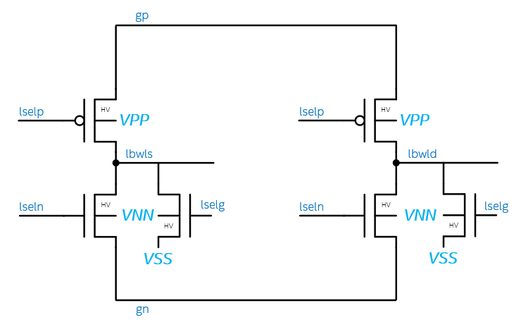
3T Bipolar Decoder circuit and layout assessment based on 41P DTS
 | 3T
 | POS |  | NEG |  | IDLE
 | SEL | DESEL | SEL | DESEL
gp | 3.7 | 3.7 | 0 | 0 | 0
lselp | 0 | 3.7 | 0 | 3.7 | 3.7
lbwl | 3.7 | 0 | -3.7 | 0 | 0
lseln | 0 | -3.7 | 0 | -3.7 | -3.7
gn | 0 | 0 | -3.7 | -3.7 | 0
lselg | 0 | 1.2 | -3.7 | 1.2 | 1.2
vss | 0 | 0 | 0 | 0 | 0
#/patch | 32 | 992 | 32 | 992 | 1024
3.7
0
3.7
POS
NEG
IDLE
0
3.7
3.7
0
0
-3.7
3.7
0
3.7
3.7
0
0
0
0
-3.7
1.2
0
0
-3.7
1.2
-3.7
1.2
-3.7
1.2
0
-3.7
-3.7
3T Solves the energy problem present in 2T POR
  No Deselect Toggle
  At Cost of adding on transistor. (Small N Xtr.)
Decoder footprint is expected on par with 2T POR
  [Med P + Med N + Small N] vs. [Big N (or P) + small P (or N)]
Interconnect track density increases due to bipolar operations
  Metal pitch reduction is expected
 | ALF32 | S24S | 3T
Status | POR | POR | Pre POR
Cell Arch | Unipolar | Bipolar | Bipolar
Decode Type | 2T | 2T | 3T
Deselect Togl. | No | Yes | No
Float Deselects | No | No | No
Energy | 104 | 154 | ~104
Die size | 198 | 221 | 227

Slide 14
Read
3DXP Full Stack
SET Pulse 3 (25ns)
BL 1st Termination (20ns)
Yes
Start
Read Pulse incl. Ramp
(37.5ns)
Sense Amp &
Latch
(12.5ns)
Set? (5ns)
No
BiSM Read
Start
Read Pulse incl. Ramp
(37.5ns)
Sense Amp Latch
(12.5ns)
BL 1st Termination (20ns)

Slide 15
Set a reset cell
3DXP Full Stack
WL/BL Ramp
(211ns)
Incl.
Spike Miti (71ns)
Snap Detect (45ns)
C-cell (95ns)
Start
I_{low} (P1)
(30ns)
I_{high} (P3)
(103ns)
P4
(30ns)
BL1st
(20ns)
BiSM
WL/BL Ramp
(140ns)
Incl.
Snap Detect (45ns)
C-cell (95ns)
Start
I_{high} (P3)
(50ns)
BL1st
(20ns)

Slide 16
Reset a set cell
3DXP full Stack
Reset Pulse (15ns)
Yes
Start
WL/BL Ramp
(37.5ns)
Sense
(12.5ns)
Set? (5ns)
No
BiSM
WL/BL Ramp
(140ns)
Incl.
Snap Detect (45ns)
C-cell (95ns)
Start
I_{high} (P3)
(50ns)
BL1st
(20ns)

