Slide 1
Bipolar Decoder Architecture for 2-T memory Analysis
Mase Taub & DerChang Kau, 7/26/2018
Privileged - Prepared under the direction of Legal Counsel
Mission – To benchmark bipolar cross point array architecture
Goal – To establish and rank candidates beyond SXP scaling path
Problem statement: Explore the following attributes of bipolar decoding
  Decoder footprint
  Access energy
  Latency
  Memory density
  Impact of reliability

Slide 2
Bipolar Memory Cell
Bipolar RRAM to be examined
  Current Control Memory Switch type (II) – Interface (2D)
  Voltage Control Memory Switch type (I) – Filament (1D)
  Voltage Control Memory Switch type (II) – Interface (2D)
  Voltage Control Memory Switch type (III) – bulk (3D)
Cell isolation:
  1S1R, including threshold switch at different on-state voltage.

Slide 3
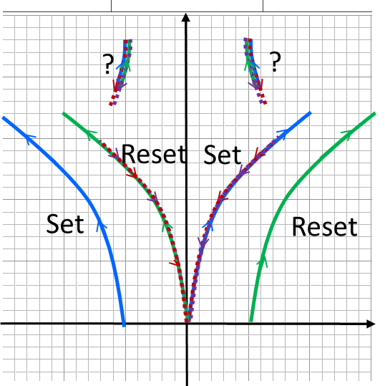
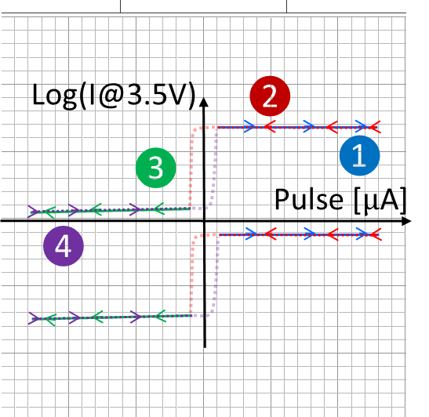
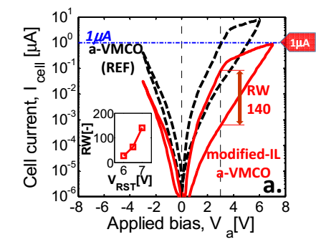
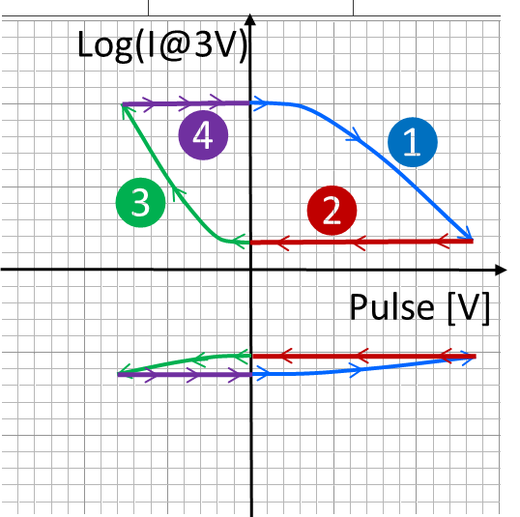
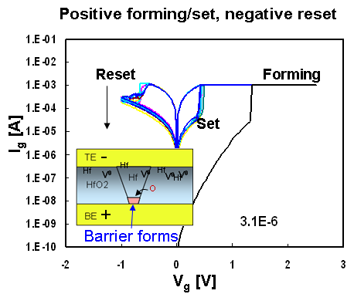
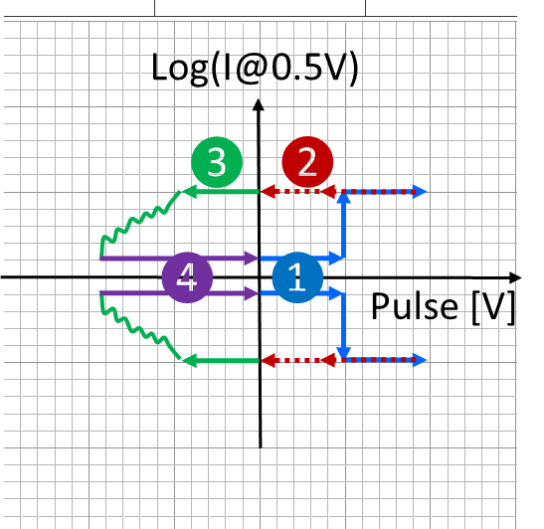
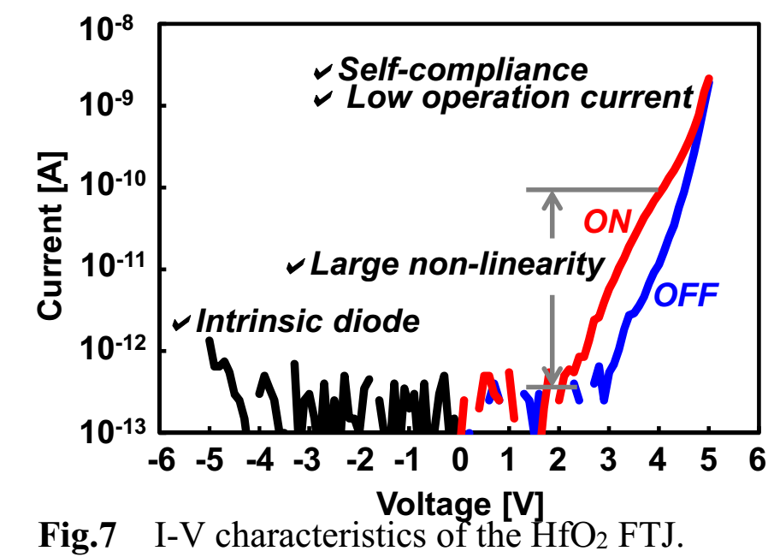
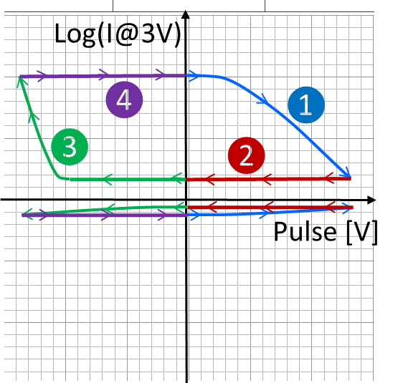
Memory Switch Devices: I-V and Program Transfer Characteristics
Current Control memory Switch
Voltage Control memory Switch -Interface
Voltage Control memory Switch –Filament
Voltage Control memory Switch – Bulk

Slide 4
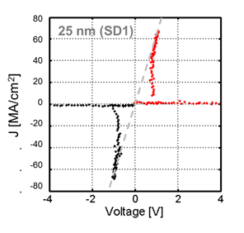
Bidirectional 2-T selector (Diac)

Slide 5
Preliminary Plan
Create 1S1R behavior model as input for
  Write Stimuli (V, I, t)
  Read metrology
  Coupled with physical cell scaling & array density
Seeking for decode/read/write architecture impact on Tile sizes, Energy and Latency
  Including silicon technology such as MOST, BJT and Interconnect required
  Also exploring the feasibility of MLC

Slide 6
ZBB List
Bipolar RRAM to be examined
  Current Control Memory Switch type (I) – Filament
  Current Control Memory Switch type (III) – Bulk
Cell isolation:
  0S1R
Array decode/read/write architecture
  MBA

Slide 7
Supporting Materials

Slide 8
Atomistic memory switching
See also: https://en.wikipedia.org/wiki/Resistive_random-access_memory
https://semiengineering.com/what-happened-to-reram/
https://semiengineering.com/a-new-memory-contender/ (FECAP/FEFET)
2-T NVM (focus on memory element)
Other NVM (not benchmarked)
PCM (Samsung, Micron, IBM/Macronix)
SSM (Intel/Micron)
VMCO/CMOx (IMEC, Unity)
  4DS: PCMO (CMOSx) with HGST/WD partnership?
  WD/Toshiba: Binary conductive oxide instead of PCMO
  IMEC: VMCO
  CMOx: Unity (Rambus)
V_{O}RAM/CBRAM (Redox)
  Weebit: Porous SiO, TaO
  Panasonic/Fujitsu/HP: TaO
  TSMC/ITRI: HfO
  Macronix: WO
  Adesto: Te in AlO
  Micron/Sony: Cu in GdO
  NEC: Cu in oxide(?) – targeting FPGA
  Crossbar: Ag/Cu in α-Si (with Si/SiO diode)
STT (too many)
FTJ
  Toshiba: HfO + interface layer
  AIST consortium: UoTokyo and etc
SXP-like
  Intel/Micron
  Macronix/IBM: Si-STAG + N doped 225
  Hynix: As doped SiO + ReRAM(?)
  IMEC: N doped GeSe (selector only)
  LETI: GeSe + HfO
FECAP as in 1T1C
  IMEC, NAMLAB (GF), MFC, Hynix/LAM : HfO
  TI: PZT in production/ research HfO
  Panasonic: PZT in production
  Sony: SBT in production
FEFET
NRAM (Nantero)
Charge trap

Slide 9
“Hysteresis” of Transfer characteristics
Output traces subject to input and prior history in a cyclic loop
SRAM PCM
Input (WRITE) metrology actuates the switching mechanism
Output (READ) metrology manifests the switched physics
It’s a phenomenological “duck test”. Using abductive reasoning to prioritize possible switching mechanism for SSM risk assessment – also to eliminate unlike mechanisms.
It can also serve for inductive reasoning to derive physics from specific observations – assumptions will be called out for additional tests.
o/p [v]
V_{T} [v]
i/p
o/p
i/p [v]
Pulse [μA]

