Slide 1
Bipolar Decoder Architecture for 2-T memory Analysis
Mase Taub & DerChang Kau, 7/27/2018
Privileged - Prepared under the direction of Legal Counsel
Mission – To benchmark bipolar cross point array architecture
Goal – To establish and rank candidates beyond SXP scaling path
Problem statement: Explore the following attributes of bipolar decoding
Decoder footprint
Access energy
Latency
Memory density
Impact of reliability

Slide 2
Bipolar Memory Cell
Bipolar RRAM to be examined
Current Control Memory Switch type (II) – Interface (2D)
Voltage Control Memory Switch type (I) – Filament (1D)
Voltage Control Memory Switch type (II) – Interface (2D)
Voltage Control Memory Switch type (III) – bulk (3D)
Cell isolation:
1S1R, including threshold switch at different on-state voltage.

Slide 3
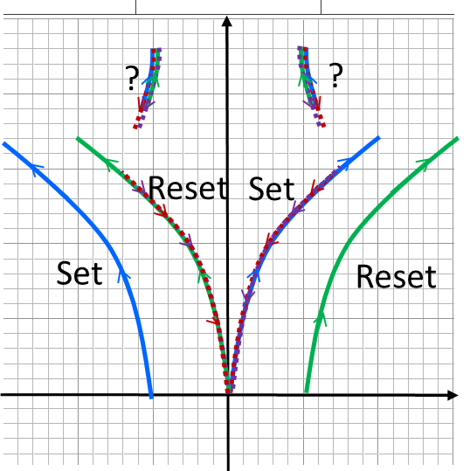
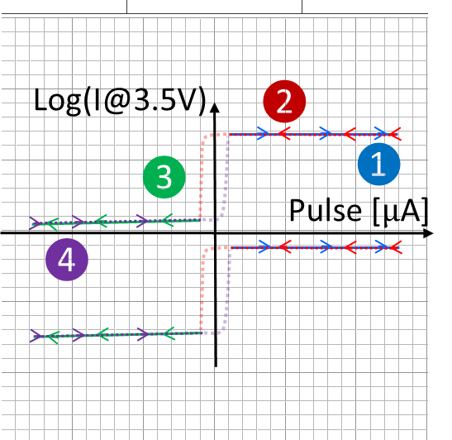
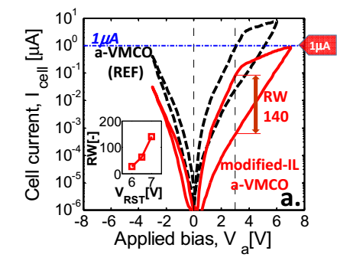
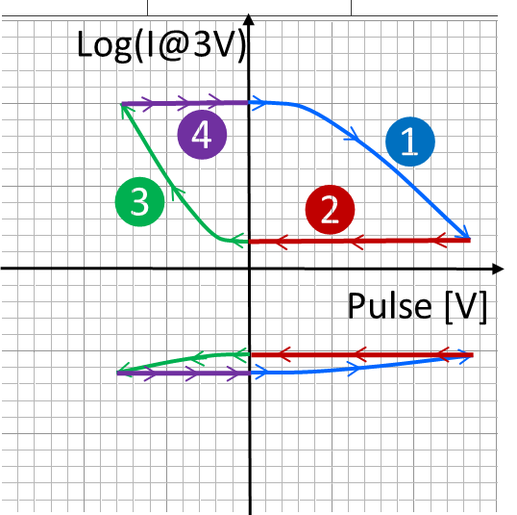
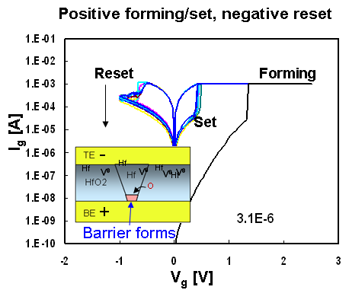
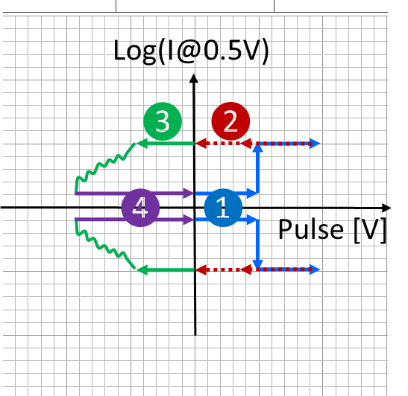
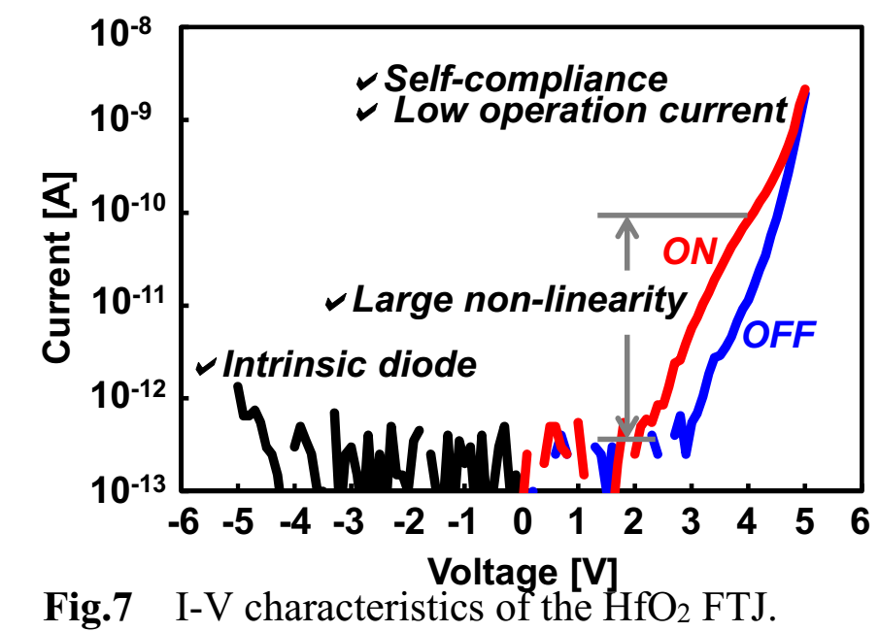
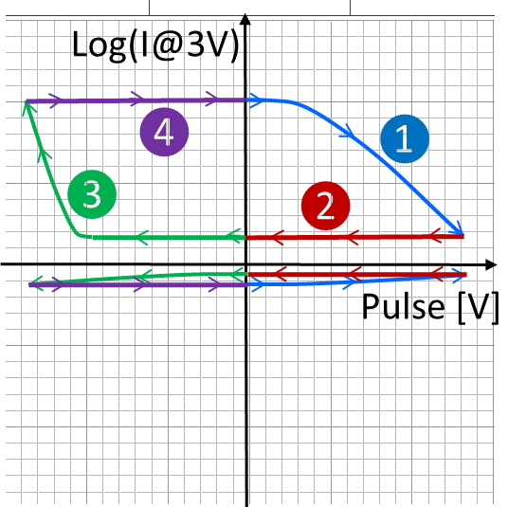
Memory Switch Devices: I-V and Program Transfer Characteristics
Current Control memory Switch -- Interface
Voltage Control memory Switch -Interface
Voltage Control memory Switch –Filament
Voltage Control memory Switch – Bulk

Slide 4
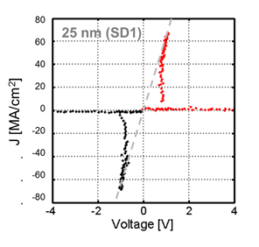
Bidirectional 2-T selector (Diac)

Slide 5
Preliminary Plan
Create 1S1R behavior model as input for
Write Stimuli (V, I, t)
Read metrology
Coupled with physical cell scaling & array density
Seeking for decode/read/write architecture impact on Tile sizes, Energy and Latency
Including silicon technology such as MOST, BJT and Interconnect required
Also exploring the feasibility of MLC

Slide 6
ZBB List
Bipolar RRAM to be examined
Current Control Memory Switch type (I) – Filament
Current Control Memory Switch type (III) – Bulk
Cell isolation:
0S1R
Array decode/read/write architecture
MBA

Slide 7
Supporting Materials

Slide 8
Atomistic memory switching
See also: https://en.wikipedia.org/wiki/Resistive_random-access_memory
https://semiengineering.com/what-happened-to-reram/
https://semiengineering.com/a-new-memory-contender/ (FECAP/FEFET)
2-T NVM (focus on memory element)
Other NVM (not benchmarked)
PCM (Samsung, Micron, IBM/Macronix)
SSM (Intel/Micron)
VMCO/CMOx (IMEC, Unity)
4DS: PCMO (CMOSx) with HGST/WD partnership?
WD/Toshiba: Binary conductive oxide instead of PCMO
IMEC: VMCO
CMOx: Unity (Rambus)
V_{O}RAM/CBRAM (Redox)
Weebit: Porous SiO, TaO
Panasonic/Fujitsu/HP: TaO
TSMC/ITRI: HfO
Macronix: WO
Adesto: Te in AlO
Micron/Sony: Cu in GdO
NEC: Cu in oxide(?) – targeting FPGA
Crossbar: Ag/Cu in α-Si (with Si/SiO diode)
STT (too many)
FTJ
Toshiba: HfO + interface layer
AIST consortium: UoTokyo and etc
SXP-like
Intel
Micron
Macronix/IBM: Si-STAG + N doped 225
Hynix: As doped SiO + ReRAM(?)
IMEC: N doped GeSe (selector only)
LETI: GeSe + HfO
FECAP as in 1T1C
IMEC, NAMLAB (GF), MFC, Hynix/LAM : HfO
TI: PZT in production/ research HfO
Panasonic: PZT in production
Sony: SBT in production
FEFET
NRAM (Nantero)
Charge trap

Slide 9
“Hysteresis” of Transfer characteristics
Output traces subject to input and prior history in a cyclic loop SRAM PCM
Input (WRITE) metrology actuates the switching mechanism
Output (READ) metrology manifests the switched physics
o/p [v]
V_{T} [v]
i/p
o/p
i/p [v]
Pulse [μA]

