Slide 1
IDEA#1 poly break
Pitch transistors are packed at A2A spacing, ie with shared gate.
Need to break the poly to increase predriver count and decrease global area for better foot print of the decoder.

Slide 2
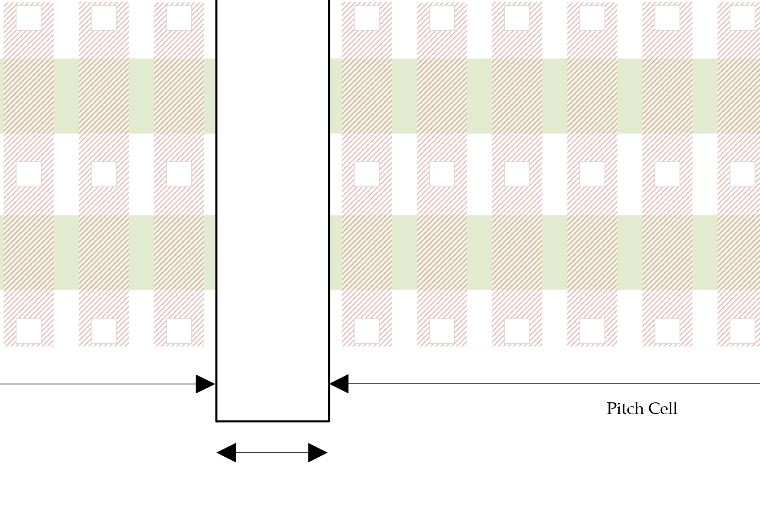
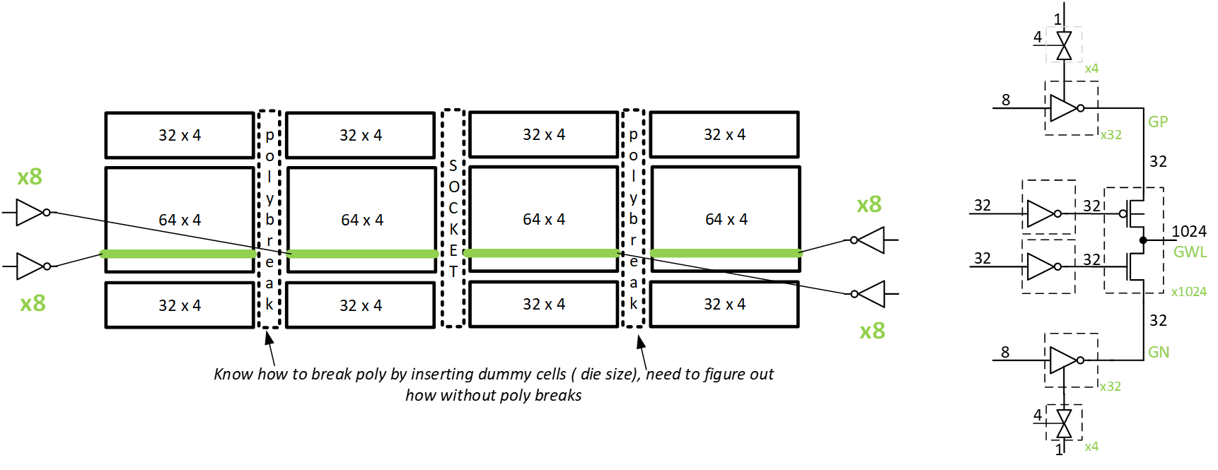
IDEA#1 Poly Break
Math: ( 1 + 6.8*8/4096)^2 -1 = 2.7%
CUA under array with this decoder. Diffusion limited
( 133-17 ) x ( 1 +2.7% ) + 17 ~ 136.2mm^2
<4mm^2 more than ATF
Metal requirements are next. → Eddie
2 Endcap + 1 Pol2Pol – 1 A2A
2*2.2+2.4-2.2 = 4.6 = 6.8 cell ~ 8 cells @0.67L
Poly break add about 2.7% to tile area

Slide 3
Proposed decoder footprint 0.79x
Diffusion limited footprint is 0.79x of ATF, but routing may grow this. Assumption is metal requirement is TBD.

Slide 4
IDEA#1 Poly break Die size 137mm^2

Slide 5
IDEA 2 :rotated POLY relaxed DR
Case 3
2 XTOR | Dim | Count | Total |  |  |  | 1 XTOR | Dim | Count | Total
Cont | 1.6 | 3 | 4.8 |  |  |  |  | 1.6 | 2 | 3.2
Gate | 7 | 2 | 14 |  |  |  |  | 7 | 1 | 7
Con2gate | 1.7 | 4 | 6.8 |  |  |  |  | 1.7 | 2 | 3.4
ConOv | 0.1 | 2 | 0.2 |  |  |  |  | 0.1 | 2 | 0.2
A2A | 2.2 | 1 | 2.2 |  |  |  |  | 2.2 | 1 | 2.2
 |  | Pitch | 28 |  |  |  |  |  |  | 16
 | cell | count | Width | Width/Pitch |  |  |  | cell | count | Width | Width/Pitch
Cell | 0.67 | 8 | 5.36 | 0.19 |  |  |  | 0.67 | 8 | 5.36 | 0.34
 | 0.67 | 32 | 21.44 | 0.77 |  |  |  | 0.67 | 32 | 21.44 | 1.34
 | 0.67 | 64 | 42.88 | 1.53 |  |  |  | 0.67 | 64 | 42.88 | 2.68 | Plan | 4.34
 | 0.67 | 128 | 85.76 | 3.06 |  |  |  | 0.67 | 128 | 85.76 | 5.36
 |  |  |  | no integers |  |  |  |  |  |  | no integers
L1
L3
S1
S3
G1
G2
S2
S4
L2
L4
Single transistor pitch is 16L: we can fit only 2 in pitch of 64 cells ie 42.88L
Shared drain single transistor pitch is 28L we can only fit one pair in 42.88L
implication isa gross inefficiency in the Local select P/N FP

Slide 6
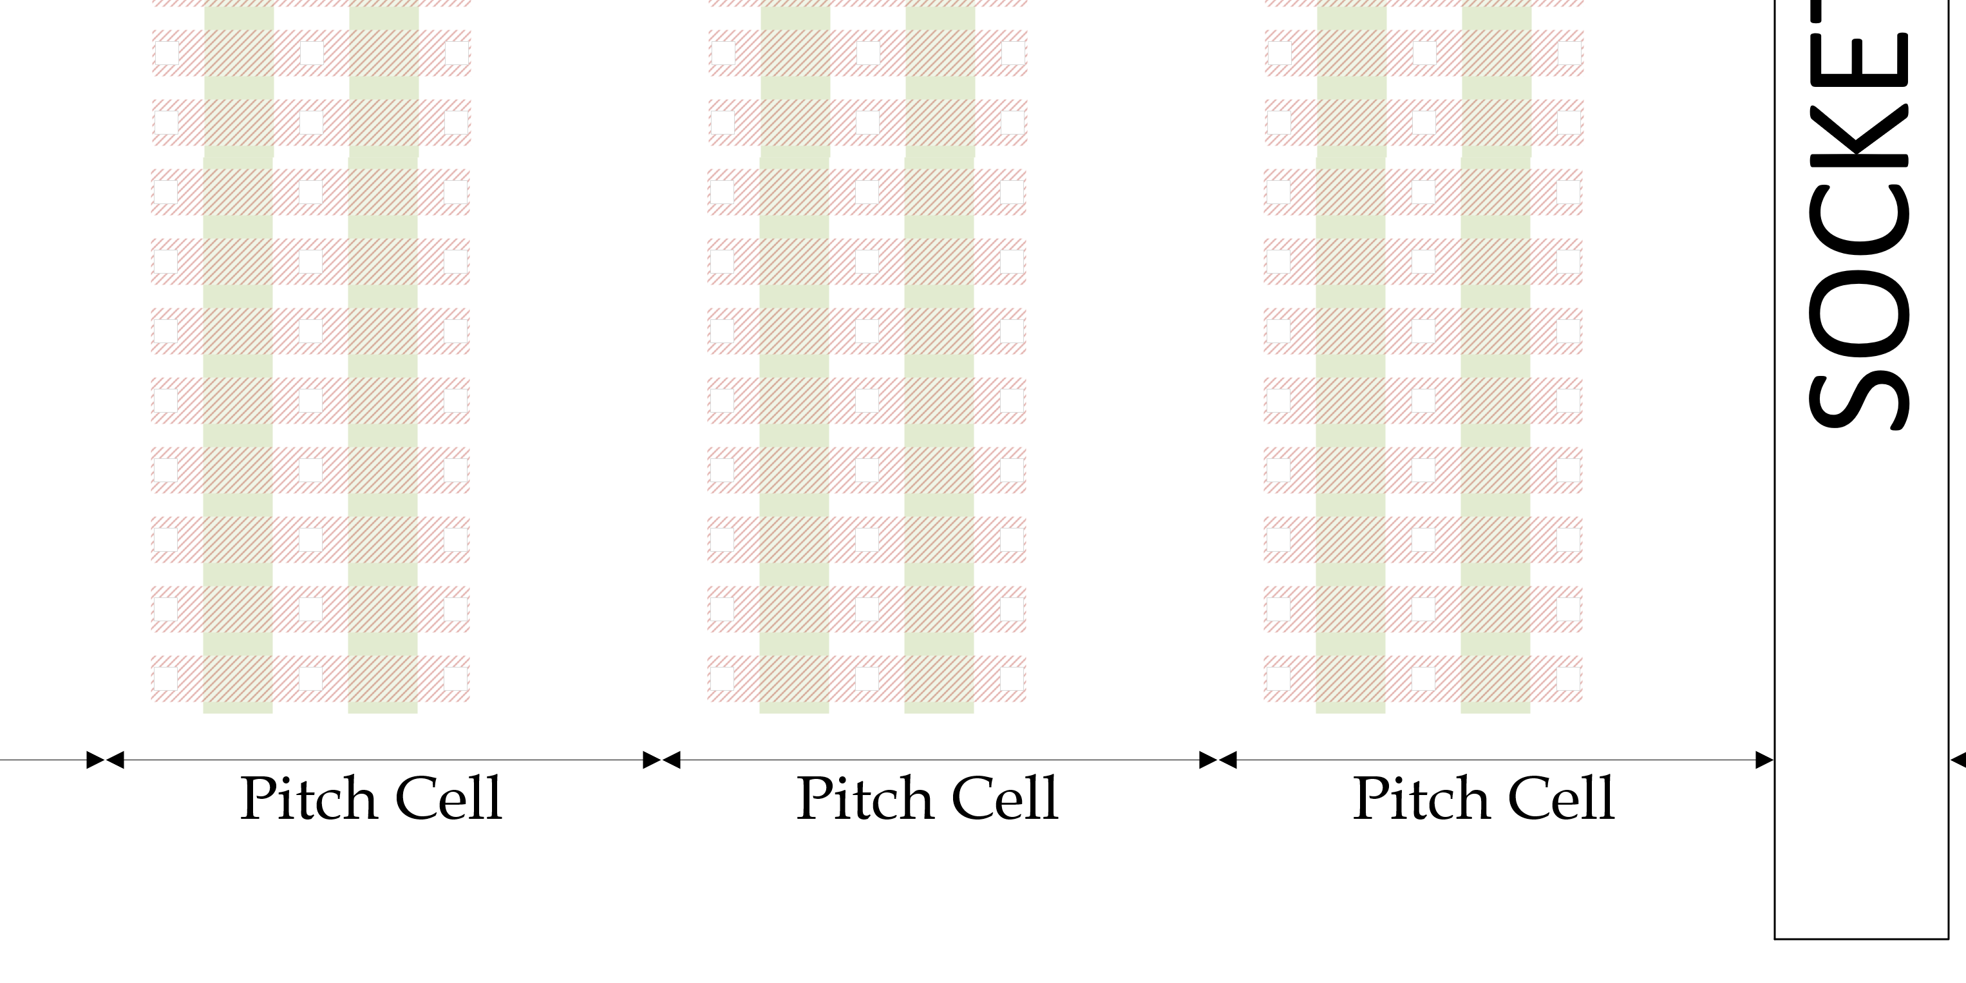
IDEA 2 Rotated Poly Relaxed DR
This is relaxed DR
Sea of gates is next

Slide 7
IDEA 2 Rotated Poly Relaxed DR
 |  |  |  |  |  |  |  |  |  |  | Predriver | 32 | Predriver
 |  | Unipolar 2T |  |  |  | Bipolar 2T |  |  |  |  |  |  |  | U2B
 |  | M (# of fingers) | W | L |  | M (# of fingers) | W | L |  |  | Unipolar 2T |  | Bipolar 2T | scope difference
LMIN |  |  |  |  |  |  |  |  |  | 1: N | dum^2 | 1: N | dum^2
W LXS - rowmux | NHV | 1.0 | 8.52 | 7 | NHV | 1.0 | 3.16 | 7 |  | 1 | 161.9 | 1 | 109.0 | y
W LXD/LYD - rowmux | PHV | 1.0 | 3.16 | 8 | NHV | 1.0 |  |  |  | 1 | 86.3 | 1
W LYS - rowmux | PHV |  |  |  | PHV | 1.0 | 3.16 | 7 |  |  |  | 1 | 109.0 | y
W LXS - colmux | NHV |  |  |  | NHV | 1.0 | 3.16 | 7 |  |  |  | 1 | 109.0 | y
W LXD/LYD - colmux | NHV | 1.0 | 3.16 | 5.52 | NHV | 1.0 |  |  |  | 1 | 73.0 | 1
W LYS - colmux | PHV | 1.0 | 8.52 | 7 | PHV | 1.0 | 3.16 | 7 |  | 1 | 161.9 | 1 | 109.0 | y
W GXS - rowmux | NHV | 1.0 | 15.02 | 7 | NHV | 1.0 | 8.52 | 7 |  | 32 | 10.3 | 32 | 7.2 | n
W GXD - rowmux | NHV | 1.0 | 4.24 | 7 | PHV | 1.0 | 4.24 | 7 |  | 32 | 5.2 | 32 | 5.2 | n
W GYS - rowmux |  |  |  |  | PHV | 1.0 | 8.52 | 7 |  |  |  | 32 | 7.2 | n
W GYD - rowmux |  |  |  |  | NHV | 1.0 | 3.16 | 9.7 |  |  |  | 32 | 5.5 | n
W GXS - colmux |  |  |  |  | NHV | 1.0 | 8.52 | 7 |  |  |  | 32 | 7.2 | n
W GXD - colmux |  |  |  |  | PHV | 1.0 | 4.24 | 7 |  |  |  | 32 | 5.2 | n
W GYS - colmux | PHV | 1.0 | 20.38 | 7 | PHV | 1.0 | 8.52 | 7 |  | 32 | 12.8 | 32 | 7.2 | n
W GYD - colmux | NHV | 1.0 | 3.16 | 9.7 | NHV | 1.0 | 3.16 | 9.7 |  | 32 | 5.5 | 32 | 5.5 | n
INVT P | PHV | 1.0 | 4.24 | 9.7 | PHV | 1.0 | 4.24 | 9.7 |  | 64 | 3.1 | 32 | 6.1 | n
INVT N | NHV | 1.0 | 4.24 | 9.7 | NHV | 1.0 | 4.24 | 9.7 |  | 64 | 3.1 | 32 | 6.1 | n
INVT P | PHV | 1.0 | 4.24 | 8 | PHV | 1.0 | 4.24 | 8 |  | 32 | 5.6 | 32 | 5.6 | n
INVT N | NHV | 1.0 | 4.24 | 8 | NHV | 1.0 | 4.24 | 8 |  | 32 | 5.6 | 32 | 5.6 | n
Foot print in dum^2 for 1 decoder. Local only |  |  |  |  |  |  |  |  |  |  | 483.0 |  | 436.1
Foot print in dum^2 for 1 decoder. Local + Global |  |  |  |  |  |  |  |  |  |  | 534.2 |  | 509.9
Foot print normalized to Unipolar 2T |  |  |  |  |  |  |  |  |  |  | 1X |  | 0.95X
 |  |  |  |  |  |  | Area | Gl Dr. |  |  | 28.3 |  | 44.9
 |  |  |  |  |  |  | Area | Pr Dr. |  |  | 17.3 |  | 23.4
 |  |  |  |  |  |  |  | Ratio |  |  | 1.6 |  | 1.9

Slide 8
IDEA #2 Rotated Select gate: relaxed DR 144mm^2 worse than poly break

Slide 9
#S x #G = #L
Case 1
Case 2
Case 3
Case 4
L1
L3
L1
L3
L1
L3
L1
L3
S1
S3
S1
S3
S1
S1
G1
G2
G1
G2
G1
G1
G1
G1
G2
G1
G1
G1
S2
S2
S4
S4
S2
S2
L2
L4
L2
L4
L2
L4
L2
L4
2S x 2G = 4L
2S x 2G = 4L
4S x 1G = 4L
4S x 1G = 4L
#S x #G = #L ; #L count local, #G count global driver, #S count of predriver
Product of Predriver count and Global driver Count = LWL/LBL count.
Increasing one will decrease the other.
STRATEGY: area of global driver > area of predriver → Increase predriver, to reduce Footprint

Slide 10
 |  |  |  |  |  |  |  |  |  |  | Predriver | 8 | Predriver | 8 | Predriver | 16 | Predriver | 16 | Predriver | 32 | Predriver | 32 | Predriver | 64 | Predriver | 64
 |  | Unipolar 2T |  |  |  | Bipolar 2T
 |  | M (# of fingers) | W | L |  | M (# of fingers) | W | L |  |  | Unipolar 2T |  | Bipolar 2T |  | Bipolar 2T |  | Bipolar 2T |  | Bipolar 2T |  | Bipolar 2T |  | Bipolar 2T |  | Bipolar 2T |  | Bipolar 2T
LMIN |  |  |  |  |  |  |  |  |  | 1: N | dum^2 | 1: N | dum^2 | 1: N | dum^2 | 1: N | dum^2 | 1: N | dum^2 | 1: N | dum^2 | 1: N | dum^2 | 1: N | dum^2 | 1: N | dum^2
W LXS - rowmux | NHV | 1.0 | 8.52 | 7 | NHV | 1.0 | 3.16 | 7 |  | 1 | 161.9 | 1 | 80.9 | 1 | 80.9 | 1 | 80.9 | 1 | 80.9 | 1 | 80.9 | 1 | 80.9 | 1 | 80.9 | 1 | 80.9
W LXD/LYD - rowmux | PHV | 1.0 | 3.16 | 8 | NHV | 1.0 |  |  |  | 1 | 86.3 | 1 |  | 1 |  | 1 |  | 1 |  | 1 |  | 1 |  | 1 |  | 1
W LYS - rowmux | PHV |  |  |  | PHV | 1.0 | 3.16 | 7 |  |  |  | 1 | 80.9 | 1 | 80.9 | 1 | 80.9 | 1 | 80.9 | 1 | 80.9 | 1 | 80.9 | 1 | 80.9 | 1 | 80.9
W LXS - colmux | NHV |  |  |  | NHV | 1.0 | 3.16 | 7 |  |  |  | 1 | 80.9 | 1 | 80.9 | 1 | 80.9 | 1 | 80.9 | 1 | 80.9 | 1 | 80.9 | 1 | 80.9 | 1 | 80.9
W LXD/LYD - colmux | NHV | 1.0 | 3.16 | 5.52 | NHV | 1.0 |  |  |  | 1 | 73.0 | 1 |  | 1 |  | 1 |  | 1 |  | 1 |  | 1 |  | 1 |  | 1
W LYS - colmux | PHV | 1.0 | 8.52 | 7 | PHV | 1.0 | 3.16 | 7 |  | 1 | 161.9 | 1 | 80.9 | 1 | 80.9 | 1 | 80.9 | 1 | 80.9 | 1 | 80.9 | 1 | 80.9 | 1 | 80.9 | 1 | 80.9
W GXS - rowmux | NHV | 1.0 | 15.02 | 7 | NHV | 1.0 | 8.52 | 7 |  | 32 | 10.3 | 4 | 57.8 | 8 | 28.9 | 8 | 28.9 | 16 | 14.5 | 16 | 14.5 | 32 | 7.2 | 32 | 7.2 | 64 | 3.6
W GXD - rowmux | NHV | 1.0 | 4.24 | 7 | PHV | 1.0 | 4.24 | 7 |  | 32 | 5.2 | 4 | 41.7 | 8 | 20.8 | 8 | 20.8 | 16 | 10.4 | 16 | 10.4 | 32 | 5.2 | 32 | 5.2 | 64 | 2.6
W GYS - rowmux |  |  |  |  | PHV | 1.0 | 8.52 | 7 |  |  |  | 4 | 57.8 | 8 | 28.9 | 8 | 28.9 | 16 | 14.5 | 16 | 14.5 | 32 | 7.2 | 32 | 7.2 | 64 | 3.6
W GYD - rowmux |  |  |  |  | NHV | 1.0 | 3.16 | 9.7 |  |  |  | 4 | 44.3 | 8 | 22.2 | 8 | 22.2 | 16 | 11.1 | 16 | 11.1 | 32 | 5.5 | 32 | 5.5 | 64 | 2.8
W GXS - colmux |  |  |  |  | NHV | 1.0 | 8.52 | 7 |  |  |  | 4 | 57.8 | 8 | 28.9 | 8 | 28.9 | 16 | 14.5 | 16 | 14.5 | 32 | 7.2 | 32 | 7.2 | 64 | 3.6
W GXD - colmux |  |  |  |  | PHV | 1.0 | 4.24 | 7 |  |  |  | 4 | 41.7 | 8 | 20.8 | 8 | 20.8 | 16 | 10.4 | 16 | 10.4 | 32 | 5.2 | 32 | 5.2 | 64 | 2.6
W GYS - colmux | PHV | 1.0 | 20.38 | 7 | PHV | 1.0 | 8.52 | 7 |  | 32 | 12.8 | 4 | 57.8 | 8 | 28.9 | 8 | 28.9 | 16 | 14.5 | 16 | 14.5 | 32 | 7.2 | 32 | 7.2 | 64 | 3.6
W GYD - colmux | NHV | 1.0 | 3.16 | 9.7 | NHV | 1.0 | 3.16 | 9.7 |  | 32 | 5.5 | 4 | 44.3 | 8 | 22.2 | 8 | 22.2 | 16 | 11.1 | 16 | 11.1 | 32 | 5.5 | 32 | 5.5 | 64 | 2.8
INVT P | PHV | 1.0 | 4.24 | 9.7 | PHV | 1.0 | 4.24 | 9.7 |  | 64 | 3.1 | 128 | 1.5 | 128 | 1.5 | 64 | 3.1 | 64 | 3.1 | 32 | 6.1 | 32 | 6.1 | 16 | 12.3 | 16 | 12.3
INVT N | NHV | 1.0 | 4.24 | 9.7 | NHV | 1.0 | 4.24 | 9.7 |  | 64 | 3.1 | 128 | 1.5 | 128 | 1.5 | 64 | 3.1 | 64 | 3.1 | 32 | 6.1 | 32 | 6.1 | 16 | 12.3 | 16 | 12.3
INVT P | PHV | 1.0 | 4.24 | 8 | PHV | 1.0 | 4.24 | 8 |  | 32 | 5.6 | 128 | 1.4 | 128 | 1.4 | 64 | 2.8 | 64 | 2.8 | 32 | 5.6 | 32 | 5.6 | 16 | 11.1 | 16 | 11.1
INVT N | NHV | 1.0 | 4.24 | 8 | NHV | 1.0 | 4.24 | 8 |  | 32 | 5.6 | 128 | 1.4 | 128 | 1.4 | 64 | 2.8 | 64 | 2.8 | 32 | 5.6 | 32 | 5.6 | 16 | 11.1 | 16 | 11.1
Foot print in dum^2 for 1 decoder. Local only |  |  |  |  |  |  |  |  |  |  | 483.0 |  | 323.7 |  | 323.7 |  | 323.7 |  | 323.7 |  | 323.7 |  | 323.7 |  | 323.7 |  | 323.7
Foot print in dum^2 for 1 decoder. Local + Global |  |  |  |  |  |  |  |  |  |  | 534.2 |  | 732.9 |  | 531.3 |  | 537.1 |  | 436.3 |  | 448.0 |  | 397.6 |  | 420.9 |  | 395.7
Foot print normalized to Unipolar 2T |  |  |  |  |  |  |  |  |  |  | 1X |  | 1.37X |  | 0.99X |  | 1.01X |  | 0.82X |  | 0.84X |  | 0.74X |  | 0.79X |  | 0.74X
 |  |  |  |  |  |  | Area | Gl Dr. |  |  | 28.3 |  | 359.0 |  | 179.5 |  | 179.5 |  | 89.8 |  | 89.8 |  | 44.9 |  | 44.9 |  | 22.4
 |  |  |  |  |  |  | Area | Pr Dr. |  |  | 17.3 |  | 5.8 |  | 5.8 |  | 11.7 |  | 11.7 |  | 23.4 |  | 23.4 |  | 46.8 |  | 46.8
 |  |  |  |  |  |  |  | Ratio |  |  | 1.6 |  | 61.4 |  | 30.7 |  | 15.3 |  | 7.7 |  | 3.8 |  | 1.9 |  | 1.0 |  | 0.5
Takeaway: we need 32 predrivers to make the decoder viable.
CUA for bipolar is larger so decoder needs to be ~10% smaller.
Plan is 32
Don’t know how to do that yet.
0.67 * 64 = 42.88L is pitch cell
42.88/8 – 2.2 = 3.16L select transistor size

Slide 11
Backup

Slide 12
Decoder Strategy
IDEA 2
Doubled number of HiZ invt. This reduces lowZinvt Count & this the decoder foot print.
The two things need layout for is how do we do poly break and how we connect the global across the tile.
ORIG PROPOSAL
ATF

Slide 13
Proposal

Slide 14
Proposed decoder footprint 0.74x
Diffusion limited footprint is 0.74x of ATF, but routing may grow this. Assumption is metal requirement is TBD.

Slide 15
Die size 133.7 mm^2 array limited

Slide 16
Transistor Footprint
No
Shared
contact
Shared Gate | Shared Contact | FootPrint
Y | Y | (8.1+L) (2.2+W)
N | Y | (8.1+L) (6.8+W)
Y | N | (9.0+L) (2.2+W)
N | N | (9.0+L) (6.8+W)
One
Shared
contact
Isolated gate
Shared gate

Slide 17
#S x #G = #L
Case 3
Case 4
L1
L3
L1
L3
S3
S1
S3
S1
G1
G1
G1
G1
G1
G1
S2
S4
S4
S2
L2
L4
L2
L4
Case 3 has a smaller footprint compared with Case 4
Due to shared contact for the same G:L ratio.

Slide 18
ATF is Case 3 with shared global.
SOCKET
L1
L3
S1
S3
G1
G1
S2
S4
L2
L4
G1
SG1
H1
Adding Socket in the middle: (Quilt) increases predriver count. So we can share Global.

Slide 19
ATF is Case 3 with shared global.
L9
L11
L13
L15
S5
S5
S7
S7
G2
G1
SOCKET
G1
G2
S6
S6
S8
S8
L10
L12
L14
L16
L5
L1
G2
L3
L7
S1
S1
SG2
S3
S3
G2
G1
H1
G1
G2
S2
S2
S4
S4
L6
L2
L4
L8
G1
SG1
H1
LowZ invt PMOS and Hiz Invt not shown
8 predriverx 2 global driver = 16 locals; this is ATF

Slide 20
ATF is Case 3 with shared global.
L9
L11
L13
L15
S5
S5
S7
S7
G1
G2
SOCKET
G1
G2
S6
S6
S8
S8
Vert. Global route
L10
L12
L14
L16
L5
L1
G2
L3
L7
S1
S1
SG2
S3
Horiz. Global route
S3
G2
G1
H1
G1
G2
S2
S2
S4
S4
L6
L2
L4
L8
G1
SG1
H1
32 predriver x 32 global driver = 1024 Locals

Slide 21
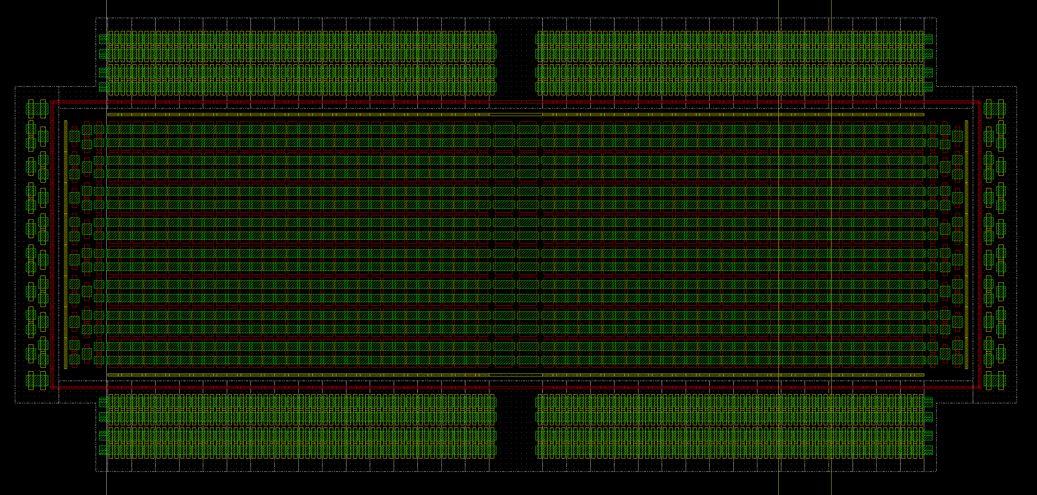
ATF is Case 3 with shared global. Takeaway: The shorting of global nodes left to right amortizes the global driver by 1/2
L9
L11
L13
L15
16 + 16 predriver
S5
S5
S7
S7
G1
G2
SOCKET
G1
G2
64 x 4 ldsel
S6
S6
S8
S8
Vert. Global route
64 x 4 ldsel
L10
L12
L14
L16
L5
L1
G2
L3
L7
S1
S1
SG2
S3
S3
Horiz. Global route
32 x 16
lsel
G2
G1
H1
G1
G2
32 x 16
lsel
S2
S2
S4
S4
L6
L2
L4
L8
G1
32 global driver
(Desel not shown).
SG1
64 x 4 ldsel
64 x 4 ldsel
H1

Slide 22
With rotated poly
 |  |  |  |  |  |  |  |  |  |  | Predriver | 32 | Predriver
 |  | Unipolar 2T |  |  |  | Bipolar 2T |  |  |  |  |  |  |  | U2B
 |  | M (# of fingers) | W | L |  | M (# of fingers) | W | L |  |  | Unipolar 2T |  | Bipolar 2T | scope difference
LMIN |  |  |  |  |  |  |  |  |  | 1: N | dum^2 | 1: N | dum^2
W LXS - rowmux | NHV | 1.0 | 8.52 | 7 | NHV | 1.0 | 3.16 | 7 |  | 1 | 161.9 | 1 | 109.0 | y
W LXD/LYD - rowmux | PHV | 1.0 | 3.16 | 8 | NHV | 1.0 |  |  |  | 1 | 86.3 | 1
W LYS - rowmux | PHV |  |  |  | PHV | 1.0 | 3.16 | 7 |  |  |  | 1 | 109.0 | y
W LXS - colmux | NHV |  |  |  | NHV | 1.0 | 3.16 | 7 |  |  |  | 1 | 109.0 | y
W LXD/LYD - colmux | NHV | 1.0 | 3.16 | 5.52 | NHV | 1.0 |  |  |  | 1 | 73.0 | 1
W LYS - colmux | PHV | 1.0 | 8.52 | 7 | PHV | 1.0 | 3.16 | 7 |  | 1 | 161.9 | 1 | 109.0 | y
W GXS - rowmux | NHV | 1.0 | 15.02 | 7 | NHV | 1.0 | 8.52 | 7 |  | 32 | 10.3 | 32 | 7.2 | n
W GXD - rowmux | NHV | 1.0 | 4.24 | 7 | PHV | 1.0 | 4.24 | 7 |  | 32 | 5.2 | 32 | 5.2 | n
W GYS - rowmux |  |  |  |  | PHV | 1.0 | 8.52 | 7 |  |  |  | 32 | 7.2 | n
W GYD - rowmux |  |  |  |  | NHV | 1.0 | 3.16 | 9.7 |  |  |  | 32 | 5.5 | n
W GXS - colmux |  |  |  |  | NHV | 1.0 | 8.52 | 7 |  |  |  | 32 | 7.2 | n
W GXD - colmux |  |  |  |  | PHV | 1.0 | 4.24 | 7 |  |  |  | 32 | 5.2 | n
W GYS - colmux | PHV | 1.0 | 20.38 | 7 | PHV | 1.0 | 8.52 | 7 |  | 32 | 12.8 | 32 | 7.2 | n
W GYD - colmux | NHV | 1.0 | 3.16 | 9.7 | NHV | 1.0 | 3.16 | 9.7 |  | 32 | 5.5 | 32 | 5.5 | n
INVT P | PHV | 1.0 | 4.24 | 9.7 | PHV | 1.0 | 4.24 | 9.7 |  | 64 | 3.1 | 32 | 6.1 | n
INVT N | NHV | 1.0 | 4.24 | 9.7 | NHV | 1.0 | 4.24 | 9.7 |  | 64 | 3.1 | 32 | 6.1 | n
INVT P | PHV | 1.0 | 4.24 | 8 | PHV | 1.0 | 4.24 | 8 |  | 32 | 5.6 | 32 | 5.6 | n
INVT N | NHV | 1.0 | 4.24 | 8 | NHV | 1.0 | 4.24 | 8 |  | 32 | 5.6 | 32 | 5.6 | n
Foot print in dum^2 for 1 decoder. Local only |  |  |  |  |  |  |  |  |  |  | 483.0 |  | 436.1
Foot print in dum^2 for 1 decoder. Local + Global |  |  |  |  |  |  |  |  |  |  | 534.2 |  | 509.9
Foot print normalized to Unipolar 2T |  |  |  |  |  |  |  |  |  |  | 1X |  | 0.95X
 |  |  |  |  |  |  | Area | Gl Dr. |  |  | 28.3 |  | 44.9
 |  |  |  |  |  |  | Area | Pr Dr. |  |  | 17.3 |  | 23.4
 |  |  |  |  |  |  |  | Ratio |  |  | 1.6 |  | 1.9

Slide 23
 |  |  |  |  |  |  |  |  |  |  | Predriver | 8 | Predriver | 8 | Predriver | 16 | Predriver | 16 | Predriver | 32 | Predriver | 32 | Predriver | 64 | Predriver | 64
 |  | Unipolar 2T |  |  |  | Bipolar 2T
 |  | M (# of fingers) | W | L |  | M (# of fingers) | W | L |  |  | Unipolar 2T |  | Bipolar 2T |  | Bipolar 2T |  | Bipolar 2T |  | Bipolar 2T |  | Bipolar 2T |  | Bipolar 2T |  | Bipolar 2T |  | Bipolar 2T
LMIN |  |  |  |  |  |  |  |  |  | 1: N | dum^2 | 1: N | dum^2 | 1: N | dum^2 | 1: N | dum^2 | 1: N | dum^2 | 1: N | dum^2 | 1: N | dum^2 | 1: N | dum^2 | 1: N | dum^2
W LXS - rowmux | NHV | 1.0 | 8.52 | 7 | NHV | 1.0 | 8.52 | 7 |  | 1 | 161.9 | 1 | 161.9 | 1 | 161.9 | 1 | 161.9 | 1 | 161.9 | 1 | 161.9 | 1 | 161.9 | 1 | 161.9 | 1 | 161.9
W LXD/LYD - rowmux | PHV | 1.0 | 3.16 | 8 | NHV | 1.0 |  |  |  | 1 | 86.3 | 1 |  | 1 |  | 1 |  | 1 |  | 1 |  | 1 |  | 1 |  | 1
W LYS - rowmux | PHV |  |  |  | PHV | 1.0 | 8.52 | 7 |  |  |  | 1 | 161.9 | 1 | 161.9 | 1 | 161.9 | 1 | 161.9 | 1 | 161.9 | 1 | 161.9 | 1 | 161.9 | 1 | 161.9
W LXS - colmux | NHV |  |  |  | NHV | 1.0 | 8.52 | 7 |  |  |  | 1 | 161.9 | 1 | 161.9 | 1 | 161.9 | 1 | 161.9 | 1 | 161.9 | 1 | 161.9 | 1 | 161.9 | 1 | 161.9
W LXD/LYD - colmux | NHV | 1.0 | 3.16 | 5.52 | NHV | 1.0 |  |  |  | 1 | 73.0 | 1 |  | 1 |  | 1 |  | 1 |  | 1 |  | 1 |  | 1 |  | 1
W LYS - colmux | PHV | 1.0 | 8.52 | 7 | PHV | 1.0 | 8.52 | 7 |  | 1 | 161.9 | 1 | 161.9 | 1 | 161.9 | 1 | 161.9 | 1 | 161.9 | 1 | 161.9 | 1 | 161.9 | 1 | 161.9 | 1 | 161.9
W GXS - rowmux | NHV | 1.0 | 15.02 | 7 | NHV | 1.0 | 8.52 | 7 |  | 32 | 10.3 | 4 | 57.8 | 8 | 28.9 | 8 | 28.9 | 16 | 14.5 | 16 | 14.5 | 32 | 7.2 | 32 | 7.2 | 64 | 3.6
W GXD - rowmux | NHV | 1.0 | 4.24 | 7 | PHV | 1.0 | 4.24 | 7 |  | 32 | 5.2 | 4 | 41.7 | 8 | 20.8 | 8 | 20.8 | 16 | 10.4 | 16 | 10.4 | 32 | 5.2 | 32 | 5.2 | 64 | 2.6
W GYS - rowmux |  |  |  |  | PHV | 1.0 | 8.52 | 7 |  |  |  | 4 | 57.8 | 8 | 28.9 | 8 | 28.9 | 16 | 14.5 | 16 | 14.5 | 32 | 7.2 | 32 | 7.2 | 64 | 3.6
W GYD - rowmux |  |  |  |  | NHV | 1.0 | 3.16 | 9.7 |  |  |  | 4 | 44.3 | 8 | 22.2 | 8 | 22.2 | 16 | 11.1 | 16 | 11.1 | 32 | 5.5 | 32 | 5.5 | 64 | 2.8
W GXS - colmux |  |  |  |  | NHV | 1.0 | 8.52 | 7 |  |  |  | 4 | 57.8 | 8 | 28.9 | 8 | 28.9 | 16 | 14.5 | 16 | 14.5 | 32 | 7.2 | 32 | 7.2 | 64 | 3.6
W GXD - colmux |  |  |  |  | PHV | 1.0 | 4.24 | 7 |  |  |  | 4 | 41.7 | 8 | 20.8 | 8 | 20.8 | 16 | 10.4 | 16 | 10.4 | 32 | 5.2 | 32 | 5.2 | 64 | 2.6
W GYS - colmux | PHV | 1.0 | 20.38 | 7 | PHV | 1.0 | 8.52 | 7 |  | 32 | 12.8 | 4 | 57.8 | 8 | 28.9 | 8 | 28.9 | 16 | 14.5 | 16 | 14.5 | 32 | 7.2 | 32 | 7.2 | 64 | 3.6
W GYD - colmux | NHV | 1.0 | 3.16 | 9.7 | NHV | 1.0 | 3.16 | 9.7 |  | 32 | 5.5 | 4 | 44.3 | 8 | 22.2 | 8 | 22.2 | 16 | 11.1 | 16 | 11.1 | 32 | 5.5 | 32 | 5.5 | 64 | 2.8
INVT P | PHV | 1.0 | 4.24 | 9.7 | PHV | 1.0 | 4.24 | 9.7 |  | 64 | 3.1 | 128 | 1.5 | 128 | 1.5 | 64 | 3.1 | 64 | 3.1 | 32 | 6.1 | 32 | 6.1 | 16 | 12.3 | 16 | 12.3
INVT N | NHV | 1.0 | 4.24 | 9.7 | NHV | 1.0 | 4.24 | 9.7 |  | 64 | 3.1 | 128 | 1.5 | 128 | 1.5 | 64 | 3.1 | 64 | 3.1 | 32 | 6.1 | 32 | 6.1 | 16 | 12.3 | 16 | 12.3
INVT P | PHV | 1.0 | 4.24 | 8 | PHV | 1.0 | 4.24 | 8 |  | 32 | 5.6 | 128 | 1.4 | 128 | 1.4 | 64 | 2.8 | 64 | 2.8 | 32 | 5.6 | 32 | 5.6 | 16 | 11.1 | 16 | 11.1
INVT N | NHV | 1.0 | 4.24 | 8 | NHV | 1.0 | 4.24 | 8 |  | 32 | 5.6 | 128 | 1.4 | 128 | 1.4 | 64 | 2.8 | 64 | 2.8 | 32 | 5.6 | 32 | 5.6 | 16 | 11.1 | 16 | 11.1
Foot print in dum^2 for 1 decoder. Local only |  |  |  |  |  |  |  |  |  |  | 483.0 |  | 647.5 |  | 647.5 |  | 647.5 |  | 647.5 |  | 647.5 |  | 647.5 |  | 647.5 |  | 647.5
Foot print in dum^2 for 1 decoder. Local + Global |  |  |  |  |  |  |  |  |  |  | 534.2 |  | 1056.7 |  | 855.0 |  | 860.8 |  | 760.0 |  | 771.7 |  | 721.3 |  | 744.7 |  | 719.5
Foot print normalized to Unipolar 2T |  |  |  |  |  |  |  |  |  |  | 1X |  | 1.98X |  | 1.6X |  | 1.61X |  | 1.42X |  | 1.44X |  | 1.35X |  | 1.39X |  | 1.35X
 |  |  |  |  |  |  | Area | Gl Dr. |  |  | 28.3 |  | 359.0 |  | 179.5 |  | 179.5 |  | 89.8 |  | 89.8 |  | 44.9 |  | 44.9 |  | 22.4
 |  |  |  |  |  |  | Area | Pr Dr. |  |  | 17.3 |  | 5.8 |  | 5.8 |  | 11.7 |  | 11.7 |  | 23.4 |  | 23.4 |  | 46.8 |  | 46.8
 |  |  |  |  |  |  |  | Ratio |  |  | 1.6 |  | 61.4 |  | 30.7 |  | 15.3 |  | 7.7 |  | 3.8 |  | 1.9 |  | 1.0 |  | 0.5
0.67 * 64 = 42.88L is pitch cell
42.88/4 – 2.2 = 8.52L select transistor size
Increasing local select size increases decoder footprint beyond unipolar. Not viable.

Slide 24
CUA tile logic is larger for Bipolar, so decoder needs to ~10% smaller for bipolar.
 |  |  |  | 33.5
 |  |  |  | Bipolar |  | Unipolar
Function | Sub block | synergy | synergy | λ² | Occupancy [%] | λ² | Occupancy [%]
FOOT PRINT |  |  |  | 8460694 | 94.9% | 8913071 | 100.0%
ROWMUX |  | 4 | 4. New circuit topo due to Bipolar | 2556053 | 28.7% | 3235510 | 36.3%
COLMUX |  | 4 | 4. New circuit topo due to Bipolar | 2556053 | 28.7% | 2986803 | 33.5%
2X2 LOGIC |  |  |  | 1386388 | 15.6% | 788352 | 8.8%
 | blsupmux | 2 | 2. Same topo different sizing | 55892 | 0.6% | 111784 | 1.3%
 | axn sw | 3 | 3. Added circuit due to bipolar/signaling (functionality demonstrated in unipolar) | 336000 | 3.8% | 168000 | 1.9%
 | hnreg sw | 3 | 3. Added circuit due to bipolar/signaling (functionality demonstrated in unipolar) | 304064 | 3.4% | 152032 | 1.7%
 | gwl_gnd | 5 | 5. removed circuit due to bipolar/signaling (functionality demonstrated in unipolar) | 273568 | 3.1% | 136784 | 1.5%
 | gbl gnd | 5 | 5. removed circuit due to bipolar/signaling (functionality demonstrated in unipolar) | 218080 | 2.4% | 109040 | 1.2%
 | and3 | 3 | 3. Added circuit due to bipolar/signaling (functionality demonstrated in unipolar) | 31248 | 0.4% | 15624 | 0.2%
 | ccellbias | 3 | 3. Added circuit due to bipolar/signaling (functionality demonstrated in unipolar) | 144896 | 1.6% | 72448 | 0.8%
 | guardring | 1 | 1. Identical | 22640 | 0.3% | 22640 | 0.3%
TILE LOGIC |  |  |  | 1761655 | 19.8% | 1489824 | 16.7%
 | iref | 2 | 2. Same topo different sizing | 374234 | 4.2% | 374234 | 4.2%
 | blvdm_mux | 2 | 2. Same topo different sizing | 381470 | 4.3% | 381470 | 4.3%
 | tko_bl | 2 | 2. Same topo different sizing | 17116 | 0.2% | 17116 | 0.2%
 | tko_wl | 2 | 2. Same topo different sizing | 40158 | 0.5% | 40158 | 0.5%
 | tilelogic_bl | 3 | 3. Added circuit due to bipolar/signaling (functionality demonstrated in unipolar) | 101437 | 1.1% | 101437 | 1.1%
 | masklogic_bl | 2 | 2. Same topo different sizing | 90432 | 1.0% | 90432 | 1.0%
 | data_lat | 2 | 2. Same topo different sizing | 49560 | 0.6% | 49560 | 0.6%
 | masklogic_wl | 2 | 2. Same topo different sizing | 54302 | 0.6% | 54302 | 0.6%
 | tilelogic_wl | 3 | 3. Added circuit due to bipolar/signaling (functionality demonstrated in unipolar) | 69176 | 0.8% | 69176 | 0.8%
 | lwlselv_mux | 3 | 3. Added circuit due to bipolar/signaling (functionality demonstrated in unipolar) | 487264 | 5.5% | 243632 | 2.7%
 | wl_supmux | 2 | 2. Same topo different sizing | 56398 | 0.6% | 28199 | 0.3%
 | capacitor | 2 | 2. Same topo different sizing | 40108 | 0.4% | 40108 | 0.4%
FREE SPACE |  |  |  | -40108 | -0.4% | 171351 | 1.9%
SLIVER |  |  |  | 240653 | 2.7% | 241231 | 2.7%
tile logic + 2 x 2 logic |  |  |  |  | 35.3% |  | 25.6%
 |  |  | Tile area | 8913071 | L^2 | 8913071
 |  |  | Tile Logic Area | 3348588 |  | 2690758
 |  |  | Tile logic area Normalized to array | 37.6% | 62.43% | 30.2% | 69.81% | 89.43%
Decoder

