Slide 1
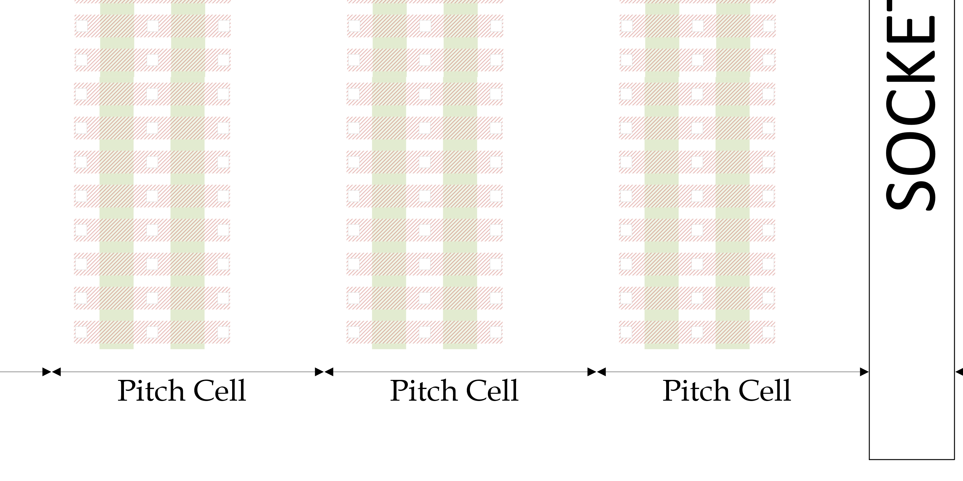
CASE 2 Rotated Poly LMIN=7 & relaxed DR
This is relaxed DR
Sea of gates is next

Slide 2
CASE 2 sel/desel w/ rotated poly
Die size is 144mm^2
LMIN=7 for selects and deselects
Still need to figure out GN/GP decoder placement in layout & metal stack

Slide 3
CASE 2 Rotated Poly Relaxed DR
 |  |  |  |  |  |  |  |  |  |  | Predriver | 32 | Predriver
 |  | Unipolar 2T |  |  |  | Bipolar 2T |  |  |  |  |  |  |  | U2B
 |  | M (# of fingers) | W | L |  | M (# of fingers) | W | L |  |  | Unipolar 2T |  | Bipolar 2T | scope difference
LMIN |  |  |  |  |  |  |  |  |  | 1: N | dum^2 | 1: N | dum^2
W LXS - rowmux | NHV | 1.0 | 8.52 | 7 | NHV | 1.0 | 3.16 | 7 |  | 1 | 161.9 | 1 | 109.0 | y
W LXD/LYD - rowmux | PHV | 1.0 | 3.16 | 8 | NHV | 1.0 |  |  |  | 1 | 86.3 | 1
W LYS - rowmux | PHV |  |  |  | PHV | 1.0 | 3.16 | 7 |  |  |  | 1 | 109.0 | y
W LXS - colmux | NHV |  |  |  | NHV | 1.0 | 3.16 | 7 |  |  |  | 1 | 109.0 | y
W LXD/LYD - colmux | NHV | 1.0 | 3.16 | 5.52 | NHV | 1.0 |  |  |  | 1 | 73.0 | 1
W LYS - colmux | PHV | 1.0 | 8.52 | 7 | PHV | 1.0 | 3.16 | 7 |  | 1 | 161.9 | 1 | 109.0 | y
W GXS - rowmux | NHV | 1.0 | 15.02 | 7 | NHV | 1.0 | 8.52 | 7 |  | 32 | 10.3 | 32 | 7.2 | n
W GXD - rowmux | NHV | 1.0 | 4.24 | 7 | PHV | 1.0 | 4.24 | 7 |  | 32 | 5.2 | 32 | 5.2 | n
W GYS - rowmux |  |  |  |  | PHV | 1.0 | 8.52 | 7 |  |  |  | 32 | 7.2 | n
W GYD - rowmux |  |  |  |  | NHV | 1.0 | 3.16 | 9.7 |  |  |  | 32 | 5.5 | n
W GXS - colmux |  |  |  |  | NHV | 1.0 | 8.52 | 7 |  |  |  | 32 | 7.2 | n
W GXD - colmux |  |  |  |  | PHV | 1.0 | 4.24 | 7 |  |  |  | 32 | 5.2 | n
W GYS - colmux | PHV | 1.0 | 20.38 | 7 | PHV | 1.0 | 8.52 | 7 |  | 32 | 12.8 | 32 | 7.2 | n
W GYD - colmux | NHV | 1.0 | 3.16 | 9.7 | NHV | 1.0 | 3.16 | 9.7 |  | 32 | 5.5 | 32 | 5.5 | n
INVT P | PHV | 1.0 | 4.24 | 9.7 | PHV | 1.0 | 4.24 | 9.7 |  | 64 | 3.1 | 32 | 6.1 | n
INVT N | NHV | 1.0 | 4.24 | 9.7 | NHV | 1.0 | 4.24 | 9.7 |  | 64 | 3.1 | 32 | 6.1 | n
INVT P | PHV | 1.0 | 4.24 | 8 | PHV | 1.0 | 4.24 | 8 |  | 32 | 5.6 | 32 | 5.6 | n
INVT N | NHV | 1.0 | 4.24 | 8 | NHV | 1.0 | 4.24 | 8 |  | 32 | 5.6 | 32 | 5.6 | n
Foot print in dum^2 for 1 decoder. Local only |  |  |  |  |  |  |  |  |  |  | 483.0 |  | 436.1
Foot print in dum^2 for 1 decoder. Local + Global |  |  |  |  |  |  |  |  |  |  | 534.2 |  | 509.9
Foot print normalized to Unipolar 2T |  |  |  |  |  |  |  |  |  |  | 1X |  | 0.95X
 |  |  |  |  |  |  | Area | Gl Dr. |  |  | 28.3 |  | 44.9
 |  |  |  |  |  |  | Area | Pr Dr. |  |  | 17.3 |  | 23.4
 |  |  |  |  |  |  |  | Ratio |  |  | 1.6 |  | 1.9
Next steps: don’t know how to place GN/GP decoders and route them.

Slide 4
IDEA 2 :rotated POLY relaxed DR
Case 3
2 XTOR | Dim | Count | Total |  |  |  | 1 XTOR | Dim | Count | Total
Cont | 1.6 | 3 | 4.8 |  |  |  |  | 1.6 | 2 | 3.2
Gate | 7 | 2 | 14 |  |  |  |  | 7 | 1 | 7
Con2gate | 1.7 | 4 | 6.8 |  |  |  |  | 1.7 | 2 | 3.4
ConOv | 0.1 | 2 | 0.2 |  |  |  |  | 0.1 | 2 | 0.2
A2A | 2.2 | 1 | 2.2 |  |  |  |  | 2.2 | 1 | 2.2
 |  | Pitch | 28 |  |  |  |  |  |  | 16
 | cell | count | Width | Width/Pitch |  |  |  | cell | count | Width | Width/Pitch
Cell | 0.67 | 8 | 5.36 | 0.19 |  |  |  | 0.67 | 8 | 5.36 | 0.34
 | 0.67 | 32 | 21.44 | 0.77 |  |  |  | 0.67 | 32 | 21.44 | 1.34
 | 0.67 | 64 | 42.88 | 1.53 |  |  |  | 0.67 | 64 | 42.88 | 2.68 | Plan | 4.34
 | 0.67 | 128 | 85.76 | 3.06 |  |  |  | 0.67 | 128 | 85.76 | 5.36
 |  |  |  | no integers |  |  |  |  |  |  | no integers
L1
L3
S1
S3
G1
G2
S2
S4
L2
L4
Single transistor pitch is 16L: we can fit only 2 in pitch of 64 cells ie 42.88L
Shared drain single transistor pitch is 28L we can only fit one pair in 42.88L
implication isa gross inefficiency in the Local select P/N FP

