Slide 1
BiSM Decoders
Feb 3’21
Balaji/Mase/Derchang

Slide 2
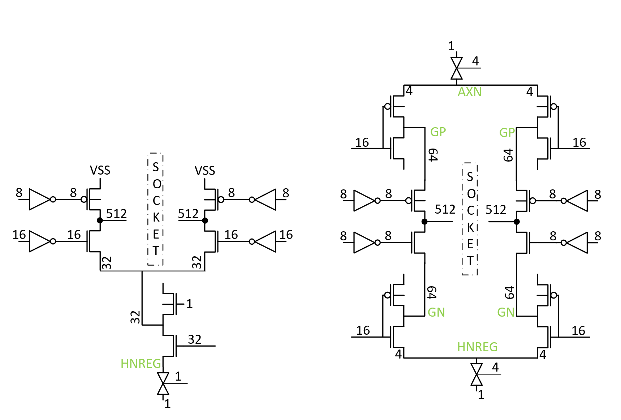
2T bipolar vs. 2T unipolar Decoder
2T Bipolar: Floated C type cell →
Change from past designs
How do we make it refresh free?
Footprint:
Trade larger Select ( Uni 2T) for Extra Global Decoder (Bip 2T)
Grounded Adjacent select
Mitigate false selection risk.
Unipolar
Bipolar

Slide 3
Decoder FP Uni. 2T vs Bip. 2T
Tile becomes Array limited when Dec FP < 86% of Uni
Bipolar G/L Balance curve
Uni~6%
Figure out how to ↑ L:G ratio in layout
L are already Min devices, ↑ L:G ratio will reduce FP without Reducing G device sizes & iRST capability.
Bipolar FP needs to be < 86% of unipolar Decode to make tile array limited.
Need to figure out how to raise L:G ratio > 10
 |  | Unipolar 2T |  |  |  | Bipolar 2T
 |  | M (# of fingers) | W | L |  | M (# of fingers) | W | L |  |  | Unipolar 2T |  | Bipolar 2T |  | Bipolar 2T |  | Bipolar 2T |  | Bipolar 2T |  | Bipolar 2T |  | Bipolar 2T |  | Bipolar 2T |  | Bipolar 2T |  | Bipolar 2T |  | Bipolar 2T |  | Bipolar 2T |  | Bipolar 2T |  | Bipolar 2T |  | Bipolar 2T |  | Bipolar 2T
LMIN |  |  |  |  |  |  |  |  |  | 1: N | dum^2 | 1: N | dum^2 | 1: N | dum^2 | 1: N | dum^2 | 1: N | dum^2 | 1: N | dum^2 | 1: N | dum^2 | 1: N | dum^2 | 1: N | dum^2 | 1: N | dum^2 | 1: N | dum^2 | 1: N | dum^2 | 1: N | dum^2 | 1: N | dum^2 | 1: N | dum^2 | 1: N | dum^2
W LXS - rowmux | NHV | 1.0 | 8.52 | 7 | NHV | 1.0 | 3.16 | 7 |  | 1 | 161.9 | 1 | 75.0 | 1 | 75.0 | 1 | 75.0 | 1 | 75.0 | 1 | 75.0 | 1 | 75.0 | 1 | 75.0 | 1 | 75.0 | 1 | 75.0 | 1 | 75.0 | 1 | 75.0 | 1 | 75.0 | 1 | 75.0 | 1 | 75.0 | 1 | 75.0
W LXD/LYD - rowmux | PHV | 1.0 | 3.16 | 8 | NHV | 1.0 |  |  |  | 1 | 86.3 | 1 |  | 1 |  | 1 |  | 1 |  | 1 |  | 1 |  | 1 |  | 1 |  | 1 |  | 1 |  | 1 |  | 1 |  | 1 |  | 1 |  | 1
W LYS - rowmux | PHV |  |  |  | PHV | 1.0 | 3.16 | 7 |  |  |  | 1 | 75.0 | 1 | 75.0 | 1 | 75.0 | 1 | 75.0 | 1 | 75.0 | 1 | 75.0 | 1 | 75.0 | 1 | 75.0 | 1 | 75.0 | 1 | 75.0 | 1 | 75.0 | 1 | 75.0 | 1 | 75.0 | 1 | 75.0 | 1 | 75.0
W LXS - colmux | NHV |  |  |  | NHV | 1.0 | 3.16 | 7 |  |  |  | 1 | 75.0 | 1 | 75.0 | 1 | 75.0 | 1 | 75.0 | 1 | 75.0 | 1 | 75.0 | 1 | 75.0 | 1 | 75.0 | 1 | 75.0 | 1 | 75.0 | 1 | 75.0 | 1 | 75.0 | 1 | 75.0 | 1 | 75.0 | 1 | 75.0
W LXD/LYD - colmux | NHV | 1.0 | 3.16 | 5.52 | NHV | 1.0 |  |  |  | 1 | 73.0 | 1 |  | 1 |  | 1 |  | 1 |  | 1 |  | 1 |  | 1 |  | 1 |  | 1 |  | 1 |  | 1 |  | 1 |  | 1 |  | 1 |  | 1
W LYS - colmux | PHV | 1.0 | 8.52 | 7 | PHV | 1.0 | 3.16 | 7 |  | 1 | 161.9 | 1 | 75.0 | 1 | 75.0 | 1 | 75.0 | 1 | 75.0 | 1 | 75.0 | 1 | 75.0 | 1 | 75.0 | 1 | 75.0 | 1 | 75.0 | 1 | 75.0 | 1 | 75.0 | 1 | 75.0 | 1 | 75.0 | 1 | 75.0 | 1 | 75.0
W GXS - rowmux | NHV | 1.0 | 15.02 | 7 | NHV | 1.0 | 8.52 | 7 |  | 32 | 9.7 | 8 | 26.7 | 10 | 21.3 | 12 | 17.8 | 14 | 15.2 | 16 | 13.3 | 18 | 11.8 | 20 | 10.7 | 22 | 9.7 | 24 | 8.9 | 26 | 8.2 | 28 | 7.6 | 28 | 7.6 | 30 | 7.1 | 32 | 6.7 | 34 | 6.3
W GXD - rowmux | NHV | 1.0 | 4.24 | 7 | PHV | 1.0 | 4.24 | 7 |  | 32 | 4.6 | 8 | 18.6 | 10 | 14.9 | 12 | 12.4 | 14 | 10.6 | 16 | 9.3 | 18 | 8.3 | 20 | 7.4 | 22 | 6.8 | 24 | 6.2 | 26 | 5.7 | 28 | 5.3 | 28 | 5.3 | 30 | 5.0 | 32 | 4.6 | 34 | 4.4
W GYS - rowmux |  |  |  |  | PHV | 1.0 | 8.52 | 7 |  |  |  | 8 | 26.7 | 10 | 21.3 | 12 | 17.8 | 14 | 15.2 | 16 | 13.3 | 18 | 11.8 | 20 | 10.7 | 22 | 9.7 | 24 | 8.9 | 26 | 8.2 | 28 | 7.6 | 28 | 7.6 | 30 | 7.1 | 32 | 6.7 | 34 | 6.3
W GYD - rowmux |  |  |  |  | NHV | 1.0 | 3.16 | 9.7 |  |  |  | 8 | 19.5 | 10 | 15.6 | 12 | 13.0 | 14 | 11.1 | 16 | 9.7 | 18 | 8.7 | 20 | 7.8 | 22 | 7.1 | 24 | 6.5 | 26 | 6.0 | 28 | 5.6 | 28 | 5.6 | 30 | 5.2 | 32 | 4.9 | 34 | 4.6
W GXS - colmux |  |  |  |  | NHV | 1.0 | 8.52 | 7 |  |  |  | 8 | 26.7 | 10 | 21.3 | 12 | 17.8 | 14 | 15.2 | 16 | 13.3 | 18 | 11.8 | 20 | 10.7 | 22 | 9.7 | 24 | 8.9 | 26 | 8.2 | 28 | 7.6 | 28 | 7.6 | 30 | 7.1 | 32 | 6.7 | 34 | 6.3
W GXD - colmux |  |  |  |  | PHV | 1.0 | 4.24 | 7 |  |  |  | 8 | 18.6 | 10 | 14.9 | 12 | 12.4 | 14 | 10.6 | 16 | 9.3 | 18 | 8.3 | 20 | 7.4 | 22 | 6.8 | 24 | 6.2 | 26 | 5.7 | 28 | 5.3 | 28 | 5.3 | 30 | 5.0 | 32 | 4.6 | 34 | 4.4
W GYS - colmux | PHV | 1.0 | 20.38 | 7 | PHV | 1.0 | 8.52 | 7 |  | 32 | 12.3 | 8 | 26.7 | 10 | 21.3 | 12 | 17.8 | 14 | 15.2 | 16 | 13.3 | 18 | 11.8 | 20 | 10.7 | 22 | 9.7 | 24 | 8.9 | 26 | 8.2 | 28 | 7.6 | 28 | 7.6 | 30 | 7.1 | 32 | 6.7 | 34 | 6.3
W GYD - colmux | NHV | 1.0 | 3.16 | 9.7 | NHV | 1.0 | 3.16 | 9.7 |  | 32 | 4.9 | 8 | 19.5 | 10 | 15.6 | 12 | 13.0 | 14 | 11.1 | 16 | 9.7 | 18 | 8.7 | 20 | 7.8 | 22 | 7.1 | 24 | 6.5 | 26 | 6.0 | 28 | 5.6 | 28 | 5.6 | 30 | 5.2 | 32 | 4.9 | 34 | 4.6
Foot print in dum^2 for 1 decoder. Local only |  |  |  |  |  |  |  |  |  |  | 483.0 |  | 300.2 |  | 300.2 |  | 300.2 |  | 300.2 |  | 300.2 |  | 300.2 |  | 300.2 |  | 300.2 |  | 300.2 |  | 300.2 |  | 300.2 |  | 300.2 |  | 300.2 |  | 300.2 |  | 300.2
Foot print in dum^2 for 1 decoder. Local + Global |  |  |  |  |  |  |  |  |  |  | 514.5 |  | 482.9 |  | 446.3 |  | 422.0 |  | 404.6 |  | 391.5 |  | 381.4 |  | 373.3 |  | 366.6 |  | 361.1 |  | 356.4 |  | 352.4 |  | 352.4 |  | 348.9 |  | 345.8 |  | 343.2
Foot print normalized to Unipolar 2T |  |  |  |  |  |  |  |  |  |  | 1X |  | 0.94X |  | 0.87X |  | 0.82X |  | 0.79X |  | 0.76X |  | 0.74X |  | 0.73X |  | 0.71X |  | 0.7X |  | 0.69X |  | 0.68X |  | 0.68X |  | 0.68X |  | 0.67X |  | 0.67X
 |  |  |  |  |  |  |  | Local |  |  | 483.0 |  | 300.2 |  | 300.2 |  | 300.2 |  | 300.2 |  | 300.2 |  | 300.2 |  | 300.2 |  | 300.2 |  | 300.2 |  | 300.2 |  | 300.2 |  | 300.2 |  | 300.2 |  | 300.2 |  | 300.2
 |  |  |  |  |  |  |  | Global |  |  | 31.5 |  | 182.7 |  | 146.2 |  | 121.8 |  | 104.4 |  | 91.4 |  | 81.2 |  | 73.1 |  | 66.4 |  | 60.9 |  | 56.2 |  | 52.2 |  | 52.2 |  | 48.7 |  | 45.7 |  | 43.0
 |  |  |  |  |  |  |  | Ar (G/L) |  |  | 6.52% |  | 60.88% |  | 48.70% |  | 40.59% |  | 34.79% |  | 30.44% |  | 27.06% |  | 24.35% |  | 22.14% |  | 20.29% |  | 18.73% |  | 17.39% |  | 17.39% |  | 16.23% |  | 15.22% |  | 14.32%
 |  |  |  |  |  |  |  | L:G |  |  | 32.0 |  | 8.0 |  | 10.0 |  | 12.0 |  | 14.0 |  | 16.0 |  | 18.0 |  | 20.0 |  | 22.0 |  | 24.0 |  | 26.0 |  | 28.0 |  | 28.0 |  | 30.0 |  | 32.0 |  | 34.0

Slide 4
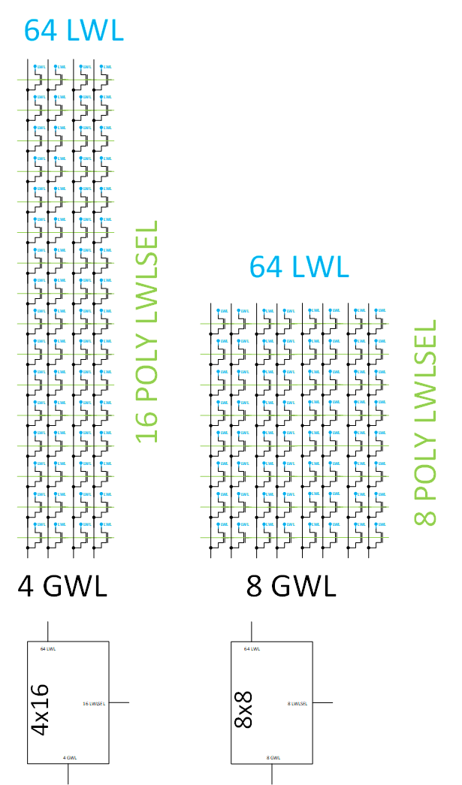
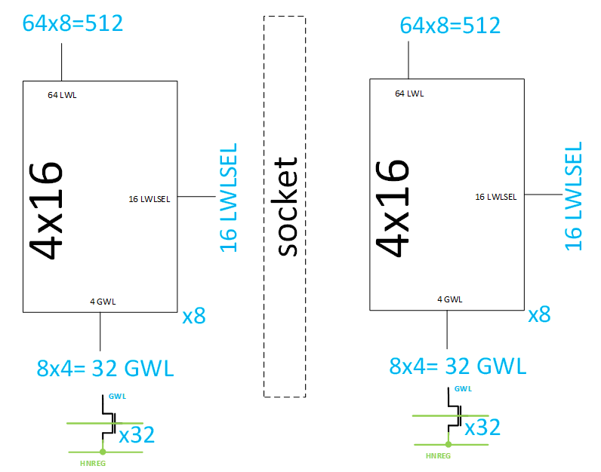
G:L ratio calc. for uni/bip 2T decoders
Selector array configuration | GWL Count | GSEL GDSEL Count | G:L count ratio
4x16 | 4 gwl/pc x 8 pc/side x 2 side/patch = 64 | 64 GSEL + 64 GDSEL per patch | 1 : 16
4x16 with 32 M3 Shorter bus between patch sides | 4 gwl/pc x 8 pc/side x 2 side/patch = 64 | 64/2=32 GSEL + 64/2=32 GDSEL per patch | Uni 2T POR 1:32
8x8 | 8 gwl/pc x 8 pc/side x 2 side/patch = 128 | 128 GSEL + 128 GDSEL per patch | 1 : 8
8x8 with 64 M3 Shorter bus between patch sides | 8 gwl/pc x 8 pc/side x 2 side/patch = 128 | 64 GSEL + 64 GDSEL per patch | 1 : 16 still doesn't match Uni 2T die growth for track needed
M3 shorting bus helps mitigate G:L ratio, by cutting GSEL/GDSEL count in half.

Slide 5
0.86X decoder FP needed to make tile Array limited.

Slide 6
Backup

Slide 7
2T bipolar vs. 2T unipolar Decoder
2T Bipolar: Floated C type cell →
change from past designs
Can we live without refresh?
Footprint:
Trade larger Select ( Uni 2T) for Extra Global Decoder (Bip 2T)
Grounded Adjacent select
Mitigate false selection risk.
Unipolar
Bipolar

Slide 8
2T bipolar decoder vs. die size
Config | Sel. Xtor. array | Decode Footprint | G:L ratio count | Dupl. GP dec | Die size (mm^2) | Notes
Unipolar 2T | 4x16 | 1x | 1:32 | NA | 133.7 | Reference
Bipolar 2T - with ATF DR | 4x16 | 1.41x | 1:32 | YES | 175.4 | Con/M1/M2/M3 limits diffusion include duplication of GP decoder
Bipolar 2T - with ATF FE DR | 8x8 | 1.12X | 1:8 | YES | 153.4 | Con/M1/M2/M3 Need change include duplication of GP decoder
Bipolar 2T - with ATF FE DR + Additional Metal | 8x8 | 0.94x | 1:8 | NO | 139.7 | Con/M1/M2/M3 Need change + one additional metal beyond ATF stack additional metal removes need to duplicate GP decoder
Bipolar 2T - with ATF FE DR + Additional Metal + 18 tr/pc M3 | 8x8 | 0.76x | 1:16 | NO | ~133.7 Cel. Arr. Limited | Con/M1/M2/M3 Need change + one additional metal beyond ATF stack + 16 tr/pc M3 goes to 18 tr/pc
Causes for High Die size → Decoder footprint →
Metal limited diffusion → mitigated by enhanced metal capability 175 → 153
Duplicated global p decoder/pitch-cell → mitigated by additional metal 153 → 139
High G:L ratio → mitigated by finer pitch 139 → 133
m3 (16 tr/pc → 18 tr/pc & need dec layout to see if routable)

Slide 9
G:L ratio calc. for uni/bip 2T decoders
Selector array configuration | GWL Count | GSEL GDSEL Count | G:L count ratio
4x16 | 4 gwl/pc x 8 pc/side x 2 side/patch = 64 | 64 GSEL + 64 GDSEL per patch | 1 : 16
4x16 with 32 M3 Shorter bus between patch sides | 4 gwl/pc x 8 pc/side x 2 side/patch = 64 | 64/2=32 GSEL + 64/2=32 GDSEL per patch | Uni 2T POR 1:32
8x8 | 8 gwl/pc x 8 pc/side x 2 side/patch = 128 | 128 GSEL + 128 GDSEL per patch | 1 : 8
8x8 with 64 M3 Shorter bus between patch sides | 8 gwl/pc x 8 pc/side x 2 side/patch = 128 | 64 GSEL + 64 GDSEL per patch | 1 : 16 still doesn't match Uni 2T die growth for track needed
M3 shorting bus helps mitigate G:L ratio, by cutting GSEL/GDSEL count in half.

Slide 10
2T bipolar Decoder with ATF FE DR
Contact + M1/2/3
Finer pitch.
M1 16 tracks
M2/3 18 tracks
GSELP1
LSELP
LSELN
GSELN
LSELP
GSELP1
N 5.2/7?
P 8.52/7
P 3.16/7
TWN 3.16/7
TWN 8.52/7
P 3.16/7
P 3.16/7
P 8.52/7
N 5.2/7?

Slide 11
2T bipolar Decoder with ATF FE DR + addl. metal layer
Contact + M1/2/3
Finer pitch.
M1 16 tracks
M2/3 18 tracks
M3A for GP routes
Removes need to
Duplicate decoder.
GSELP1
LSELP
LSELN
GSELN
LSELP
N 5.2/7?
P 8.52/7
P 3.16/7
TWN 3.16/7
TWN 8.52/7
P 3.16/7
P 3.16/7

Slide 12
2T bipolar Decoder with ATF FE DR and 18 tr/pc M3
Contact + M1/2/3
Finer pitch.
M1 16 tracks
M2/3 18 tracks
GSELP1
LSELP
LSELN
GSELN
LSELP
GSELP1
Picture is TBD
N 5.2/7?
P 8.52/7
P 3.16/7
TWN 3.16/7
TWN 8.52/7
P 3.16/7
P 3.16/7
P 8.52/7
N 5.2/7?

Slide 13
8x8 vs 4x16 : # global xtors
4x16 → 4 GWL/ Pitchcell.
4 gbl/pitchcell x 8 pitchcell/side x 2 sides
32 GWl/per side.
64 GSEL + 64 GDSEL devices/patch

Slide 14
8x8 vs 4x16 : # global xtors
4x16 → 4 GWL/ Pitchcell.
4 gbl/pitchcell x 8 pitcell/side x 2 sides
32 GWl/per side.
32 Shorter M3 tracks per side : ATF POR
32 GSEL + 32 GDSEL devices/patch

Slide 15
8x8 vs 4x16 : # global xtors
8x8 → 8 GWL/ Pitchcell.
8 gbl/pitchcell x 8 pitcell/side x 2 sides
64 GWl/per side.
128 GSEL + 128 GDSEL devices/patch

Slide 16
backup

Slide 17
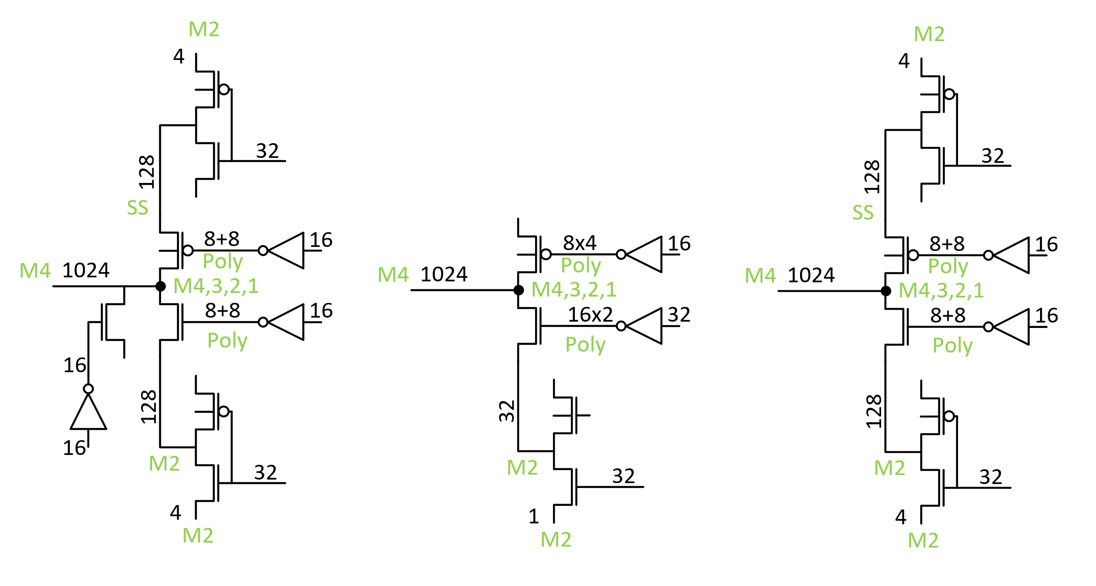
2T bipolar vs. 2T unipolar Decoder
FP – wip, expect smaller than 3t
Track count is smaller x16
Need adjacent wl grounding scheme – prevent false selection, minimize refresh
Powerup init and periodic refresh.
Bipolar
Unipolar
Bipolar-float

Slide 18
2T float with both adjacent lines grounded.
VPPs
AXN
VPP
FLOAT=VSS
ACTIVE BL
FLOAT=VSS
VSS
-VEE
VSS
VPPs
VNN
AXN
VPP
VSS
VSS
VNN
VNN
HNREG
VNNs
VSS
ACTIVE WL
VPPs
VSS
AXN
VPP
VSS
VSS
VSS
HNREG
-VEE
VNNs
VSS
VNN
VSS
VNN
HNREG
VNNs

Slide 19
2T float with One adjacent line grounded.
VPPs
AXN
VPP
FLOAT=VSS
ACTIVE BL
FLOAT=VSS
VSS
-VPP
FLOAT
VPPs
VNN
AXN
VPP
VSS
VSS
VNN
VNN
HNREG
VNNs
VSS
ACTIVE WL
VPPs
VSS
AXN
VPP
VSS
VSS
VSS
HNREG
-VEE
VNNs
VSS
VNN
VSS
VNN
HNREG
VNNs

Slide 20
2T float with All.
VPPs
AXN
VPP
FLOAT=VSS
ACTIVE BL
FLOAT=VSS
VSS
VPP
FLOAT
VPPs
VNN
AXN
VPP
VSS
VSS
VNN
VNN
HNREG
VNNs
VSS
ACTIVE WL
VPPs
VSS
AXN
VPP
VSS
VSS
VSS
HNREG
VPP
VNNs
FLOAT
VNN
VSS
VNN
HNREG
VNNs

Slide 21
Bipolar Enabled Die size with 3T decoder
 | Sel Xtor Arr. | Dec FP | die size
 | # | # | mm^2
Unipolar reference | 4x16 | 1X | 133.6
Bipolar 32G - with ATF DR | 4x16 | 1.63X | 192.1 | Con/M1/M2/M3 limits diff placement eff.
Bipolar 32G - ATF FE DR limited | 8x8 | 1.12X | 153.4 | Con/M1/M2/M3 need change.
3t decoder: is large compared with unipolar decoder. Need alternatives.

Slide 22
Tile synergy pareto
Function | Sub block | synergy | synergy | l² | Occupancy [%] | l² | Occupancy [%]
FOOT PRINT |  |  |  | 13896351 | 155.9% | 8913071 | 100.0%
ROWMUX |  | 4 | 4. New circuit topo due to Bipolar | 5273882 | 59.2% | 3235510 | 36.3%
COLMUX |  | 4 | 4. New circuit topo due to Bipolar | 5273882 | 59.2% | 2986803 | 33.5%
2X2 LOGIC |  |  |  | 1386388 | 15.6% | 788352 | 8.8%
 | blsupmux | 2 | 2. Same topo different sizing | 55892 | 0.6% | 111784 | 1.3%
 | axn sw | 3 | 3. Added circuit due to bipolar/signaling (functionality demonstrated in unipolar) | 336000 | 3.8% | 168000 | 1.9%
 | hnreg sw | 3 | 3. Added circuit due to bipolar/signaling (functionality demonstrated in unipolar) | 304064 | 3.4% | 152032 | 1.7%
 | gwl_gnd | 5 | 5. removed circuit due to bipolar/signaling (functionality demonstrated in unipolar) | 273568 | 3.1% | 136784 | 1.5%
 | gbl gnd | 5 | 5. removed circuit due to bipolar/signaling (functionality demonstrated in unipolar) | 218080 | 2.4% | 109040 | 1.2%
 | and3 | 3 | 3. Added circuit due to bipolar/signaling (functionality demonstrated in unipolar) | 31248 | 0.4% | 15624 | 0.2%
 | ccellbias | 3 | 3. Added circuit due to bipolar/signaling (functionality demonstrated in unipolar) | 144896 | 1.6% | 72448 | 0.8%
 | guardring | 1 | 1. Identical | 22640 | 0.3% | 22640 | 0.3%
TILE LOGIC |  |  |  | 1761655 | 19.8% | 1489824 | 16.7%
 | iref | 2 | 2. Same topo different sizing | 374234 | 4.2% | 374234 | 4.2%
 | blvdm_mux | 2 | 2. Same topo different sizing | 381470 | 4.3% | 381470 | 4.3%
 | tko_bl | 2 | 2. Same topo different sizing | 17116 | 0.2% | 17116 | 0.2%
 | tko_wl | 2 | 2. Same topo different sizing | 40158 | 0.5% | 40158 | 0.5%
 | tilelogic_bl | 3 | 3. Added circuit due to bipolar/signaling (functionality demonstrated in unipolar) | 101437 | 1.1% | 101437 | 1.1%
 | masklogic_bl | 2 | 2. Same topo different sizing | 90432 | 1.0% | 90432 | 1.0%
 | data_lat | 2 | 2. Same topo different sizing | 49560 | 0.6% | 49560 | 0.6%
 | masklogic_wl | 2 | 2. Same topo different sizing | 54302 | 0.6% | 54302 | 0.6%
 | tilelogic_wl | 3 | 3. Added circuit due to bipolar/signaling (functionality demonstrated in unipolar) | 69176 | 0.8% | 69176 | 0.8%
 | lwlselv_mux | 3 | 3. Added circuit due to bipolar/signaling (functionality demonstrated in unipolar) | 487264 | 5.5% | 243632 | 2.7%
 | wl_supmux | 2 | 2. Same topo different sizing | 56398 | 0.6% | 28199 | 0.3%
 | capacitor | 2 | 2. Same topo different sizing | 40108 | 0.4% | 40108 | 0.4%
FREE SPACE |  |  |  | -40108 | -0.4% | 171351 | 1.9%
SLIVER |  |  |  | 240653 | 2.7% | 241231 | 2.7%
tile logic + 2 x 2 logic |  |  |  |  | 35.3% |  | 25.6%
 |  |  | Tile area | 13896351 | L^2 | 8913071
identical | 374234 | 3%
resize | 1159670 | 8%
added ckt | 1474085 | 10%
new ckt | 10547763 | 75%
remove | 491648 | 3%
 | 14047400
1. Identical
2. Same topo different sizing
3. Added circuit due to bipolar/signaling (functionality demonstrated in unipolar)
4. New circuit topo due to Bipolar
5. removed circuit due to bipolar/signaling (functionality demonstrated in unipolar)

Slide 23
Decoder pareto
ATF DR – local causes bulk
Of the area growth.
ATF DR – with changed metal stack the global is the limiter.

Slide 24
Backup

Slide 25
Die size based on tile that supports bipolar algorithm
Decoder FP | Die size | Tile Area/Tile array area | notes | Tile X | Tile Y | extra/ direction | Area
ratio | mm^2 | ratio to unipolar |  | L | L | L | L^2
0.85 | 132.9 | 0.99
0.86 | 133.7 | 1.00 | match unipolar die size | 3002 | 2969 | 0 | 8912938
0.9 | 136.7 | 1.03
0.95 | 140.5 | 1.07
1 | 144.3 | 1.10 | die size if decoder matches unipolar foot print | 3141 | 3108 | 139 | 9762228
1.05 | 148.1 | 1.14
1.1 | 151.9 | 1.17
1.12 | 153.4 | 1.19 | 3t decoder with 8 transistor/pitch cell; need M1/M2/M3 at finer pitch; non starter | 3272 | 3239 | 270 | 10598008
1.15 | 155.7 | 1.21
1.2 | 159.5 | 1.25
1.25 | 163.3 | 1.28
1.3 | 167.1 | 1.32
1.35 | 170.8 | 1.36
1.4 | 174.6 | 1.39
1.45 | 178.4 | 1.43
1.5 | 182.2 | 1.46
1.55 | 186.0 | 1.50
1.6 | 189.8 | 1.54
1.63 | 192.1 | 1.56 | atf process 3T decoder with diffusion limited foot print, uses 4 xtor per pitchcell the 740 L per side covers the 128 extra tracks needed to support extra partition routes needed by the M2/M3 decoder. | 3742 | 3709 | 740 | 13879078
1.65 | 193.6 | 1.57
1.7 | 197.4 | 1.61
1.75 | 201.2 | 1.65

Slide 26
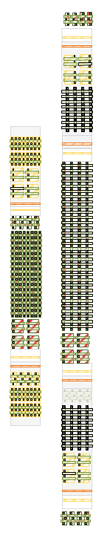
Decoder Routable with ATF metal stack
 |  | Unipolar 2T |  |  |  | Bipolar 3T |  |  |  |  |  |  |  | U2B
 |  | M (# of fingers) | W | L |  | M (# of fingers) | W | L |  |  | Unipolar 2T |  | Bipolar 3T | scope difference
LMIN |  |  |  |  |  |  |  |  |  | 1: N | dum^2 | 1: N | dum^2
W LXS - rowmux | NHV | 1.0 | 8.52 | 7 | NHV | 1.0 | 3.16 | 7 |  | 1 | 161.9 | 1 | 129.1 | y
W LXD/LYD - rowmux | PHV | 1.0 | 3.16 | 8 | NHV | 1.0 | 3.16 | 5.52 |  | 1 | 86.3 | 1 | 113.2 | y
W LYS - rowmux | PHV |  |  |  | PHV | 1.0 | 3.16 | 7 |  |  |  | 1 | 150.6 | y
W LXS - colmux | NHV |  |  |  | NHV | 1.0 | 3.16 | 7 |  |  |  | 1 | 129.1 | y
W LXD/LYD - colmux | NHV | 1.0 | 3.16 | 5.52 | NHV | 1.0 | 3.16 | 5.52 |  | 1 | 73.0 | 1 | 113.2 | y
W LYS - colmux | PHV | 1.0 | 8.52 | 7 | PHV | 1.0 | 3.16 | 7 |  | 1 | 161.9 | 1 | 150.6 | y
W GXS - rowmux | NHV | 1.0 | 15.02 | 7 | NHV | 1.0 | 8.52 | 7 |  | 32 | 9.7 | 8 | 36.8 | n
W GXD - rowmux | NHV | 1.0 | 4.24 | 7 | PHV | 1.0 | 4.24 | 7 |  | 32 | 4.6 | 8 | 18.6 | n
W GYS - rowmux |  |  |  |  | PHV | 1.0 | 8.52 | 7 |  |  |  | 4 | 53.3 | n
W GYD - rowmux |  |  |  |  | NHV | 1.0 | 3.16 | 9.7 |  |  |  | 4 | 39.0 | n
W GXS - colmux |  |  |  |  | NHV | 1.0 | 8.52 | 7 |  |  |  | 8 | 26.7 | n
W GXD - colmux |  |  |  |  | PHV | 1.0 | 4.24 | 7 |  |  |  | 8 | 18.6 | n
W GYS - colmux | PHV | 1.0 | 20.38 | 7 | PHV | 1.0 | 8.52 | 7 |  | 32 | 12.3 | 4 | 53.3 | n
W GYD - colmux | NHV | 1.0 | 3.16 | 9.7 | NHV | 1.0 | 3.16 | 9.7 |  | 32 | 4.9 | 4 | 39.0 | n
Foot print in dum^2 for 1 decoder. Local only |  |  |  |  |  |  |  |  |  |  | 483.0 |  | 785.9
Foot print in dum^2 for 1 decoder. Local + Global |  |  |  |  |  |  |  |  |  |  | 514.5 |  | 1071.1
Foot print normalized to Unipolar 2T |  |  |  |  |  |  |  |  |  |  | 1X |  | 2.08X

Slide 28
Boundary condition assumptions
BOUNDARY CONDITIONS:
Process Tech: P1241
33.5 Cell pitch
ATF CMOS Collateral – metal stack + transistors
Pending: LXD=3.16/5.52 LMIN End of Week. iOFF meets requirements.
BiSM Algo. Read/Write already defined.
Die density : 128 tile/part 32 partitions 4Kx4Kx4 32G
What I can Change
Circuit arch
Decoder Arch 3T/ 2T float etc.
Decoder layout topology inc Routing & sizes of devices. W only
Tile logic : Circuits needed to enable bipolar operation
Algo dependent circuit simplification
Layout change included for above changes.

Slide 29
Path1 is shown today ….
Path 1 – 3T decoder: footprint analysis based on CMOS and Interconnect for fast fail or decision path
Path 2 – 2T decoder with neighboring deselect ground: will it work? if pass, footprint analysis
Path 3 – 2T decoder with deselect float: same critical milestone above.

Slide 30
ATF Decoder
background
M4 @ 2X pitch AM0/7 (red)
AM0/7 Cell pitch (blue)
32 + 32 M4 offset at middle of the decoder.
32 decoders in top half 32 decoders in bot half
Decoders connect to M4

Slide 31
1.63x decoder includes tracks to
Route 32 gpsel
Not in pitch cell
Not in pitch cell
Unipolar to Bipolar step by step.

Slide 32
Backup

Slide 33
Unipolar to Bipolar
N + P 8.52 → 3.16 x 2
(3.16+2.2)*2 = 8.52+2.2
64*0.67 = 42.88
42.88/1 →??
42.88/2 →??
42.88/4 --> 8.52 routable but 1.63x Foot print
42.88/8 →3.16 metal pitch problem, not routable with current metal stack, 1.12x footprint →
Plus Additional Global → cut gr + gbl in half
N 8.52 →VG increases fits and routable
Bias point change → rel + energy

Slide 34
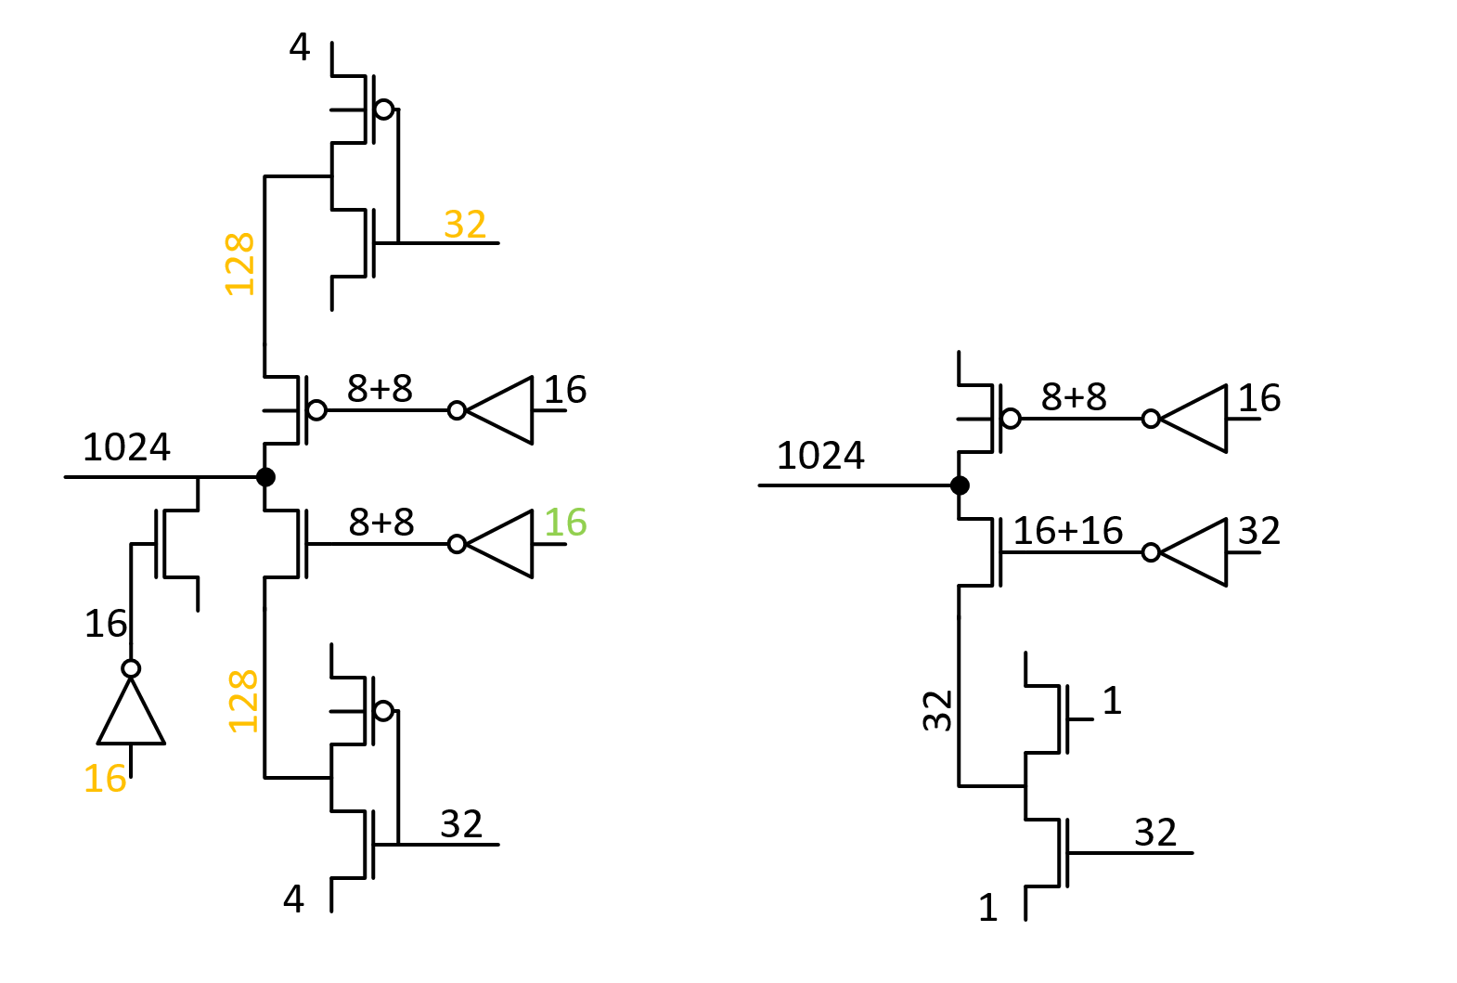
3T Bipolar vs 2T unipolar Decoder
3T requires extra tracks (red)
Pbm#2 32 extra partition tracks/patch: 128 tracks/tile/direction
Pbm#1 128+128 (8+8/pitch-cell)
Bipolar
Unipolar

Slide 35
3T Bipolar vs 2T unipolar Decoder
Pbm#1 8+8-4=12 extra global nodes in 3T, with no metal available.
Short 12 tracks here.
8/pitch-cell
8/pitch-cell
Metal | Pitch | Count | ATF usage | BiSM usage
M1 | 3 | 14 | 4 LWL | 8 LBWL + 6 Free
M2 | 2.68 | 16 | 4 LWL + 4 GWL + 8 Feedthrus | 8 LBWL + 8 Feedthrus
M3 | 2.68 | 16 | 0: ortho direction | 0: ortho direction
M4 | 1.34 | 32 | All used for LWL | All used for LBWL

Slide 36
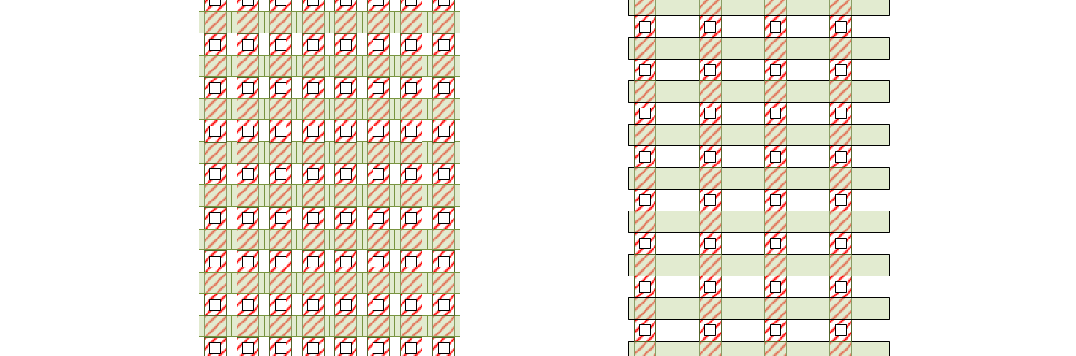

Pbm#1
Metal | Pitch | ATF usage | BiSM usage
M1/V/Con | 3/2.68 | 4L | 8 L + 8G
M2 | 2.68/2.38 | 4 L + 4 G + 8 F | 8 L + 10 F
M3 | 2.68/2.38 | 0: ortho direction | 0: ortho direction
M4 | 1.34 | 64 | 64
One approach to solving the first route problem is to add die size.
I move the locals to a relaxed pitch from 8 per pitch cell to 4 per pitch cell and make two copied of the global decode this allows me to route the
GN/GP routes.
L
G
L
0
L
G
L
0
L

Slide 37
Decoder Routable with ATF metal stack
 |  | Unipolar 2T |  |  |  | Bipolar 3T |  |  |  |  |  |  |  | U2B
 |  | M (# of fingers) | W | L |  | M (# of fingers) | W | L |  |  | Unipolar 2T |  | Bipolar 3T | scope difference
LMIN |  |  |  |  |  |  |  |  |  | 1: N | dum^2 | 1: N | dum^2
W LXS - rowmux | NHV | 1.0 | 8.52 | 7 | NHV | 1.0 | 3.16 | 7 |  | 1 | 161.9 | 1 | 129.1 | y
W LXD/LYD - rowmux | PHV | 1.0 | 3.16 | 8 | NHV | 1.0 | 3.16 | 5.52 |  | 1 | 86.3 | 1 | 113.2 | y
W LYS - rowmux | PHV |  |  |  | PHV | 1.0 | 3.16 | 7 |  |  |  | 1 | 150.6 | y
W LXS - colmux | NHV |  |  |  | NHV | 1.0 | 3.16 | 7 |  |  |  | 1 | 129.1 | y
W LXD/LYD - colmux | NHV | 1.0 | 3.16 | 5.52 | NHV | 1.0 | 3.16 | 5.52 |  | 1 | 73.0 | 1 | 113.2 | y
W LYS - colmux | PHV | 1.0 | 8.52 | 7 | PHV | 1.0 | 3.16 | 7 |  | 1 | 161.9 | 1 | 150.6 | y
W GXS - rowmux | NHV | 1.0 | 15.02 | 7 | NHV | 1.0 | 8.52 | 7 |  | 32 | 9.7 | 8 | 36.8 | n
W GXD - rowmux | NHV | 1.0 | 4.24 | 7 | PHV | 1.0 | 4.24 | 7 |  | 32 | 4.6 | 8 | 18.6 | n
W GYS - rowmux |  |  |  |  | PHV | 1.0 | 8.52 | 7 |  |  |  | 4 | 53.3 | n
W GYD - rowmux |  |  |  |  | NHV | 1.0 | 3.16 | 9.7 |  |  |  | 4 | 39.0 | n
W GXS - colmux |  |  |  |  | NHV | 1.0 | 8.52 | 7 |  |  |  | 8 | 26.7 | n
W GXD - colmux |  |  |  |  | PHV | 1.0 | 4.24 | 7 |  |  |  | 8 | 18.6 | n
W GYS - colmux | PHV | 1.0 | 20.38 | 7 | PHV | 1.0 | 8.52 | 7 |  | 32 | 12.3 | 4 | 53.3 | n
W GYD - colmux | NHV | 1.0 | 3.16 | 9.7 | NHV | 1.0 | 3.16 | 9.7 |  | 32 | 4.9 | 4 | 39.0 | n
Foot print in dum^2 for 1 decoder. Local only |  |  |  |  |  |  |  |  |  |  | 483.0 |  | 785.9
Foot print in dum^2 for 1 decoder. Local + Global |  |  |  |  |  |  |  |  |  |  | 514.5 |  | 1071.1
Foot print normalized to Unipolar 2T |  |  |  |  |  |  |  |  |  |  | 1X |  | 2.08X

Slide 38
Diffusion limited decoder.
 |  | Unipolar 2T |  |  |  | Bipolar 3T |  |  |  |  |  |  |  | U2B
 |  | M (# of fingers) | W | L |  | M (# of fingers) | W | L |  |  | Unipolar 2T |  | Bipolar 3T | scope difference
LMIN |  |  |  |  |  |  |  |  |  | 1: N | dum^2 | 1: N | dum^2
W LXS - rowmux | NHV | 1.0 | 8.52 | 7 | NHV | 1.0 | 3.16 | 7 |  | 1 | 161.9 | 1 | 64.3 | y
W LXD/LYD - rowmux | PHV | 1.0 | 3.16 | 8 | NHV | 1.0 | 3.16 | 5.52 |  | 1 | 86.3 | 1 | 56.4 | y
W LYS - rowmux | PHV |  |  |  | PHV | 1.0 | 3.16 | 7 |  |  |  | 1 | 75.0 | y
W LXS - colmux | NHV |  |  |  | NHV | 1.0 | 3.16 | 7 |  |  |  | 1 | 64.3 | y
W LXD/LYD - colmux | NHV | 1.0 | 3.16 | 5.52 | NHV | 1.0 | 3.16 | 5.52 |  | 1 | 73.0 | 1 | 56.4 | y
W LYS - colmux | PHV | 1.0 | 8.52 | 7 | PHV | 1.0 | 3.16 | 7 |  | 1 | 161.9 | 1 | 75.0 | y
W GXS - rowmux | NHV | 1.0 | 15.02 | 7 | NHV | 1.0 | 8.52 | 7 |  | 32 | 9.7 | 8 | 26.7 | n
W GXD - rowmux | NHV | 1.0 | 4.24 | 7 | PHV | 1.0 | 4.24 | 7 |  | 32 | 4.6 | 8 | 18.6 | n
W GYS - rowmux |  |  |  |  | PHV | 1.0 | 8.52 | 7 |  |  |  | 8 | 26.7 | n
W GYD - rowmux |  |  |  |  | NHV | 1.0 | 3.16 | 9.7 |  |  |  | 8 | 19.5 | n
W GXS - colmux |  |  |  |  | NHV | 1.0 | 8.52 | 7 |  |  |  | 8 | 26.7 | n
W GXD - colmux |  |  |  |  | PHV | 1.0 | 4.24 | 7 |  |  |  | 8 | 18.6 | n
W GYS - colmux | PHV | 1.0 | 20.38 | 7 | PHV | 1.0 | 8.52 | 7 |  | 32 | 12.3 | 8 | 26.7 | n
W GYD - colmux | NHV | 1.0 | 3.16 | 9.7 | NHV | 1.0 | 3.16 | 9.7 |  | 32 | 4.9 | 8 | 19.5 | n
Foot print in dum^2 for 1 decoder. Local only |  |  |  |  |  |  |  |  |  |  | 483.0 |  | 391.5
Foot print in dum^2 for 1 decoder. Local + Global |  |  |  |  |  |  |  |  |  |  | 514.5 |  | 574.2
Foot print normalized to Unipolar 2T |  |  |  |  |  |  |  |  |  |  | 1X |  | 1.12X

Slide 39
3T Bipolar vs 2T unipolar Decoder
3T requires extra tracks (red)
Pbm#2 32 extra partition tracks
Pbm#1 128+128 (8+8/pitch-cell)
Bipolar
Unipolar

Slide 40
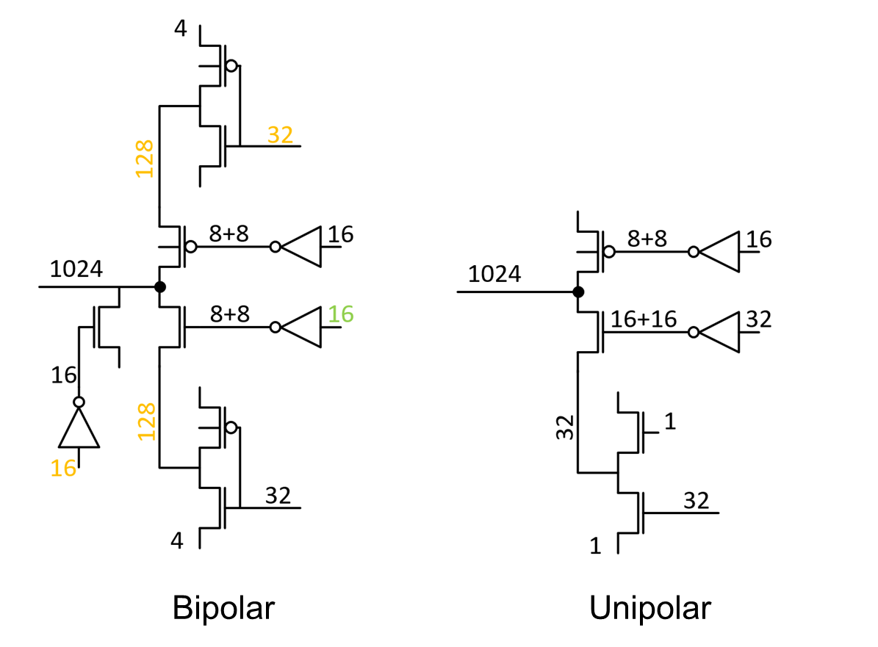
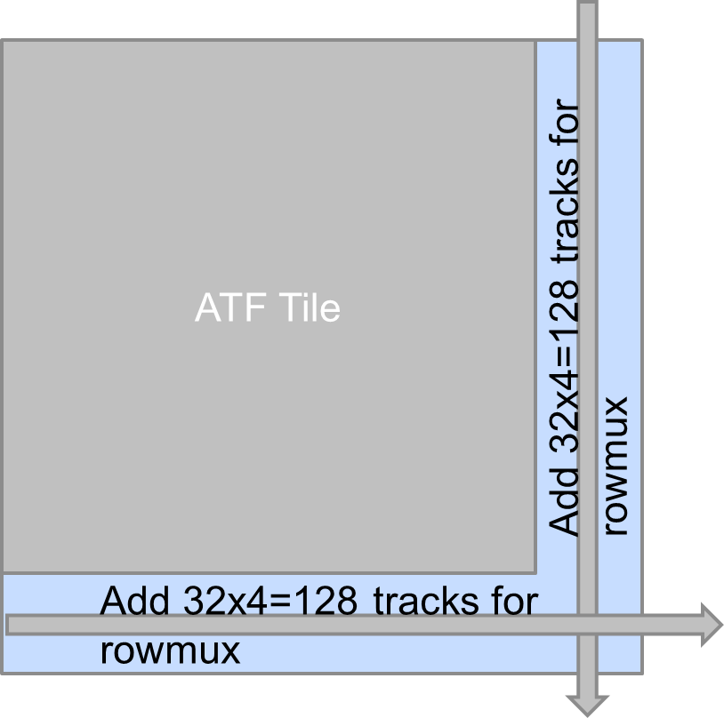
3T Bipolar vs 2T unipolar Decoder
Pbm#2 32 extra global nodes in 3T, with no metal available.
ATF is balanced metal vs diffusion
Solution: grow tile size
16+16=32

Slide 41
Pbm#2 -
ATF Tile
3000^2
3343^2
Add 32x4=128 tracks for
rowmux
Add 32x4=128 tracks for
rowmux

Slide 42
Updated Die size
226mm^2 is a showstopper
My recommendations is to add metals not grow diffusion.

