Slide 1
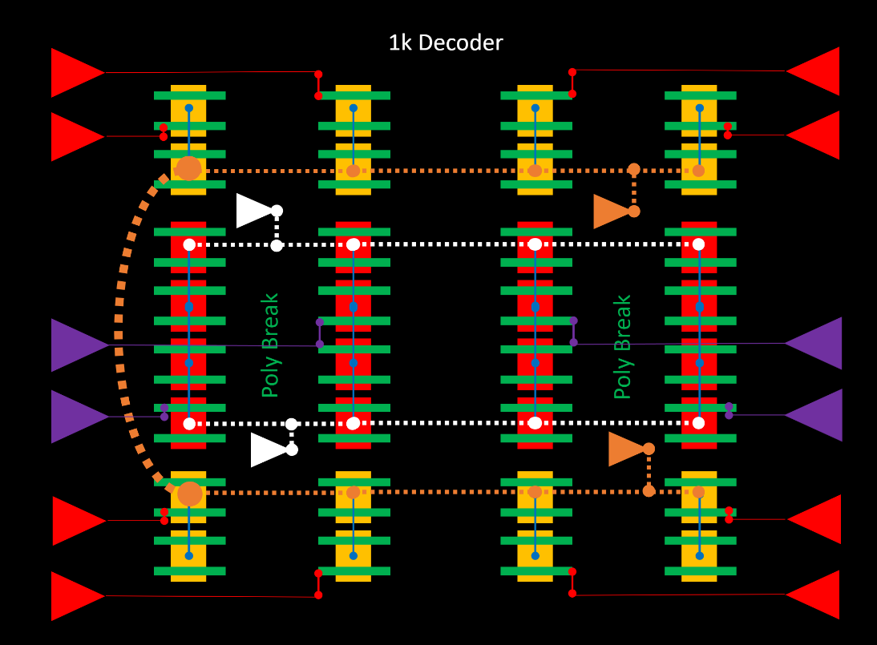
BiSM Decoder
Learning Q2
Key learning: compact decoder enabling bipolar cell operation.
  Assumption is floating of deselected rows and columns.
Strategies deployed:
  Rebalance Pre-driver to Global Driver counts to reduce decoder footprint. Achieved thru poly breaks.
  Smaller select device size needed to support lower BiSM cell current compare with ATF.
  Metal stack: M1/M2/M3 at 8F + added metal to allow tile route-ability.
  Double up Global P decoder to minimize metal stack.
Unoptimized Die size estimates: For 32G ATF like die are ~137mm^2
  using ATF transistors-Design rules, with an enhanced metal stack requirements.
Optimization is work in progress & addressing float assumptions are next.
ACK:Mase/Derchang/Eddie/Balaji

