Slide 1
Ww01-02 2021
Tile with 3T bipolar read/write decoding.
  CMOS limited dies size: ATF all the M1 ( contact included )
  routing limited die size M1 port (Via1) to AM socket )
  Energy (Next)
 | decoder | xtor per decoder pitch | dec FP | ATF CMOS + Mtl | summary | die size | Notes
 |  |  |  |  |  | mm^2
reference: 3dxp -balanced metal/diffusion | unipolar | 4 xtr / pitch cell | 1x | yes | product | 133.66 | reference
diffusion limited die size - M1 & below | bipolar 3t | 4 xtr / pitch cell | 1.63x | yes | include | 192.09 | atf cmos + metal --> diffusion limited
diffusion limited die size - M1 & below | bipolar 3t | 8 xtr / pitch cell | 1.12x | no | zbb | 153.40 | need M1/M2/M3 to be 16 track/pitch cell
diffusion limited die size - M1 & below + Mtl stack | bipolar 3t | 4 xtr / pitch cell | 1.63x | yes | include | 192.09 | atf cmos + metal --> metl + diffusion limited

Slide 2
Details
Decoder FP | Die size | Tile Area/Tile array area | notes | Tile X | Tile Y | extra/ direction | Area
ratio | mm^2 | ratio to unipolar |  | L | L | L | L^2
0.85 | 132.9 | 0.99
0.86 | 133.7 | 1.00 | match unipolar die size | 3002 | 2969 | 0 | 8912938
0.9 | 136.7 | 1.03
0.95 | 140.5 | 1.07
1 | 144.3 | 1.10 | die size if decoder matches unipolar foot print | 3141 | 3108 | 139 | 9762228
1.05 | 148.1 | 1.14
1.1 | 151.9 | 1.17
1.12 | 153.4 | 1.19 | 3t decoder with 8 transistor/pitch cell; need M1/M2/M3 at finer pitch; non starter | 3272 | 3239 | 270 | 10598008
1.15 | 155.7 | 1.21
1.2 | 159.5 | 1.25
1.25 | 163.3 | 1.28
1.3 | 167.1 | 1.32
1.35 | 170.8 | 1.36
1.4 | 174.6 | 1.39
1.45 | 178.4 | 1.43
1.5 | 182.2 | 1.46
1.55 | 186.0 | 1.50
1.6 | 189.8 | 1.54
1.63 | 192.1 | 1.56 | atf process 3T decoder with diffusion limited foot print, uses 4 xtor per pitchcell the 740 L per side covers the 128 extra tracks needed to support extra partition routes needed by the M2/M3 decoder. | 3742 | 3709 | 740 | 13879078
1.65 | 193.6 | 1.57
1.7 | 197.4 | 1.61
1.75 | 201.2 | 1.65

Slide 3
Backup

Slide 4
 |  |  |  | 33.5
 |  |  |  | Bipolar |  | Unipolar
Function | Sub block | Synergy - simplest change to functioning bism |  | l² | Occupancy [%] | l² | Occupancy [%]
FOOT PRINT |  |  |  | 13896351 | 155.9% | 8913071 | 100.0%
ROWMUX |  | dedicated 3t decoder - this is new design, even with 33.5 | paper | 5273882 | 59.2% | 3235510 | 36.3%
COLMUX |  | dedicated 3t decoder - this is new design, even with 33.5 | paper | 5273882 | 59.2% | 2986803 | 33.5%
2X2 LOGIC |  |  |  | 1386388 | 15.6% | 788352 | 8.8%
 | blsupmux | minor re-layout/size change fit |  | 55892 | 0.6% | 111784 | 1.3%
 | axn sw | minor re-layout/size change fit, 2 x count needed cannot share vertically, horizontally only diagonally in 2x2 patch, same as s24 |  | 336000 | 3.8% | 168000 | 1.9%
 | hnreg sw | minor re-layout/size change fit, 2 x count needed cannot share vertically, horizontally only diagonally in 2x2 patch, same as s24 |  | 304064 | 3.4% | 152032 | 1.7%
 | gwl_gnd | may not be needed for full cmos global selects. Wip |  | 273568 | 3.1% | 136784 | 1.5%
 | gbl gnd | may not be needed for full cmos global selects. Wip |  | 218080 | 2.4% | 109040 | 1.2%
 | and3 | 2x count, bl/wl ccell - same as S24 config |  | 31248 | 0.4% | 15624 | 0.2%
 | ccellbias | 2x count, bl/wl ccell - same as S24 config |  | 144896 | 1.6% | 72448 | 0.8%
 | guardring | no change, can reuse with minor tweeks |  | 22640 | 0.3% | 22640 | 0.3%
TILE LOGIC |  |  |  | 1761655 | 19.8% | 1489824 | 16.7%
 | iref | minor re-layout/size change fit |  | 374234 | 4.2% | 374234 | 4.2%
 | blvdm_mux | minor re-layout/size change fit |  | 381470 | 4.3% | 381470 | 4.3%
 | tko_bl | minor re-layout/size change fit |  | 17116 | 0.2% | 17116 | 0.2%
 | tko_wl | minor re-layout/size change fit |  | 40158 | 0.5% | 40158 | 0.5%
 | tilelogic_bl | partial redesign witl bipolar algo |  | 101437 | 1.1% | 101437 | 1.1%
 | masklogic_bl | minor re-layout/size change fit |  | 90432 | 1.0% | 90432 | 1.0%
 | data_lat | minor re-layout/size change fit |  | 49560 | 0.6% | 49560 | 0.6%
 | masklogic_wl | minor re-layout/size change fit |  | 54302 | 0.6% | 54302 | 0.6%
 | tilelogic_wl | partial redesign witl bipolar algo |  | 69176 | 0.8% | 69176 | 0.8%
 | lwlselv_mux | resize and double circuit count in same layout foot print |  | 487264 | 5.5% | 243632 | 2.7%
 | wl_supmux | minor re-layout/size change fit |  | 56398 | 0.6% | 28199 | 0.3%
 | capacitor | minor re-layout/size change fit |  | 40108 | 0.4% | 40108 | 0.4%
FREE SPACE |  |  |  | -40108 | -0.4% | 171351 | 1.9%
SLIVER |  |  |  | 240653 | 2.7% | 241231 | 2.7%
tile logic + 2 x 2 logic |  |  |  |  | 35.3% |  | 25.6%
 |  | Tile area |  | 13896351 | L^2 | 8913071
 |  | Tile Count X per partition |  | 16.75 | # | 16.75
 |  | Tile Count Y per partition |  | 8.75 | # | 8.75
 |  | Tile Count XY inc Term |  | 146.56 | # | 146.56
 |  | Partition area + term |  | 2036683950 | # | 1306321984
 |  | Partition area + term |  | 5.0917 | L^2 | 3.2658
 |  | Ptn overhead (pcl, decoders etc.), assumes extra gx/gy decoders shrink to fit in same area, need estimate to upsize - wip |  | 0.3733 | mm^2 | 0.3733
 |  | Partition count |  | 32 | # | 32
 |  | Core area |  | 174.9 | mm^2 | 116.5
 |  | IO+Periphery area |  | 17.2 | mm^2 | 17.2
 |  | Die size |  | 192.1 | mm^2 | 133.7

Slide 5
Boundary condition assumptions
BOUNDARY CONDITIONS:
Process Tech: P1241
  33.5 Cell pitch
  ATF CMOS Collateral – metal stack + transistors
  Pending: LXD=3.16/5.52 LMIN End of Week. iOFF meets requirements.
BiSM Algo. Read/Write already defined.
Die density : 128 tile/part 32 partitions 4Kx4Kx4 32G
What I can Change
Circuit arch
  Decoder Arch 3T/ 2T float etc.
  Decoder layout topology inc Routing & sizes of devices. W only
  Tile logic : Circuits needed to enable bipolar operation
    Algo dependent circuit simplification
    Layout change included for above changes.

Slide 6
Path1 is shown today ….
Path 1 – 3T decoder: footprint analysis based on CMOS and Interconnect for fast fail or decision path
Path 2 – 2T decoder with neighboring deselect ground: will it work? if pass, footprint analysis
Path 3 – 2T decoder with deselect float: same critical milestone above.

Slide 7
ATF Decoder
background
M4 @ 2X pitch AM0/7
(red)
AM0/7 Cell pitch
(blue)
32 + 32 M4 offset at
middle of the decoder.
32 decoders in top half
32 decoders in bot half
Decoders connect to M4

Slide 8
1.63x decoder
includes tracks to
Route 32 gpsel
Not in pitch cell
Not in pitch cell
Unipolar to Bipolar step by step.

Slide 9
Backup

Slide 10
Unipolar to Bipolar
N + P 8.52 → 3.16 x 2
  (3.16+2.2)*2 = 8.52+2.2
  64*0.67 = 42.88
    42.88/1 →??
    42.88/2 →??
    42.88/4 --> 8.52 routable but 1.63x Foot print
    42.88/8 →3.16 metal pitch problem, not routable with current metal stack, 1.12x footprint →
  Plus Additional Global → cut gr + gbl in half
N 8.52 →VG increases fits and routable
  Bias point change → rel + energy

Slide 11
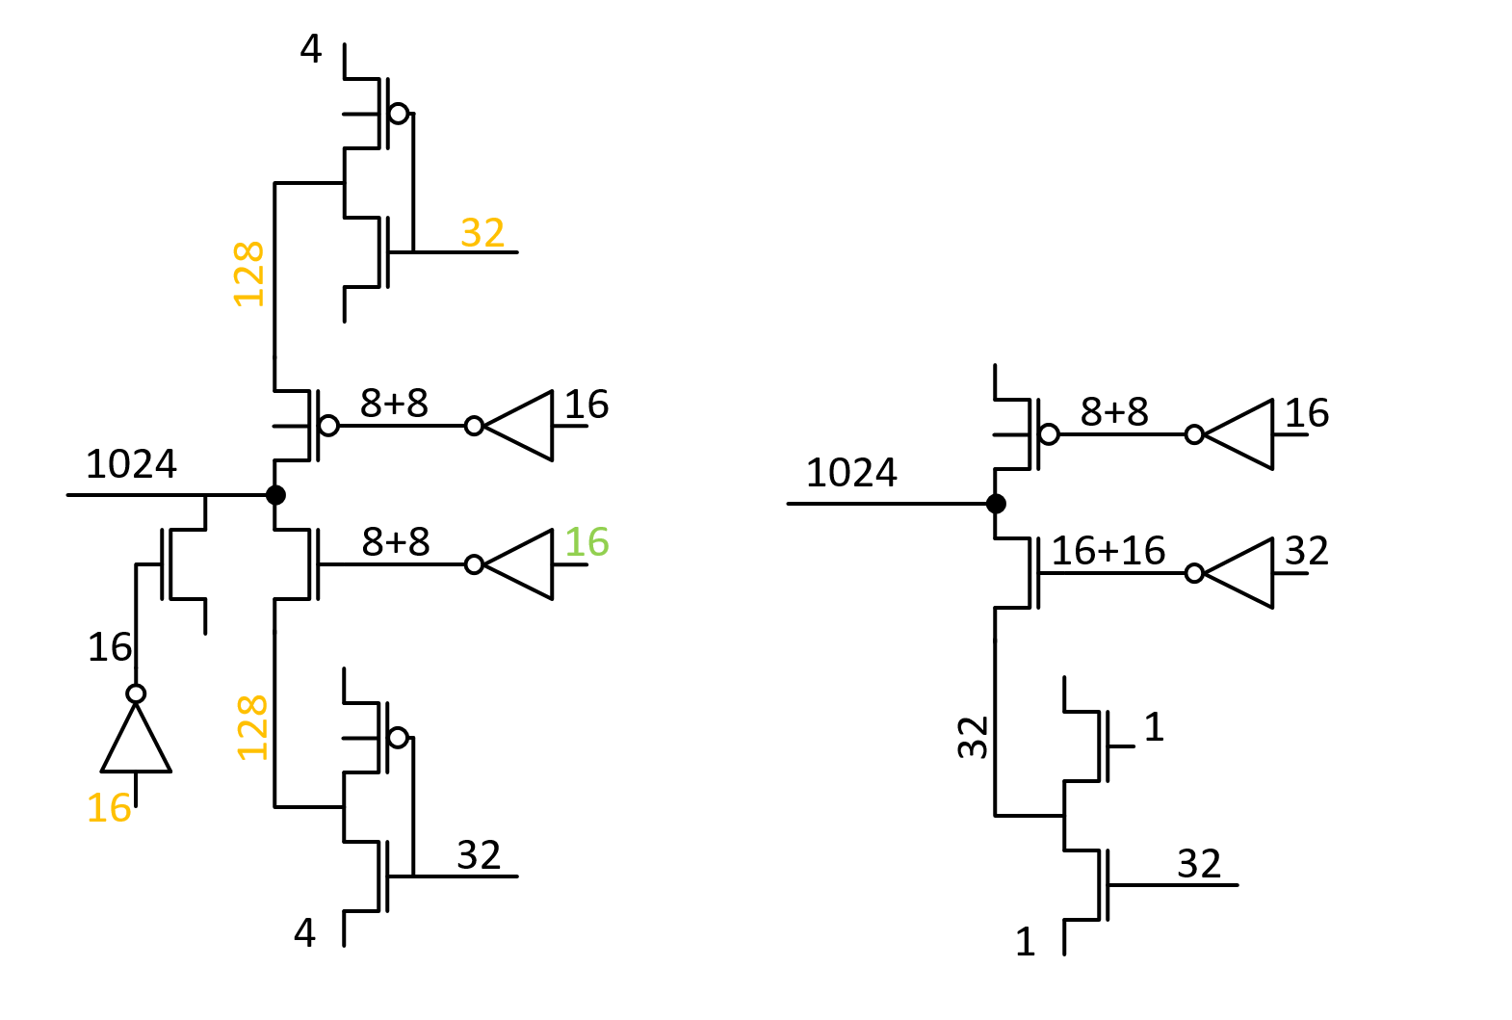
3T Bipolar vs 2T unipolar Decoder
3T requires extra tracks (red)
  Pbm#2 32 extra partition
  tracks/patch: 128 tracks/tile/direction
  Pbm#1 128+128 (8+8/pitch-cell)
Bipolar
Unipolar

Slide 12
3T Bipolar vs 2T unipolar Decoder
Pbm#1 8+8-4=12 extra global
nodes in 3T, with no metal
available.
Short 12 tracks here.
8/pitch-cell
8/pitch-cell
Metal | Pitch | Count | ATF usage | BiSM usage
M1 | 3 | 14 | 4 LWL | 8 LBWL + 6 Free
M2 | 2.68 | 16 | 4 LWL + 4 GWL + 8 Feedthrus | 8 LBWL + 8 Feedthrus
M3 | 2.68 | 16 | 0: ortho direction | 0: ortho direction
M4 | 1.34 | 32 | All used for LWL | All used for LBWL

Slide 13
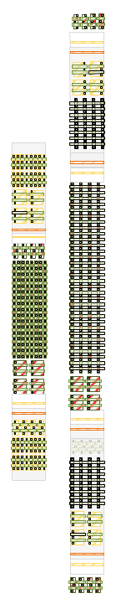
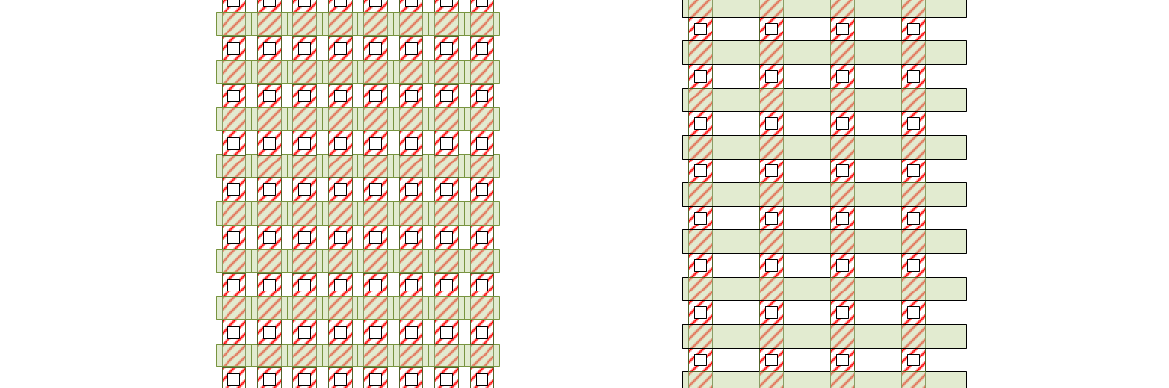
Pbm#1
One approach to solving the first route problem is to add die size.
I move the locals to a relaxed pitch from 8 per pitch cell to 4 per pitch cell
and make two copied of the global decode this allows me to route the
GN/GP routes.

Slide 14
Decoder Routable with ATF metal stack
 |  | Unipolar 2T |  |  |  | Bipolar 3T |  |  |  |  |  |  |  | U2B
 |  | M (# of fingers) | W | L |  | M (# of fingers) | W | L |  |  | Unipolar 2T |  | Bipolar 3T | scope difference
LMIN |  |  |  |  |  |  |  |  |  | 1: N | dum^2 | 1: N | dum^2
W LXS - rowmux | NHV | 1.0 | 8.52 | 7 | NHV | 1.0 | 3.16 | 7 |  | 1 | 161.9 | 1 | 129.1 | y
W LXD/LYD - rowmux | PHV | 1.0 | 3.16 | 8 | NHV | 1.0 | 3.16 | 5.52 |  | 1 | 86.3 | 1 | 113.2 | y
W LYS - rowmux | PHV |  |  |  | PHV | 1.0 | 3.16 | 7 |  |  |  | 1 | 150.6 | y
W LXS - colmux | NHV |  |  |  | NHV | 1.0 | 3.16 | 7 |  |  |  | 1 | 129.1 | y
W LXD/LYD - colmux | NHV | 1.0 | 3.16 | 5.52 | NHV | 1.0 | 3.16 | 5.52 |  | 1 | 73.0 | 1 | 113.2 | y
W LYS - colmux | PHV | 1.0 | 8.52 | 7 | PHV | 1.0 | 3.16 | 7 |  | 1 | 161.9 | 1 | 150.6 | y
W GXS - rowmux | NHV | 1.0 | 15.02 | 7 | NHV | 1.0 | 8.52 | 7 |  | 32 | 9.7 | 8 | 36.8 | n
W GXD - rowmux | NHV | 1.0 | 4.24 | 7 | PHV | 1.0 | 4.24 | 7 |  | 32 | 4.6 | 8 | 18.6 | n
W GYS - rowmux |  |  |  |  | PHV | 1.0 | 8.52 | 7 |  |  |  | 4 | 53.3 | n
W GYD - rowmux |  |  |  |  | NHV | 1.0 | 3.16 | 9.7 |  |  |  | 4 | 39.0 | n
W GXS - colmux |  |  |  |  | NHV | 1.0 | 8.52 | 7 |  |  |  | 8 | 26.7 | n
W GXD - colmux |  |  |  |  | PHV | 1.0 | 4.24 | 7 |  |  |  | 8 | 18.6 | n
W GYS - colmux | PHV | 1.0 | 20.38 | 7 | PHV | 1.0 | 8.52 | 7 |  | 32 | 12.3 | 4 | 53.3 | n
W GYD - colmux | NHV | 1.0 | 3.16 | 9.7 | NHV | 1.0 | 3.16 | 9.7 |  | 32 | 4.9 | 4 | 39.0 | n
Foot print in dum^2 for 1 decoder. Local only |  |  |  |  |  |  |  |  |  |  | 483.0 |  | 785.9
Foot print in dum^2 for 1 decoder. Local + Global |  |  |  |  |  |  |  |  |  |  | 514.5 |  | 1071.1
Foot print normalized to Unipolar 2T |  |  |  |  |  |  |  |  |  |  | 1X |  | 2.08X

Slide 15
Diffusion limited decoder.
 |  | Unipolar 2T |  |  |  | Bipolar 3T |  |  |  |  |  |  |  | U2B
 |  | M (# of fingers) | W | L |  | M (# of fingers) | W | L |  |  | Unipolar 2T |  | Bipolar 3T | scope difference
LMIN |  |  |  |  |  |  |  |  |  | 1: N | dum^2 | 1: N | dum^2
W LXS - rowmux | NHV | 1.0 | 8.52 | 7 | NHV | 1.0 | 3.16 | 7 |  | 1 | 161.9 | 1 | 64.3 | y
W LXD/LYD - rowmux | PHV | 1.0 | 3.16 | 8 | NHV | 1.0 | 3.16 | 5.52 |  | 1 | 86.3 | 1 | 56.4 | y
W LYS - rowmux | PHV |  |  |  | PHV | 1.0 | 3.16 | 7 |  |  |  | 1 | 75.0 | y
W LXS - colmux | NHV |  |  |  | NHV | 1.0 | 3.16 | 7 |  |  |  | 1 | 64.3 | y
W LXD/LYD - colmux | NHV | 1.0 | 3.16 | 5.52 | NHV | 1.0 | 3.16 | 5.52 |  | 1 | 73.0 | 1 | 56.4 | y
W LYS - colmux | PHV | 1.0 | 8.52 | 7 | PHV | 1.0 | 3.16 | 7 |  | 1 | 161.9 | 1 | 75.0 | y
W GXS - rowmux | NHV | 1.0 | 15.02 | 7 | NHV | 1.0 | 8.52 | 7 |  | 32 | 9.7 | 8 | 26.7 | n
W GXD - rowmux | NHV | 1.0 | 4.24 | 7 | PHV | 1.0 | 4.24 | 7 |  | 32 | 4.6 | 8 | 18.6 | n
W GYS - rowmux |  |  |  |  | PHV | 1.0 | 8.52 | 7 |  |  |  | 8 | 26.7 | n
W GYD - rowmux |  |  |  |  | NHV | 1.0 | 3.16 | 9.7 |  |  |  | 8 | 19.5 | n
W GXS - colmux |  |  |  |  | NHV | 1.0 | 8.52 | 7 |  |  |  | 8 | 26.7 | n
W GXD - colmux |  |  |  |  | PHV | 1.0 | 4.24 | 7 |  |  |  | 8 | 18.6 | n
W GYS - colmux | PHV | 1.0 | 20.38 | 7 | PHV | 1.0 | 8.52 | 7 |  | 32 | 12.3 | 8 | 26.7 | n
W GYD - colmux | NHV | 1.0 | 3.16 | 9.7 | NHV | 1.0 | 3.16 | 9.7 |  | 32 | 4.9 | 8 | 19.5 | n
Foot print in dum^2 for 1 decoder. Local only |  |  |  |  |  |  |  |  |  |  | 483.0 |  | 391.5
Foot print in dum^2 for 1 decoder. Local + Global |  |  |  |  |  |  |  |  |  |  | 514.5 |  | 574.2
Foot print normalized to Unipolar 2T |  |  |  |  |  |  |  |  |  |  | 1X |  | 1.12X

Slide 16
3T Bipolar vs 2T unipolar Decoder
3T requires extra tracks (red)
  Pbm#2 32 extra partition tracks
  Pbm#1 128+128 (8+8/pitch-cell)
Bipolar
Unipolar

Slide 17
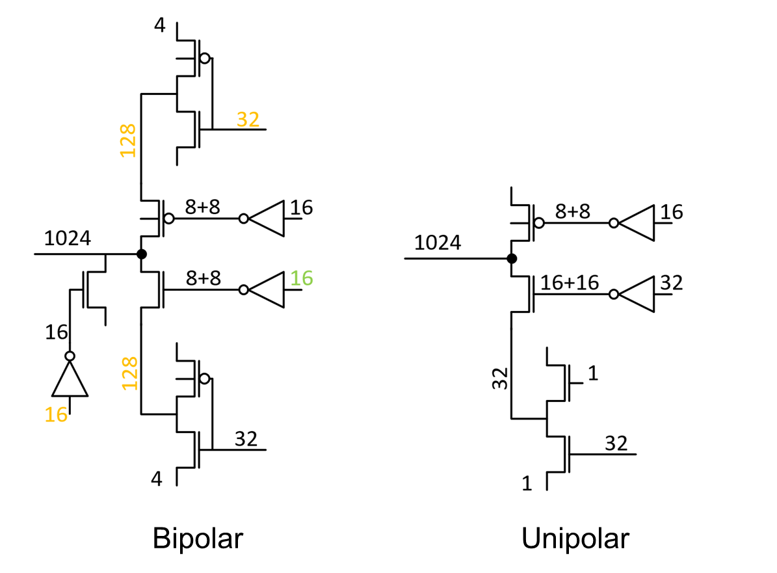
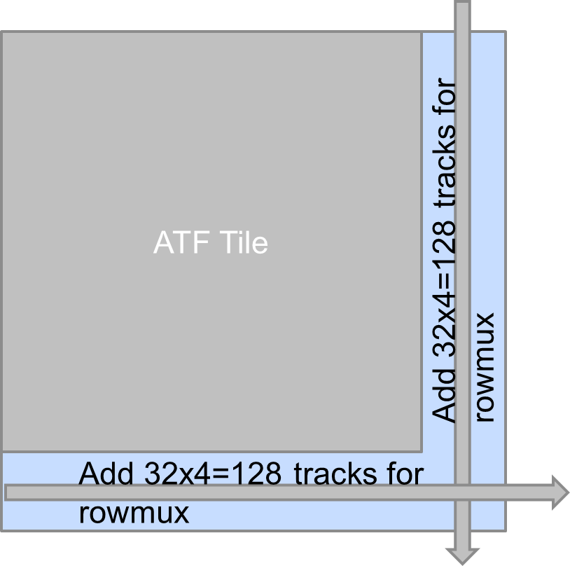
3T Bipolar vs 2T unipolar Decoder
Pbm#2 32 extra global
nodes in 3T, with no metal
available.
  ATF is balanced metal
  vs diffusion
Solution: grow tile size
16+16=32

Slide 18
Pbm#2 -
ATF Tile
3000^2
3343^2
Add 32x4=128 tracks for
rowmux
Add 32x4=128 tracks for
rowmux

Slide 19
Updated
Die size
226mm^2 is a showstopper
My recommendations is to
add metals not grow diffusion.

