Slide 1
2T-memory cell Behavior Model
DerChang Kau, Aug/13/2018
Privileged - Prepared under the direction of Legal Counsel
Current Control Memory Switch + 2T Diac – Interface (2D)
Voltage Control Memory Switch + 2T Diad – Filament (1D)

Slide 2
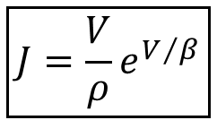
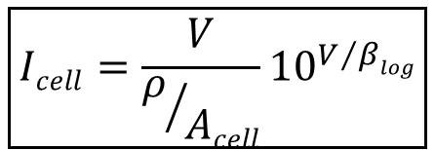
Current Control Memory Switch + 2T Diac – Interface (2D)
$$\boxed{J=\frac{V}{ρ}e^{V/β}}$$
$$\boxed{Icell=\frac{V}{ρ/{Acell}}{10}^{V/{βlog}}}$$

Slide 3
Voltage Control Memory Switch and Diac
R_{ohmic} 1G𝛀 to 1T𝛀
I_{TH} .1μA to 10μA
Set Resistance: 10K𝛀 to 1M𝛀

Slide 4
CBRAM from Sony
Set: <
100K𝛀
Set
Reset
Reset
1R
1S1R

