Slide 1
BISM64 Update
Balaji/Mase/Luo/Divesh/Derchang

Slide 2
 | ATF64 | BISM64_1 | BISM64_2
Density | 512 | 512 | 512 | Gb
Partitions | 64 | 64 | 32 | #
Architecture | 4kx4k | 4kx4k | 8kx4k | Bl x Wl
Select Transistor Type | HV (unipolar) | tgHV (bipolar) | tgHV(bipolar)
Die size | 198 | 269-214 | 198-191 | mm^2
Energy Write | 77 | >80 | ??-80 | mWr in pJ/bit
Energy Read | 28 | >28 | ??-28 | Rd in pJ/bit
BW Wr/Rd | 5400/2200 | 5400/2200 | 5400/2200 | MT/s
Wr Completion time/Rd Latency | 475/95 | 240/95 | 240/95 | Wr/Rd in nS
Problem: Die size >> 198mm^2 at best known TGmos device dimension (P806 HVT Tox=148A, Ldrawn=9.87um, Lg=0.5um)
Forward Strategy:
1.) Change tile size from 4kx4k to 8kx4k to make room for larger tgMOS device. → Enabled by shorter BISM64 write completion time.

Slide 3
Next Steps
Item | Enablers | Issues/Concerns | Impacts | Next Steps
Die Size | 1.) Tgmos 2.) 8Kx4K Tile | 1.) Close on TOX=148A, Wmin/Lmin = 7.16/9.87 2.) BL Leakage increase impact on selection window 2.) Self-consistent energy assessment | 1.+2.) Die Size: 198mm^2 – 192mm^2 | 1a.) Define requirement for Set/Reset currents (ww48) 1b.) Close w/ device on risk (ww48) 2.) BL leakage impact to Selection Window (ww48) 2.) Complete energy assessment (ww48)
Summary:
To achieve die size goal need to align on window w/ technology and close on device requirements w/ process.
Depending on self consistent energy, may need to explore energy reduction items

Slide 4
Backup

Slide 5
8kx4k Pulse current delivery to Far cell
Reduced Set/Reset Pulse current requirement → we can tolerate a longer BL compared with ATF64
 | ATF64 | BISM
HPVPP | 4.85 | 4.85
HNVNN_RST | -3.9 | -3.9
VON cel | 2.6 | 2.6
iPULSE | 6.90E-05 | 5.76E-05 | needs 50
Rcol | 8.91E+04 | 8.91E+04
Rcol 8k bl impact |  | 1.77E+04 | 2048*
Rcol total | 8.91E+04 | 1.07E+05

Slide 6
 | Today | Sub enablers | Owners | Next RO Date | Notes
Thick Gate Xtrs
 | TOX = 148A | Optimal TOX? To support 9.25V | Luo/Divesh | ww48 | Scaled for 9.25V from 10V 160A 806 based process used on TC03
tgNMOS |  |  |  | ww48
 | L=9.87; from 6x148/90 | Optimal L to support iON 50u/25u/7V vdm iOFF 10n | Luo/Divesh/Balaji | ww48 | Local+ Global Stack xtrs to support iON; Lmax of Global needs 12L socket increase from process min
 | WL=7.16 WG=16.95 | Optimal WL & WG? | Luo/Divesh/Balaji | ww48 | WL max limited by cell pitch, WG is 9.21 + 2 x ( 9.87 - 6 ) or socket area grows
 | iON selection=25uA | redux Strategies: cell | Fuga/Derchang | ww48 | 25uA leakage ; simple calculation 8192*2*50%*60%*5
 |  | redux strategies: optimal ccell? | Balaji/Mase | ww48 | 25uA leakage ; simple calculation 8192*2*50%*60%*5
 |  | first fire strategy? Biasing the stack for First fire selection/Seasoning | Derchang/Balaji | ww48
tgPMOS
 | L=8 |  |  |  | Lmax limited to 8 in by cell pitch, but iOFF 100nA
 | W=2.4 | Optimal W? | Luo/Divesh | ww48 | Scaled for 9.25V from 10V 160A 802 based process used on TC03
 |  | VT @ VGS/VDS/VBS: -3.7/0/5 to ground rows | Luo/Divesh | ww48
8k x 4k array
 | 8k bl : BL cell impacts? | 200fF Cap impact on cell | Fuga/Derchang | ww48
 | 8k bl : Sense SNR | will atf64 sense work with reduced SNR due to 8kbl | Balaji | ww48
 | 8k bl: 50uA Pulse delivery | 50uA support for far cell at due to 2k more cells in path | Balaji | ww48
 | Cmos Fit under tile | expanded shift,ccell logic & axn/hnreg swicthes | Balaji/Eddie | ww48
 | partition decoder fit | will the HV decoders fit in area? | Eddie/Balaji | ww48
 | routability | expanded routing for shift/ccell | Eddie | ww48 | it worked on S24S, so this is assigned med low risk
 | Energy |  | Balaji/Mase | ww48 | BL partition decode & tile logic energy goes up, need assesment
240nS write comp time
 | 32 partition array |  |  |  | 50% redux in write comp time --> need 50% ptns as ATF64 for iso BW
 |  | 191mm^2 die < than ATF64 | Balaji | ww48
 |  | package socket fit | Balaji | ww48 | 12.48mm x 15.27mm fits in package socket

Slide 7
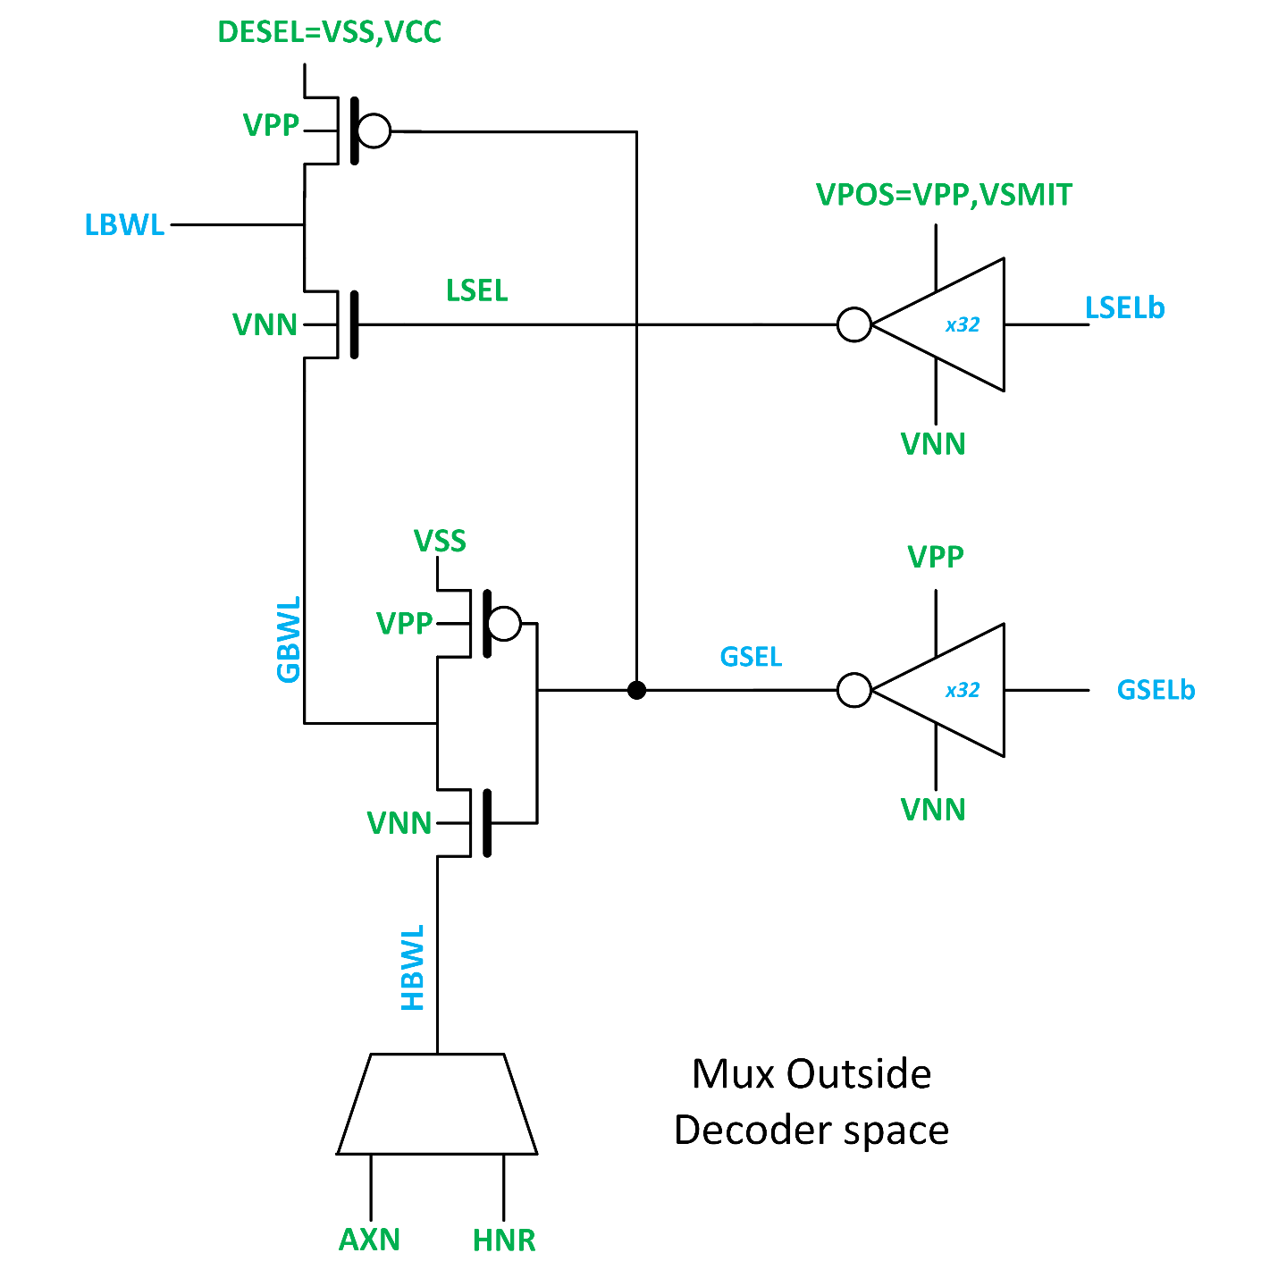
Optimal Decoder Arch for bipolar arch
3.5/3.8tcad
Decode Device Sizes
 | BISM1
 |  | (in Lambda)
Name | type | width | len | m
LDESEL | tgPMOS | 1.4 | 8 | 1
LSEL | tgNMOS | 7.16 | 9.87-7 | 1
GSEL | tgNMOS | 9.21 | 9.87-7 | 2
GDESEL | tgPMOS | 1.4 | 8 | 1
LSEL INV | tgPMOS | 5.14 | 13 | 1
 | tgNMOS | 5.14 | 13 | 1
GSEL INV | tgPMOS | 5.14 | 13 | 1
 | tgNMOS | 5.14 | 13 | 1
-4.0
4.85
7.16/9.87
14.5/7tcad
3.x
4.85
-4.0
19.8/7
14.5/7tcad
4.85
Enables the Following Features without Changing decode.
Bipolar Biasing of cell @ lowest energy cost
Polarity Toggle in Write operations.
Concurrent Set/Reset operations within a Partition.

Slide 8
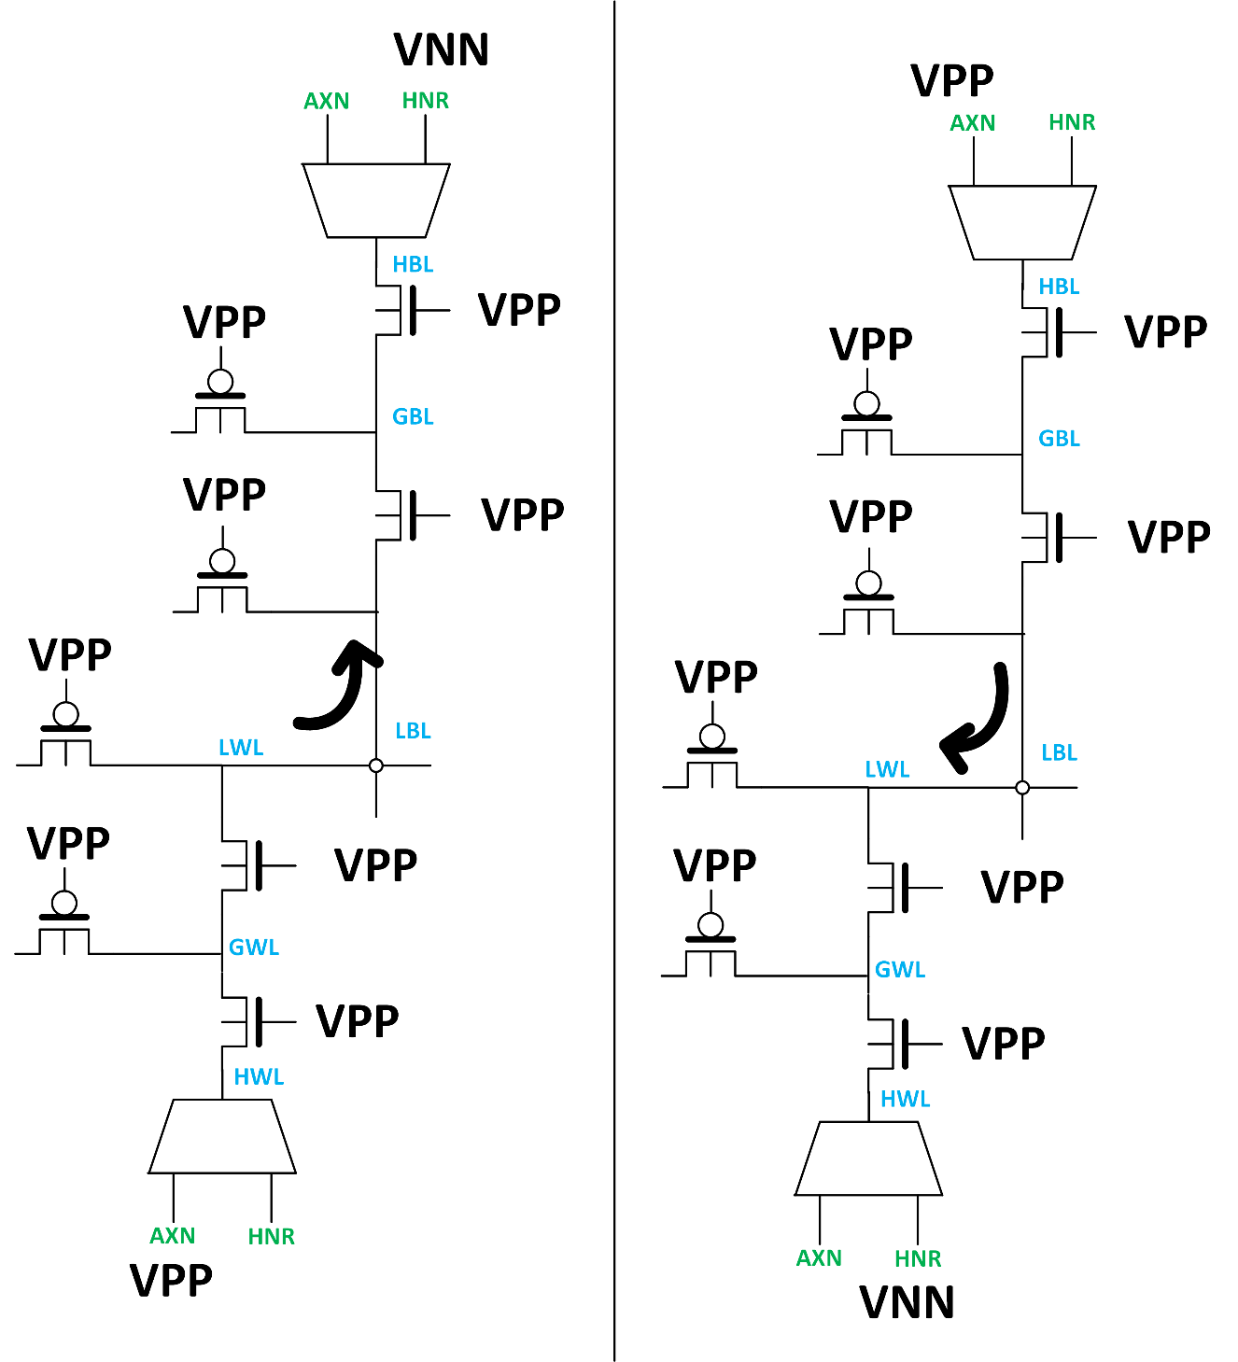
Enables the Following Features without Changing decode.
Polarity Toggle in Write operations.
Concurrent Set/Reset operations within a Partition.
Zero Energy cost of polarity toggle.
Sel/Desel devices can pass/block vpp, vnn
Device See VPP – VNN across the oxide
Need Thick Gate for reliability.
vnn
Design uses
TOX = 160A x (9.25/10) → 148A
vnn
vnn
The design rules above apply to 160A 10V HVT devices used for TC03 derived from P802
Tile ‘m’
Tile ‘n’

Slide 9
Optimal Decoder Sizes
3.5/3.8tcad
Decode Device Sizes
 | BISM1
 |  | (in Lambda)
Name | type | width | len | m
LDESEL | tgPMOS | 1.4 | 8 | 1
LSEL | tgNMOS | 7.16 | 9.87-7 | 1
GSEL | tgNMOS | 9.21 | 9.87-7 | 2
GDESEL | tgPMOS | 1.4 | 8 | 1
LSEL INV | tgPMOS | 5.14 | 13 | 1
 | tgNMOS | 5.14 | 13 | 1
GSEL INV | tgPMOS | 5.14 | 13 | 1
 | tgNMOS | 5.14 | 13 | 1
-4.0
4.85
7.16/9.87
14.5/7tcad
3.x
4.85
-4.0
19.8/7
14.5/7tcad
4.85
Tcad assumed symmetric device size, we are better on global flexible on global.
VDM Positive dropped from 3.8 → 3.5
Type b target remains same as tcad, due to cell scaling.
Need to close device size.
We can fit 15/7 local if needed → energy cost to vetted out.

