Slide 1
BiSM Status, Learning and Challenge
Balaji and DerChang, WW26.3/2019
Technology – BiSM is deemed a scalable path of 3D XPoint™ Technology
Silicon used are S26A single chal 1D and 2D Full Loop (a.k.a. L2) flow.
Wide range of SD materials exhibit robust RWB. The best fitted ∆V_{T} physics is an interfacial modulation by electric field at an elevated temperature.
PG1 RWB is deemed operable with CR6.5 SD.G02 silicon (with 70% 1D structure yield.) The array demonstrated >2M FW cycles and >130K cycles RD capability.
Design – Die size is prohibitive without higher drive of the speculative TGcMOST in this analysis.
Bipolar decoder architectures – the functional changes require schematics change and/or CMOS augmentation
Analysis of die size, energy, performance using our 20nm baseline and black box device
.

Slide 2
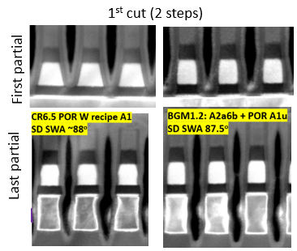
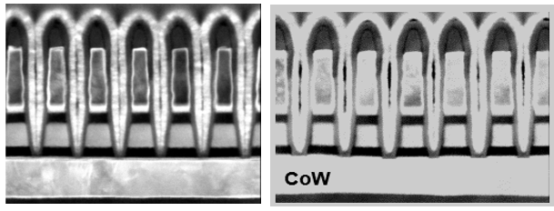
1st and 2nd cut profile
CR6.5 demonstrated >70% PG4 structure yield & PG4 capable RWB
2nd cut (single step)
MTS Metric | SPEC | POR | FWD
HM thk (nm) | 18 | 17 | 23
W top CD (nm) | 21 | 18 | 22.5
W bot CD (nm) | 17.2 | 14 | 18.5
TEC CD (nm) | 21.3 | 18 | 19.2
SD top CD (nm) | 21.5 | 22 | 16.5
SD bot CD (nm) | 23 | 26 | 18.5
SD SWA (degree) | 89 | 84 | 87
Specs | MTS Metric | SPEC | POR | FWD
First partial | SD top (nm) | 18.1 | 16.3 | 15.6
 | SD bot (nm) | 18.9 | 24.9 | 18
 | SD SWA (degree) | 89 | 79 | 87.5
Last partial | SD top(nm) | 18.1 | 16.1 | 15.6
 | SD mid(nm) | 18.5 | 17.2 | 18
 | SD bot (nm) | 18.9 | 17.8 | 18.1
 | SD SWA(degree) | 89 | 88 | 87.5
 | W Sep (nm) | 20.8 | 18.7 | 18.5
 | W Bot (nm) | 21.2 | 22.3 | 22
July/12/2018

Slide 3
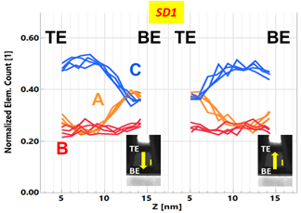
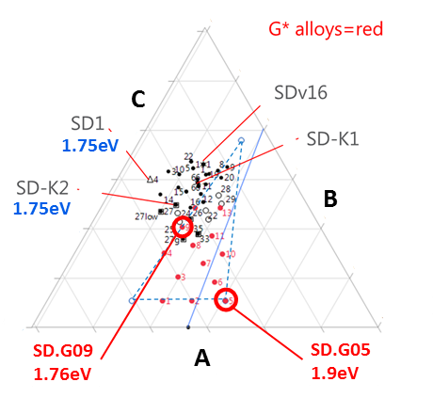
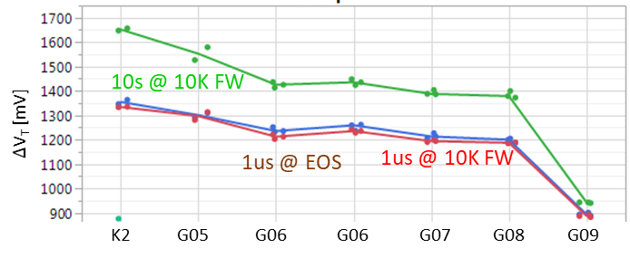
Read/Write
A V_{T} window (∆V_{T}) is exhibited by applying programming pulses with opposite polarity.
  Symmetric write pulses for set and reset operations: 44ns@±45µA
  Demarcation read is identical to SXP (40ns read)
The best known ∆V_{T} physics is an interfacial modulation subject to mass transport by E-field at an elevated temperature.
  Retention behavior and thermally insensitive bias disturb suggest nonvolatility is different from electrostatic memory.
  Bipolar Read signature and write current fingerprint refutes the best known conductive filamentation behavior.
  Bipolar Write supports mass transport between electrodes.
RWB: 200 mV (3.54σ 1µs E3 - 10s E2), 1350 mV (1µs < ∆V_{T}>)
  Besides V_{T}σ and E2 drift, E3 read disturb is yet another component consumes ∆V_{T}. A speculative mechanism is SD mass transport reversal by reverse bias·time (low visibility / unquantifiable in PFA.) G-class alloys exhibit near 0mV E3 margin loss of 130K RD.
  Bipolar memory switching with elemental segregation are observed in wide range of Chalcogenide glasses
Threshold switching characteristics are not limited to Chalcogenide glass. It has been sighted also with other (doped) binary oxide, such as NbO_{x}, SiO_{x} and etc.
In additional to G-class alloy exploration in horizon, we are also actively seeking doped oxide at CR

Slide 4
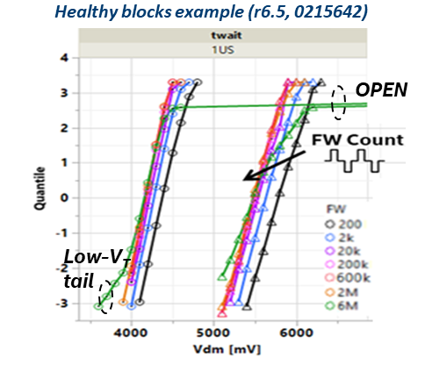
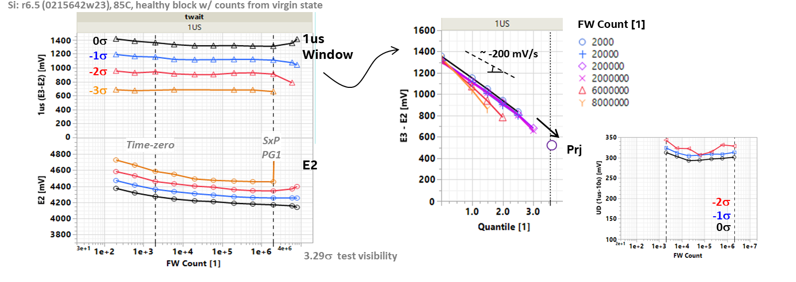
Write Endurance
No window closure of 2K bits up to 2M FW cycles @ 10ms ipd, low ED
Other Critical Characteristics
Seasoning Required – Yes, dual polarity for 10µsec cumulatively used for all data collected
Read Scheme – dual VDM is needed due to E2 drift
Cell leakage – SET is the same as SXP (5nA/cell), RESET is 1/10 of SET
C-cell bias – (E3 drift/shift) seeking elimination with material and/or process solution
TempCo – 0% for I_{program}, 4.5% for V_{DM}
WD – expected none; WD is subject to thermal proximity and reverse bias of A-/B-type cell (< 65% E_{TH})
Scaling expectations: (no CD scaling data available)
  I_{program} – the same as SXP, subject to T_{g}
  RWB – no worse than SXP
  Read/Write Latency – no change

Slide 5
Bipolar decoder architecture – Selected BL Path Shown
ALF32
S24S
TGcMOST
AXN=VPPs
AXN=VPPs
VSS
VSS
VPPs
VSS
VPPs
VPP
VPPs
VSS
VSS
AXN=VPPs
HNREG
VPPs
VSS
VSS
VPP
VPPs
LBL
VPPs
LBL/LWL
VPPs
LBL/LWL
VSS
VSS
VPP
VSS
VSS
VSS
VSS
VNN
HNREG
Bipolar
160A? tgTWN + tgP
VT: 1.2V @ 9.3 VB for TWN
9.6V compliant DR
AXN/HNREG Mux/tile
Unipolar
110A TWN + P
Bipolar
110A TWN + P
2 extra global Xtrs.
Extra Xtrs. in tile predec

Slide 6
Die Size and Energy Assessment
Architecture | Decoder | CMOS and Interconnect | Die Size [mm²] | Write [pJ/b] | Read [pJ/b] | Gap
 |  |  |  |  |  | Die Size | Write | Read
ALF32 (POR) | Unipolar | P1240.0 | 200 | 104 | 44 | [mm²] | [pJ/b] | [pJ/b]
S24S | Bipolar | P1240.0 | 221 | 154 | 55 | 21 | 50 | 11
BiSM32 | Bipolar | P1240.0+tgCMOST | 255 | 107 | 47 | 55 | 3 | 3
S24S Dec Creates Energy & Die size gap
TGcMOST Dec Arch Solves the Energy Gap, but has a 55mm^2 die size gap.
  Die Size gap above maybe recovered by using the Black Box Xtr (see backup material)
  TGcMOST carries a residual decode cost penalty due to 2x swing on Decoders wrtx ALF32
TGcMOST with Blackbox Xtr: What does it take to make tgMOST that enables BiSM 200mm^2 and ~equivalent energy? (Shafqat and/or Chuck?)
Next Steps: TGcMOST with Blackbox Xtr., BiSM Option 3, ISSCC Paper search

Slide 7
Backup Materials

Slide 8
BiSM Key Contributors
Process – Kyuchul, Yao, Eva
Material – Fuga
CR – Max, Fuga, Noriyuki, Abhishek
(engagement started with team Max and team CQN MA lab)
Device – Fuga, Hank
Array – Qawi
CMOS – Divesh, Luo
Design – Balaji, Ashir, Sandeep, Mase

Slide 9
BiSM Integration Risks
Item | Strategy | Gating requirements to determine resolution
Etch profile for doped SD films, improved L1D processes show significant Vt shift and leakage. (scaling risk) Goal for 28nm pitch is >88 deg profile in SD without Vt lowering. | Segment driving force (dry/wet process components). | A BiSM line: Dry/wet etch process and PI resourcing, 4C chamber availability and PVD process resourcing, S26A silicon funding (alt via mask TBD). Tool sharing strategy for process development. Metrology resourcing. CMP process resourcing.
Large target manufacturing for modified SD films. Challenges highlighted in 1H ’18 work in the JDP. | Work with target vendors to improve manufacturing process. Further strategy could be to look for alternate dopants.
New SD films chemical or thermal concerns. Potential modification of PL/treat/seal strategies versus the Optane POR. | Quantify any concerns as risks or non-issues.
CMP/chop process window with thinner stack (concern) | Centering, modification of chop chemistry(?).
Other integration risks are all improved versus full stack for scaling trends.
CMOS scaling risks are not reviewed here.
Speculative BiSM model suggests T_{g} correlation with write current/speed. This model and the usable T_{g} range for integration of the material is yet to be validated.

Slide 10
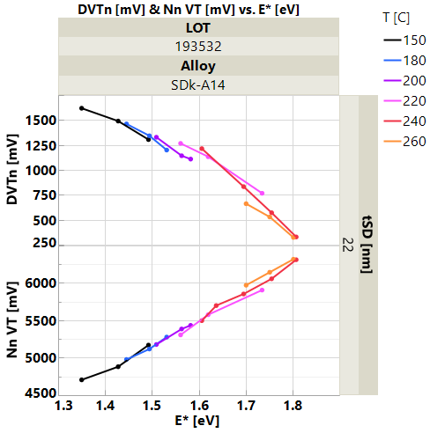
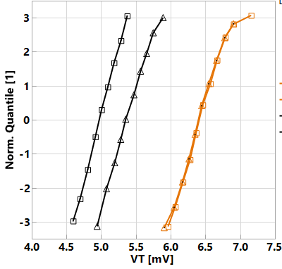
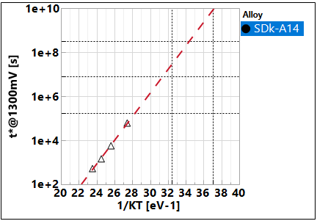
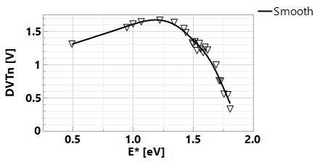
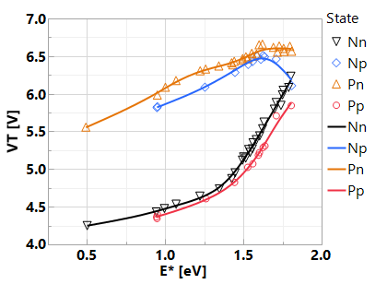
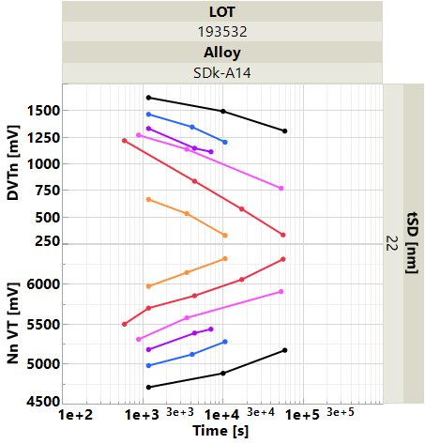

Retention proj’s from T-bake
SET/RST Distrib. Vs. T-bake
Window closure: Single EA analysis
VT retention: E-front analysis
E_{A} ~ 1.25 eV
10y
3m
2d
85C
2days
SET
RST
@180C
-- 1μs
1e3 s
1e4 s
85C 40C
0193532w10 SDk-A14, r5.3
SET state retention ~ mimicking 3DxP trends; RST state retention relatively solid within 3s visibility (JDP data)
Window-based retention single E_{A} in ~ 1.25 eV range → Further char to be triggered on r6.6 to validate proj’s.
The retention data, both set and reset shifts up, suggests a ‘nonreversible’ process or structure relaxation at temperature range explored. This seems indicative a deep-level-trap or strong-bond-energy modification process in “write”

Slide 11
Dual-Vdm: V_{dm1} RWB up to ~ +200mV w/ SD alloy
ww23 table (w/ embedded formulas)
To compare @ same t_{SD}
w/ t_{SD} ↑, I_{leak} marginal
Need tSD increase
Trending w/ V_{T}
Low RD
(~4-10x TTF ↑)

Slide 12

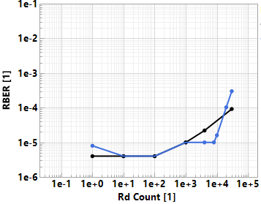
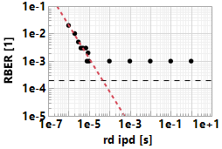
BiSM Read Disturb: Problem statement
Gap-to-Goal:
BiSM fast read disturb is on PAR with 10s PG1
BiSM fast read disturb has greater cycling capability Vs. 20s PG1
Problem Characteristics:
Read Disturb is an E3 problem
There is maximum total stress time (#cycles) that a bit can withstand
Time-To-Fail (TTF) is
  exponentially dependent on V_{DM}/V_{T,1us} (~ 1dec/10%)
  Independent on pre-stress time (t₁, aka ‘drift’)
  Minimum ipd is the worst case stress scenario
Next steps:
Close on DTS Vs. Media Policy/Strategy Scenarios (Qawi/Kiran,ww27).
Empirical | BiSM | 10s SxP
Dominant Read Disturb Edge | E3 | E2
Does drift help? | No | No
Does ↑ iPD help? | Yes | No
Impacted by Fast Read Disturb? | Yes | Yes
Impacted by Slow Read Disturb? | No | Yes
Near-Miss RBER Slope | ~1 | ~0.8
Success criterion | Array Capability assessment @ 3.54σ
 | Vdm | WC Capability, (t₁/ipd/t₃), mV shift
130K reads, -3.25σ cell | Vdm1 | ~100k (1us/1us/1us)
 | Vdm2 (Vdm1+300mV) | ~10k (10s/1us/1us)
r6.6: Fast RD exhibit (t₁/ipd/t₃ = 1µs)
@65k
Vdm+
V_{DM}= E3(3.54σ) - 100mV
( > DTS)

Slide 13
Bipolar decoder architecture – Selected WL Path Shown
ALF32
S24S
TGcMOST
VSS
AXN
VPP
VNNs
VPP
VSS
HNREG=VNNs
VSS
VSS
AXN
VNNs
VSS
VSS
VPP
VNNs
LWL
VNNs
LBL/LWL
VNNs
LBL/LWL
VSS
VSS
VPP
VNNs
VSS
VSS
VNN
VSS
VNNs
VSS
VSS
HNREG=VNNs
HNREG=VNNs

Slide 14
The Blackbox transistor
VSS
VSS
Thick gate CMOST
  Size: LSEL W/L 10/10 Max, GSEL 13/10
  VTn TWNMOS
    1.15V @ 28uA,
    Zero Back Bias Coeff.
  iOFF: < 1nA
  GM: 2x of POR Xtr
  VGS On Max=9.6V → TG Devices
  VDB Max=9.6V
BENEFIT
  200mm^2
  104+10% pJ/bit nWrite
  44+10% pJ/bit Read
  (Hand Calc estimates need Validation)
VPP
VPP
VNN
VNN
LWL/LBL
VPPs
VSS
LWL/LBL
VNNs
VSS
VNN
VNN
VPP
VPP
VPPs
VNNs
VSS
VSS
VPP
VPP
VPPs
VNNs
Patch Applies
Pos. Bias to BL/WL.
Patch Applies
Neg. Bias to BL/WL.

Slide 15
Enabler 1 of 2: tgMOS enables BISM
Problem: Deselects toggle when polarity toggles impact
> 20pJ/bit in a hvCMOS decoder
VPP-VTn
VSS
VNN
VSS
VPP
VSS
VSS
VNN
We are able to build a decoder
with HV devices.
  Energy cost of polarity toggle
  is high. > 20pJ/bit, why?
  HV devices can tolerate VGS of
  VPP, VNN but not VPP-VNN.
  To satisfy the above reliability
  criteria we need to toggle LSEL
  /GSEL gates of all deselected rows
  when toggling polarity of a patch
  from positive bias to neg bias or
  vice versa. This is ~800fF
  This 20pF is a showstopper.
  This problem was also seen in S24s
Local sel
VPP-VTn
VPP-Vtn
VNN
VNN
VPP
VPP
VSS
VSS
VPP
Global sel
VPP
VNN
VNN
VPP
VPP
VNN
VNN
Pos. patch
Selected Local
Selected Global
Pos. patch
Deselected Local
Selected Global
Neg. patch
Selected Local
Selected Global
Neg. patch
Deselected Local
Selected Global
LBWL is local word or bit line.
GBWL is global word or bit line.
PMOS device which are Off are not shown.

Slide 16
Enabler 1 of 2: tgMOS enables BISM
No toggle of deselects when polarity toggle with
tgMOS enabled decoder
VPP-VTn
VSS
VNN
VSS
Tg
VPP
Tg
VNN
Tg
VPP
Tg
VNN
Once we add the tgMOS device
Which can tolerate VPP-VNN across VGS,
This need to toggle deselected decoder
gates (LSEL/GSEL) goes away
and we have a low energy solution.
Thus tgMOS is needed.
VPP-VTn
VPP
VNN
VNN
Tg
VPP
Tg
VPP
Tg
VPP
Tg
VPP
VPP
VPP
VNN
VNN
VPP
VPP
VNN
VNN
Pos. patch
Selected Local
Selected Global
Pos. patch
Deselected Local
Selected Global
Neg. patch
Selected Local
Selected Global
Neg. patch
Deselected Local
Selected Global
Tg – Thick Gate Xtr.
LBWL is local word or bit line.
GBWL is global word or bit line.
PMOS device which are Off are not shown.

