Slide 1
Exploring New Classes of Glass Materials for
Built-in-Select Memory
DerChang Kau, Sep/26/2018
3DXP cell architecture in memory subsystem
Introduction to atomistic memory switch with built-in selector
Value proposition and incentive
Project proposal and collaboration
Milestone and Decision Point

Slide 2
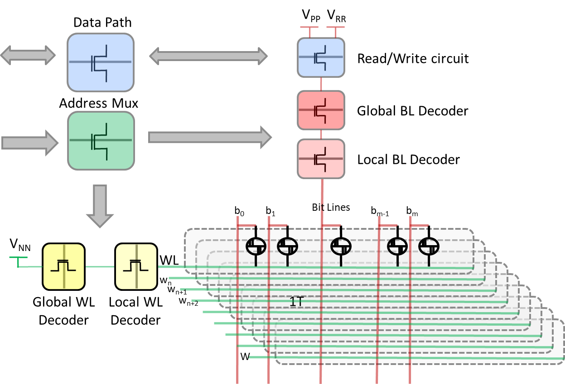
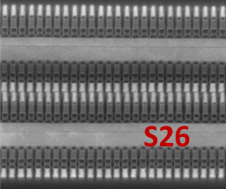
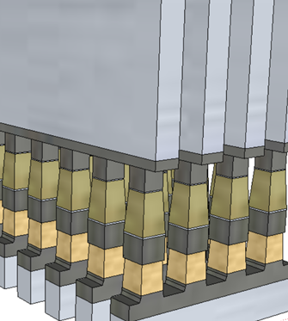
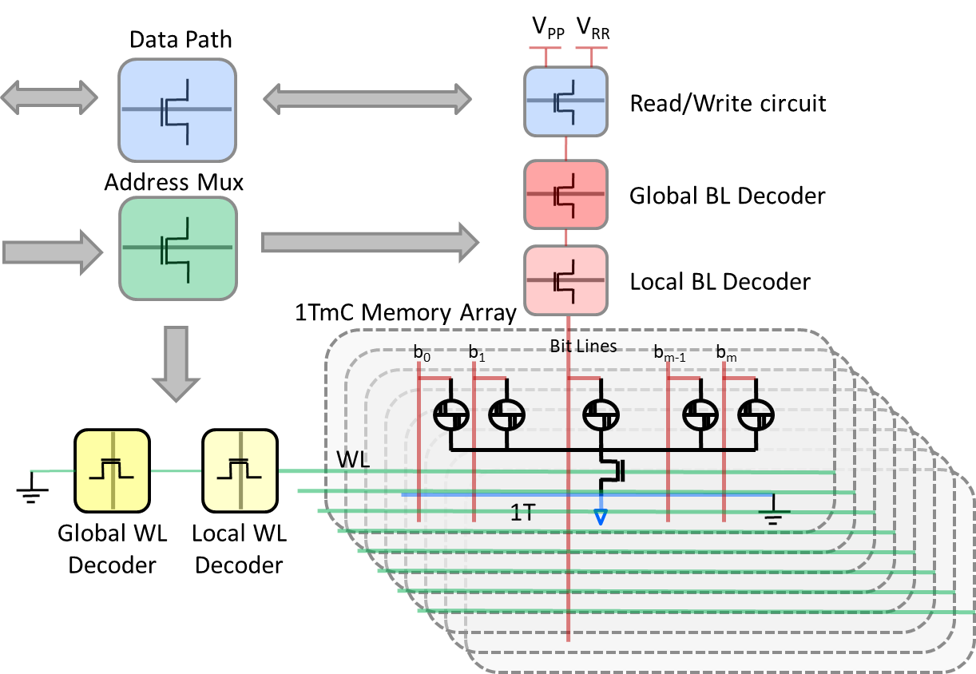
3DXP cell architecture and augmentation in memory subsystem
High Density Memory Array (V_{PP}-V_{NN}= 9V)
Basic Cross Point Array
Embedded Memory Array (VPP ~4V)

Slide 3
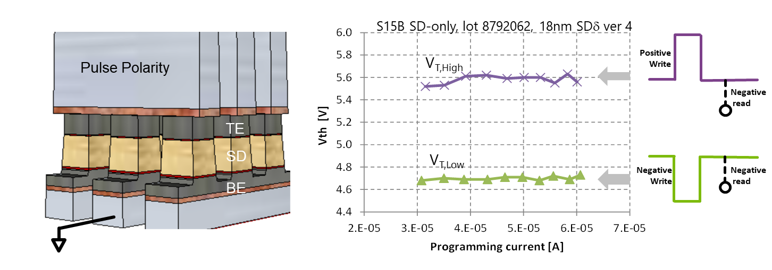
Introduction to atomistic memory switch with Built-in Selector a.k.a. Built-in-Select Memory (BiSM)
Beginning of Life
After 4M cycles
Deck 0
Deck 1
Deck 0
Deck 1
Set
Reset
Set
Reset
Set
Reset
Set
Reset
Sigma of Bit
Sigma of Bit
V_{T} [mV]
V_{T} [mV]
Conceptually, it is a 3D XPoint™ technology.
  Physical construction of BiSM array is BEOL 3D stackable X-Y cross point array comptatible with mainstream CMOS.
  Read/Write access deploys threshold selecting one cell while inhibiting the rest of cells in an array with subthreshold bias.
A V_{T} window (∆V_{T}) has been observed by applying programming pulses with opposite polarity.
The best known ∆V_{T} physics is an electrochemical potential modulation subject to mass transport by polarity.
  High retention E_{A} (~3eV) and thermally insensitive bias disturb suggest nonvolatility is different from electrostatic memory.
  Bipolar Read signature and write current fingerprint refutes the best known filamentation behavior.
  Bipolar Write supports mass transport between electrodes.

Slide 4
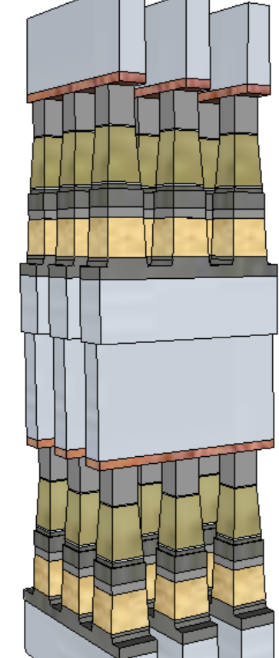
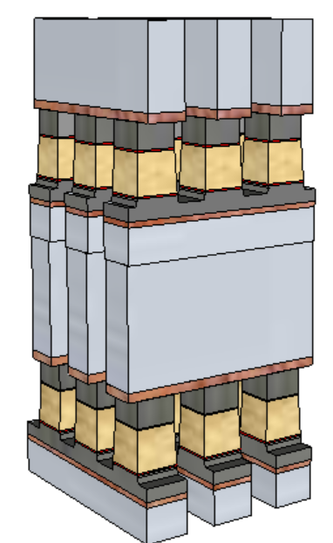
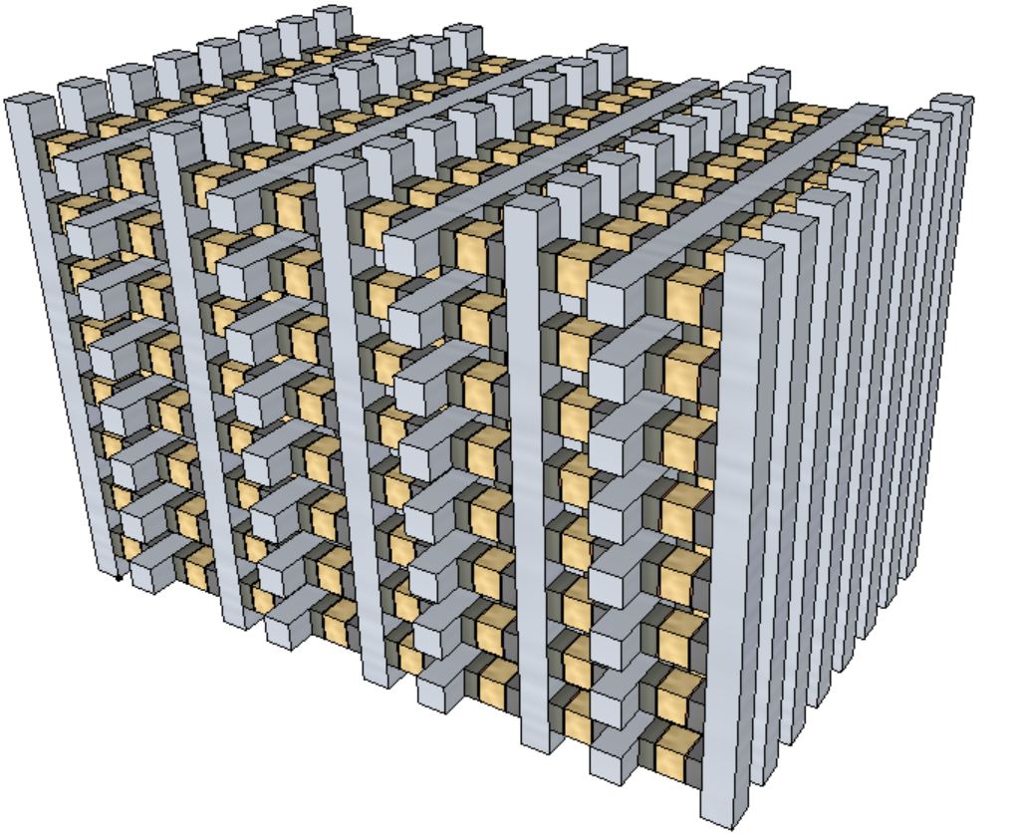
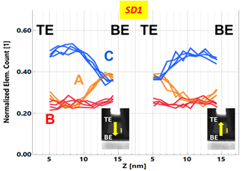
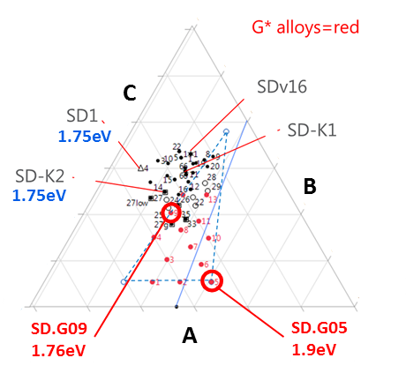
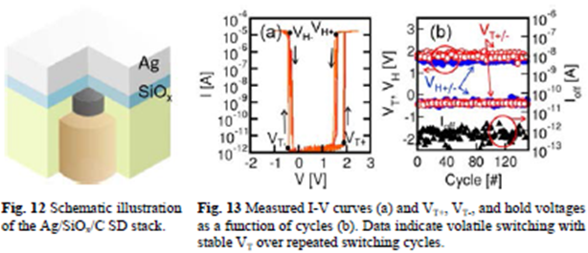
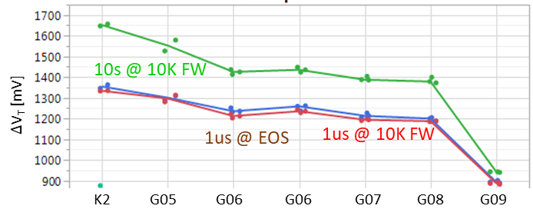
Value Proposition of Built-in-Select Memory Architecture & Motivation
Value Proposition (ref. tech: 3DXP)
  No cross-contamination between Memory and Selector materials
  Lower cell aspect-ratio (10:1➔ 5:1)
  Lower programming current ➔ relaxes metal (WL/BL) requirements and array capacitance
  No nucleation required, fast write (40ns)
  ➔ an opportunity for symmetric memory access (read/set/reset)
  Perceived as 3D-Tier integration Friendly
BiSM
3DXP
3D-tier
Motivation
  Bipolar memory switching with elemental segregation are observed in wide range of Chalcogenide glasses
  Threshold switching characteristics are not limited to Chalcogenide glass. It has been sighted also with other binary oxide, such as NbO_{x}, SiO_{x} and etc.
Develop and synthesize glass materials for BiSM devices & harvest IP

Slide 5
Project Proposal
Strategy & Scope: “Fail fast or succeed” in 4 incremental stages
  This proposal covers L0 (thin film, stage-1) and L1/L1E (single bit, stage-2)
  Full-loop integration for mini array (Mb, stage-3) & component level (Gb, stage-4) verification are beyond the project scope.
Objective: Identifying glass materials for BiSM devices
Porject outline for key results:
  Design and synthesize thin film materials for experiment.
  L0 physical characterization with score card.
  Upon L0 graduation, L1/L1E with Moat Isolated Device (MID) vehicle will be conducted for next level of electrical and physical screening.
  L1E score card and device modeling will be conducted for mini-array candidate selection.

Slide 6
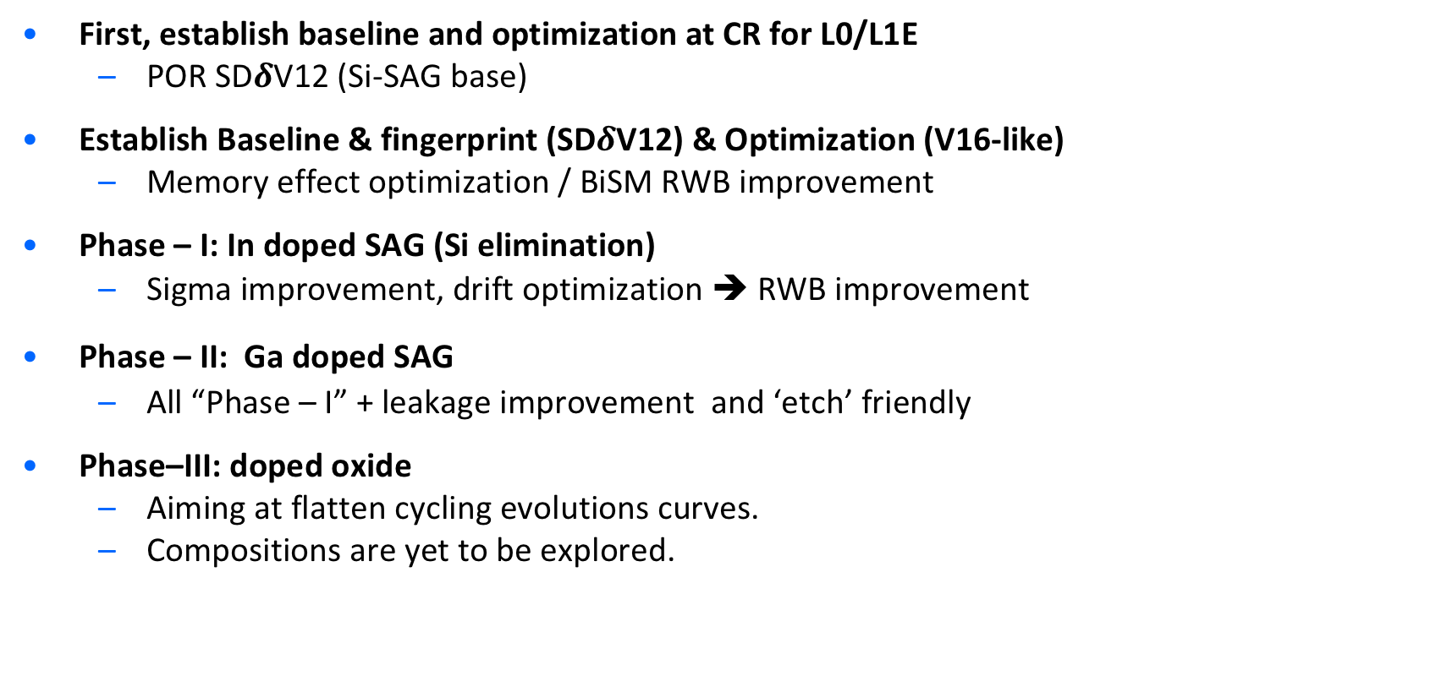
SD/BiSM Exploration Strategy (WIP)
First, establish baseline and optimization at CR for L0/L1E
  POR SD$δ$V12 (Si-SAG base)
Establish Baseline & fingerprint (SD$δ$V12) & Optimization (V16-like)
  Memory effect optimization / BiSM RWB improvement
Phase – I: In doped SAG (Si elimination)
  Sigma improvement, drift optimization ➔ RWB improvement
Phase – II: Ga doped SAG
  All “Phase – I” + leakage improvement and ‘etch’ friendly
Phase–III: doped oxide
  Aiming at flatten cycling evolutions curves.
  Compositions are yet to be explored.

Slide 7
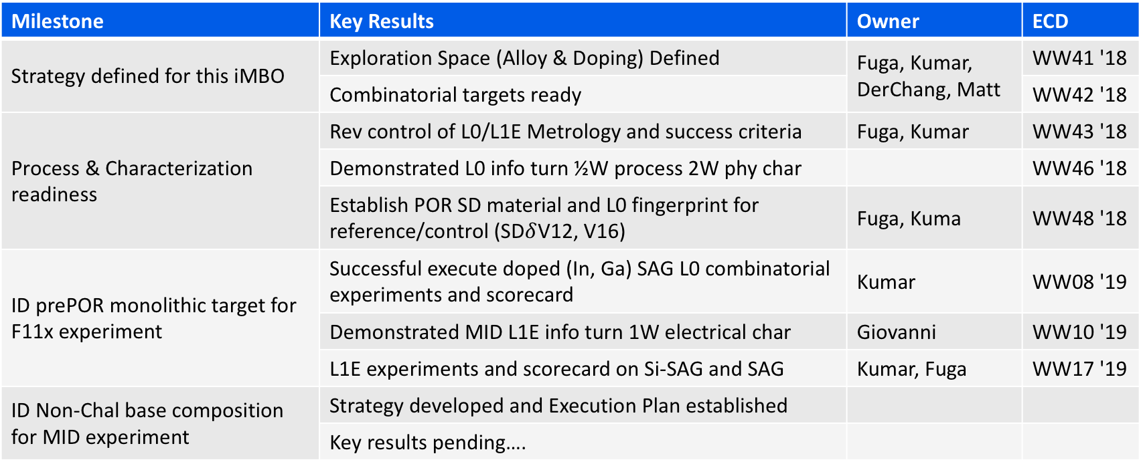
SD/BiSM Material Exploration iMBO (WIP)
Objective: Establish Internal SD baseline for alternative SD/BiSM material search
Milestone & Key Results for Decision (DerChang, Max, Matt)
Milestone | Key Results | Owner | ECD
Strategy defined for this iMBO | Exploration Space (Alloy & Doping) Defined | Fuga, Kumar, DerChang, Matt | WW41 '18
 | Combinatorial targets ready |  | WW42 '18
Process & Characterization readiness | Rev control of L0/L1E Metrology and success criteria | Fuga, Kumar | WW43 '18
 | Demonstrated L0 info turn ½W process 2W phy char |  | WW46 '18
 | Establish POR SD material and L0 fingerprint for reference/control (SD$δ$V12, V16) | Fuga, Kuma | WW48 '18
ID prePOR monolithic target for F11x experiment | Successful execute doped (In, Ga) SAG L0 combinatorial experiments and scorecard | Kumar | WW08 '19
 | Demonstrated MID L1E info turn 1W electrical char | Giovanni | WW10 '19
 | L1E experiments and scorecard on Si-SAG and SAG | Kumar, Fuga | WW17 '19
ID Non-Chal base composition for MID experiment | Strategy developed and Execution Plan established
 | Key results pending….

Slide 8
Supporting Materials

Slide 9
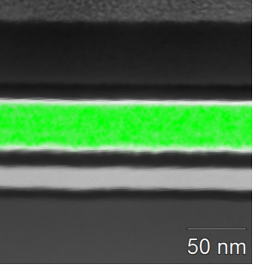
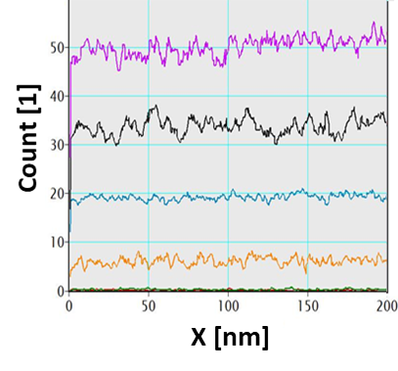
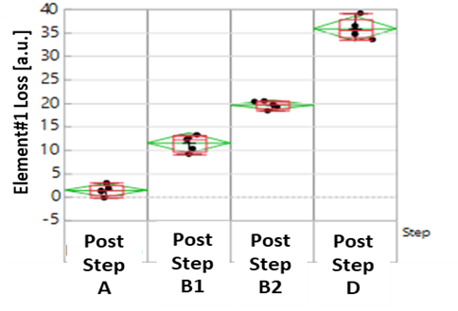
L0/L1D Physical characterization
1. L0: As-deposited film char: Material intrinsic properties
2. L1D ’movies’: Composition transfer function & bit-2-bit
As deposited Elemental mapping
Category | Technique | Metrics (μ, σ)
Avg. Composition | XRF, ICP-OES XRD | Element % Match peak ratio x-wafer
Process Int. compatibility | EDS ‘wrikle’ test (200C-340C) | El % std dev (eq. bit-2-bit) ‘bubbling’ onset
Electrical proxy | Rs Vs T scans [30C-650C] UV-vis spectroscopy TDTR [SC9] | R(post-DT)/R(asdep), E_{A},… Opt. Egap (pre-/post-anneal) Thermal Resistance
Category | Technique | Metrics (m, s)
Cell Health (composition) | XRF, EDS, (XRD) | Element % Stack x-contamination
Cell morphology | STEM | CDx, CDy, thicknesses

Slide 10
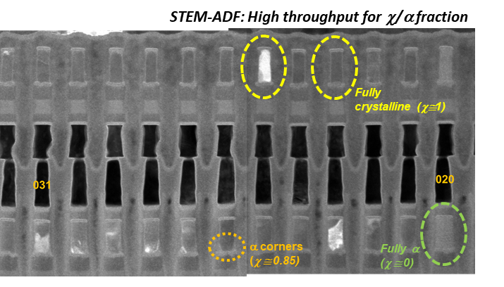
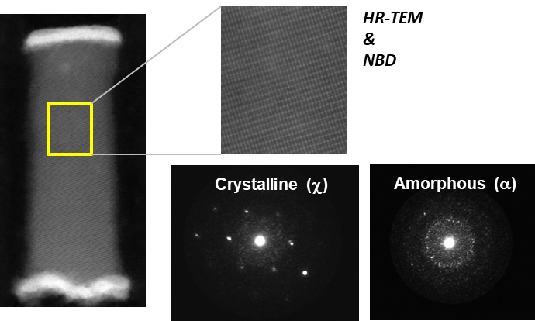
L1E/L3 Physical characterization
3. L1E/L3, including EoL & reliability (FM-TEM): Physical root-causing to intercept (i) PE, (ii) PI, and (iii) TD changes
4. Metrology and methodology main gaps and plan
Category | Technique [multi-bit cut] | Metrics (μ, σ) [Automated]
Sample preparation | FIB ‘grounding’ method | Output: Reduce beam sensitivity artifacts on element distrib. ^
Physical Structure | STEM | CDx, CDy, thicknesses
Composition/x-contam. | EDS, (EELS) | Element % vertical/lateral elem. gradients
Crystallinity / (amorphous) | STEM-ADF (coarse resol.) NBD (fine) | Crystalline fraction Phase determination
Atomic resolution | HR-TEM | CDx, CDy, thicknesses Phases location
Gap/Challenge | Comments and current plan
Chal. selector fingerprint (elem. profile, bonding, band align.) Vs. e-stimuli | Collaboration w/ OR-CQN started w.r.t. APT and XPS/IPE Raman also being evaluated (TBD)
Mobile species detection | N/A

Slide 11
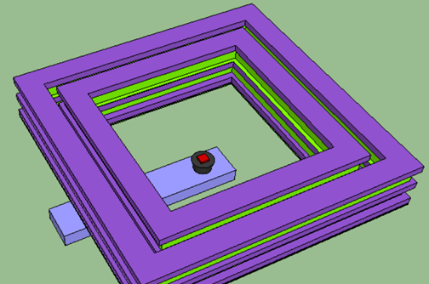
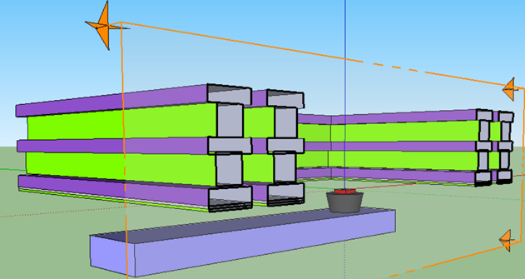
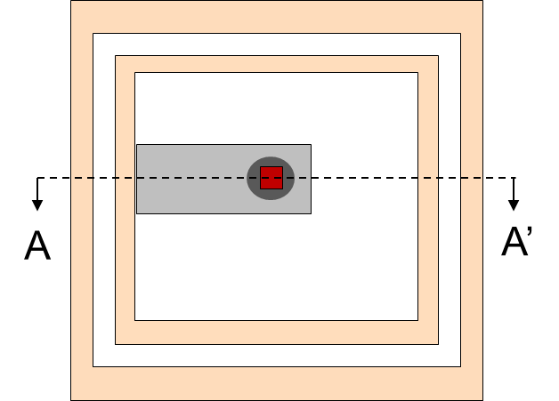
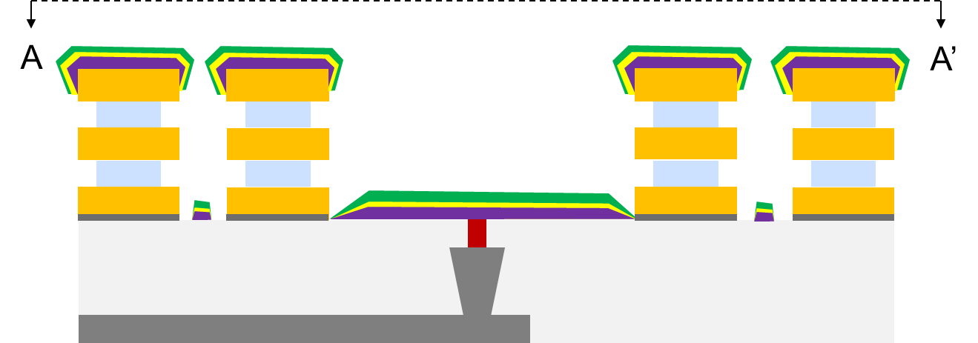
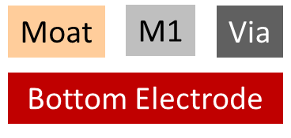

Moat isolated Thin Film Device

Slide 12
Connectivity of “Bottom” Electrode
Basic Device Formation
Connectivity below top electrode
  DUT load-line, such as
  Ballast Resistors, MOSTs
  Proximity heaters
  And other active components
Options including
  “C-pad” – 10~100K:1 high “R” ratio
  Budding contact to backside
  Poor man’s Anti Fuse

Slide 13
DUT examples
TE
TE
To exploit Intel’s CMOS power house for thin film device characterization in 10s nm regime without thin film patterning.
The CMOS base technology is used for DUT loadline, electrical/thermal stimuli and sensing metrology.
Heater
Heater
BE
BE1
BE2
BE3
BE4
TE
TE
TE
TE
Heater
Kelvin
Probe
Heater
Kelvin
Probe
Control
Cntl-P
Cntl-N
Control
Control
GND
“P”
“N”
GND
GND

Slide 14
MID Info Turn
Device Design
Structure Design
Template
Film Dep
Evaluation
Structure Design
Collateral
Process Flow
Design Rule
GDS layers
(Device and Frame)
Mask Synthesis
Content
Test Structures
F11 Bank
TO Production
TD Fab
SC9 Ele. Char
NSG Adv PF
CR
CR
FM Phy. Char
Ext.
OR Phy. Char
Davide Fugazza
Jan Smudski
Shafqat Ahmed
Kumar Virwani
Davide Fugazza
Kuma Virwani

Slide 15
High Density 3DXP Array
Data Path
V_{PP}
V_{RR}
Read/Write circuit
Address Mux
Global BL Decoder
Local BL Decoder
b₀
b₁
Bit Lines
b_{m-1}
b_{m}
V_{NN}
WL
w_{n}
w_{n+1}
Global WL
Decoder
Local WL
Decoder
w_{n+2}
1T
W

Slide 16
Embedded 3DXP
Data Path
V_{PP}
V_{RR}
Read/Write circuit
Address Mux
Global BL Decoder
Local BL Decoder
1TmC Memory Array
b₀
b₁
Bit Lines
b_{m-1}
b_{m}
WL
1T
Global WL
Decoder
Local WL
Decoder

