Slide 1
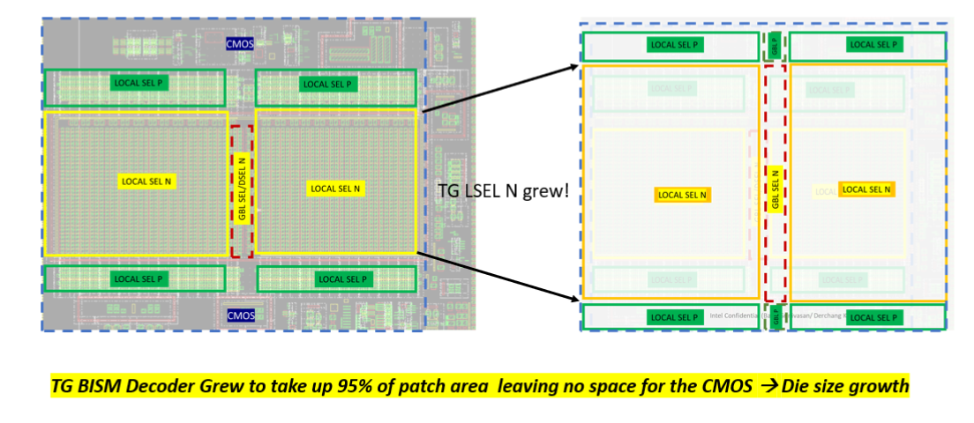
BiSM Die Size Analysis
normalized to 4kx4k tile |  |  | CMOS | Decode | CMOS+DEC | Tile | CUA Gap | Die size (inc. 20mm² I/O) | Comment
Product/ Density | Deck | Tile Density | % | % | CMOS Need + Decode Need | % | % | mm^2
ALF32 | 4D | 4Kx4K | 29 | 69 | 69+29=98 | 100 | 98 – 100 = -2 | 180 x ( 100 / 100 ) + 20 = 200 | POR
BiSM32 | 4D | 4Kx4K | 36 | 95 | 36+95 = 131 | 100 | 131 - 100 = 31 | 180 x ( 131 / 100 ) + 20 = 255 | Larger tg decoder due to higher voltage, lower Vt ==> larger transistor
BiSM32 | 4D | 8Kx4K | 36 | 95 x ( 24 / 16 ) = 143 | 143+36 = 179 | 200 | 179 - 200 = -22 | 180 x ( 200 / 200 ) + 20 = 200+2 = 202 | 50% incr in decode with 100% incr in array
BiSM16 | 2D | 4Kx4K | 36 | 95 x ( 12 / 16 ) = 71 | 71 + 26 = 107 | 100 | 107 - 100 = 7 | 180 x ( 107 / 100 ) + 20 = 211 | 2D --> 25% Decode Footprint Reduction
BiSM16 OPT | 2D | 4Kx4K | 36 | 95 x ( 12 / 16 ) = 71 | 71 + 26 = 107 | 100 | 107 - 100 = 7 | 180 x ( 107 / 100 ) + 20 - 6 = 205 This | Cut BL termination
ALF-32 one Patch
BiSM-32 one Patch

