Slide 2
SD states subject to pulsing polarity, amplitude and duty
1µs
1µs, 1s
Silicon:
0224662 W25 A4 (Die 3,1), K2 BiSM
Experiment flow:
4k bits cycled to 10k, NPT blocks 98/99/101/102
Skews:
Key Metric:
V_{T1µs}, V_{T1s}
Drift_{1µs→1s},
∆V_{T} of opposite polarity (read or write) of the symmetric wave form
i
W
r
W
t
W
W
r
t
I₁ [µA] | t₁ [ns] | I₂ [µA] | t₂ [ns]
0 | 0ns | 30/45/65/80 | 20/30/40/60/80/120/160/240
45 | 60ns
80
65
W
r
W
t
W
W
r
t
P₀: 45µA@40ns
P₁:Varied I₁ @ 60ns
P₂: varied I₂ @ varied t₂

Slide 3
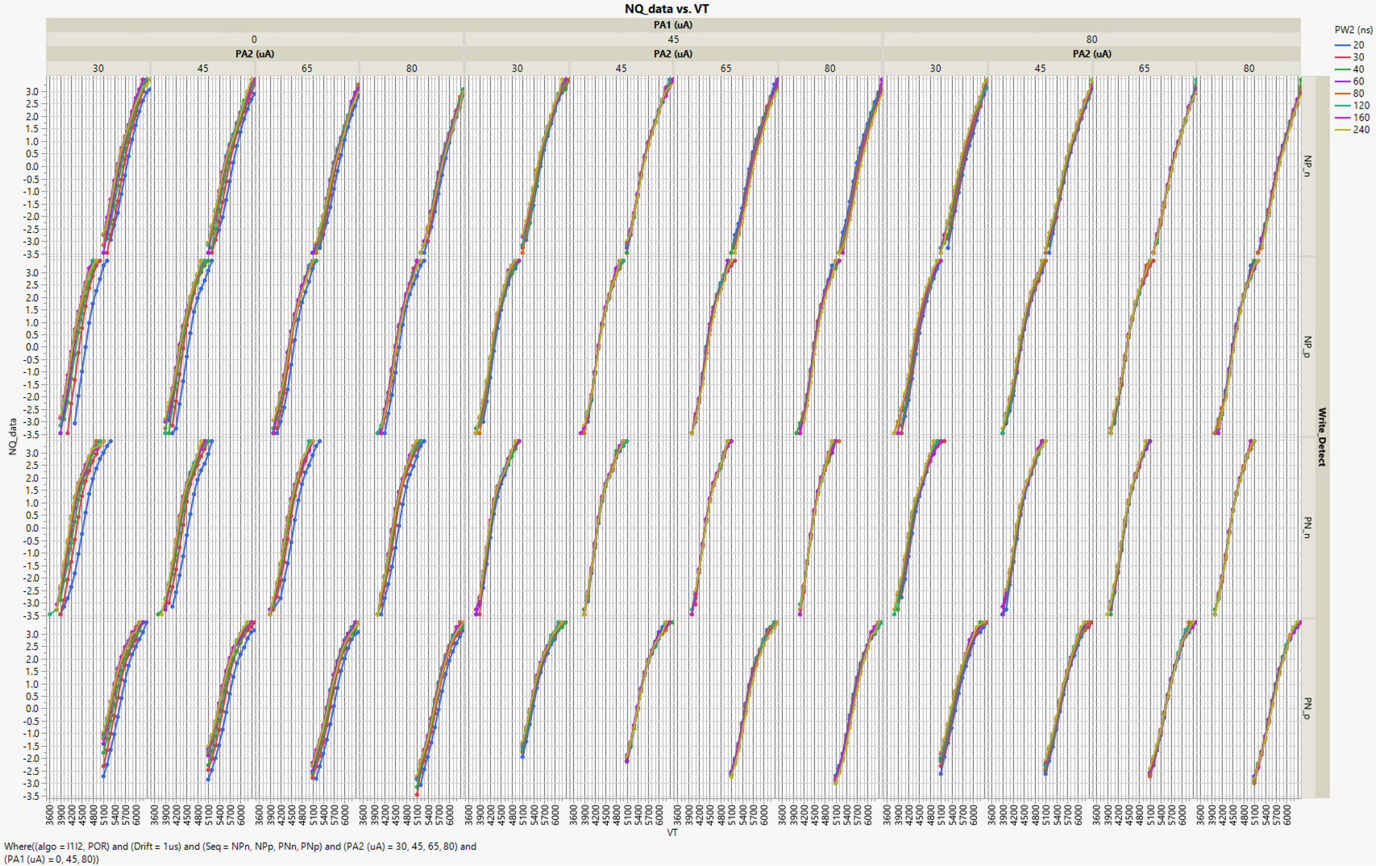

Slide 4
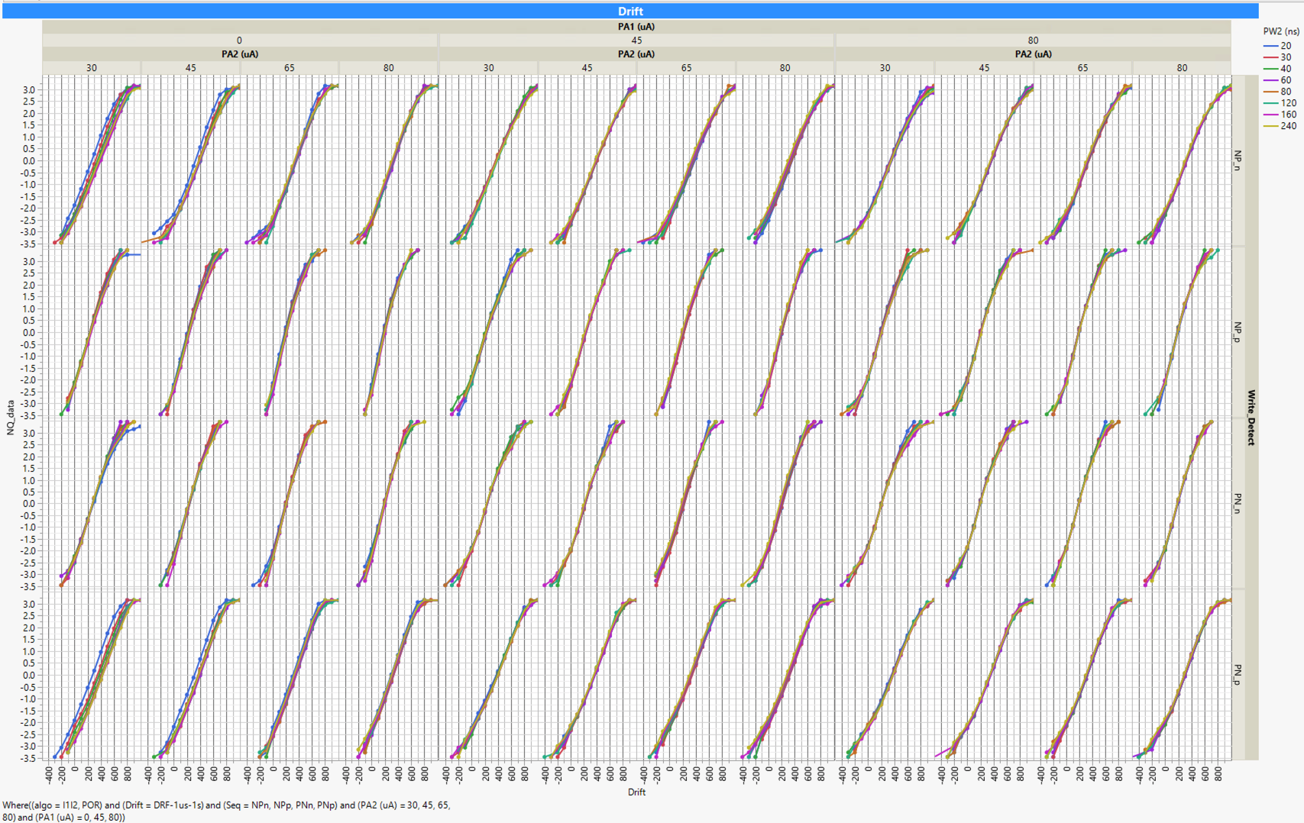

Slide 5
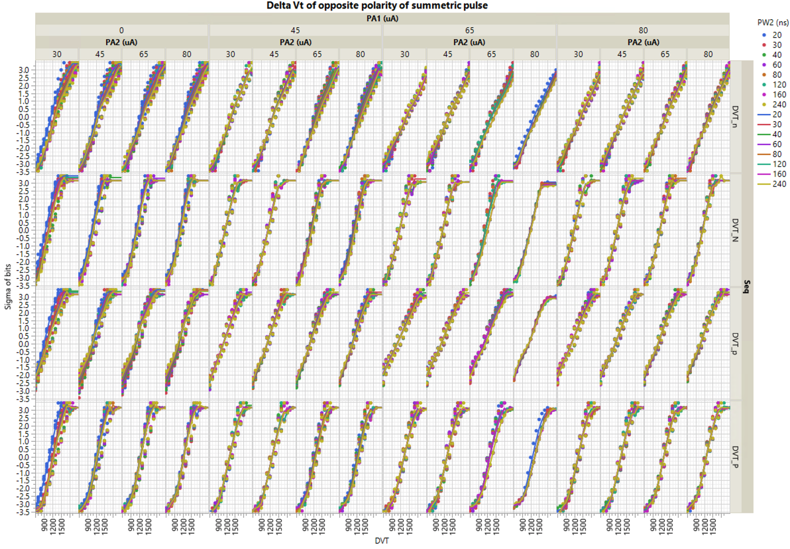

Slide 6
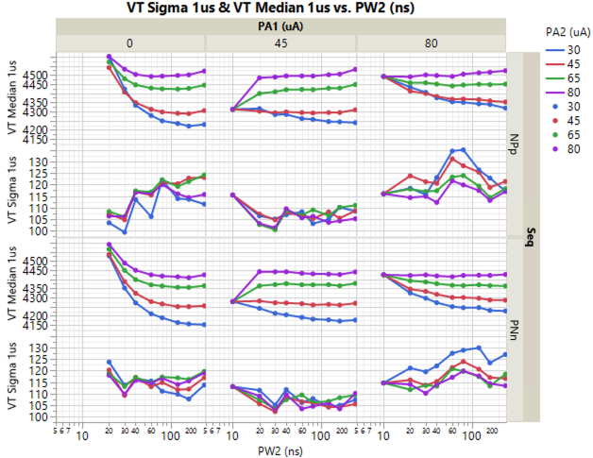
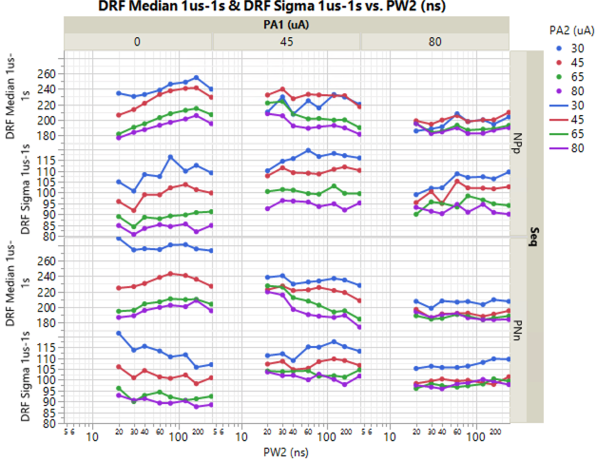
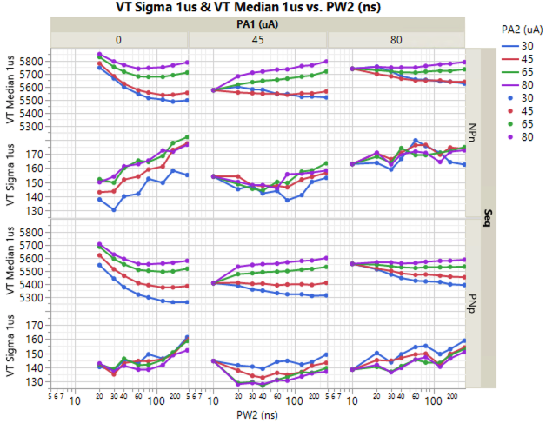
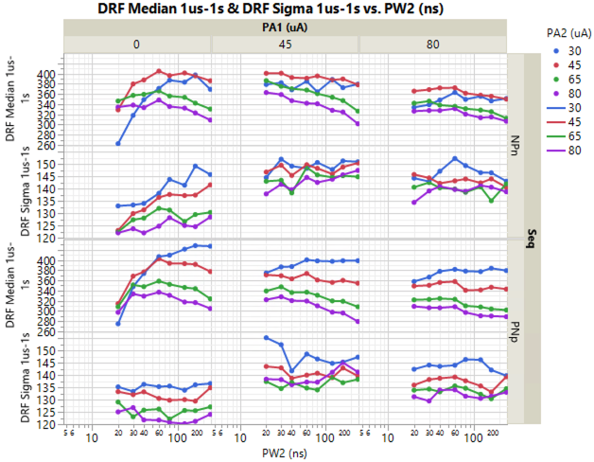

Slide 7
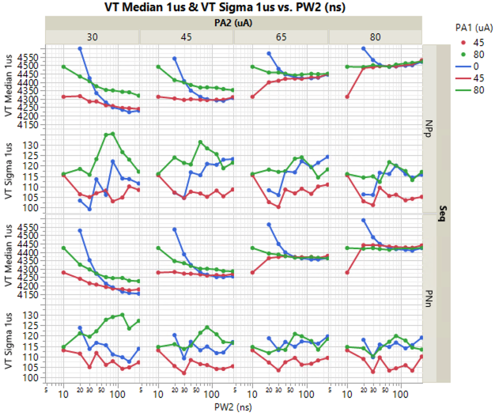
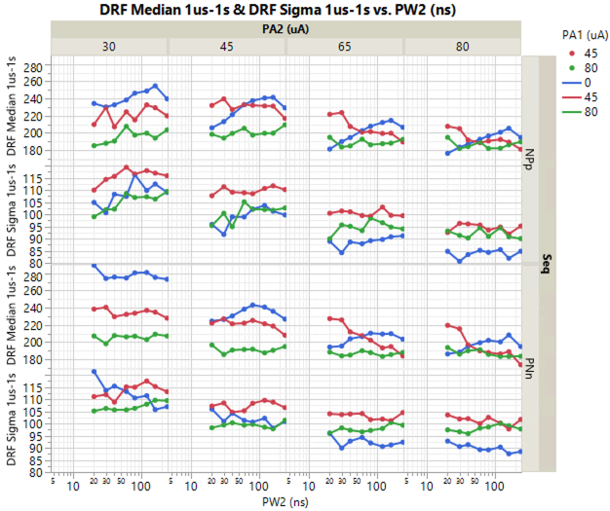
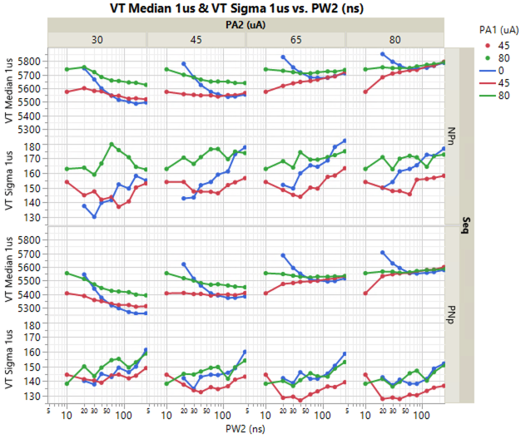
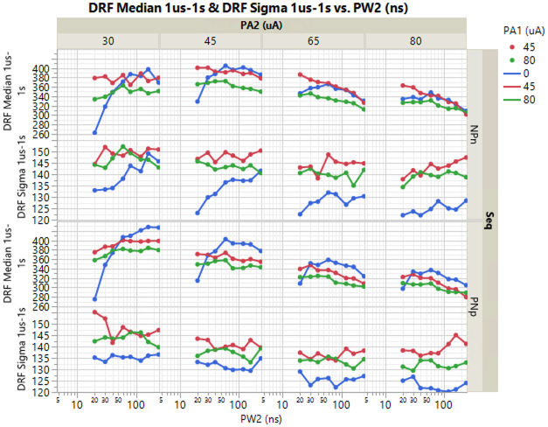

Slide 8
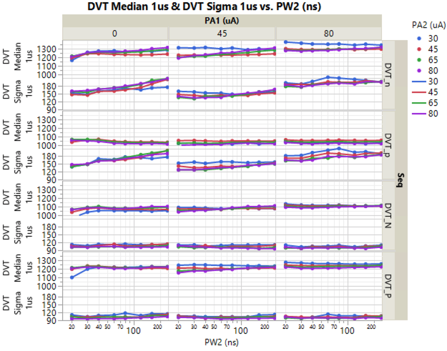

Slide 9
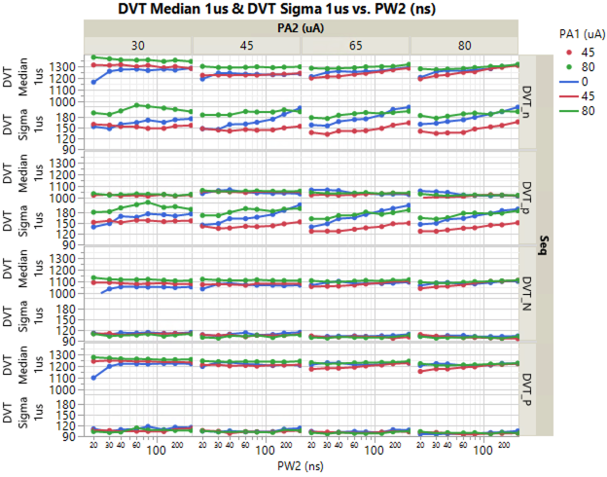

Slide 10
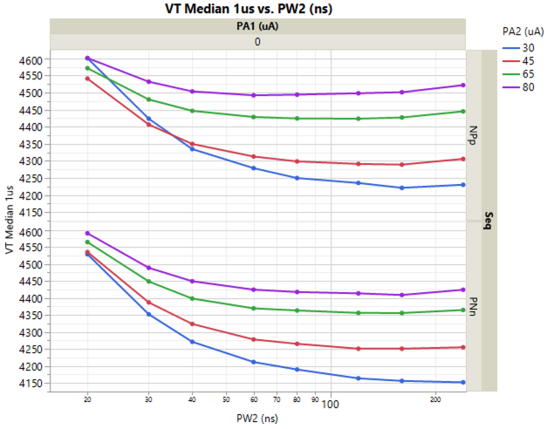
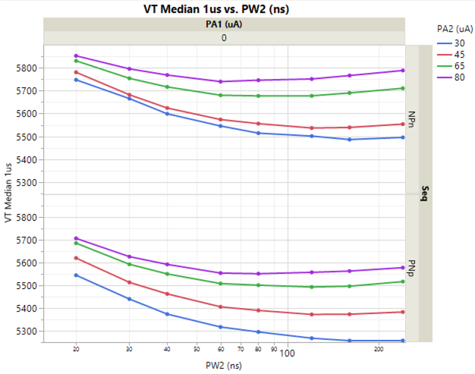
PreCond
V_{T}=5.45V
PreCond
V_{T}=4.33V
PreCond
V_{T}=5.63V
PreCond
V_{T}=4.35V

