Slide 1
Built-in Selector Memory (BiSM) Overview
DerChang Kau
Al Fazio

Slide 2
Built-in Selector Memory (BiSM)
Basic Concept Intro
Assuming it works, what do we gain?
Key things we think we know / Don’t know

Slide 3
3D XPoint™: Memory (PM) + Selector Device (SD)
Cross point requires very good selector
WL
WL
WL
+V
PM
PM
PM
SD
SD
SD
-V
V_{prog}/2
V_{prog}
V_{prog}/2
BL
BL
PM
PM
PM
WL: Tungsten Wordline
BL: Tungsten Bitline
SD
SD
SD
WL
WL
WL
V_{prog}/2
Isolation
PM: Phase Change Memory
SD: Ovonic Threshold Device Select Device
1 BL Sockets
2 WL Sockets
1st Generation (20nm): 2 Decks 128Gbit
0 V
V_{prog}/2
Each deck is a repeat (process) of lower deck, but operated in reverse polarity
Each deck is always operated in the same uni-polar bias for read/write (not bi-polar per deck)
WL
WL
WL
PM
PM
PM
SD
SD
SD
BL
BL
PM
PM
PM
SD
SD
SD
+V
WL
WL
WL
-V
Selector Device ensures high performance in terms of leakage and single cell selection
Memory element permits to store information using two stable states
WL
WL
WL
PM
PM
PM
SD
SD
SD
BL
BL
PM
PM
PM
SD
SD
SD
WL
WL
WL
Isolation
2 BL Sockets
2 WL Sockets
2nd Generation (20nm): 4 Decks 256Gbit

Slide 4
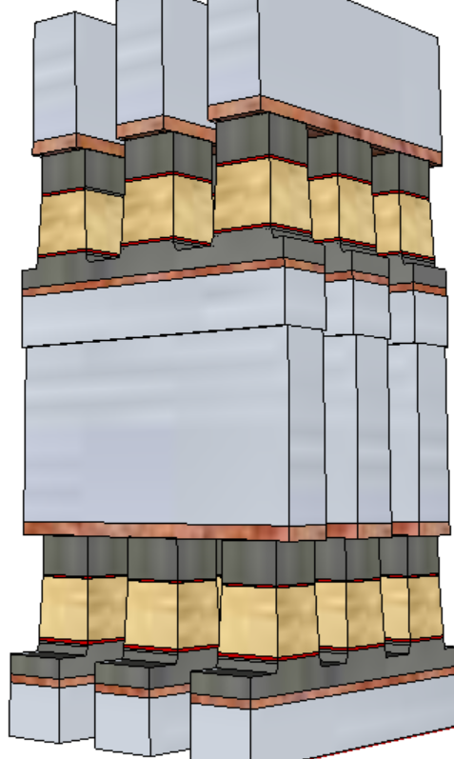
Ovonic Threshold Switch (Switch Device, “SD”) Polarity Effect
A SD only memory cell sandwiched between a X-Y cross point, BEOL stackable, compatible with mainstream CMOS.
S15B SD-only, lot 8792062, 18nm SDδ ver 4
Positive Write
V_{T,High}
Negative read
Opposite polarity detection
V_{T}=5.6V (High V_{T} )
Dual Polarity Pulsing
V_{T,Low}
Negative Write
Negative read
Same polarity detection V_{T}=4.7V (Low V_{T})
SD
It exhibits a window by applying programming pulses with opposite polarity.
In a typical selector-less (0S1R) cross point memory array, leakage and disturb fundamentally limit the density and usability of the technology. BiSM is working well because of the built-in selector to reduce leakage for high density and to increase immunity to read/write disturbance for nonvolatility; hence Built-in-Selector Memory, a.k.a. BiSM, is coined.

Slide 5
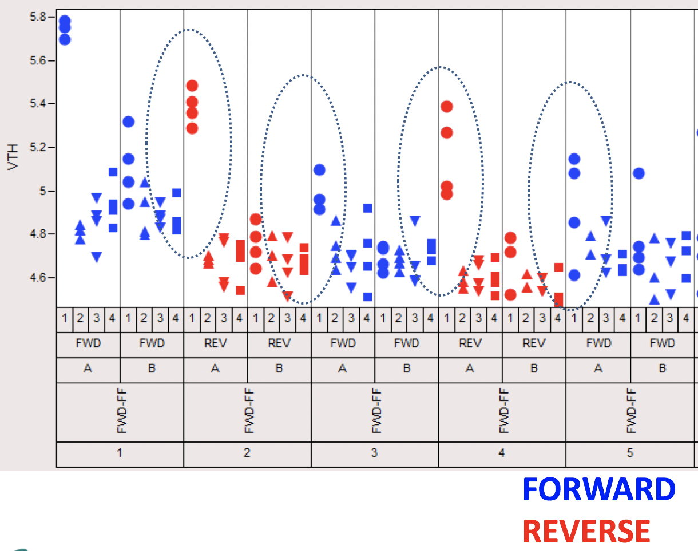
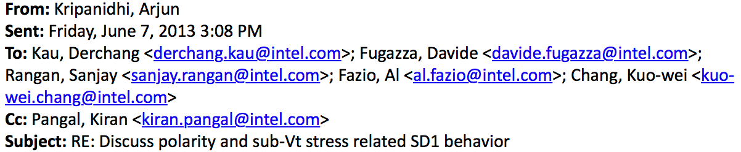
A Brief History
In June, 2013, as 3DXP dual-deck development shifted to high gear, a subtle BiSM “window” was sighted by Arjun Kripanidhi at SC9 Device Lab.
Subsequently, with 3DXP
process improved, BiSM V_{T}
window became more evident.
The concept of BiSM was
conceived in the JDP with
Micron and worked on jointly by both companies under the research initiative called Self-Select Memory, a.k.a. SSM.

Slide 6
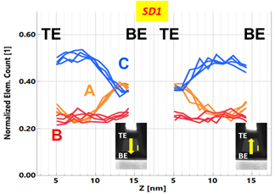
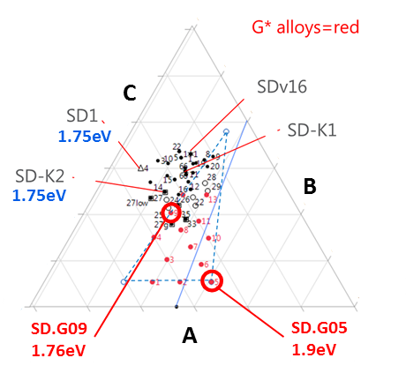
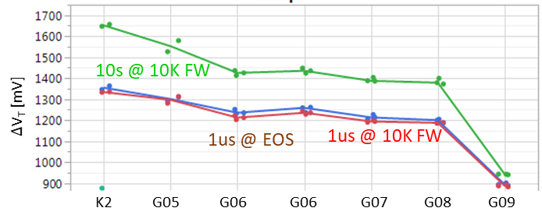
Read/Write
Read is identical to 3DXP (40ns pulse)
Symmetric write pulses for set and reset operations: 44ns@±45µA (~10MA/cm²)
Potential switching model: ∆V_{T} is interfacial modulation subject to mass transport by E-field at an elevated temperature.
Read Window Budget (∆V_{T}): 200 mV @ 5E-4 RBER (1µs E3 - 10s E2), 1350 mV (1µs < ∆V_{T}>)
  Reverse SubVt bias disturb (such as Write inhibit and Read disturb) is a BiSM unique disturb mechanism as manifested in BiSM POR material, SD.K2. A speculative model is SD mass transport reversal by reverse bias·time (low visibility / unquantifiable in PFA.) G-class alloys exhibit near 0mV E3 margin loss of 130K RD.
  Bipolar memory switching with elemental segregation are observed in wide range of Chalcogenide glasses
Threshold switching characteristics are not limited to Chalcogenide glass. It has been sighted also with other (doped) binary oxide, such as NbO_{x}, SiO_{x} and etc.
In additional to G-class alloy exploration in horizon, we are also actively seeking doped oxide at CR

Slide 7
Built-in Selector Memory (BiSM)
Basic Concept Intro
Assuming it works, what do we gain?
Key things we think we know / Don’t know

Slide 8
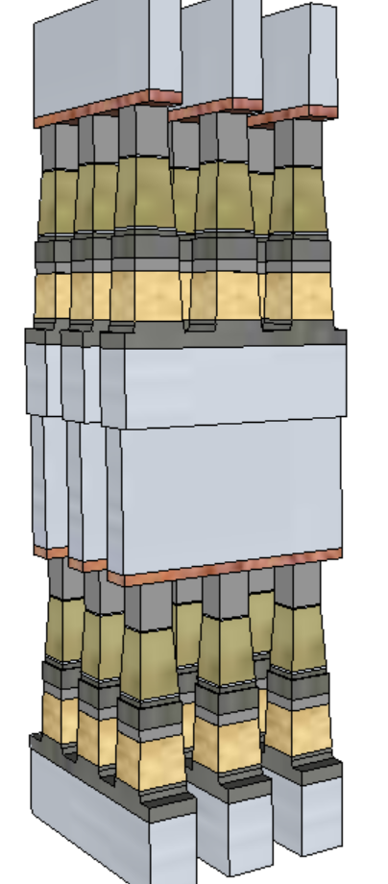
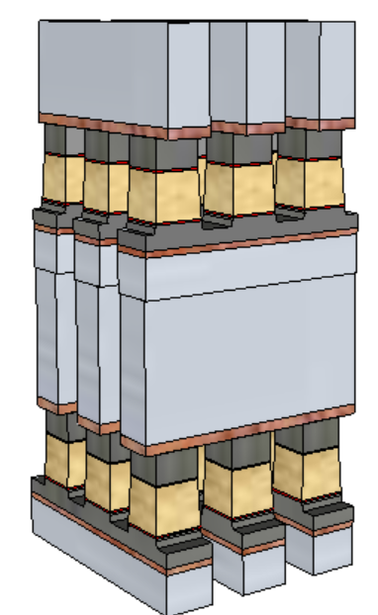
Potential Process Simplification
  Simplified manufacturing with Phase Change Memory, “PM”, removed
  3DXP etch done in 2 steps (First & Last Partial Etches: FP, LP) with liners deposited in between
  No cross-contamination between Memory and Selector materials
  Lower cell aspect-ratio
  Lower write current (more than 50% reduction) to relaxes WL/BL thickness requirements and array capacitance
PM
SD
SD
BiSM
3DXP
20nm node | 1st Cut |  | 2nd Cut
Technology Example | 3DXP | BiSM | 3DXP | BiSM
Stack height [nm] | 141 | 69 | 152 | 85
Stack Height, inc. HM [nm] | 296 | 142.6 | 297 | 191.7
Height/ Space for FP [nm] | 212.5/25.5 |  | 261/21.7
Height/ Space for LP [nm] | 246/19.6 | 142.6/19.6 | 182/18.4 | 191.7/18.4
Space Aspect Ratio for FP | 6.4 |  | 6.7
Space Aspect Ratio for LP | 8.4 | 4.8 | 9.1 | 5.4
Aspect Ratios, including hardmask resist are estimates – useful for comparative purposes

Slide 9
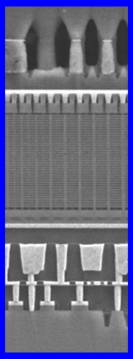
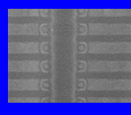
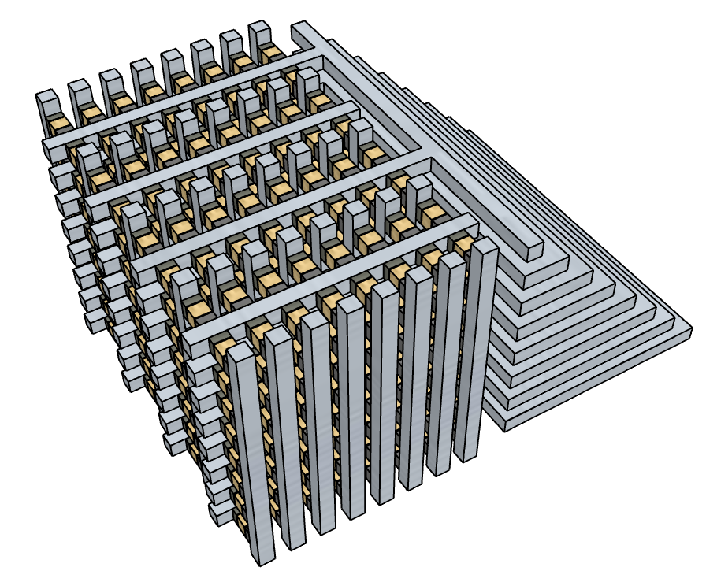
Process simplification ➔ Lower Cost & Further Opportunities
Definite: Removes all the PM related process cost (deposition, etch, liner, etc)
Possibility #1: Further Lower Cost Opportunities become potentially viable
  Lower mask count process: N+1 critical masks (vs. 2N) for N decks (use 2 step 3DXP-like etch/liner for 2 BiSM decks)
Possibility #2: Potential for “3D-NAND-like” Cross-point array architecture, for lower cost
  Thinner/simpler stack might be possible for lateral cell (vs planar / subtractive in 3DXP)
  ALD required for SD switch (ALD process does not exist today)
  Power/Performance unknown w/ larger array RC
    3D NAND-like architecture for RRAM was not as good as our present 3DXP approach when we explored in past
    Never as low cost as 3D NAND (NAND = MLC/TLC/QLC)
  Theoretically simplified cell enables
  tier architecture (3D-NAND-like) to lower processing cost.
Replace floating gate Transistor of 3D NAND with BiSM.
Replace channel with metal.
We think can work with FG NAND flow, but may require Replacement Gate-like process flow?

Slide 10
Potential Performance Gain
 |  | Read |  | Write
 |  | 3DXP | BiSM | 3DXP | BiSM
Latency | ns | 105 | 105 | 465 | 175
Latency limited BW | MB/s | 4876 | 4876 | 1101 | 2926
BiSM
3DXP
Elimination of PM reliability constraint
Fast write; no crystallization required
Potential for improving one of the key limiters of 3DXP: low write bandwidth (vs read and vs. DRAM)
Near Symmetrical Read/Write Latency…but can we build a bipolar operated low energy / low cost cross-point??

Slide 11
Built-in Selector Memory (BiSM)
Basic Concept Intro
Assuming it works, what do we gain?
Key things we think we know / Don’t know

Slide 12
Assessment Summary
BiSM technology:
  Opportunity for higher speed Storage Class Memory with simplified manufacturing without obvious showstopper.
  Basic Switching model is not fully known, but have potential working model and characterized memory attributes
  Solves known 3DXP issues; likely introduces others which we are yet to fully see.
  Scaling has yet to be demonstrated (20nm only data).
Efficient Design / Layout with bi-polar operation is a key constraint:
  Optane™ Memory Media has Circuit Under the Array (CUA) to reduce die size.
  BiSM bidirectional circuit topology is a key constraint of CUA for product cost and performance, despite the improved cell level write latency. Currently die size is prohibitive with the speculative Thick Gate CMOS (TGcMOST) design rule. Efficient tile design is a key challenge to product viability.
Competitive landscape:
  We believe Micron is pursuing this technology at a priority over the current Optane™ approach.
  In the research of atomistic switches (Intel sponsored or public domain), sighting, discussions and disclosures of similar behavior are emerging.

Slide 13
Integration Assessment
CR6.5 demonstrates >70% structure yield, which provides a baseline for a reliable assessment of Read Window Budget (cell yield metric)
Scaling Risks and Mitigation Strategy
High Risk
Improved etch profile exhibits significant Vt shift and leakage.
  Segmentation: contamination and/or composition shift subject to dry/wet etch/clean and/or liner/seal integrity
SD g-class large target manufacturing issues from current supplier
  Root cause identification and containment deployment:
  1. Work with target vendors to improve manufacturing process. 2. Further strategy could be to look for alternate dopants.
Medium Risk and Known Unknowns
New SD films chemical or thermal integration tolerance.
  Speculative model suggests glass transition temperature (T_{G}) a key knob for BiSM performance. This model and the usable T_{G} range for new material integration is yet to be explored/validated
  Potential modification of Liner/seal and densification strategies
CMP/chop process window with thinner stack
  Centering/Optimization is needed.
Other scaling integration risks are all improved versus 3DXP

Slide 14
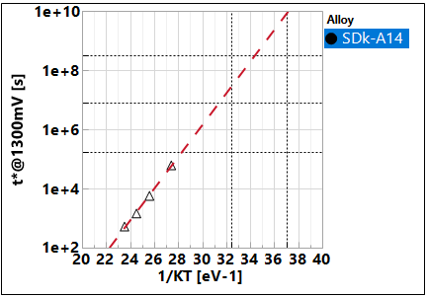
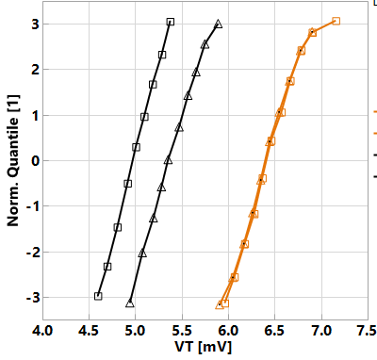
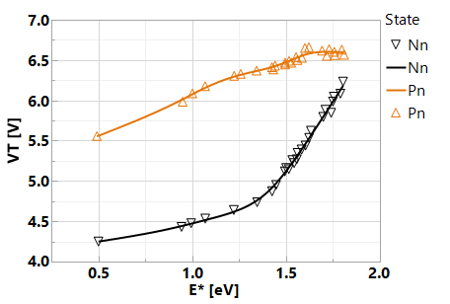
Retention
Window closure
SET/RST Distrib. Vs. T-bake
85C
5years
E_{A} ~ 1.25 eV
10y
3m
2d
SET
RST
@180C
-- 1μs
1e3 s
1e4 s
85C 40C
0193532w10 SDk-A14, r5.3
Window-based retention: E_{A} in ~ 1.25 eV range; ~ 1 year retention @ 85C → Mainly due to lower drift of reset state. Additional segmentation wip.
The retention characteristics, both set and reset shifting up, suggests the dominant retention mechanism subject to structure relaxation at temperature range explored.

Slide 15
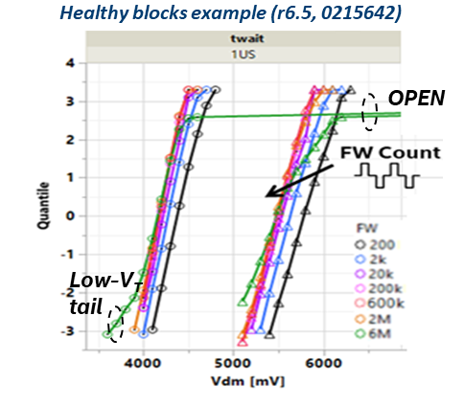
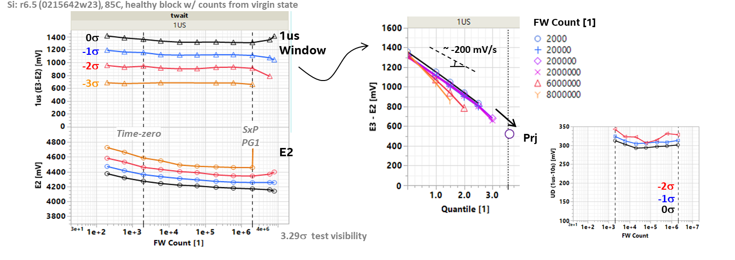
Write Endurance
No window closure of 2K bits up to 2M FW cycles @ 10ms ipd, low ED
Other Critical Characteristics
Seasoning Required – Yes, dual polarity for 10µsec cumulatively used for all data collected
Read Scheme – dual VDM is needed due to E2 drift
Cell leakage – SET is the same as 3DXP (5nA/cell), RESET is 1/10 of SET
C-cell bias – (E3 drift/shift) seeking elimination with material and/or process solution
TempCo – 0% for I_{program}, 4.5% for V_{DM}
WD – expected none; WD is subject to thermal proximity and reverse bias of A-/B-type cell (< 65% E_{TH})
Scaling expectations: (no CD scaling data available)
  I_{program} – the same as 3DXP, subject to T_{g}
  RWB – no worse than 3DXP
  Read/Write Latency – no change

Slide 16
Unipolar vs. Bipolar Decoder
Unipolar
Bipolar
WL Decoder
BL Decoder
WL/BL Decoder

Slide 17
Don’t Know Circuit Topology to Fit CMOS under Array…yet
3DXP cross section: array + circuits under tile
3DXP has all CMOS under array for each sub-tile (decoders, sense circuits, etc).
Not fitting CMOS ➔ blows up die size??
Bi-polar operation adds transistors to critical pitch circuits under the array and increases voltage swing (requires higher voltage transistors)

Slide 18
Die Size and Energy Assessment
Architecture | Decoder | CMOS and Interconnect | Density [Gb/mm²] | Write [pJ/b] | Read [pJ/b] | Gap [%]
 |  |  |  |  |  | Density | Write | Read
ALF32 (3DXP POR) | Unipolar | P1240.0 | 1.28 | 104 | 44
S24S (BiSM Test Chip) | Bipolar | P1240.0 | 1.16 | 154 | 55 | 9% | 48% | 25%
BiSM32 (BiSM Conceptual Design) | Bipolar | P1240.0+Thicker Gate CMOS | 1.00 | 107 | 47 | 23% | 3% | 7%
S24S decoder creates big energy gap and lowers density
BiSM32 decoder Arch bridges the energy gap, but reduces density further.
Density gap of BiSM32 can be recovered by improving CMOS performance.

Slide 19
Backup

Slide 20


Model (II) – Heterojunction, higher 𝛘
Bias
C
D₊(Ab_{x})
D₋(Ab_{x})
C
Vacuum
(–) Bias Read, same polarity of write
  Space charge region maintained or little change. Potential drop evenly cross Chalcogenide glass.
(+) Bias Read, opposite polarity of Write
  Bias initially contributed in compensating built-in potential, shift I-V to right.
Higher 𝛘 heterogeneous junction model supports the observed polarity effect
⊕
$$\vec{ℰ}$$
ϕ
⊖
(−)
(−)
⊕
$$\vec{ℰ}$$
ϕ
⊖
0V
0V
$$\vec{ℰ}$$
ϕ
(+)
⊕
⊖

