Slide 1
Blackbox Cell
DerChang, WW29.4/2019
RWB drives supply rail requirement therefore
Power/Energy
CMOS
POR RWB requires VPP-VNN ≈ 9V
Blackbox Cell goal is to reduce RWB to achieve 3V reduction on supply rail (> 50% of displacement energy reduction)

Slide 2
3DXP RWB Model
Set@1us,
fresh
Reset@1us
fresh
∆V_{wlr}
dft_{rst}
3.54σ
TCs of V_{set} and V_{rst} are identical (-4~5mV/C). Vt distributions parallel shift cross temperature
Set@2d
fresh
∆V_{T} = V_{rst} − V_{set} + V_{xt}
0σ
Reset@1us
EOL
Reset@2d
fresh
Set@1𝛍s
EOL
∆V_{inh}
E₃ − E₂ =
GB_{RD}
V_{para}
dft_{set}
GB_{endu}
3.54σ
V_{inh}
E₁
V_{set}
E₂
E₃
V_{rst}
E₄
V_{sel}
Voltage [V]
E₁ = V_{set} − n∙𝛔_{set} − ∆V_{wlr}
E₂ = V_{set} + n∙𝛔_{set} + dft_{set}
E₃ = V_{rst} − n∙𝛔_{rst} − GB_{end}
E₄ = V_{rst} + n∙𝛔_{rst} + dft_{rst}

Slide 3
3DXP V_{T}’s, Inhibit & Select Voltages
∆V_{T} = GB_{end} + GB_{dist} + V_{xt} + dft_{set} + n∙(𝛔_{set} + 𝛔_{rst})
V_{set} = GB_{RD} + GB_{endu} + V_{xt} + V_{para} + dft_{set} + dft_{rst} + 2∙(∆V_{inh} + ∆V_{wlr} + n∙𝛔_{rst}) + + 3∙n∙𝛔_{set}
V_{rst} = V_{para} + dft_{rst} + 2∙(GB_{RD} + GB_{endu} + V_{xt} + dft_{set} + ∆V_{wlr} + ∆V_{inh}) + 3∙n∙𝛔_{rst} + 4∙n∙𝛔_{set}
V_{inh} = GB_{RD} + GB_{endu} + V_{xt} + V_{para} + dft_{set} + dft_{rst} + ∆V_{inh} + ∆V_{wlr} + 2∙n∙(𝛔_{set} + 𝛔_{rst})
V_{sel} = 2∙(GB_{RD} + GB_{endu} + V_{xt} + V_{para} + dft_{rst} + dft_{set} + ∆V_{wlr} + ∆V_{inh}) + 4∙n∙(𝛔_{rst} + 𝛔_{set} )

Slide 4
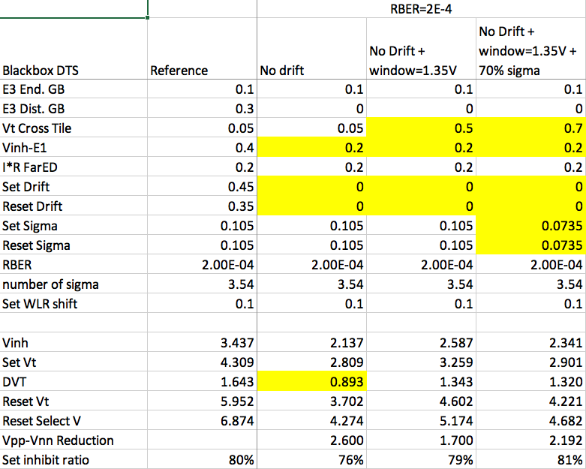
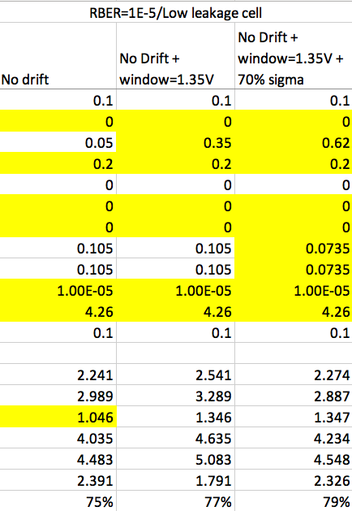
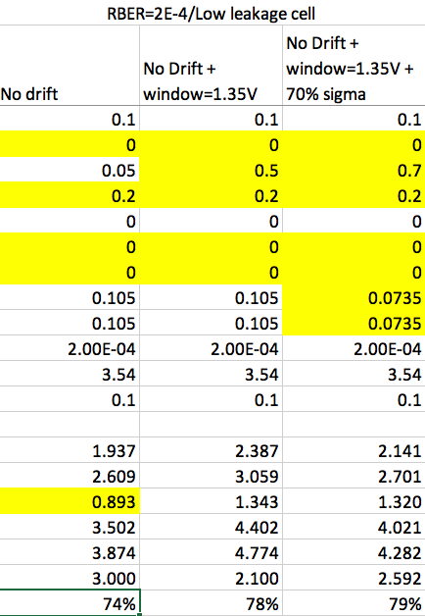
Ideas

