Slide 1
3D XPoint™ Memory Alternative
Team BiSM, WW31, 2019
Incumbent Technology
Introduction to BiSM
Cell Technology
Memory Switching Physics
Array Architecture
Critical Path to α-Product Definition

Slide 2
Incumbent Technology
Introduction to BiSM
Cell Technology
Memory Switching Physics
Array Architecture
Critical Path to α-Product Definition

Slide 3
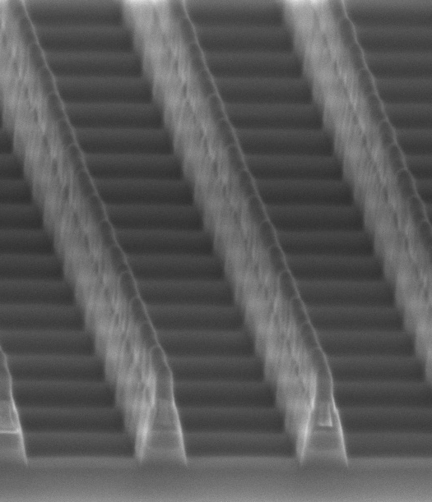
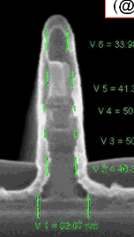
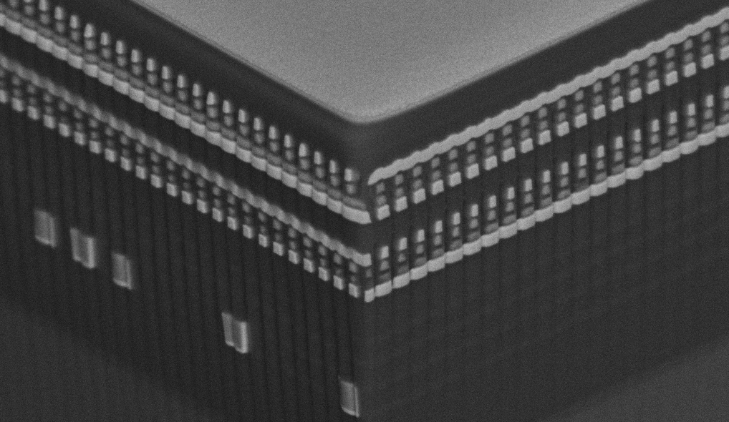
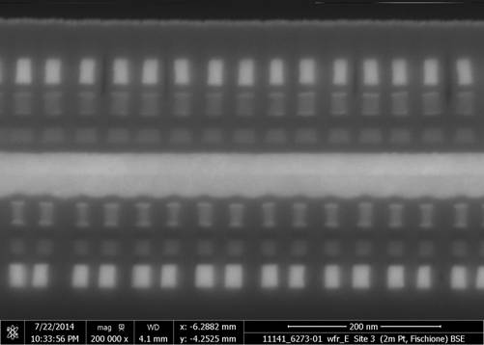
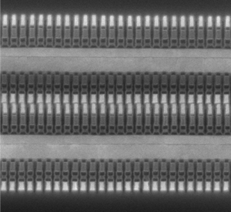
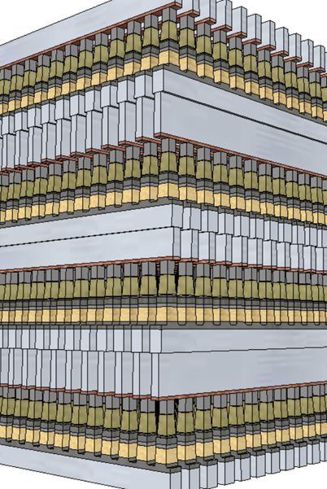
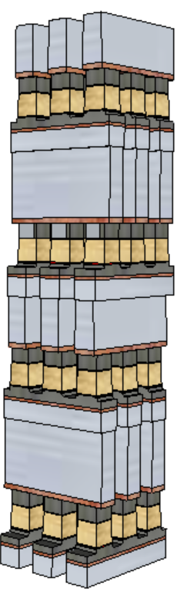
3D XPoint™ Technology Development Evolution
4Kb 200nm feature, 2-Mask Sublitho Heater
Damascene PM Subtractive SD
2003~2006 Santa Clara, CA
64Mb 180nm ½ Pitch 6-Mask Sublitho Heater Damascene PM, Subtractive SD
2007~2009 Santa Clara, CA
64Mb 100nm feature, 2-Mask
Self-Aligned, Subtractive Cell
2010~2011 Agrate, Italy
64Mb 50nm ½ Pitch, 2-Mask
Dual Deck, Self Aligned Subtractive Cell
2012~2013 Agrate, Italy
X-section along ROW
TiAlN
SD
C
W
PM
TiAlN
SD
C
C
SD
TiSiN
PM
Mid Electrodes
TiSiN
PM
SXP cell
SD only
128Gb 20nm ½ Pitch 7-Mask
Dual Deck Self Aligned Subtractive Cell
2013~2018 Boise, ID
256Gb 20nm ½ Pitch 13-Mask
Quad Deck Self Aligned Subtractive Cell
2015~2020 Lehi, UT & Rio Rancho, NM
256Gb 17nm ½ Pitch 13-Mask
Quad Deck Self Aligned Subtractive Cell
2020~2022 Rio Rancho, NM
512Gb 14nm ½ Pitch
Quad Deck BiSM
2020~2022, Rio Rancho, NM
?

Slide 4
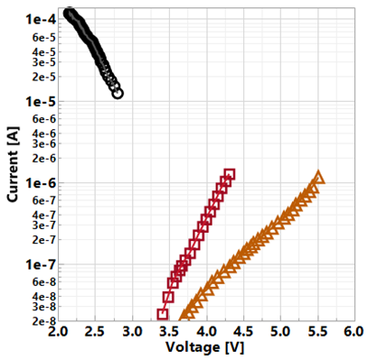
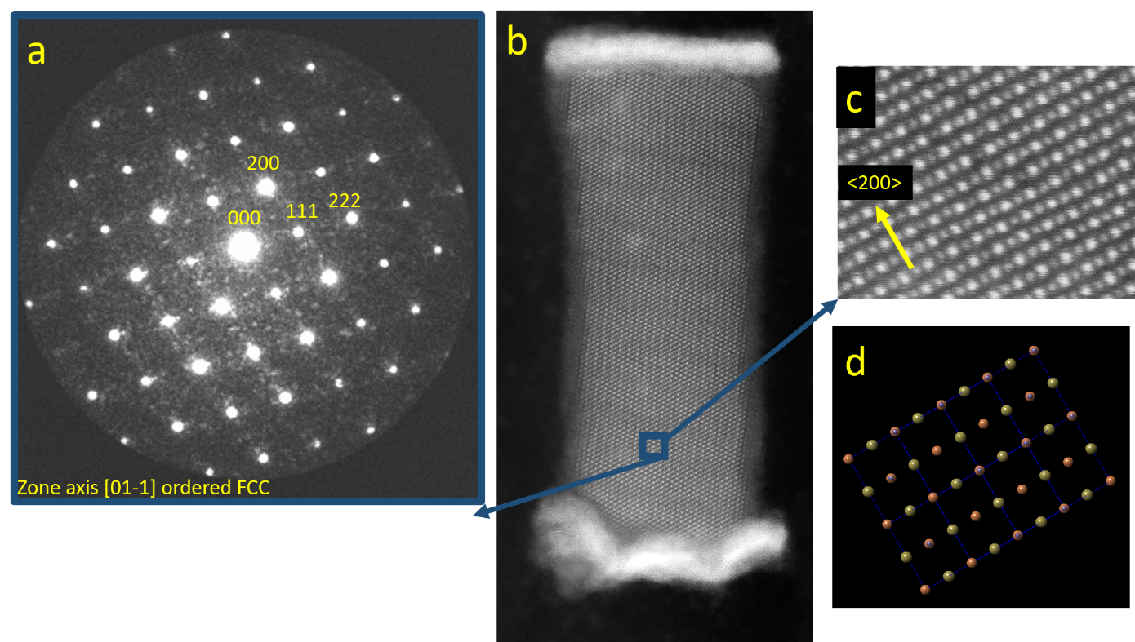
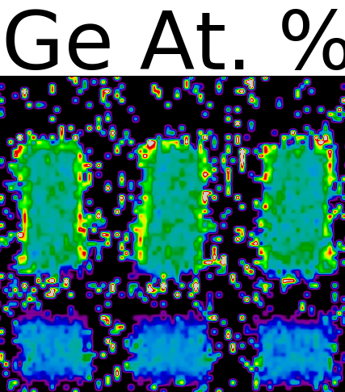
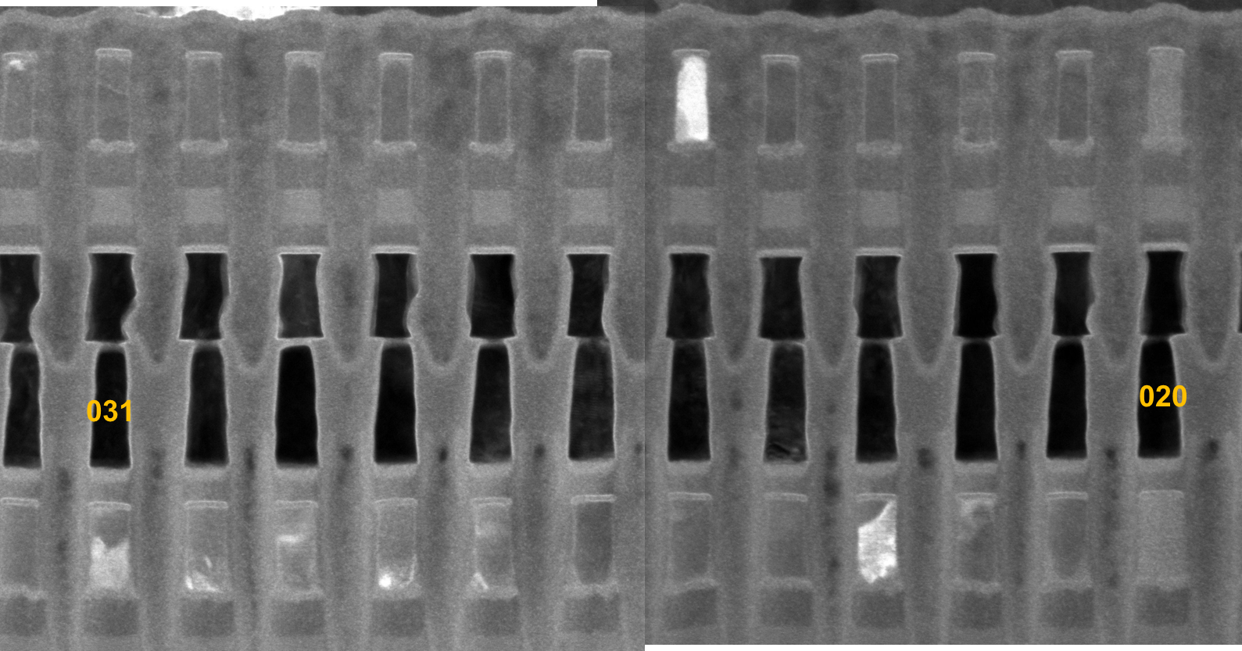
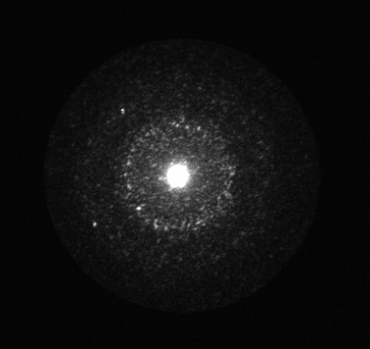
How SXP cell works
Demarcation Read on Quasi-static I-V curves
Set Operations: Solid-state recrystallization to produce crystalline PM / low threshold switching state
Key attributes: I_{SET}, V_{t,SET}, 𝜏_{SET}
On-bias
a.k.a.
Snapback NDR
V_{DM}
SET
State
RST
State
Off-bias
a.k.a.
SubVt
Reset Operations : Melt-quench vitrification to produce glassy PM / high threshold switching state
Key attributes: I_{RESET}, V_{t,RESET}
Fully crystalline (χ≅1)
Amorphous (α)
Amorphous
STEM-ADF: High throughput for χ/α fraction
α corners
(χ ≅ 0.85)
Fully α
(χ ≅ 0)

Slide 5
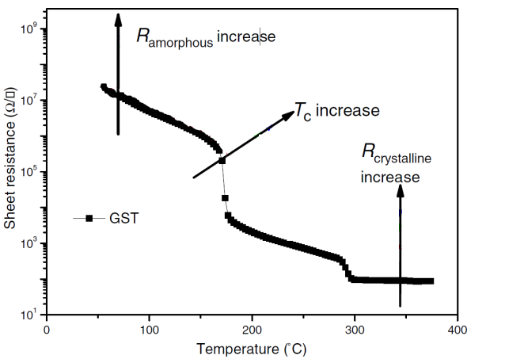
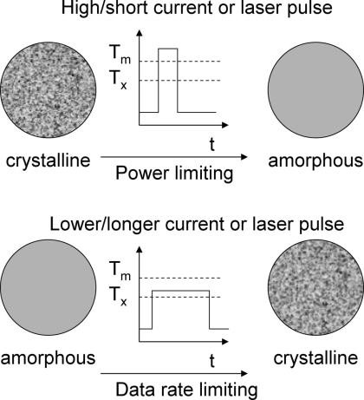
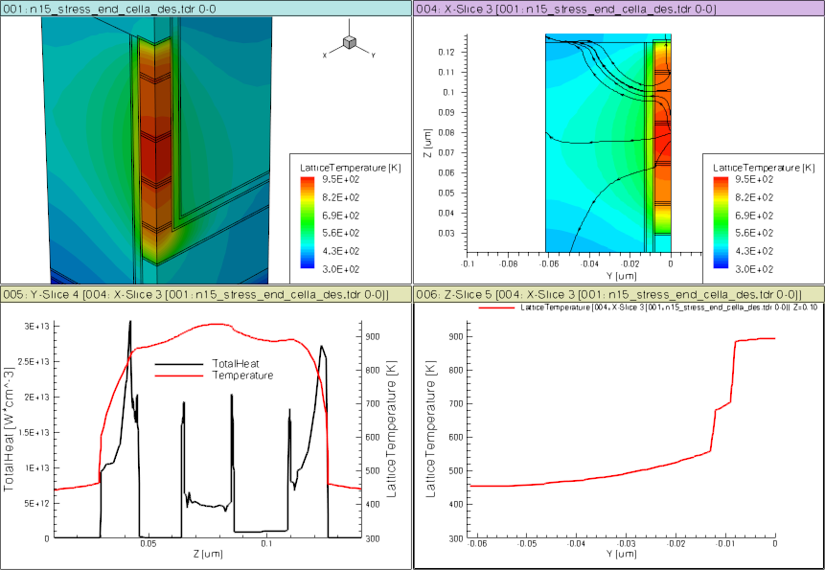
PM: Memory Switching Model (Ge₂Sb₂Te₅ example)
E
Te
V
CB
E_{c}
Crystalline
E_{v}
HCP
VB
E_{f}
FCC
10% structural vacancies result in localized states near LP band, exhibiting p-type semiconducting characteristics
E
Te
CB
E_{c}
Amorphous
SD
PM
E_{f}
E_{v}
BE
ME
TE
VB
Over- and under-coordinated Tellurium lead to defects/traps
Glassy PM exhibits threshold switch characteristics

Slide 6
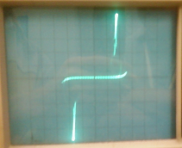
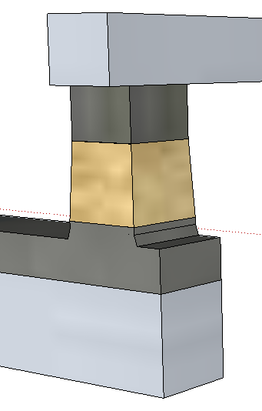
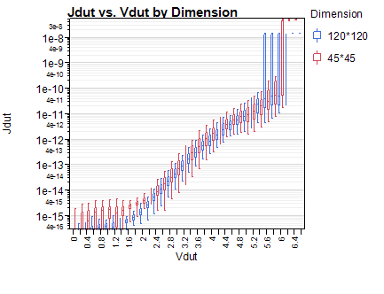
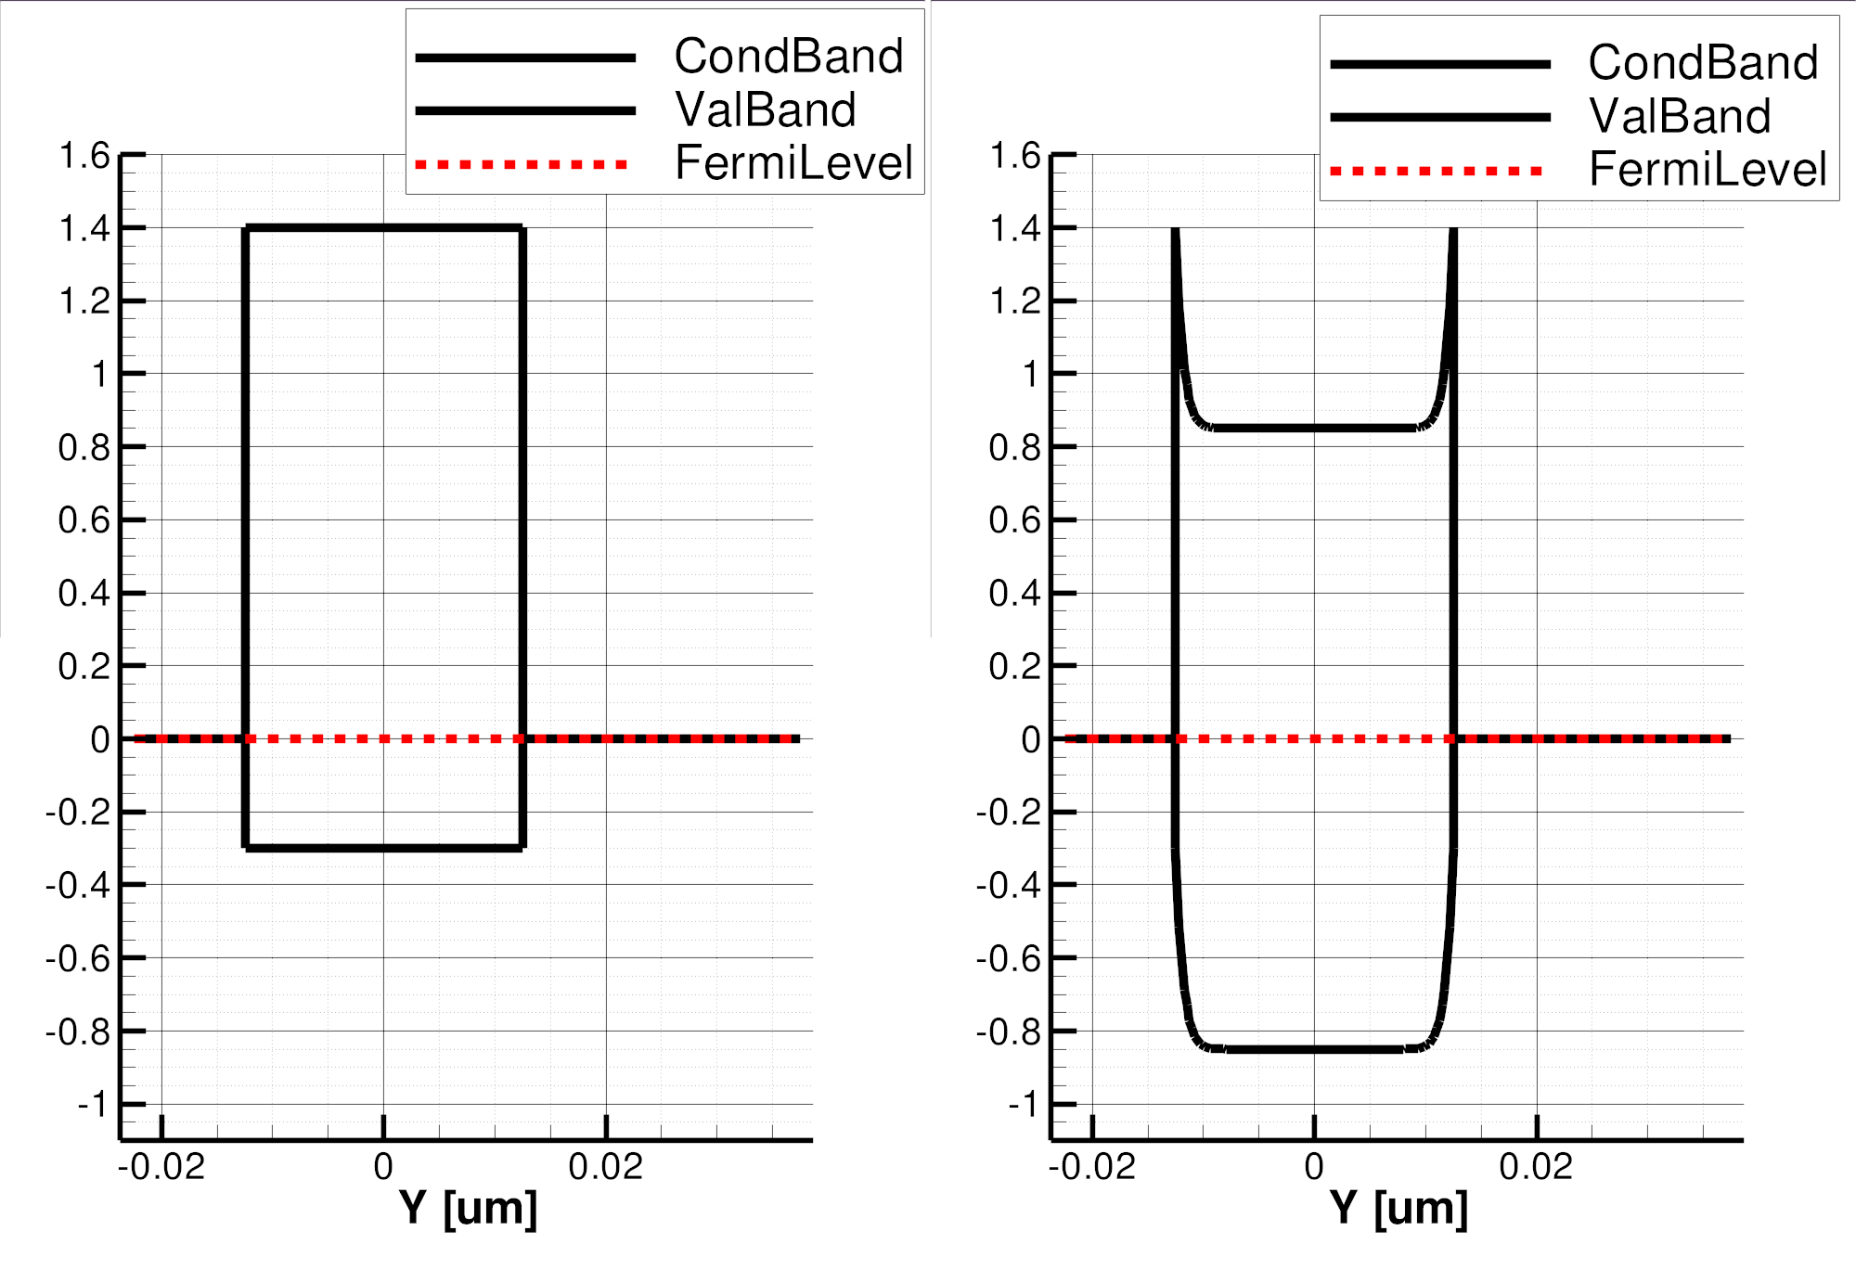
Bi-directional I-V
Ambipolar
On-state
Near Threshold
BE
BE
TE
TE
Top
Electrode
64
J [A/nm²]
(120nm)²
Selector
J [MA/cm²]
(45nm)²
48
Bottom
Electrode
32
Full-STACK
SD: Threshold Switching Model
Electrode only
16
φ_{B}=.85eV
3.0eV
4.4eV
V [Volts]
V [Volts]
1.7
1.7eV
E_{F}
BE
TE
BE
BE
SubThreshold
PF conduction
Threshold,
(positive feedback)
Snapback Regime
TE
TE

Slide 7
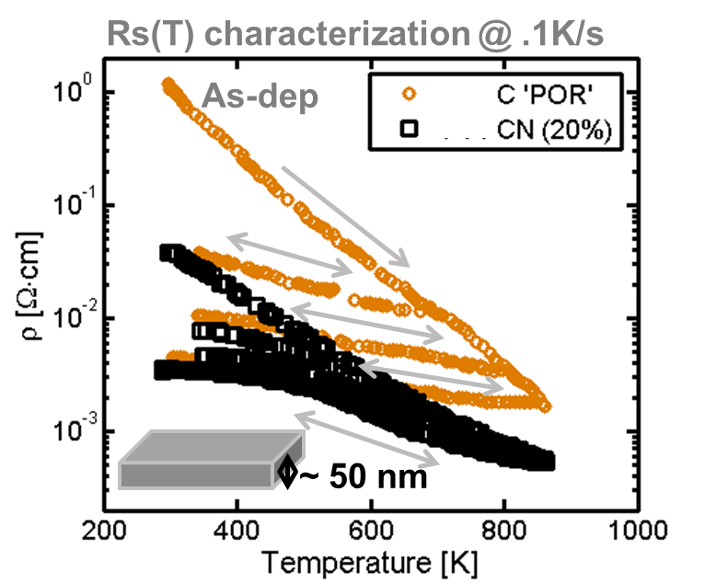
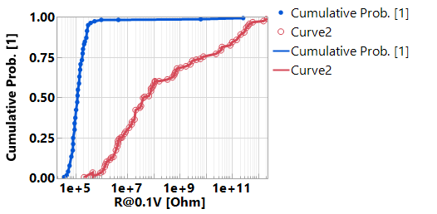
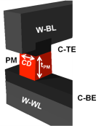
Role of Electrode
Graphitic carbon servers two roles
Physical barriers to eliminate cross contamination between PM, SD and WL/BL metals during manufacturing and product operations
Heating elements for phase change
Irreversible resistance change subject to thermal budget
Electrode Success Criteria
Interfacial liner, W, is needed to improve contact specific resistance to PM.
Component | L0 Spec (mΩ∙cm)
Electrode (El.) Bulk resistivity | As dep | 1~200
 | 300C cycled | 1~30
 | 600C cycled | 1~2.5
E/PM Interface | < 10ΜΩ∙nm²@1μΑ
E/SD Interface | < 100ΜΩ∙nm²@1μΑ
C/PM/W/C
C/PM/C

Slide 8
Incumbent Technology
Introduction to BiSM
Cell Technology
Memory Switching Physics
Array Architecture
Critical Path to α-Product Definition

Slide 9
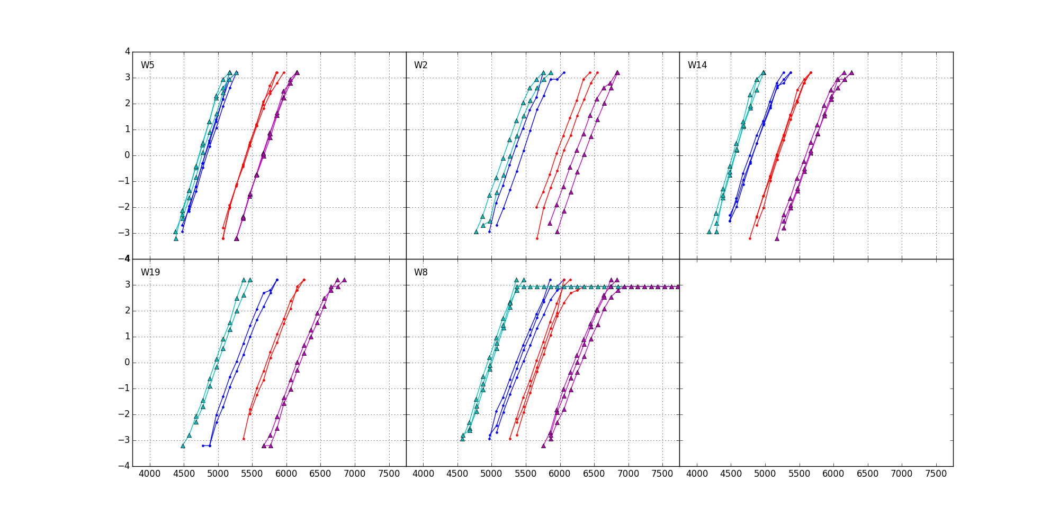
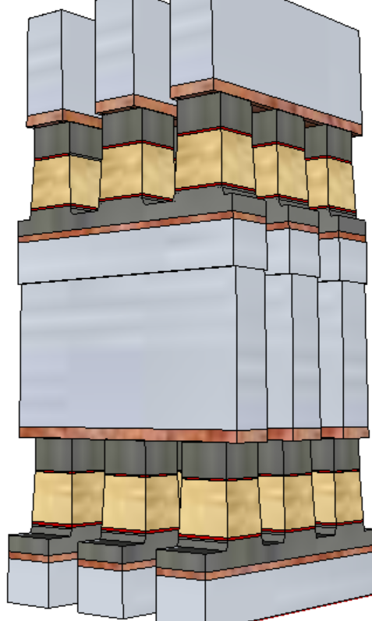
Introduction to BiSM
A SD only memory cell sandwiched between a X-Y cross point, BEOL stackable, compatible with mainstream CMOS.
Write/Read
Polarity
+/+
−/+
S15B SD-only, lot 8792062, 18nm SDδ ver 4
−/−
+/−
V_{T,High}
Positive
Write
σ of bit distribution
Negative
read
V_{T,Low}
900mV
Negative
Write
Negative
read
Pulse Polarity
TE
SD
BE
V_{TH} [mV]
It exhibits a window by applying programming pulses with opposite polarity.
In a typical selector-less (0S1R) cross point memory array, leakage and disturb fundamentally limit the density and usability of the technology. BiSM is working well because of the built-in selector to reduce leakage for high density and to increase immunity to read/write disturbance for nonvolatility; hence Built-in-Selector Memory, a.k.a. BiSM, is coined.

Slide 10
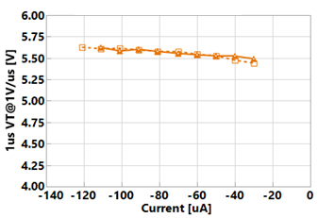
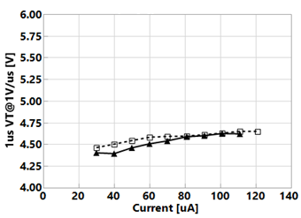
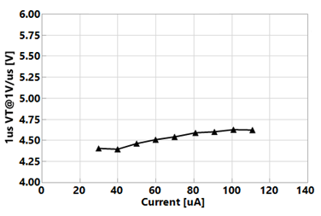
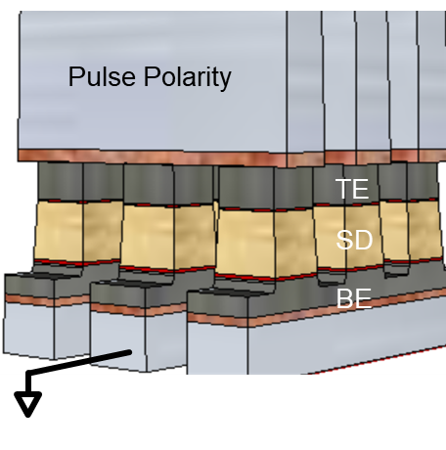
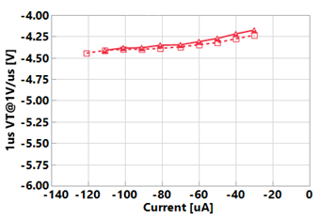
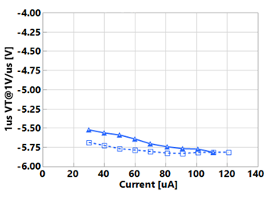
Bipolar Switching: Program Transfer curves
[Prg-Rd]
Ir(i)
Read (i)
I
[POS-POS]
…
Ir,max
Read (N)
Ir(N)
II
[NEG-POS]
~
~
~
~
IV
[POS-NEG]
@20.5nm
III
[NEG-NEG]
Program Transfer Curve in the 4 quadrants (I, II, III, IV) by exploiting on-chip dual-polarity.

Slide 11

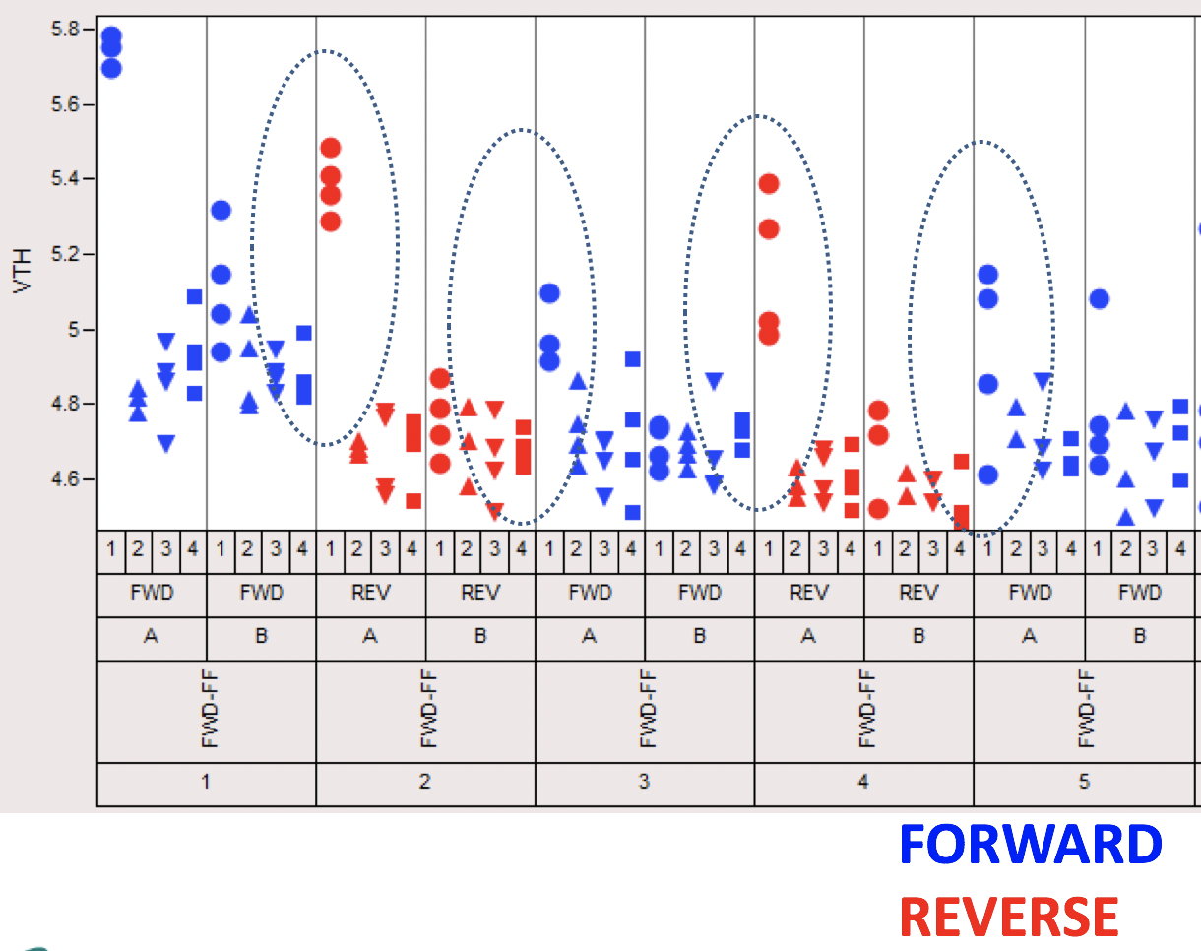
A Brief History
In June, 2013, as 3DXP dual-deck development shifted to high gear, a subtle BiSM “window” was sighted by Arjun Kripanidhi at SC9 Device Lab.
Subsequently, with 3DXP process improved, BiSM V_{T} window became more evident. The concept of BiSM was conceived in the JDP with Micron and worked on jointly by both companies under the research initiative called Self-Select Memory, a.k.a. SSM.

Slide 12
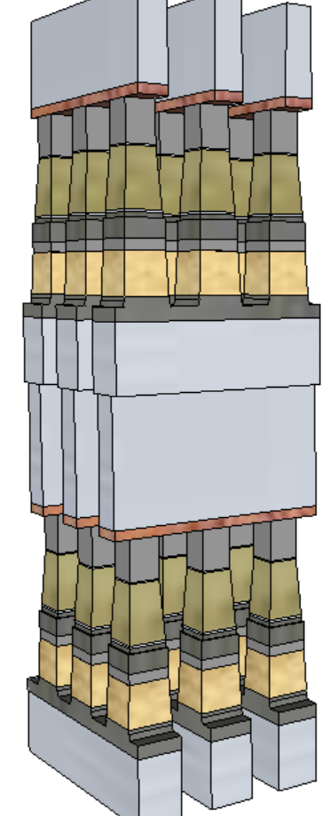
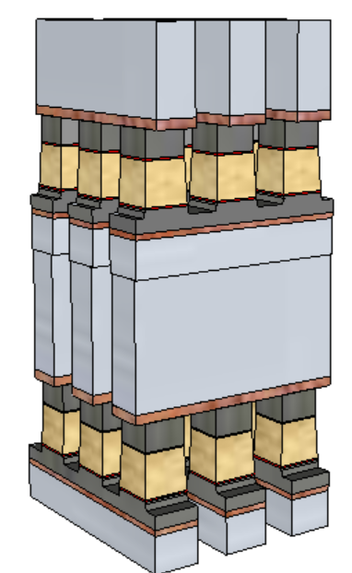
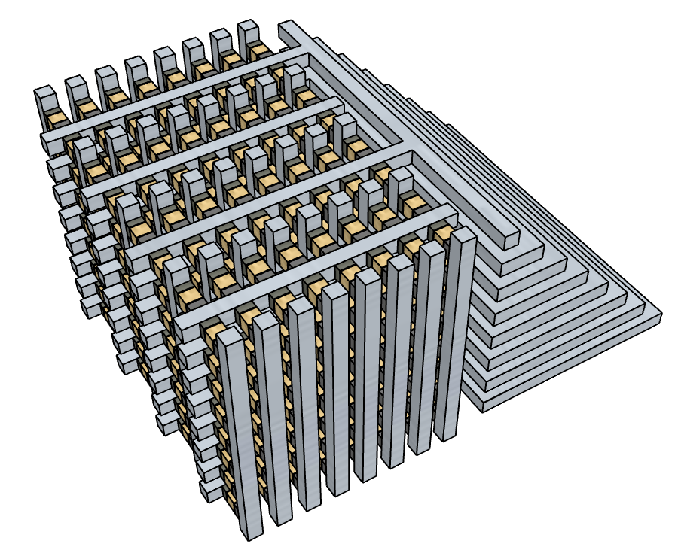
Value Proposition
Simplified manufacturing with PM removed lower cell aspect-ratio No cross-contamination between Memory and Selector materials
Improved performance and reliability
Elimination of PM reliability constraint
Lower write current to relaxes WL/BL requirements and array capacitance
Fast write; no crystallization required An opportunity for symmetric memory access (read/set/reset)
BiSM
3DXP
Theoretically simplified cell enables
Tier Architecture (3D NAND like)
to lower manufacturing cost

Slide 13
Incumbent Technology
Introduction to BiSM
Cell Technology
Memory Switching Physics
Array Architecture
Critical Path to α-Product Definition

Slide 14
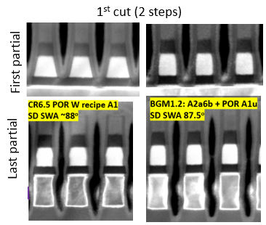
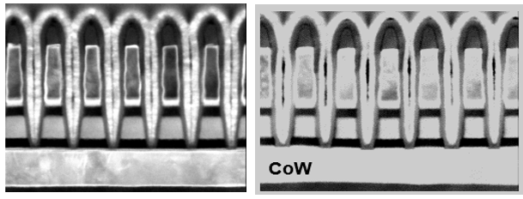
1st and 2nd cut profile CR6.5 demonstrated >70% PG4 structure yield & PG4 capable RWB
2nd cut (single step)
MTS Metric | SPEC | POR | FWD
HM thk (nm) | 18 | 17 | 23
W top CD (nm) | 21 | 18 | 22.5
W bot CD (nm) | 17.2 | 14 | 18.5
TEC CD (nm) | 21.3 | 18 | 19.2
SD top CD (nm) | 21.5 | 22 | 16.5
SD bot CD (nm) | 23 | 26 | 18.5
SD SWA (degree) | 89 | 84 | 87
Specs | MTS Metric | SPEC | POR | FWD
First partial | SD top (nm) | 18.1 | 16.3 | 15.6
 | SD bot (nm) | 18.9 | 24.9 | 18
 | SD SWA (degree) | 89 | 79 | 87.5
Last partial | SD top(nm) | 18.1 | 16.1 | 15.6
 | SD mid(nm) | 18.5 | 17.2 | 18
 | SD bot (nm) | 18.9 | 17.8 | 18.1
 | SD SWA(degree) | 89 | 88 | 87.5
 | W Sep (nm) | 20.8 | 18.7 | 18.5
 | W Bot (nm) | 21.2 | 22.3 | 22
July/12/2018

Slide 15
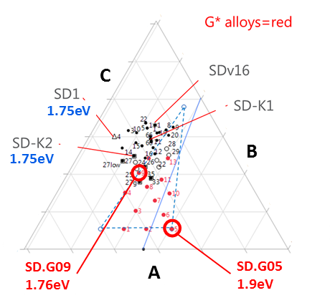
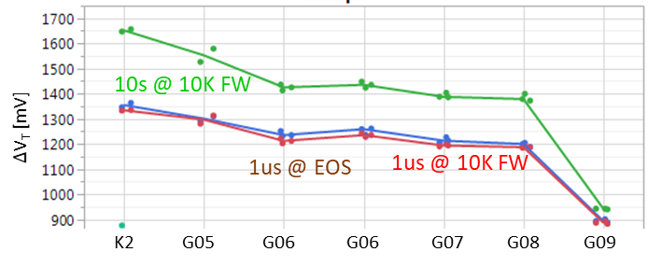
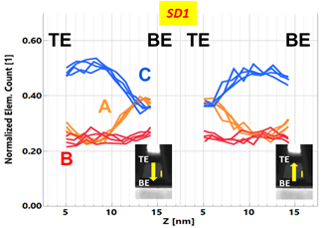
Read/Write
Symmetric write pulses for set and reset operations: 44ns@±45µA
Read is identical to 3DXP (40ns pulse)
Read Window Budget (∆V_{T}): 200 mV @ 5E-4 RBER
The best known ∆V_{T} physics is an interfacial modulation subject to mass transport by E-field at an elevated temperature.
Bipolar memory switching with elemental segregation are observed in wide range of Chalcogenide glasses

Slide 16
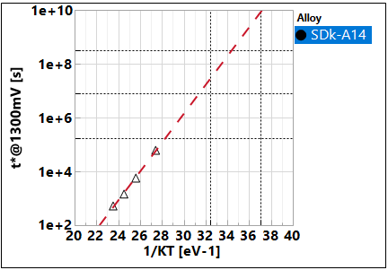
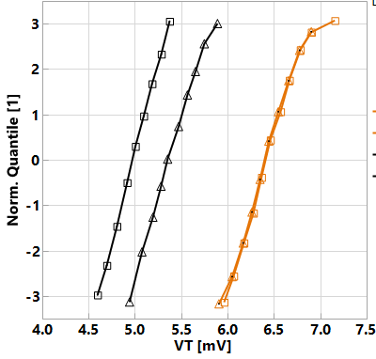
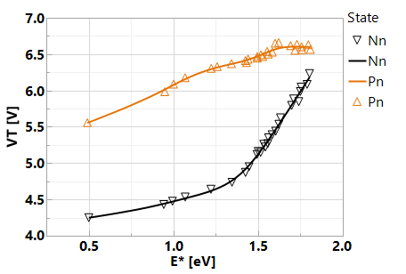
Retention
Window closure
SET/RST Distrib. Vs. T-bake
85C
5years
E_{A} ~ 1.25 eV
10y
3m
2d
SET
RST
@180C
-- 1μs
1e3 s
1e4 s
85C 40C
0193532w10 SDk-A14, r5.3
Window-based retention: E_{A} in ~ 1.25 eV range; ~ 1 year retention @ 85C → Mainly due to lower drift of reset state. Additional segmentation wip.
The retention characteristics, both set and reset shifting up, suggests the dominant retention mechanism subject to structure relaxation at temperature range explored.

Slide 17
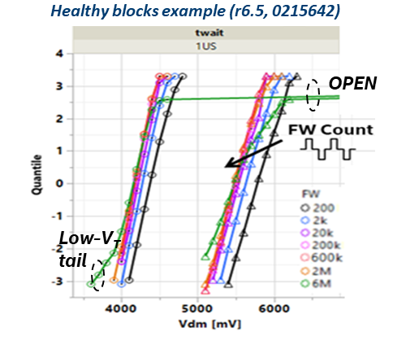
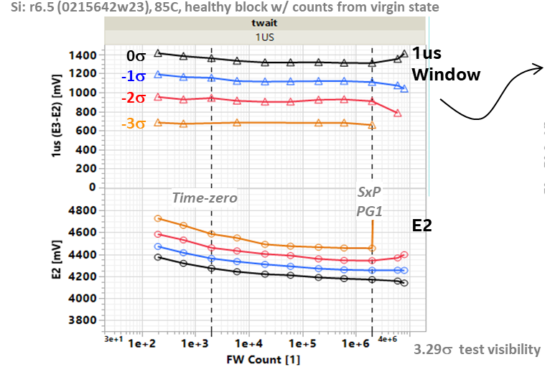
Write Endurance
No window closure of 2K bits up to 2M FW cycles @ 10ms ipd, low ED
Scaling Expectation (No Scaling Data)
I_{program} – the same as 3DXP, subject to T_{g}
RWB – no worse than 3DXP
Read/Write Latency – no change

Slide 18
Incumbent Technology
Introduction to BiSM
Cell Technology
Memory Switching Physics
Array Architecture
Critical Path to α-Product Definition

Slide 19
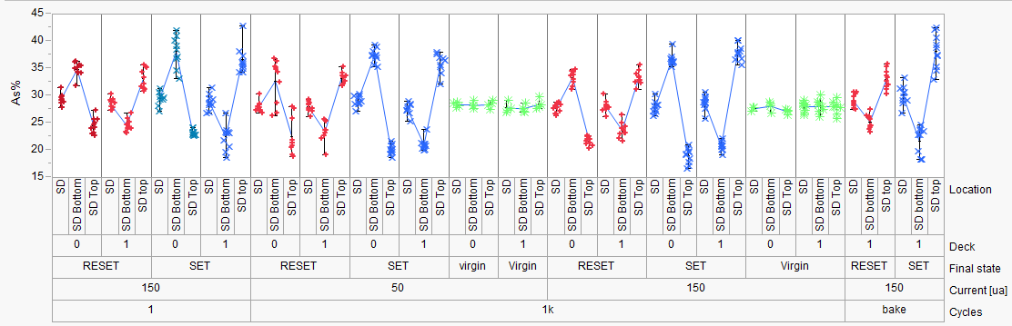
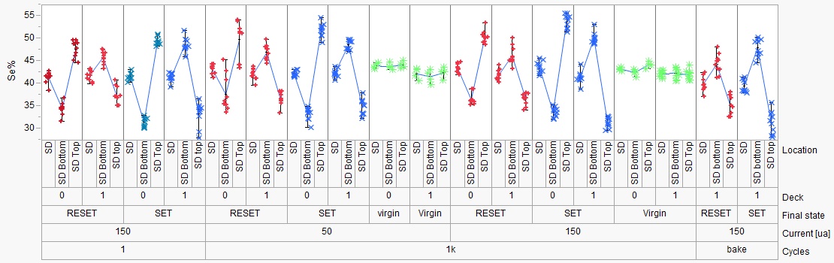
SAG20 Elements Movement (Positive Pulse), similar to GST
PFA-396 (SD1)
Hefei
1k cycles
1k cycles
50 ns | 1000 ns | 50 ns | 1000 ns
50 uA |  | 150 uA
1us
50ns
1us
50ns

Slide 20
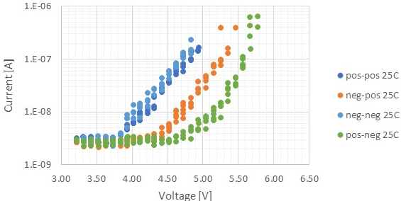
Electrical Equivalent Circuit and Possible Underline Physics
A V_{T} window (∆V_{T}) has been observed by applying programming pulses with opposite polarity. The best known ∆V_{T} physics is an electrochemical potential modulation effect subject to mass transport by polarity.
Leakage characteristics of SD is unlikely to sustain a charge-trap nonvolatile memory model.
Bipolar Read signature refutes filamentation.
Bipolar Write supports mass transport between electrodes.
Near parallel shift on SubVt I-V subject to polarity
For ‘neg read’ – 1V of ∆V_{T} in SubVt
The equivalent circuit – a programmable battery connected to a Chal Glass Resistor serially
Where and what is the battery modulation (near 1V)
Fermi Level (homogeneous junction)
Band structure (heterogeneous junction) in Electronegativity or Work Function (Bandgap is 2^{ndary} augmentation)
Assuming Electrode to Chal Glass junction is subject to defect tunneling therefore voltage contribution is insignificant (On-State I-V and other evidence?)
Chal Glass Res

Slide 21
Basic Band Diagram of SAG and Model assumptions Electronic Structure of Amorphous Semiconductors, D. Adler and E. J. Yoffa, Phys. Rev. Lett. 36, 1197-1200 (1976)
Assumptions:
EG:2eV
Effective intrasite electronic correlation energy is negative therefore P-type is exhibited (pinned)
3 Electronic models on with SAG mass transport by polarity
As (Ge?) moves toward cathode
Homojunction – Correlation energy changed to positive therefore n-type (similar to tetrahedrally coordinated amorphous semiconductor)
Heterojunction-I – Band offset due to coordination changes (Michaelson’s Electronegativity Scales & The work Function, IBM JRD 1978), higher Work Function
Heterojunction-II – Band offset, but lower Work Function
0.8eV Change is used to illustrate all 3 models
C
As-GeSe_{x}
C
Vacuum
E_{c}
E_{f}
ϕ_{e}
E_{v}
As+/Ge+
Vacuum
(I)
(II)
(III)
∆E_{f}=+0.8eV
∆χ=−0.8eV
∆χ=+0.8eV

Slide 22
1D Space Charge and Built-in Field
Trap Density [cc⁻¹]
ϵ_{SD} = 10
ε_{max} [MV/cm]
V_{bi}=1V
V_{bi}=.1V
Space Charge Width [nm]
ε[MV/cm]
Space Charge Width
ε_{max}
Trap Density [cc⁻¹]
E_{BD} : Si ~0.3MV/cm SiO₂ 10~15MV/cm, GST ~0.3MV/cm, TAG ~1MV/cm, SAG ~3MV/cm

Slide 23
Physical model – working principles & assumptions
SSM device is a string of domains serially concatenated. Node is an abstract point junction between domains.
Simplified with 1D model
Per Kirchhoff law
The nodal current is zero
Assumption – Qausi-static SubVt I-V represents device I-V at nano-second regime
The “domain” voltage drop for a current level will determine the shape of the I-V curve;
Shift right is higher threshold voltage and Voltage contribution of shifting is the memory effects
4 carrier transport mechanisms –
Conduction in delocalized state such as Diffusion and Drift
Conduction between localized and delocalized states such Poole-Frankel
Direct tunneling such as band to band and defect to defect between metallurgical junctions
Drift is linear function of electrical field – contribution is very low due to low free carrier and low mean-free path
Likewise, Diffusion contribution is also low (Einstein relation)
Electronic trap density is in the order of 1% of atomic density (inactive or pinned) ~10²¹/cc
10% structural vacancies in typical crystalline GST225, If electronically active, Debye length is < lattice constant; CV measurement exhibits Debye length in the order of μm or longer
Space charge region @ junction established by direct tunneling with build-in potential

Slide 24
1D Space Charge and Built-in Field in SAG
ε[MV/cm]
V_{bi} [volt]
Trap Density [cc⁻¹]
ε_{BD}
E_{BD} : SAG ~3MV/cm
Space Charge Width

Slide 25


Model Comparison
Model (I) – Homojunction
Model (II) – Heterojunction, higher 𝛘
Model (III) – Heterojunction, lower 𝛘
Bias
C
As+
GeSe_{x}
C
Bias
C
As+
GeSe_{x}
C
Bias
C
As+
GeSe_{x}
C
Vacuum
Vacuum
Vacuum
$$\vec{ℰ}$$
ϕ
⊕
$$\vec{ℰ}$$
ϕ
⊖
⊖
⊕
$$\vec{ℰ}$$
ϕ
⊕
(−)
(−)
⊖
$$\vec{ℰ}$$
ϕ
(−)
$$\vec{ℰ}$$
ϕ
(−)
⊕
⊕
$$\vec{ℰ}$$
ϕ
⊕
⊖
⊖
⊖
0V
0V
0V
0V
$$\vec{ℰ}$$
ϕ
⊕
$$\vec{ℰ}$$
ϕ
$$\vec{ℰ}$$
ϕ
(+)
⊖
(+)
⊖
⊕
(+)
⊕
⊖

Slide 26
Model (I) – Homojunction
(–) Bias Read, same polarity of write
Bias initially contributed to barrier reduction, very low current, shift I-V to right.
(+) Bias Read, opposite polarity of Write
Space charge region maintained or no change. Potential drop evenly cross Chal glass.
Homogeneous junction model does not support the observed polarity effect
Bias
C
As+
GeSe_{x}
C
Vacuum
$$\vec{ℰ}$$
ϕ
⊕
⊖
(−)
$$\vec{ℰ}$$
ϕ
⊕
⊖
0V
$$\vec{ℰ}$$
ϕ
⊕
(+)
⊖

Slide 27
Model (II) – Heterojunction, higher 𝛘
(–) Bias Read, same polarity of write
Space charge region maintained or little change. Potential drop evenly cross Chal glass.
(+) Bias Read, opposite polarity of Write
Bias initially contributed in compensating built-in potential, shift I-V to right.
Higher 𝛘 heterogeneous junction model supports the observed polarity effect
Bias
C
As+
GeSe_{x}
C
Vacuum
⊕
$$\vec{ℰ}$$
ϕ
⊖
(−)
(−)
⊕
$$\vec{ℰ}$$
ϕ
⊖
0V
0V
$$\vec{ℰ}$$
ϕ
(+)
⊕
⊖

Slide 28
Model (III) – Heterojunction, lower 𝛘
(–) Bias Read, same polarity of write
Bias initially contributed in compensating built-in potential, shift I-V to right.
(+) Bias Read, opposite polarity of Write
Space charge region maintained or very low. Potential drop evenly cross Chal glass.
Lower 𝛘 heterogeneous junction model does not support the observed polarity effect
Bias
C
As+
GeSe_{x}
C
Vacuum
$$\vec{ℰ}$$
ϕ
⊕
⊖
$$\vec{ℰ}$$
ϕ
(−)
⊕
⊖
0V
$$\vec{ℰ}$$
ϕ
(+)
⊕
⊖

Slide 29
Electrical Equivalent Circuit and Possible Underline Physics
A V_{T} window (∆V_{T}) has been observed by applying programming pulses with opposite polarity. The best known ∆V_{T} physics is an electrochemical potential modulation effect subject to mass transport by polarity.
Near parallel shift on SubVt I-V on polarity effects
The equivalent circuit – a programmable battery connected to a Chal Glass Resistor serially
From empirical to physical
Pursuing the validation of heterogeneous junction model
Programmable battery is formed by the band offset
Write –Band offset switching subject to mass transport.
Read – Space Charge modulation results in voltage shift
Post
Neg
Write
C
As+
GeSe_{x}
C
SD Resistor
⊖
⊕
$$\vec{ℰ}$$
ϕ
(−)
(−)
⊖
⊕
$$\vec{ℰ}$$
ϕ
Read Polarity
0V
0V
$$\vec{ℰ}$$
ϕ
(+)
⊖
⊕

Slide 30
Incumbent Technology
Introduction to BiSM
Cell Technology
Memory Switching Physics
Array Architecture
Critical Path to α-Product Definition

Slide 31
Unipolar vs. Bipolar
Unipolar
Bipolar

Slide 32
Challenge in Decoder Size & Energy
Invention | Architecture & Key Features | Problem addressed | Embodiments
Current Art of Unipolar Architecture | One MOSFET to select or inhibit in each of global decoder | Best Known Architecture for most compact decoder (die size) and lowest operation energy | S26A POR
Current Art of Bipolar Architecture | Inverters for global select and inhibit bias for bipolar operation, one inverter for each polarity | To address bipolar bias for wordline and bitline potential but double transistor count for global decoder & higher operating energy required | SR71 POR S24S POR
Idea #1 | Global bipolar select bias and one MOSFET for global inhibit bias | To reduce global decoder footprint and reduce energy from current art of bipolar architecture | Embodiment #1 Embodiment #2
Idea #2 | Global bipolar select bias and one MOSFET for global inhibit bias with additional high voltage MOSFET | To further reduce operating energy of idea #1 And reduce address transition sequencing | Embodiment #3 Embodiment #4 Embodiment #5 Embodiment #6

Slide 33
Embodiments of Bipolar Decoder
S24S POR
SR71 POR
Embodiment1
Embodiment2
Embodiment3
S26A POR
Embodiment6
Embodiment5
Embodiment4
“TO” → HV Transistor

Slide 34
S24S decoder
Uses separate paths to support positive and negative polarity biases.

Slide 35
Voltage Stress
POSITIVE POLARITY
POSITIVE POLARITY
Oxide Stress MAX (purple)
VPP or |VNN|
Jn Stress MAX (green)
VPP-VNN
VSS
NEGATIVE POLARITY
NEGATIVE POLARITY
VPP
VPP
Selected decoder
Deselected decoder
“Uses S26S CMOS”
VSS
Selected decoder
Deselected decoder

Slide 36
Why S24S decoder has higher energy?
Deselects gates need to toggle from VPP → VNN
or VNN → VPP when switching polarity.
This node has high fanout causing a large CV^2 component of energy when compared with the POR S26A. ~50% higher.

Slide 37
Bipolar decoder architecture – Selected BL Path Shown
AXN=VPPs
AXN=VPPs
VSS
VSS
VPPs
VSS
VPPs
VPP
VPPs
VSS
VSS
AXN=VPPs
HNREG
VPPs
VSS
VSS
VPP
VPPs
LBL
VPPs
LBL/LWL
VPPs
LBL/LWL
VSS
VSS
ALF32
S24S
BiSM32
VPP
VSS
VSS
VSS
VSS
VNN
HNREG
Bipolar
160Å TWN + tgP
VT: 1.2V @ 9.3 VB for TWN
9.6V compliant DR
AXN/HNREG Mux/tile
Unipolar
110Å TWN + P
Bipolar
110Å TWN + P
2 extra global Xtrs.
Extra Xtrs. in tile predec

Slide 38
Die Size and Energy Assessment
Architecture | Decoder | CMOS and Interconnect | Density [Gb/mm²] | Write [pJ/b] | Read [pJ/b] | Gap [%]
 |  |  |  |  |  | Density | Write | Read
ALF32 (POR) | Unipolar | P1240.0 | 1.28 | 104 | 44
S24S | Bipolar | P1240.0 | 1.16 | 154 | 55 | 9% | 48% | 25%
BiSM32 | Bipolar | P1240.0+TGcMOST | 1.00 | 107 | 47 | 23% | 3% | 7%
S24S decoder creates big energy gap and lowers density
BiSM32 decoder Arch bridges the energy gap, but reduces density further.
Density gap of BiSM32 can be recovered by improving CMOS performance.

Slide 39
Incumbent Technology
Introduction to BiSM
Cell Technology
Memory Switching Physics
Array Architecture
Critical Path to α-Product Definition

Slide 40
Assessment & Critical Path to α-Product Definition
BiSM technology presents an opportunity for higher speed SCM with simplified manufacturing without obvious technology showstopper. It solves known 3DXP issues, likely introduces others which we are yet to fully see. Scaling is yet to be demonstrated.
Optane™ Memory Media has Circuit Under the Array (CUA) to reduce die size. The bidirectional circuit topology of BiSM is a key constraint of CUA for its ability to match or to beat present Optane™ product cost, despite the improved write latency. Currently die size is prohibitive with the speculative TGcMOST design rule. Efficient tile design is a key challenge to product viability.
Besides developing a smaller footprint transistor and/or inventing new bipolar decoding scheme, a more fundamental issue is high voltage supply rail constraint, which is driven by (voltage) window budget. Integrating new material and/or read/write algorithm to reduce BiSM V_{T} sigma, drift and shift are the key enablers for voltage reduction.
Competitive landscape – We believe that Micron is pursuing this technology at a priority over the current Optane™ approach. Also, in the research segment of atomistic switches (intel sponsored or public domain), discussions and disclosures on the sighting of similar behavior are merging.

Slide 41
Backup Materials

Slide 42
“Hysteresis” of Transfer characteristics
Output traces subject to input and prior history in a cyclic loop SRAM PCM
Input (WRITE) metrology actuates the switching mechanism
Output (READ) metrology manifests the switched physics
It’s a phenomenological “duck test”. Using abductive reasoning to prioritize possible switching mechanism for SSM risk assessment – also to eliminate unlike mechanisms.
It can also serve for inductive reasoning to derive physics from specific observations – assumptions will be called out for additional tests.
o/p [v]
V_{T} [v]
i/p
o/p
i/p [v]
Pulse [μA]

Slide 43
Atomistic memory switching
2-T NVM (focus on memory element)
Other NVMs
PCM (Samsung, Micron, IBM/Macronix)
SSM (Intel/Micron)
VMCO/CMOx (IMEC, Unity)
4DS: PCMO (CMOSx) with HGST/WD partnership?
WD/Toshiba: Binary conductive oxide instead of PCMO
IMEC: VMCO
CMOx: Unity (Rambus)
V_{O}RAM/CBRAM (Redox)
Weebit: Porous SiO, TaO
Panasonic/Fujitsu/HP: TaO
TSMC/ITRI: HfO
Macronix: WO
Adesto: Te in AlO
Micron/Sony: Cu in GdO
NEC: Cu in oxide(?) – targeting FPGA
Crossbar: Ag/Cu in α-Si (with Si/SiO diode)
STT (too many)
FTJ
Toshiba: HfO + interface layer
AIST consortium: UoTokyo and etc
SXP-like (1S1R)
Intel
Micron
Macronix/IBM: Si-STAG + N doped 225
Hynix: As doped SiO + ReRAM(?)
IMEC: N doped GeSe (selector only)
LETI: GeSe + HfO
FECAP as in 1T1C
IMEC, NAMLAB (GF), MFC, Hynix/LAM : HfO
TI: PZT in production/ research HfO
Panasonic: PZT in production
Sony: SBT in production
FEFET
NRAM (Nantero)
Charge trap

Slide 44
Transfer Charx Summary
Log(I@0.4V]
Log(I@3V)
❸
❷
Log(I@3.5V)
❷
❹
❶
❸
❶
❸
❷
❹
❶
Pulse [μA]
Pulse [μA]
❹
Pulse [V]
PCM
SSM
VMCO/CMOx
Log(I@0.5V)
I@0.1V
Log(I@3V)
❷
❹
❶
❸
❷
❸
❶
❸
❷
❹
❶
❹
Pulse [V]
Pulse [V]
Pulse [V]
V_{O}RAM/CBRAM
STT
FTJ

Slide 45
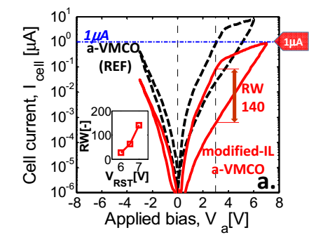
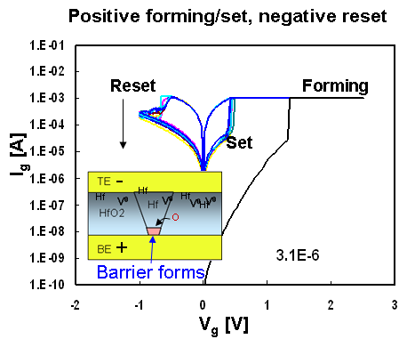
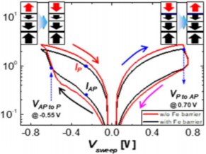

Transfer Charx Summary
?
?
Set
Set
Reset
Set
Reset
Reset
Set
Reset
Quad-3
Quad-1
SXP
SSM
VMCO/CMOx
E
❸
❹
❷
❶
V_{O}RAM/CBRAM
STT
E
FTJ

