Slide 1
BiSM March Discussion
DerChang and Fuga, WW13.5/2019
Recap of Feb Review
Three physical models to be segmented
Fingerprint matching exercise
Fast-Fail decision process

Slide 2

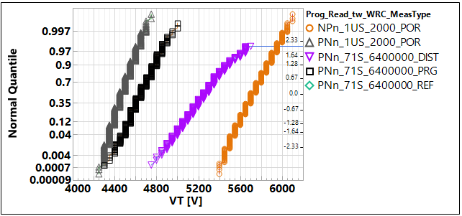
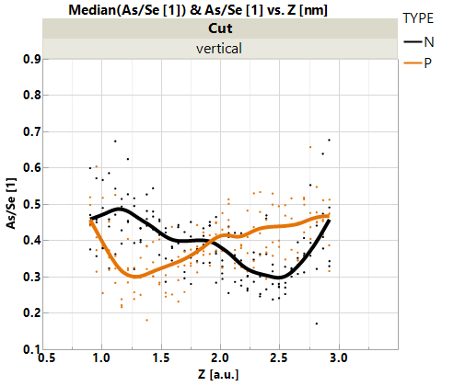
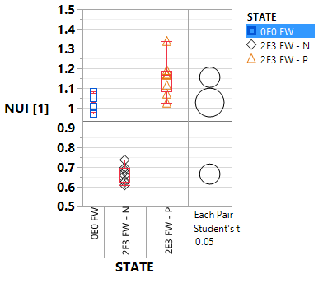
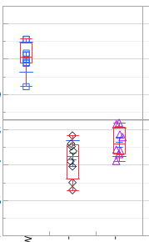
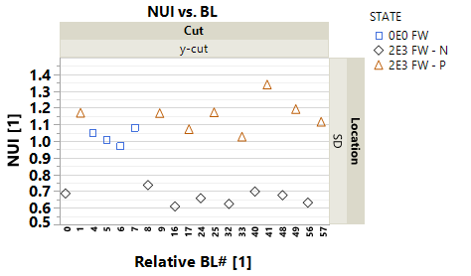
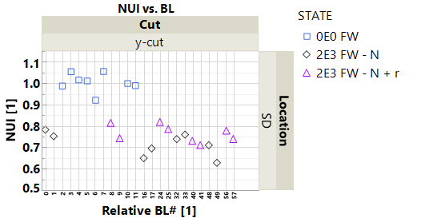
BiSM WW10 Recap
Type of disturb | Spec | 3.54σ Capability (t1/ipd/t3)
E3 Read Disturb | 130K reads | 40k (10s/1us/1us)
E3, SET inhibit | 2.5M inhibits | > 2.5 M (1us/1us/1us)
E1, RST inhibit | 2.5M inhibits | > 2.5 M (1us/1us/1us)
E3 , Read inhibit | 140M inhibits | > 200M
Gaps
  3X gap in Read Disturb count
  No gap in Inhibit disturb
EFA on SR71
Set(N), Reset (P), & rev-Disturb
Program Polarity Matches
Mass Transport
Reverse Bias Disturb exhibits
minor atom movement
N-Pgm
Reverse
Disturb
BL
WL
Vertical El. profile
P-Pgm
Virgin
10s
TE
BE
Rev-Disturb
1us
SD
Virgin
N-Pgm
As/Se
Segregation Index
N
Segregation Index
V-NUI [1]
V-NUI [1]
1us
N-Pgm
P-Pgm
P-Pgm
n-read

Slide 3


One of Possible BiSM Model – Mass Transport to flip Heterojunction
Neg.
Write
C
As+/Ge+
SAG
C
(–) Bias Read, same polarity of write
  Space charge region maintained or little change. Potential drop evenly cross Chal glass.
(+) Bias Read, opposite polarity of Write
  Bias initially contributed in compensating built-in potential, shift I-V to right.
Heterogeneous junction model (band offset) supports the observed polarity effect
  Negative Bias increase 𝛘 (more negative)
Vacuum
⊕
$$\vec{ℰ}$$
ϕ
⊖
(−)
(−)
⊕
$$\vec{ℰ}$$
ϕ
⊖
0V
0V
$$\vec{ℰ}$$
ϕ
(+)
⊕
⊖

Slide 4
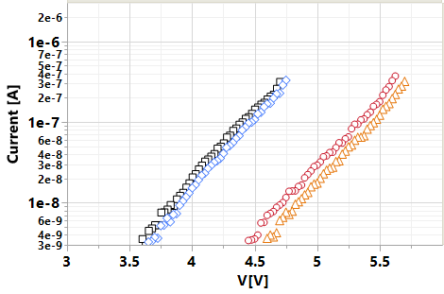
Electrical Equivalent Circuit and Possible Underline Physics
A V_{T} window (∆V_{T}) has been observed by applying programming pulses with opposite polarity. One of possible ∆V_{T} physics is an electrochemical potential modulation effect subject to mass transport by polarity.
  Near parallel shift on SubVt I-V on polarity effects
  The equivalent circuit – a programmable battery connected
  to a Chal Glass Resistor serially
  Programmable battery is formed by the band offset
  Write –Band offset switching subject to mass transport.
  Read – Space Charge modulation results in voltage shift
Likewise a modulation of Schottky barrier at C/SD interface due to SD composition change shares a similarly behavior
In another, this barrier modulation may be achieved by changing charged interface traps, which is deemed a trap generation / annihilation process at both cathode and anode subject to carrier injection direction. (A resemblance of dielectric bias stress effects)
Prog-Read
Neg-neg
Pop-pos
Neg-pos
Pos-neg
SET
Low-V_{T}
RST
High-V_{T}
SD Resistor
Neg
Write
C
As+/Ge+
SAG
C
⊖
⊕
$$\vec{ℰ}$$
ϕ
(−)
(−)
⊖
⊕
$$\vec{ℰ}$$
ϕ
Read Polarity
0V
0V
$$\vec{ℰ}$$
ϕ
(+)
⊖
⊕

Slide 5
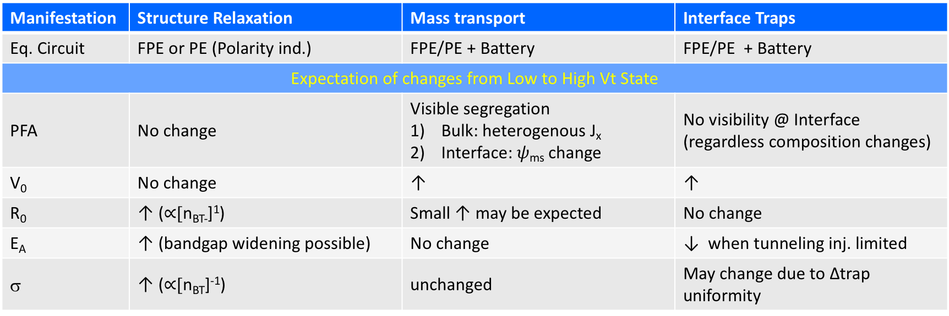
Fingerprint Matching
SubVt I-V can be generally modeled as I = (V-V₀)/R·e^{(V-V0)/𝜎}
V₀ represents a potential offset of a tunneling junctions in DC charge transport continuity
R exhibits an Arrhenius behavior on bulk thermally-assisted hopping, modeled as R₀·exp(E_{A} / q·V_{TH})
𝜎 is escape probability governed by an effective bulk trap density ([n_{BT}]⁻¹)
Manifestation | Structure Relaxation | Mass transport | Interface Traps
Eq. Circuit | FPE or PE (Polarity ind.) | FPE/PE + Battery | FPE/PE + Battery
Expectation of changes from Low to High Vt State
PFA | No change | Visible segregation Bulk: heterogenous J_{x} Interface: 𝜓_{ms} change | No visibility @ Interface (regardless composition changes)
V₀ | No change | ↑ | ↑
R₀ | ↑ ($∝$[n_{BT-}]¹) | Small ↑ may be expected | No change
E_{A} | ↑ (bandgap widening possible) | No change | ↓ when tunneling inj. limited
σ | ↑ ($∝$[n_{BT}]⁻¹) | unchanged | May change due to ∆trap uniformity
Retention characterization will be used for further segmentation.
Mass transport mechanism is expected with longer retention.

Slide 6
Silicon Results
(Changes observed from low V_{T} state to high V_{T} State)
Manifestation | Memory Switching | Reverse Bias Disturb
Eq. Circuit | FPE/PE + Battery | FPE/PE + Battery
PFA | Bulk Segregation | No visible segregation
V₀ | ↑ | ↑
R₀ | Small ↑ | No change
E_{A} | No change | drops to low temp sensitivity
σ | Some ↓ | Some ↓

Slide 7
Model Segmentation
(Base on the changes from low V_{T} state to high V_{T} state)
Results vs. Models
Memory Switching fits the profile of both Mass transport and Interface Traps
Reverse Bias Disturb fits Interface traps model but not Mass transport
Manifestation | Mass transport Predicts | Interface Traps Predicts | Memory Switching |  | Reverse Bias Disturb
 |  |  | MT | IT | MT | IT
Eq. Circuit | FPE/PE + Battery | FPE/PE + Battery | √ | √ | √ | √
PFA | Visible segregation Bulk: heterogenous J_{x} Interface: 𝜓_{ms} change | No visibility @ Interface (regardless composition changes) | √ | N/A | × tbq | N/A
V₀ | ↑ | ↑ | √ | √ | √ | √
R₀ | Small ↑ may be expected | No change | √ | √ | √ | √
E_{A} | No change | No Change or ↓ when tunneling inj. limited | √ | √ | × | √
𝜎 | unchanged | May change due to ∆trap uniformity | √(?) | √ | √(?) | √

Slide 8
Fast Fail Logic
If (Disturb gap > Critical point) { /* Success criteria and test metrology validated */
  STOP;
  };
Else {
  Check sensitivity of disturb RBER vs. RWB (V_{inh} margin); ➔ if yes ➔ go
  Matching Memory Switch and Rev. Bias Disturb with all the best known physics;
  /* Interfacial modulation including mass transport and Interface traps */
  If (memory and disturb share the same mechanisms) {
    STOP; /* Spaces to manage the risk are limited */
    };
  Else {
    Validate Bipolar design and collateral on product landing;
    If (on-par with the incumbent) { /* density, energy */
      Develop pathfinding strategy and scaling enablers;
      };
    Else { Stop and go back to completive analysis } ;
    };
  };

Slide 9
Backup

Slide 10
Manifestation | Mass transport Predicts | Interface Traps Predicts | Memory Switching | Reverse Bias Disturb
Eq. Circuit | FPE/PE + Battery | FPE/PE + Battery | FPE/PE + Battery | FPE/PE + Battery
PFA | Visible segregation Bulk: heterogenous J_{x} Interface: 𝜓_{ms} change | No visibility | Bulk Segregation | No visible segregation change
V₀ | ↑ | ↑ | ↑ | ↑
R₀ | Small ↑ may be expected | No change | Small ↑ | No change
E_{A} | No change | No Change or ↓ when tunneling inj. limited | No change | drops to low temp sensitivity
σ | Unchanged | May change | Some ↓ | Some ↓

Slide 11
Quantify seg index on disturb of ”confidence” of not being mass transport (memory switching)
RWB risk of I_{TH} reduction
RWB guardband

