Slide 1
Die Size and Energy Assessment
Architecture | Decoder | CMOS and Interconnect | Die Size [mm²] | Write [pJ/b] | Read [pJ/b] | Gap
 |  |  |  |  |  | Die Size | Write | Read
ALF32 (POR) | Unipolar | P1240.0 | 200 | 104 | 44 | [mm²] | [pJ/b] | [pJ/b]
S24S | Bipolar | P1240.0 | 221 | 154 | 55 | 21 | 50 | 11
BiSM32 | Bipolar | P1240.0+tgCMOST | 255 | 107 | 47 | 55 | 3 | 3
S24S decoder creates energy & die size gap
TGcMOST decoder Arch solves the energy gap, but has a 55mm² die size gap.
Die Size gap above maybe recovered by using the ~2x performance transistor
TGcMOST carries a residual decode cost penalty due to 2x swing on Decoders wrtx ALF32
Next Steps: TGcMOST with Blackbox transistor and/or new invention of bipolar circuit topo.

Slide 2
POR Algo
BiSM Read. Occupancy = 70ns
Start
Read Pulse incl. Ramp
(37.5ns)
Sense Amp Latch
(12.5ns)
BL 1st Termination (20ns)
BiSM Write Occupancy = 240ns (for Set) + Polarity switching time (for Reset)
WL/BL Ramp
(140ns)
Incl.
Snap Detect (45ns)
C-cell (95ns)
Start
I_{high} (P3)
(50ns)
P4
(30ns)
BL1st
(20ns)

Slide 3
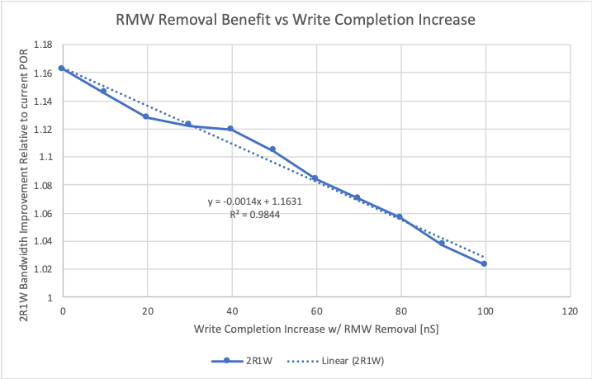
ATF PG1 media management plan (WW43’19/Prashant)
Phase | Description | Technology implication
POR | All ATF policies identical to ALF. 11 die per DIMM ( SDP,DDP,QDP) CW size = 128B | ATF capability must match ALF. RBER <= 9E-4 DPM <= 500
Pre-POR | CW size = 64B 12 die per DIMM (SDP,DDP,QDP) | None. System will enable ECC to support RBER <= 9E-4 and DPM <= 500.
Idea | Remove system pre-read | Summarized on next slide
Idea | Remove die pre-read | None. Design work required to optimize modified write for ~20ns reduction in completion time.
System pre-read removal idea dropped because benefit ~3% in BW does not outweigh risk from major changes to die and controller.
On-die ECC
Dual Vdm pre-read

Slide 4
Ideas for write Algo to reduce cycle time
Enablers required are
RMW with masked write to eliminate polarity switching from pre-read to reset ( x pJ/b)
No C-cell bias (cell leakage and Reset Drift) to improve selection time.
BiSM Read. Occupancy = 70ns
Start
Read Pulse incl. Ramp
(37.5ns)
Sense Amp Latch
(12.5ns)
BL 1st Termination (20ns)
BiSM Write Occupancy = 70~170ns
WL/BL Ramp
(37.5~70ns)
(Do we need to do Spike Mitigation ?)
Start
I_{high} (P3)
(50ns)
?
P4
(30ns)
?
BL1st
(20ns)

Slide 5
Die Size and Energy Assessment
 | Architecture | Decoder | CMOS and Interconnect | Die Size [mm²] | Write [pJ/b] | Read [pJ/b] | Gap
 |  |  |  |  |  |  | Die Size | Write | Read
POR | ALF32 (POR) | Unipolar | P1240.0 | 198 | 104 | 44 | [mm²] | [pJ/b] | [pJ/b]
POR | S24S | Bipolar | P1240.0 | 221 | 154 | 55 | 23 | 50 | 11
PrePOR | BiSM32 | Bipolar | P1240.0+tgMOS | 255 | 92 | 47 | 57 | -12 | 3
Idea 1 | BiSM32 @ ½ Width | Bipolar | P1240.0+tgMOS | 203~208 | 102 | 48 | 5~10 | -2 | 4
Idea 2 | S24S + Masked Write | Bipolar | P1240.0 | 221 | 149 | 55 | 23 | 45 | 11
Other ideas
ALF32 Topo with toggling
ALF32 topo for bipolar (no desel polarity switching)
Energy: S24S Topo with Float desel ➔ Minimum desel toggle

Slide 6
Next few steps
Bipolar decoder
BiSM Reliability
RWB
BiSM decision: Scale up or kill it.

Slide 8
BiSM Exit PF Key Events and Milestone WW50.4, 2019

Slide 9
BiSM Exit PF Key Results Alignment WW49.4, 2019
Objective | ECD | Owners | Key Results
Rev -1 Component Spec | Q4 | Mase | 1. Value Prop and tradeoff. (die size vs. process simplification, energy vs. symmetric read/write and etc. ==> "issues" = "enablers needed" )
Competitive Landscape | Q4 | Mase | 1. vs. incumbent
 | Q4 | Mase | 2. vs. Micron
 | Q4 | Mase | 3. vs. Sony
Decoding Scheme | Q4 | Balaji | 1. TGcMOST scheme
 | Q4 | Mase | 2. Cost and energy of S24S, including process simplification at same pitch and lower current(?)
Cell/Array | Q4 | Fuga | 1. TD
 | Q4 | Fuga | 2. Seasoning
 | 1st half | Fuga | 3. Scalability (RWB, Program current, Latency)
Process/ Integration | Q4 | Max | 1. Gap Fill
 | 1st half | Max | 2. Ambient control
 | 1st half | Fuga | 3. S/U Stack MTS

Slide 10
Roadmap Update
We - cross Intel team - have been evaluating an Optane roadmap POR change in order to better optimize Technology ←→ Platform ←→ Business
Today (Dec 10th 2019) we approved the roadmap change
Key Changes / New POR:
Crow Pass to utilize S26 (previously was ALF)
Synchronizes Crow Pass and Alderstream on the same media to make down-bin more attractive
Leverages all the development work we did on S26
The next product after S26 will be ATF (previously was ALF)
Focusses development efforts onto forward scaling
We will NOT productize ALF → Development vehicle to feed ATF (CMOS, CMOS + Array, etc)
All the work done on ALF is fully leveraged
RTD/F11x: S26 baseline/HVM (PRQ WW32); 400WSPW → Production Output

Slide 11
Opportunities and Implications
Drives focus on ATF
Allows organization to focus on ATF which delivers a cost reduction making it more attractive than ALF for our customers
Removing a component from the roadmap makes it more consumable for our SSD/DIMM customers (not able to transition designs or customers on a yearly cadence today)
ALF needs to continue as a test vehicle
Continue CMOS development since same as ATF, to validate circuits on ALF that will be reused for ATF (since similar interface and data path to ALF), to validate test infrastructure for high speed I/O
Overall scope reduction for TD/MCD
Removes parallel baselines since ALF will be mainly for experiments with S26 as the TD baseline throughout 2020 until ATF is established
Removes a component qual in 2020 and avoids switching development vehicles during 2020

