Slide 1
BiSM Design Update WW51 2018
Balaji/Mase/Derchang

Slide 2
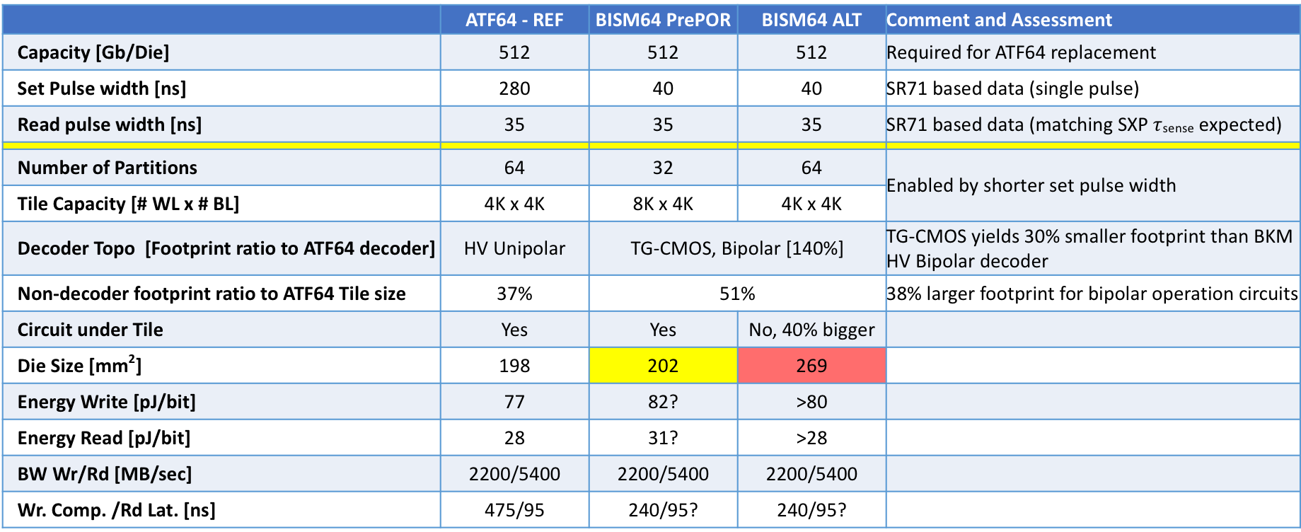
 | ATF64 - REF | BISM64 PrePOR | BISM64 ALT | Comment and Assessment
Capacity [Gb/Die] | 512 | 512 | 512 | Required for ATF64 replacement
Set Pulse width [ns] | 280 | 40 | 40 | SR71 based data (single pulse)
Read pulse width [ns] | 35 | 35 | 35 | SR71 based data (matching SXP $τ$_{sense} expected)
Number of Partitions | 64 | 32 | 64 | Enabled by shorter set pulse width
Tile Capacity [# WL x # BL] | 4K x 4K | 8K x 4K | 4K x 4K
Decoder Topo [Footprint ratio to ATF64 decoder] | HV Unipolar | TG-CMOS, Bipolar [140%] |  | TG-CMOS yields 30% smaller footprint than BKM HV Bipolar decoder
Non-decoder footprint ratio to ATF64 Tile size | 37% | 51% |  | 38% larger footprint for bipolar operation circuits
Circuit under Tile | Yes | Yes | No, 40% bigger
Die Size [mm²] | 198 | 202 | 269
Energy Write [pJ/bit] | 77 | 82? | >80
Energy Read [pJ/bit] | 28 | 31? | >28
BW Wr/Rd [MB/sec] | 2200/5400 | 2200/5400 | 2200/5400
Wr. Comp. /Rd Lat. [ns] | 475/95 | 240/95? | 240/95?

Slide 4
Risk Assessment & Next Steps
Item | Enablers | Issues/Concerns | Impacts | Next Steps
Die Size | 1.) tgMOS 2.) 32 ptn 8Kx4K Tile | 1.) CMOS Fit Term-Tile/Tile: bipolar circuits fit term tile. Based on s24s learning → term tiles are harder to fit due to bipolar circuits. 2.) Upto 4mm^2 of additional termination impact( Accounted for in Die size ), need to see if recovery is feasible thru | Die Size: 202mm^2 – 198mm^2 | Layout of partition Circuits → close impact to Die size ww10?
Energy | 1.) tgMOS 2.) 32 ptn 8Kx4K Tile | 1) Intra Tile Wire RC impact on 8Kx4K energy. Bigger Tile → RC impact on Energy. | Wr Energy: 82pJ/bit Rd Energy: 31 pJ/bit. | Spice simulation driven Energy estimate to Close Energy WW10?
Perf. | 1.) tgMOS 2.) 32 ptn 8Kx4K Tile | 1.) Partition RC impact of 8Kx4K tile on Performance. Decode travels longer with 8Kx4K tile → concern is does that make it harder to meet 5400 compared with ATF64. 2) Sense Signal budget impact of bigger 8Kx4K tile. Longer BL impact on Sense SNR | 5400MHz Rd BW | Spice simulation Driven Assessment to Show 95nS works WW10. Simualted Budget Scrub to show Sense

