Slide 1
Enabler 1 of 2: tgMOS enables BISM
Problem: Deselects toggle when polarity toggles impact
> 20pJ/bit in a hvCMOS decoder
VPP-VTn
VSS
VNN
VSS
VPP
VSS
VSS
VNN
We are able to build a decoder
with HV devices.
  Energy cost of polarity toggle
  is high. > 20pJ/bit, why?
  HV devices can tolerate VGS of
  VPP, VNN but not VPP-VNN.
  To satisfy the above reliability
  criteria we need to toggle LSEL
  /GSEL gates of all deselected rows
  when toggling polarity of a patch
  from positive bias to neg bias or
  vice versa. This is ~800fF
  This 20pF is a showstopper.
  This problem was also seen in S24s
Local sel
VPP-VTn
VPP-Vtn
VNN
VNN
VPP
VPP
VSS
VSS
VPP
Global sel
VPP
VNN
VNN
VPP
VPP
VNN
VNN
Pos. patch
Selected Local
Selected Global
Pos. patch
Deselected Local
Selected Global
Neg. patch
Selected Local
Selected Global
Neg. patch
Deselected Local
Selected Global
LBWL is local word or bit line.
GBWL is global word or bit line.
PMOS device which are Off are not shown.

Slide 2
Enabler 1 of 2: tgMOS enables BISM
No toggle of deselects when polarity toggle with
tgMOS enabled decoder
VPP-VTn
VSS
VNN
VSS
Tg
VPP
Tg
VNN
Tg
VPP
Tg
VNN
Once we add the tgMOS device
Which can tolerate VPP-VNN across VGS,
This need to toggle deselected decoder
gates (LSEL/GSEL) goes away
and we have a low energy solution.
Thus tgMOS is needed.
VPP-VTn
VPP-Vtn
VNN
VNN
Tg
VPP
Tg
VPP
Tg
VPP
Tg
VPP
VPP
VPP
VNN
VNN
VPP
VPP
VNN
VNN
Pos. patch
Selected Local
Selected Global
Pos. patch
Deselected Local
Selected Global
Neg. patch
Selected Local
Selected Global
Neg. patch
Deselected Local
Selected Global
Tg – Thick Gate Xtr.
LBWL is local word or bit line.
GBWL is global word or bit line.
PMOS device which are Off are not shown.

Slide 3
Enabler 2 of 2 8Kx4K enables BISM
ATF64 Ref
Normalized to ATF64 Tile | Atf64 Ref 4kx4k | Bism64 prepor 8kx4k | Bism64 alt 4kx4k
Array | 100 | 200 | 100
CMOS Foot print need | 37 | 51 | 51
Dec need | 63 | 1.4*63*1.5=132 | 1.4*63=88
Dec + cmos need | 100 | 51+132=183 | 88+51=141
Array limited | Yes 100 = 100 | Yes 183 < 200 | No 141 > 100 40% more
tgDecoder footprint is 140% of hvDecoder.
For 8kx4k the decoder scales up by 150% when tile scales by 200%
CMOS Foot print needs also grow to build bipolar circuits 37% → 51%
  4kx4k decoder + cmos foot print needs= 1.4*63+51 = 141 → not array limited.
  8kx4k decoder + cmos foot print needs=1.4*63*1.5+51=183 while array is 200% so it fits
BISM64 Alt
BISM64 PrePOR

Slide 4
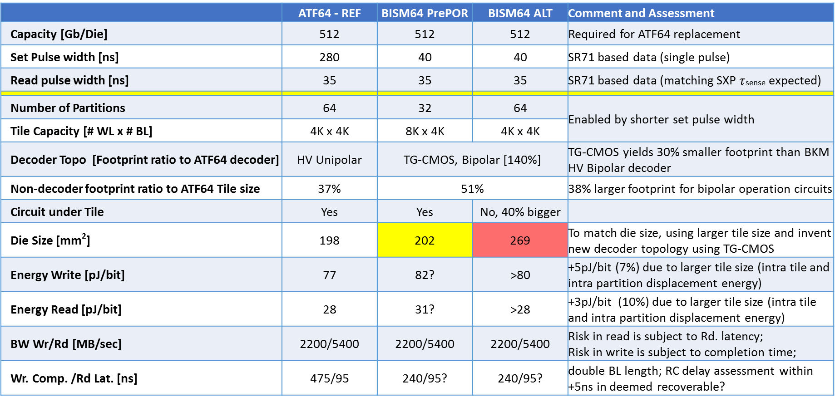
 | ATF64 - REF | BISM64 PrePOR | BISM64 ALT | Comment and Assessment
Capacity [Gb/Die] | 512 | 512 | 512 | Required for ATF64 replacement
Set Pulse width [ns] | 280 | 40 | 40 | SR71 based data (single pulse)
Read pulse width [ns] | 35 | 35 | 35 | SR71 based data (matching SXP $τ$_{sense} expected)
Number of Partitions | 64 | 32 | 64 | Enabled by shorter set pulse width
Tile Capacity [# WL x # BL] | 4K x 4K | 8K x 4K | 4K x 4K
Decoder Topo [Footprint ratio to ATF64 decoder] | HV Unipolar | TG-CMOS, Bipolar [140%] |  | TG-CMOS yields 30% smaller footprint than BKM HV Bipolar decoder
Non-decoder footprint ratio to ATF64 Tile size | 37% | 51% |  | 38% larger footprint for bipolar operation circuits
Circuit under Tile | Yes | Yes | No, 40% bigger
Die Size [mm²] | 198 | 202 | 269 | To match die size, using larger tile size and invent new decoder topology using TG-CMOS
Energy Write [pJ/bit] | 77 | 82? | >80 | +5pJ/bit (7%) due to larger tile size (intra tile and intra partition displacement energy)
Energy Read [pJ/bit] | 28 | 31? | >28 | +3pJ/bit (10%) due to larger tile size (intra tile and intra partition displacement energy)
BW Wr/Rd [MB/sec] | 2200/5400 | 2200/5400 | 2200/5400 | Risk in read is subject to Rd. latency; Risk in write is subject to completion time;
Wr. Comp. /Rd Lat. [ns] | 475/95 | 240/95? | 240/95? | double BL length; RC delay assessment within +5ns in deemed recoverable?

Slide 5
FROM WW45
Item | Enablers | Issues/Concerns | Impacts | Next Steps
Die Size | 1.) TGMOS 2.) 32 ptn. 8Kx4K Tile | 1.) Close on TOX=148A, Wmin/Lmin = 7.16/9.87 2.) BL Leakage increase impact on selection window 3.) Self-consistent energy assessment | 1.+2.) Die Size: 200mm^2 – 191mm^2 | 1a.) Define requirement for Set/Reset currents (DONE) 1b.) Close w/ device on risk (DONE) 2.) BL leakage impact to Selection Window (DONE) 3.) Complete energy assessment (DONE)
Next Steps.
Item | Enablers | Issues/Concerns | Impacts | Next Steps
Die Size | 1.) TGMOS 2.) 32 ptn. 8Kx4K Tile | 1.) CMOS Fit Term-Tile/Tile: Based on s24s learning → Term Tiles are harder to fit due to additional bipolar circuits. 2.) Up to 4mm^2 of additional termination impact ( Accounted for in Die size ), Need to see if recovery is feasible by Usage of CMOS area under term. | Die Size: 202mm^2 | Layout of partition Circuits → close impact to Die size ww10?
Energy | 1.) TGMOS 2.) 32 ptn. 8Kx4K Tile | 1) Intra Tile Wire RC impact on 8Kx4K energy. Bigger Tile → RC impact on Energy. | Wr Energy: 82pJ/bit Rd Energy: 31 pJ/bit. | 1.) Complete energy assessment based on Layout, BKM algo assumptions to close energy risk ww10? 2.) Mitigation is to PF low swing partition decoder architecture to recover energy if needed ww10?
Perf. | 1.) TGMOS 2.) 32 ptn. 8Kx4K Tile | 1.) Partition RC impact of 8Kx4K tile on Performance. Decode travels longer with 8Kx4K tile → concern is does that make it harder to meet Rd Lat./Wr. comp compared with ATF64. 2) Longer BL impact on Sense SNR & its impact to read column current. | 5400MHz Rd BW 2200MHz Wr BW | 1a.) Complete Timing assessment to close risk to Rd/Wr BW ww10? 1b.) Mitigation is to under stand impact of wire RC & count on die size to mitigate risk ww10? 2.) Complete Sense SNR assessment to close any sense risk to read column current. Ww10?

Slide 6
Backup

Slide 7
Current– S24S – doesn’t work for a product here is why…
Doesn’t provide 100% address coverage → 25% coverage due to larger decoder.
  Larger foot print of decoder doesn’t fit.
    2 extra global devices take area.
    Separate paths for Pos./Neg. Bias → Non-Min for PMOS compared withATF64
High Energy impact of Polarity Toggle due to Decode → ~50pJ/bit
  Need to toggle deselects to switch polarity
    ~1pF cap switches thru VPP → VNN every polarity toggle. ~50pJ/bit
  Energy impact of switching larger P & N Devices
    Cp + Cn both are sized comparable to S26A select → contribute to the 1pF.
On the PLUS side this
decoder never exposes any device to VMAX > (VPP,VCC-VNN) → Use HV devices
Routing Count fits without needing additional metals.
Supports concurrent set/reset algorithms in different tiles in the same partitions.
While this tradeoff is OK for test chip we need energy, routability, concurrent set/reset & 100 % coverage for products. SO THIS DECODER IS BROKEN.

