Slide 1
BiSM, an Alternative Memory
DerChang Kau, Prashant Majhi & Al Fazio, WW31.4, 2019 @ MAT-SC
Introduction
Value Proposition
Silicon Performance
Array Architecture
Critical Path to α-Product Definition

Slide 2
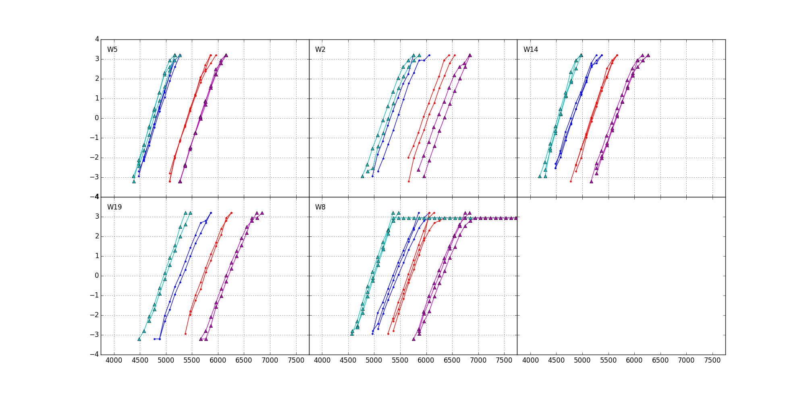
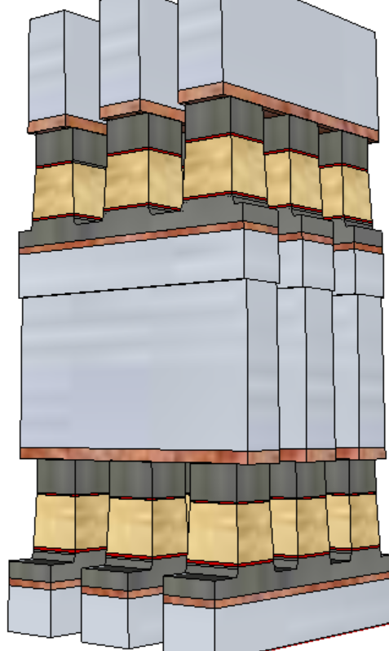
Introduction to BiSM
A SD only memory cell sandwiched between a X-Y cross point, BEOL stackable, compatible with mainstream CMOS.
Write/Read
Polarity
+/+
−/+
S15B SD-only, lot 8792062, 18nm SDδ ver 4
−/−
+/−
V_{T,High}
Positive
Write
σ of bit distribution
Negative
read
V_{T,Low}
900mV
Negative
Write
Negative
read
Pulse Polarity
TE
SD
BE
V_{TH} [mV]
It exhibits a window by applying programming pulses with opposite polarity.
In a typical selector-less (0S1R) cross point memory array, leakage and disturb fundamentally limit the density and usability of the technology. BiSM is working well because of the built-in selector to reduce leakage for high density and to increase immunity to read/write disturbance for nonvolatility; hence Built-in-Selector Memory, a.k.a. BiSM, is coined.

Slide 3

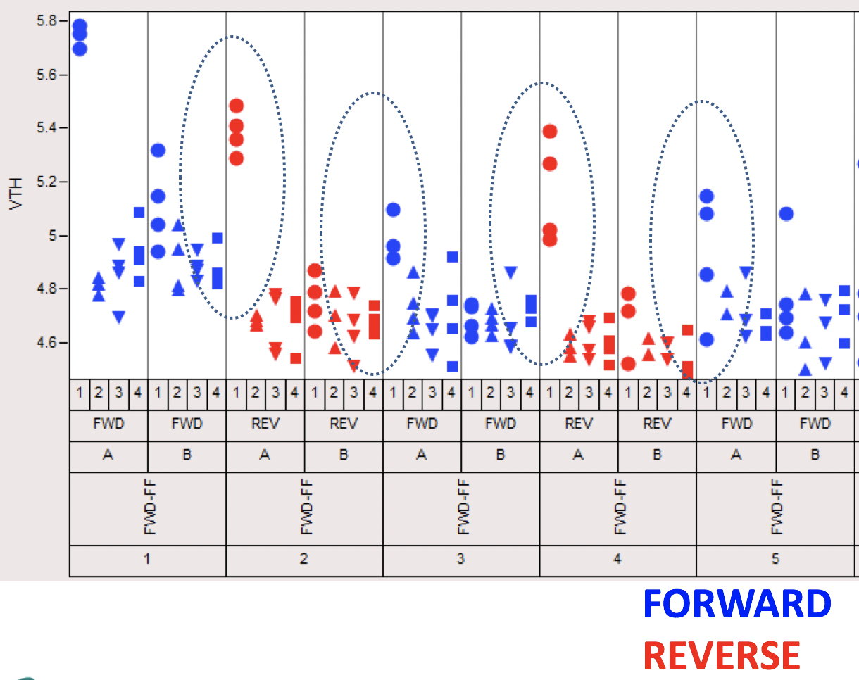
A Brief History
In June, 2013, as 3DXP dual-deck development shifted to high gear, a subtle BiSM “window” was sighted by Arjun Kripanidhi at SC9 Device Lab.
Subsequently, with 3DXP
process improved, BiSM V_{T}
window became more evident.
The concept of BiSM was
conceived in the JDP with
Micron and worked on jointly by both companies under the research initiative called Self-Select Memory, a.k.a. SSM.

Slide 4
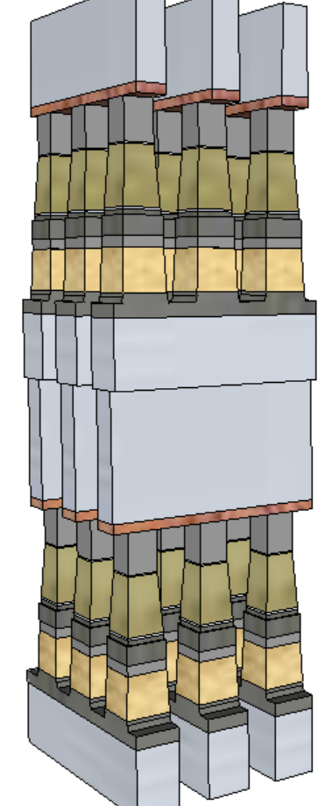
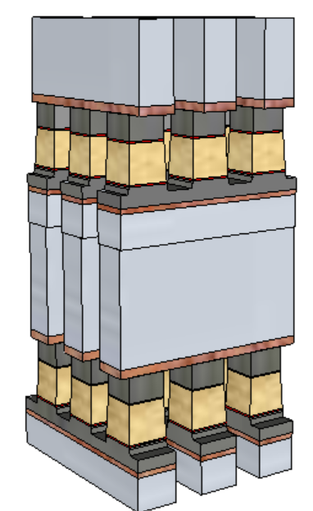
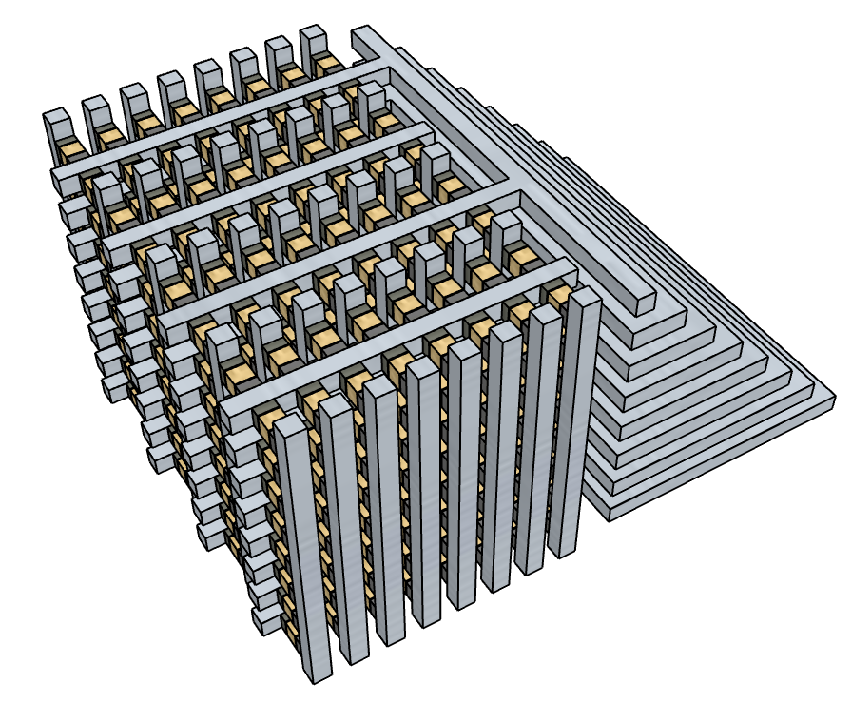
Value Proposition
  Simplified manufacturing with PM removed
  lower cell aspect-ratio
  No cross-contamination between Memory and Selector materials
  Improved performance and reliability
  Elimination of PM reliability constraint
  Lower write current to relaxes WL/BL requirements and array capacitance
  Fast write; no crystallization required
  An opportunity for symmetric memory access (read/set/reset)
BiSM
3DXP
  Theoretically simplified cell enables
  Tier Architecture (3D NAND like)
  to lower manufacturing cost

Slide 5
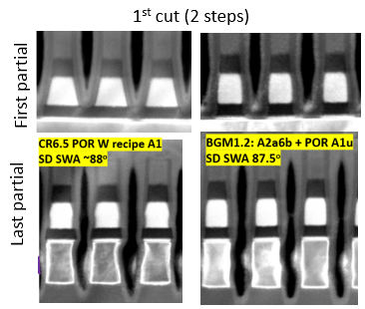
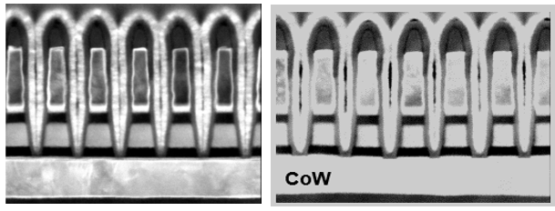
1st and 2nd cut profile
CR6.5 demonstrated >70% PG4 structure yield & PG4 capable RWB
2nd cut (single step)
MTS Metric | SPEC | POR | FWD
HM thk (nm) | 18 | 17 | 23
W top CD (nm) | 21 | 18 | 22.5
W bot CD (nm) | 17.2 | 14 | 18.5
TEC CD (nm) | 21.3 | 18 | 19.2
SD top CD (nm) | 21.5 | 22 | 16.5
SD bot CD (nm) | 23 | 26 | 18.5
SD SWA (degree) | 89 | 84 | 87
Specs | MTS Metric | SPEC | POR | FWD
First partial | SD top (nm) | 18.1 | 16.3 | 15.6
 | SD bot (nm) | 18.9 | 24.9 | 18
 | SD SWA (degree) | 89 | 79 | 87.5
Last partial | SD top(nm) | 18.1 | 16.1 | 15.6
 | SD mid(nm) | 18.5 | 17.2 | 18
 | SD bot (nm) | 18.9 | 17.8 | 18.1
 | SD SWA(degree) | 89 | 88 | 87.5
 | W Sep (nm) | 20.8 | 18.7 | 18.5
 | W Bot (nm) | 21.2 | 22.3 | 22
July/12/2018

Slide 6
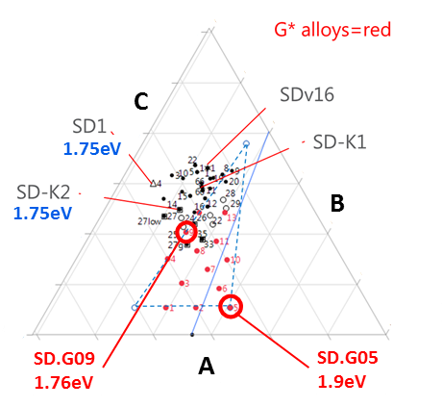
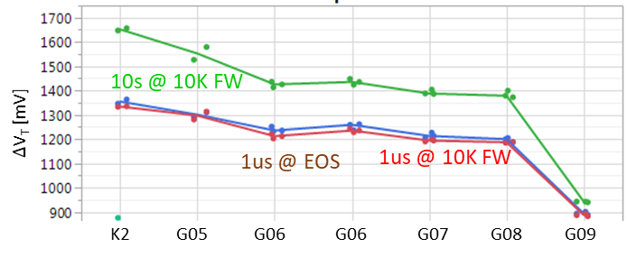
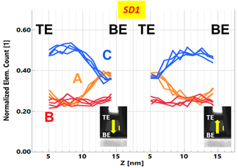
Read/Write
Symmetric write pulses for set and reset operations: 44ns@±45µA
Read is identical to 3DXP (40ns pulse)
Read Window Budget (∆V_{T}): 200 mV @ 5E-4 RBER
The best known ∆V_{T} physics is an interfacial modulation subject to mass transport by E-field at an elevated temperature.
  Bipolar memory switching with elemental segregation are observed in wide range of Chalcogenide glasses

Slide 7
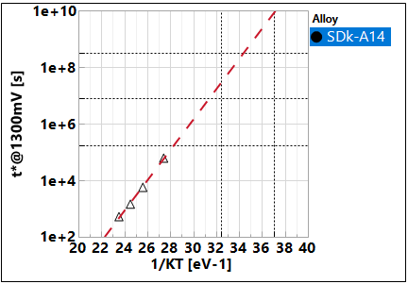
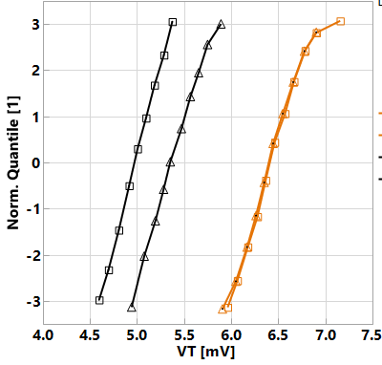
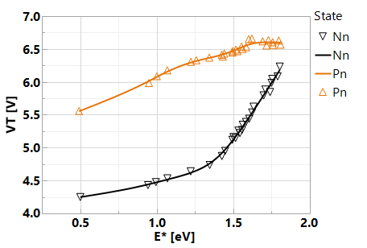
Retention
Window closure
SET/RST Distrib. Vs. T-bake
85C
5years
E_{A} ~ 1.25 eV
10y
3m
2d
SET
RST
@180C
-- 1μs
1e3 s
1e4 s
85C 40C
0193532w10 SDk-A14, r5.3
Window-based retention: E_{A} in ~ 1.25 eV range; ~ 1 year retention @ 85C → Mainly due to lower drift of reset state. Additional segmentation wip.
The retention characteristics, both set and reset shifting up, suggests the dominant retention mechanism subject to structure relaxation at temperature range explored.

Slide 8
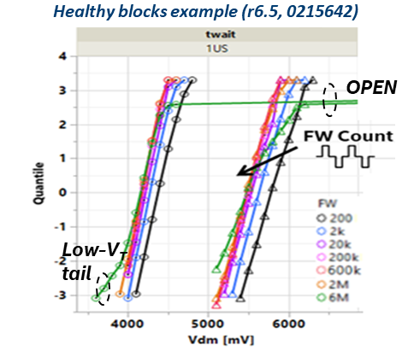
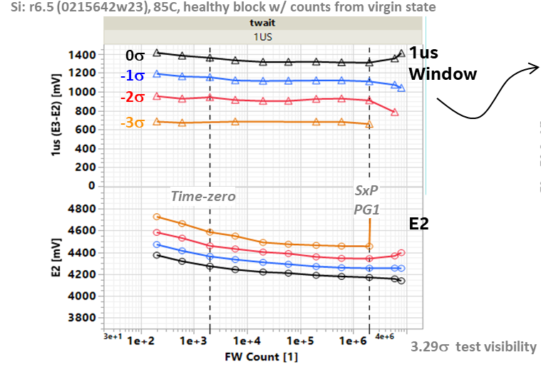
Write Endurance
No window closure of 2K bits up to 2M FW cycles @ 10ms ipd, low ED
Scaling Expectation (No Scaling Data)
I_{program} – the same as 3DXP, subject to T_{g}
RWB – no worse than 3DXP
Read/Write Latency – no change

Slide 9
Bipolar decoder architecture – Selected BL Path Shown
AXN=VPPs
AXN=VPPs
VSS
VSS
VPPs
VSS
VPPs
VPP
VPPs
VSS
VSS
AXN=VPPs
HNREG
VPPs
VSS
VSS
VPP
VPPs
LBL
VPPs
LBL/LWL
VPPs
LBL/LWL
VSS
VSS
ALF32
S24S
BiSM32
VPP
VSS
VSS
VSS
VSS
VNN
HNREG
Bipolar
160Å TWN + tgP
VT: 1.2V @ 9.3 VB for TWN
9.6V compliant DR
AXN/HNREG Mux/tile
Unipolar
110Å TWN + P
Bipolar
110Å TWN + P
2 extra global Xtrs.
Extra Xtrs. in tile predec

Slide 10
Die Size and Energy Assessment
Architecture | Decoder | CMOS and Interconnect | Density [Gb/mm²] | Write [pJ/b] | Read [pJ/b] | Gap [%]
 |  |  |  |  |  | Density | Write | Read
ALF32 (POR) | Unipolar | P1240.0 | 1.28 | 104 | 44
S24S | Bipolar | P1240.0 | 1.16 | 154 | 55 | 9% | 48% | 25%
BiSM32 | Bipolar | P1240.0+TGcMOST | 1.00 | 107 | 47 | 23% | 3% | 7%
S24S decoder creates big energy gap and lowers density
BiSM32 decoder Arch bridges the energy gap, but reduces density further.
Density gap of BiSM32 can be recovered by improving CMOS performance.

Slide 11
Assessment & Critical Path to α-Product Definition
BiSM technology presents an opportunity for higher speed SCM with simplified manufacturing without obvious technology showstopper. It solves known 3DXP issues, likely introduces others which we are yet to fully see. Scaling is yet to be demonstrated.
Optane™ Memory Media has Circuit Under the Array (CUA) to reduce die size. The bidirectional circuit topology of BiSM is a key constraint of CUA for its ability to match or to beat present Optane™ product cost, despite the improved write latency. Currently die size is prohibitive with the speculative TGcMOST design rule. Efficient tile design is a key challenge to product viability.
Besides developing a smaller footprint transistor and/or inventing new bipolar decoding scheme, a more fundamental issue is high voltage supply rail constraint, which is driven by (voltage) window budget. Integrating new material and/or read/write algorithm to reduce BiSM V_{T} sigma, drift and shift are the key enablers for voltage reduction.
Competitive landscape – We believe that Micron is pursuing this technology at a priority over the current Optane™ approach. Also, in the research segment of atomistic switches (intel sponsored or public domain), discussions and disclosures on the sighting of similar behavior are merging.

Slide 12
BiSM Value Proposition (ref: 3DXP)
  Simplified manufacturing with PM removed
  lower cell aspect-ratio (from 10:1 to 5:1)
  No cross-contamination between Memory and Selector materials
  Improved performance and reliability
  Elimination of PM reliability constraint
  Lower write current to relaxes WL/BL requirements and array capacitance
  Fast write; no crystallization required (from 240ns to 44ns set pulse)
  An opportunity for symmetric memory access (read/set/reset = 40/44/44)
BiSM
3DXP
  Theoretically simplified cell enables
  Tier Architecture (3D NAND like)
  to lower manufacturing cost

