Slide 1
ATF PG1 media management pathfinding update
Prashant
Ack.: Ben, Rajesh, Muthu, Zion, Rakan, Kunal (and many others)

Slide 2
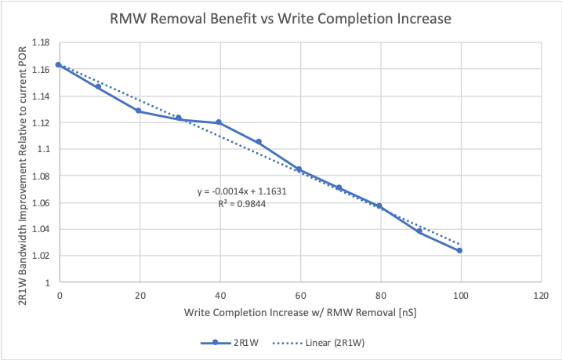
ATF PG1 media management plan
Phase | Description | Technology implication
POR | All ATF policies identical to ALF. 11 die per DIMM ( SDP,DDP,QDP) CW size = 128B | ATF capability must match ALF. RBER <= 9E-4 DPM <= 500
Pre-POR | CW size = 64B 12 die per DIMM (SDP,DDP,QDP) | None. System will enable ECC to support RBER <= 9E-4 and DPM <= 500.
Idea | Remove system pre-read | Summarized on next slide
Idea | Remove die pre-read | None. Design work required to optimize modified write for ~20ns reduction in completion time.
System pre-read removal idea dropped because benefit ~3% in BW does not outweigh risk from major changes to die and controller.
On-die ECC
Dual Vdm pre-read

Slide 3
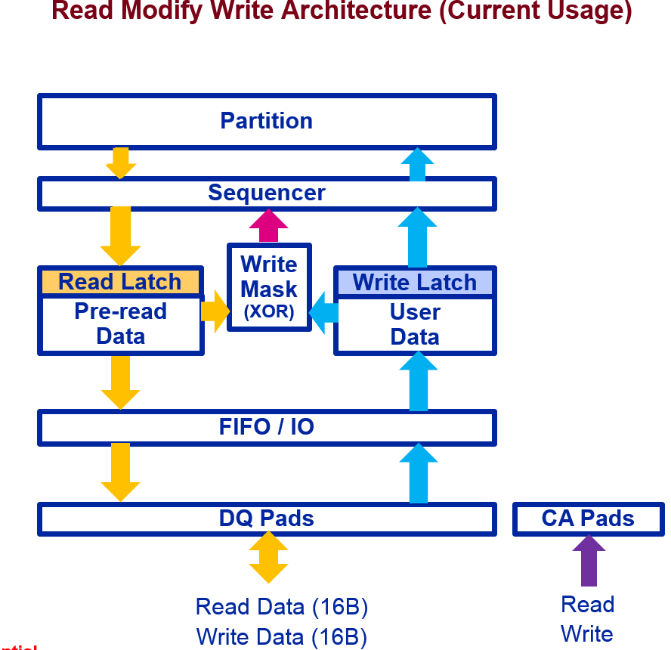
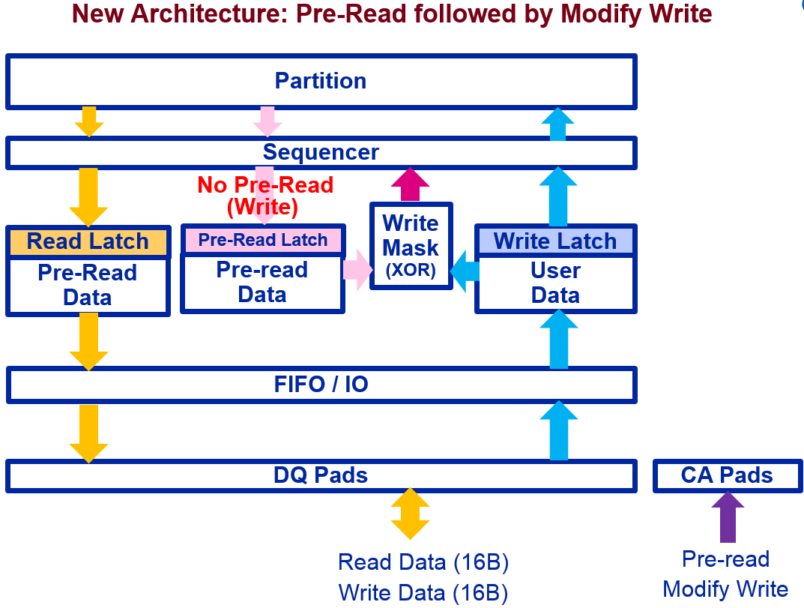
Modified write and Pre-read protocol
Rajesh Sundaram
Pre-
CWV controller optimized to work with the pre-read and modified write protocol.
100% usage not guaranteed; will use regular read/write when scheduler detects partition conflicts.
Initial PSV results show >90% usage of the pre-read and modified write.

Slide 4
Back-up

Slide 5
System pre-read removal (rev2): technology enablers
Description | POR policy | Will need to change to… | Technology enabler
1) Write algo | Single Vdm NW | Dual Vdm NW, to prevent die pre-read fake-out +44ns write time | 44ns reduction in set pulse (or 44ns reduced benefit)
2) RBER | EOL RBER = 9E-4 | EOL RBER = 8E-4 | Enable EOL RBER = 8E-4
Store full 22b write count (per CW) + 14b ECC protection in media. RBER reduced to 8E-4 to fit these extra bits in CW.
Write count error rate ~1E-6.
Controller handshake required to communicate counter roll-over, which triggers WD refresh and wear level move.
ECC latency adder ~50ns, ~4K gates per partition.
On-die ECC
Dual Vdm pre-read

Slide 6
System pre-read removal (rev1): technology enablers
Description | POR policy | Will need to change to… | Technology enabler
1) Write algo | Single Vdm NW | Dual Vdm NW, to prevent die pre-read fake-out +44ns write time | 44ns reduction in set pulse (or 26ns reduced benefit – accurate benefit quantification WIP)
2) Write disturb management | Refresh victims after every 512 writes to aggressor. Technology WD capability = 602 at 1us duty cycle. | No WD refresh. Enforce 100us duty cycle with address tracker and data cache. Some workloads throttled. | No write disturb for duty cycle >100us
3) Wear leveling | Wear level every ~3K writes to CW | Wear level every ~3K writes to DIMM | Endurance 1.4X (4Deck: 2.4M → 3.4M, 2Deck: 2.9M → 4.1M) All dynamic Vdm cycle ranges (table below) Realistic worst case workload used (seq wr to 10% span with 4kB stride)
POR wear leveling: DVDM
Statistical wear leveling: DVDM
New idea under evaluation: Store ~10b write count (per CW) + ~12b ECC protection in media. Write count error rate ~1E-6. Controller handshake required to communicate counter roll-over, which triggers WD refresh and wear level move.
10b write count also results in dynamic Vdm gap, although a lesser gap than above (0-20K → 0-65K). Need full write count.

Slide 7
