Slide 1
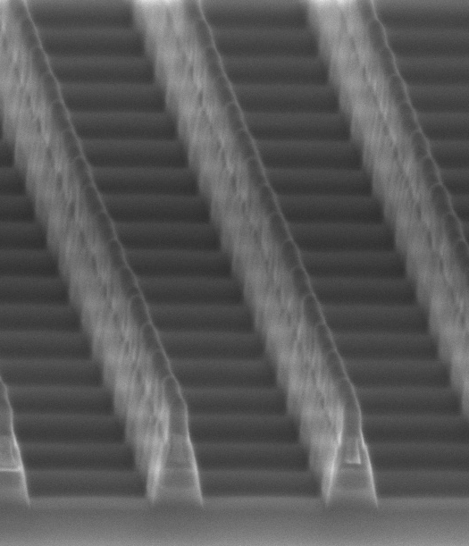
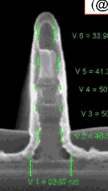
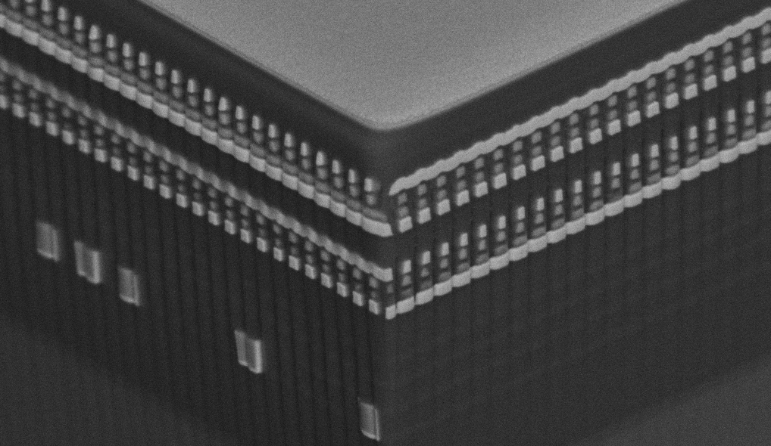
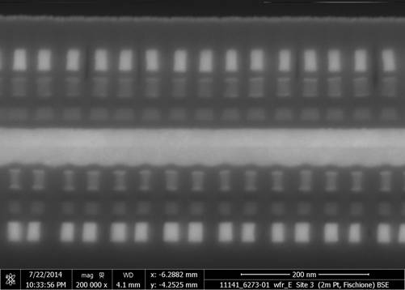
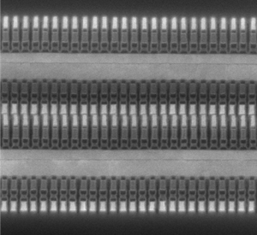
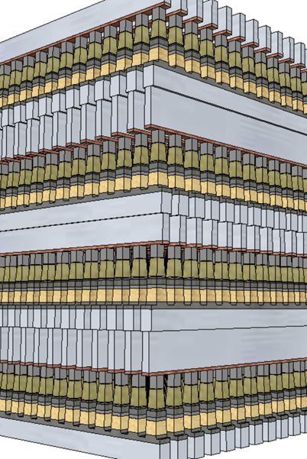
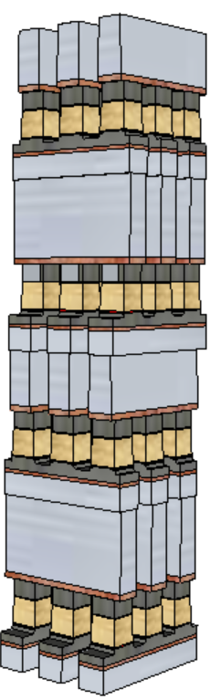
3D XPoint™ Technology Development Evolution
4Kb 200nm feature, 2-Mask Sublitho Heater
Damascene PM Subtractive SD
2003~2006 Santa Clara, CA
64Mb 180nm ½ Pitch 6-Mask Sublitho Heater Damascene PM, Subtractive SD
2007~2009 Santa Clara, CA
64Mb 100nm feature, 2-Mask
Self-Aligned, Subtractive Cell
2010~2011 Agrate, Italy
64Mb 50nm ½ Pitch, 2-Mask
Dual Deck, Self Aligned Subtractive Cell
2012~2013 Agrate, Italy
X-section along ROW
TiAlN
SD
C
W
PM
TiAlN
SD
C
C
SD
TiSiN
PM
Mid Electrodes
TiSiN
PM
SXP cell
SD only
128Gb 20nm ½ Pitch 7-Mask
Dual Deck Self Aligned Subtractive Cell
2013~2018 Boise, ID
256Gb 20nm ½ Pitch 13-Mask
Quad Deck Self Aligned Subtractive Cell
2015~2020 Lehi, UT & Rio Rancho, NM
256Gb 17nm ½ Pitch 13-Mask
Quad Deck Self Aligned Subtractive Cell
2020~2022 Rio Rancho, NM
512Gb 14nm ½ Pitch
Quad Deck BiSM
2020~2023, Rio Rancho, NM
?

