Slide 1
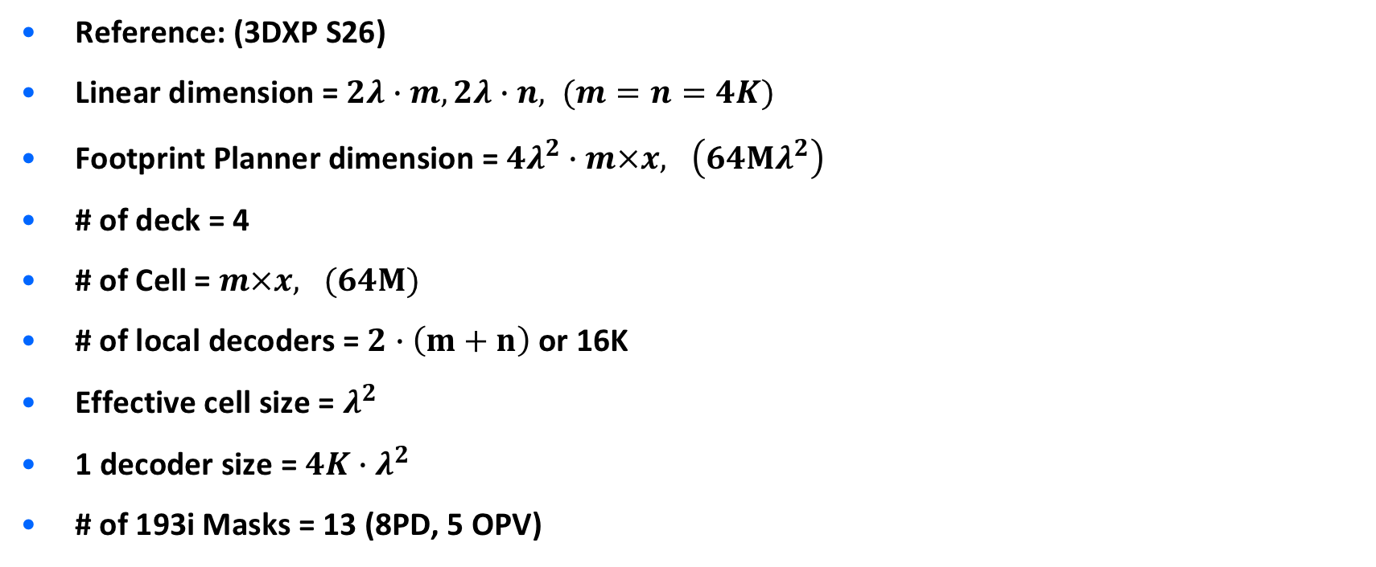
Reference: (3DXP S26)
Linear dimension = $2λ∙m,2λ∙n, (m=n=4K)$
Footprint Planner dimension = $4λ^{2}∙m×x, \left(64Mλ^{2}\right)$
# of deck = 4
# of Cell = $m×x, (64M)$
# of local decoders = $2∙\left(m+n\right)$ or 16K
Effective cell size = $λ^{2}$
1 decoder size = ${4K∙λ}^{2}$
# of 193i Masks = 13 (8PD, 5 OPV)

Slide 2
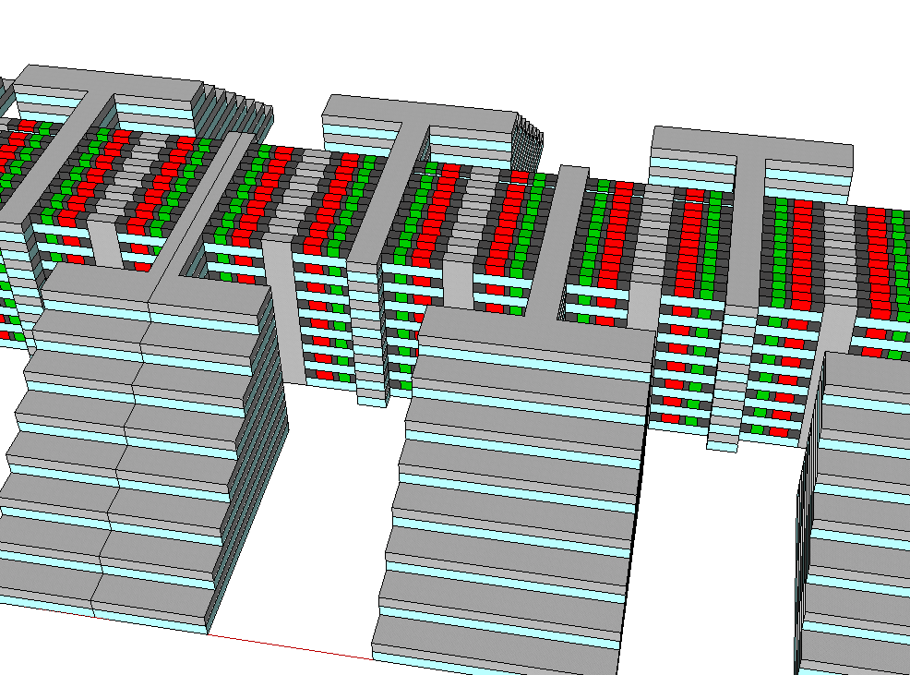
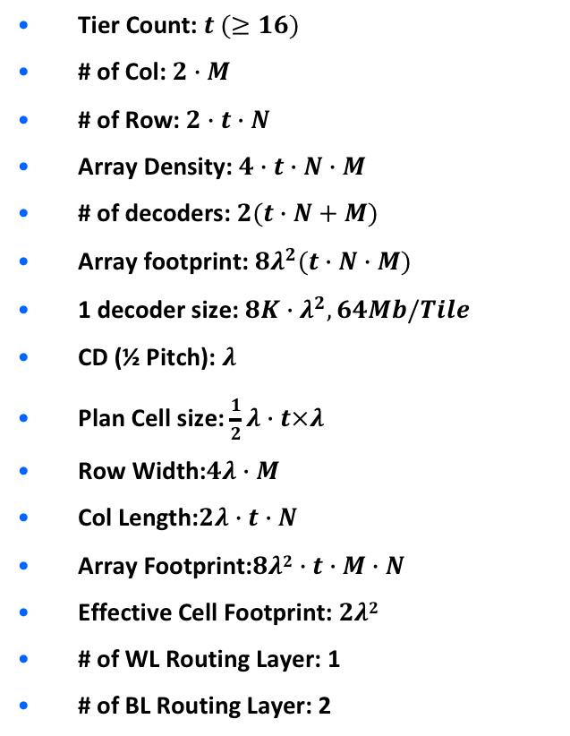



Two Pillar Routing Layers
Tier Count: $t (≥16)$
# of Col: $2∙M$
# of Row: $2∙t∙N$
Array Density: $4∙t∙N∙M$
# of decoders: $2(t∙N+M)$
Array footprint: ${8λ}^{2}(t∙N∙M)$
1 decoder size: ${8K∙λ}^{2}, 64Mb/Tile$
CD (½ Pitch): $λ$
Plan Cell size: $\frac{1}{2}λ∙t×λ$
Row Width:$4λ∙M$
Col Length:$2λ∙t∙N$
Array Footprint:$8λ2∙t∙M∙N$
Effective Cell Footprint: $2λ2$
# of WL Routing Layer: 1
# of BL Routing Layer: 2
R_{o,t,i-1}
$$2λ×t$$
$$i=1⋯N$$
$$j=1⋯M$$
R_{o,t,i}
R_{o,t,i+1}
C_{t,j-1}
C_{t,j}
C_{b,j-1}
C_{t,j+1}
C_{b,j}
C_{b,j+1}
2 routing layers
$$4λ×M$$
R_{e,t,i}
R_{e,t-1,i}
R_{e,t,i+1}
R_{e,t-2,i}
R_{e,t-1,i+1}
R_{e,t-2,i+1}

Slide 3
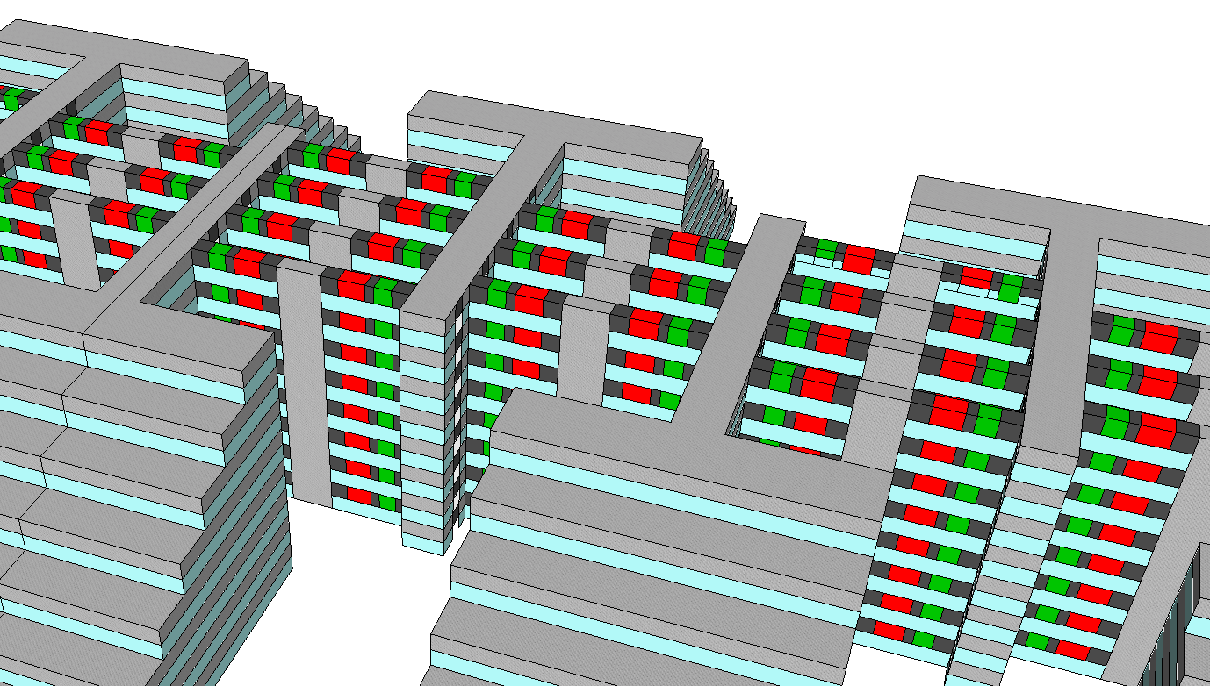
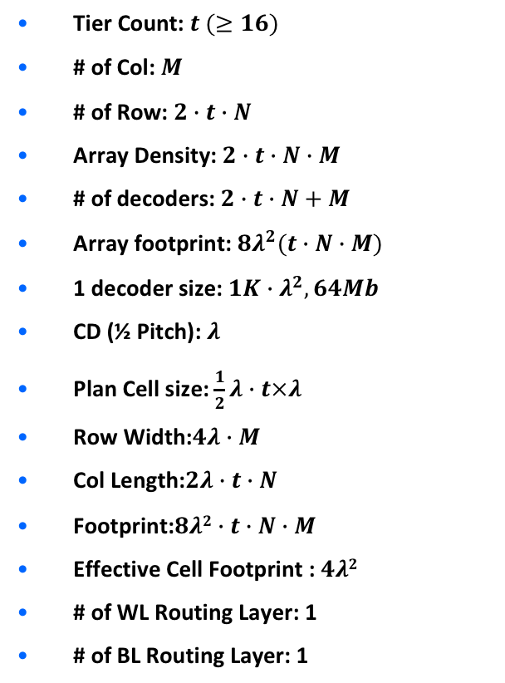


One Pillar Routing Layer
Tier Count: $t (≥16)$
# of Col: $M$
# of Row: $2∙t∙N$
Array Density: $2∙t∙N∙M$
# of decoders: $2∙t∙N+M$
Array footprint: ${8λ}^{2}(t∙N∙M)$
1 decoder size: ${1K∙λ}^{2}, 64Mb$
CD (½ Pitch): $λ$
Plan Cell size: $\frac{1}{2}λ∙t×λ$
Row Width:$4λ∙M$
Col Length:$2λ∙t∙N$
Footprint:$8λ2∙t∙N∙M$
Effective Cell Footprint : $4λ2$
# of WL Routing Layer: 1
# of BL Routing Layer: 1
$$i=1⋯N$$
$$j=1⋯M$$
R_{o,t,i-1}
$$2λ×t$$
C_{j-2}
R_{o,t,i}
C_{j}
C_{j-1}
C_{j+2}
C_{j+1}
R_{o,t,i+1}
R_{e,t,i}
$$4λ×M$$
R_{e,t-1,i}
R_{e,t-2,i}
R_{e,t,i+1}
R_{e,t-1,i+1}
R_{e,t-2,i+1}

Slide 4
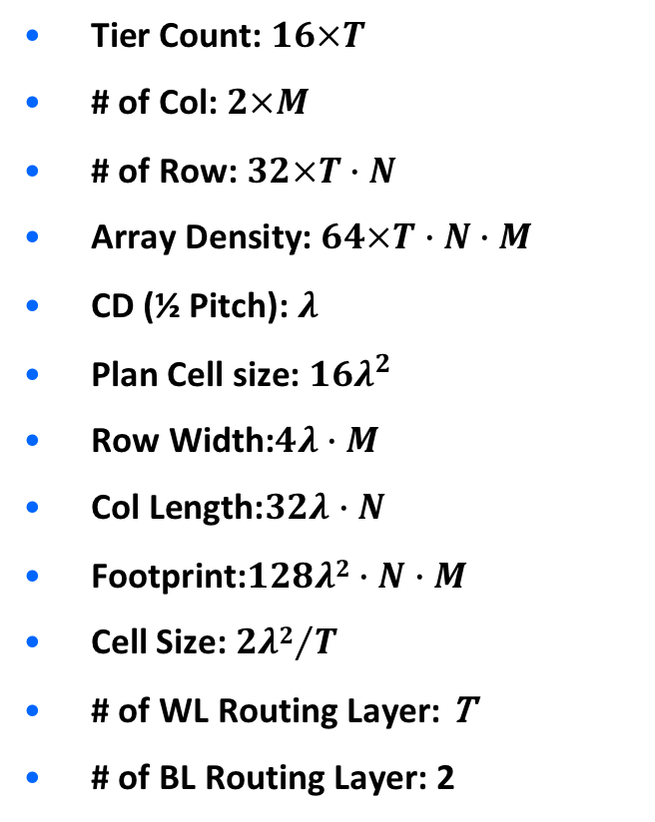


$8×$T tier
Tier Count: $16×T$
# of Col: $2×M$
# of Row: $32×T∙N$
Array Density: $64×T∙N∙M$
CD (½ Pitch): $λ$
Plan Cell size: ${16λ}^{2}$
Row Width:$4λ∙M$
Col Length:$32λ∙N$
Footprint:$128λ2∙N∙M$
Cell Size: ${2λ2}/T$
# of WL Routing Layer: T
# of BL Routing Layer: 2
R_{o,t,i-1}
32$λ$
$$i=1⋯N$$
$$j=1⋯M$$
R_{o,t,i}
R_{o,t,i+1}
C_{t,j-1}
C_{t,j}
C_{b,j-1}
C_{t,j+1}
C_{b,j}
C_{b,j+1}
2 routing layers
$$4λ×M$$
R_{e,t,i}
R_{e,t-1,i}
R_{e,t,i+1}
R_{e,t-2,i}
R_{e,t-1,i+1}
R_{e,t-2,i+1}

Slide 5
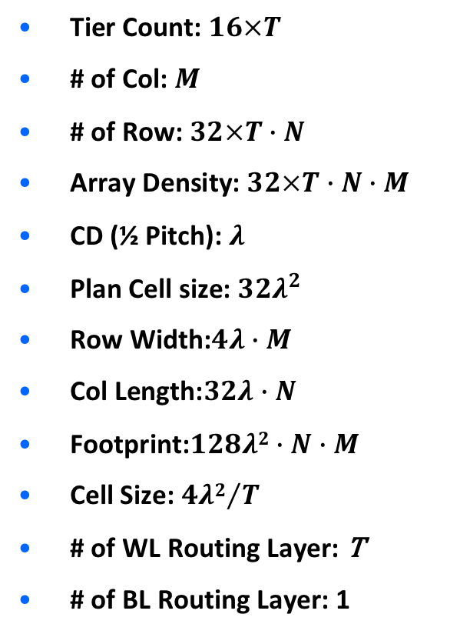

One Pillar Routing Layer
Tier Count: $16×T$
# of Col: $M$
# of Row: $32×T∙N$
Array Density: $32×T∙N∙M$
CD (½ Pitch): $λ$
Plan Cell size: ${32λ}^{2}$
Row Width:$4λ∙M$
Col Length:$32λ∙N$
Footprint:$128λ2∙N∙M$
Cell Size: ${4λ2}/T$
# of WL Routing Layer: T
# of BL Routing Layer: 1
$$i=1⋯N$$
$$j=1⋯M$$
R_{o,t,i-1}
$$32λ$$
C_{j-2}
R_{o,t,i}
C_{j}
C_{j-1}
C_{j+2}
C_{j+1}
R_{o,t,i+1}
R_{e,t,i}
$$4λ×M$$
R_{e,t-1,i}
R_{e,t-2,i}
R_{e,t,i+1}
R_{e,t-1,i+1}
R_{e,t-2,i+1}

