Slide 1
Higher Density, Higher Speed, Lower BER

Slide 2
Multi Level Cell capable for high density/high speed Storage
Read V_{TH}
+V_{DM2}
+V_{DM1}
1
0
1
-PA2’
-PA1’
+PA1
+PA2
Write PA
Write PA
SLC
-V_{DM1’}
+PA1
Y
+V_{DM2}
0
Write PW
-PA1’
1
.5
0
1
.5
1.5 b/c
Write PA
+PA2
+PA1
Y
Y
Write PW
+V_{DM1}
+V_{DM2}
0
-PA1’
11
10
01
00
11
10
01
Write PA
+PA2
MLC
+PA1
Y
Y
Y
00
Write PW
-PA1’
+V_{DM1}
+V_{DM2}
-V_{DM1’}
-PA2’

Slide 3
Multi Level Cell (II)
Read V_{TH}
+V_{DM2}
+V_{DM1}
1
0
1
-PW2’
-PW1’
+PW1
+PW2
Write PA
Write PW
SLC
+PW1
-PW1’
-V_{DM1’}
Y
0
Write PW
+V_{DM2}
1
.5
0
1
.5
1.5 b/c
Write PA
+PW2
+PW1
-PW1’
Y
Y
0
Write PW
+V_{DM1}
+V_{DM2}
11
10
01
00
11
10
01
Write PA
+PW2
+PW1
-PW2’
-PW1’
MLC
Y
Y
Y
00
Write PW
+V_{DM1}
+V_{DM2}
-V_{DM1’}

Slide 4
Multi Level Cell (III) – TLC or more
111
110
101
100
-PW1
Read V_{TH}
+PW2
+PW2
+PW1
+PW1
Write PA
+PA2
+PA1
-PW2
Write PW
+PW1
+V_{DM4}
+V_{DM3}
+PW2
+V_{DM2}
+V_{DM1}
-PA2’
-PA1’
+PA1
+PA2
-V_{DM1’}
Write PA
-V_{DM2’}
-V_{DM3’}
011
010
001
000
-PW2’
-PW2’
-PW1’
-PW1’
Write PW
Write PA
-PA1’
-PA2’

Slide 5
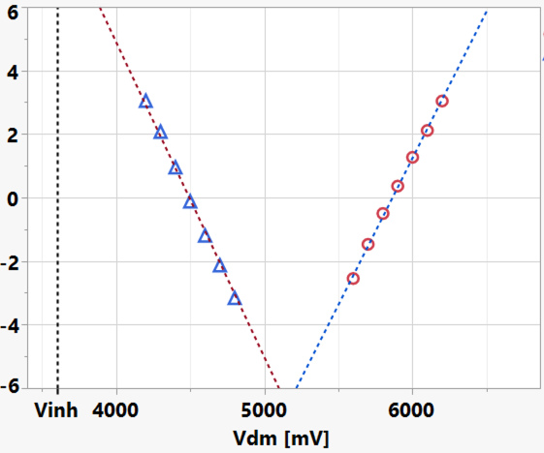
High speed / lower RBER for Random Word Access Application DRAM RBER is < 1E-9 or 5.998σ
Bianca Schroeder et.al, 'DRAM Errors in the Wild - A large scale field study’ https://doi.org/10.1145/1897816.1897844
Studied in Google server farm for 2½ years
25,000 to 70,000 FIT of 'ECC correctable error’ of 64-bit-word per Megabit
one single-bit-error every 14 to 40 hours per Gigabit
Disclaimer: This statistical analysis of RBER can not be used universally for all applications
Distribution focus include
Noise (traps), snapback (charge multiplication process) stability as manifest in threshold bounce
Glass metastability related to drift and seasoning
Cycle endurance
Extrapolation based on
Rev 6.6,
In doped SAG SD.k2
SR71 (3.3σ)
Post 1µses
After seasoning
Sigma of bit

Slide 6
Opportunities in horizon
ATF32 live-die MLC test modes enables product level learning for Bow Fall intercept assessment
ATF32 double scribe planning enables Bantu, analog circuit and other single cell capability expansion.
P1241 (G+1) |  | Stage | Owners (Customers: Darren, Sanjay, Seshu)
1 | PM & Integrity for RWB/Speed | 2 | Kumar, Fey, Lu
2 | New SD for memory effects | 3 | Dan, Fey, Lu
3 | P1241 Mechanical model | 3 | Renata, Dan
4 | 1.5 b/c | 4 | Hemant, Saad, Fuga
5 | High Thruput Seasoning | 5 | Raghu, Chris
6 | Tile Knock out elimination | 3 | Max to designate array & yield
5: Concept
4: Early Research
3: Path Validation
2: Modul Definition
1: Exiting Pathfinding

