Slide 1
BiSM Decoder update
WW51_4 2019

Slide 2
Takeaways from WW51_4 meeting
TGCMOS is ZBB
We don’t know how to build this transistor.
3T is our PREPOR
Next Steps
Build the 3T decoder and assess ways to reduce die size
Concurrently learn how to implement float deselects & CCELL requirements.
Align on the technology that we should baseline on 41nm, 33.5nm or 28nm.

Slide 3
TGcMOS remains in Pathfinding …
POS
4.8
-4.3
Measured Transistor shows ~1.5-1.63V VGS gap to goal to meet design requirements.
Here is a strategy to close this gap that requires us to use the Xtr in modes we have not done so far:
Raise PWELL VNN → VSS ( VSB -8.2 → -3.9 ) to reduce VT and thus VGS requirements.
Latch-up Risk needs assessment.
10pJ energy adder
Raise VGLSEL/GSEL to 5.7V from 4.8V
Pump + infrastructure
Die size/Energy risk due new pre-driver design design and isolation rules. 208mm^2 to be validated.
This makes the very problems made TGcMOST attractive to being with worse namely Die size & energy.
In other words we don’t know how to build this transistor today.
TCAD simulations have not shown significant ROI so far.
3.7
0
VGS = 1.1
4.8
12uA
-4.3
3.9
4.8
3.7
-4.3
0
NEG
4.8 → 5.7
-4.3 → 0
-4.3
-4.3 → 0
4.8
-3.7
-4.3
0
3.9
4.8
-4.3
1nA
-4.3
TGMOS Selector requirements.
Xtr needs to support 12uA iON VDS=0.2V VGS=1.1V VBS=-8.2V
Xtr needs to support 1nA iOFF VGS=VBS=0 VDS=5V

Slide 4
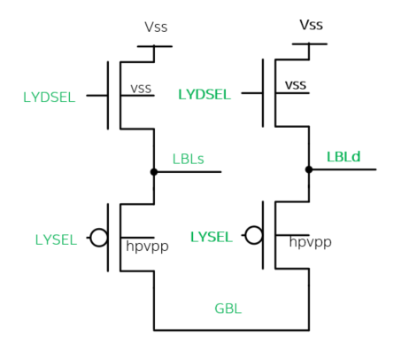
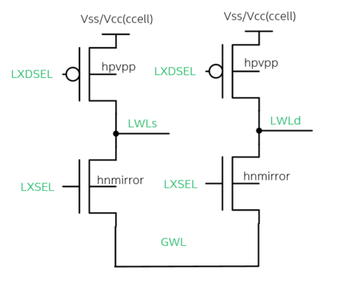
ALF32(3dxp) 2T Unipolar
POS
0
NEG
0
 | ALF32 2T Unipolar
 | POS |  | NEG
 | SEL | DESEL | SEL | DESEL
gbl | 3.7 | 3.7 | -3.7 | -3.7 | gwl
lysel | 0 | 3.7 | 0 | -3.7 | lxsel
lbl | 3.7 | 0 | -3.7 | 0/0.8 | lwl
lydesel | 0 | 3.7 | 0 | -3.7 | lxdesel
vss | 0 | 0 | 0.8 | 0/0.8 | vss/ccell
#/patch | 32 | 992 | 32 | 992 | #/patch
0
3.7
0
-3.7
3.7
0
-3.7
0
0
3.7
0
-3.7
3.7
-3.7
Yellow boxes highlight selector gate transitions
 | ALF32
Status | POR
Cell Arch | Unipolar
Decode Type | 2T
Deselect Togl. | No
Float Deselects | No
Energy | 104
Die size | 198
Unipolar reference design (3dxp)
No Deselect toggle.
Big Selects + Small Deselects

Slide 5
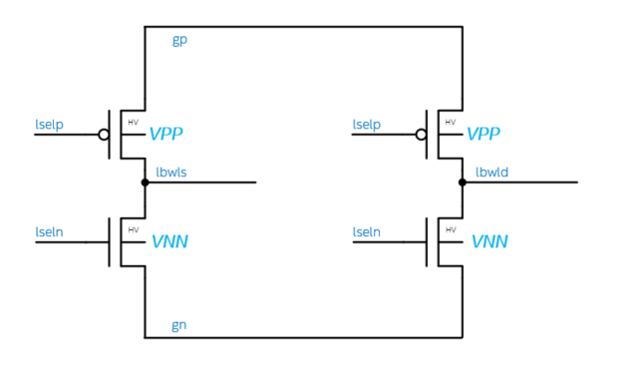
S24S 2T Bipolar
3.7
0
POS
NEG
 | S24S |  |  |  | Idle
 | POS |  | NEG
 | SEL | DESEL | SEL | DESEL
gp | 3.7 | 3.7 | 0 | 0 | 0
lselp | -1.2 | 3.7 | 0 | -1.2 | -1.2
lbwl | 3.7 | 0 | -3.7 | 0 | 0
lseln | 0 | 1.2 | 1.2 | -3.7 | 1.2
gn | 0 | 0 | -3.7 | -3.7 | 0
#/patch | 32 | 992 | 32 | 992 | 1024
-1.2
3.7
3.7
0
-3.7
-1.2
0
0
0
1.2
1.2
-3.7
0
-3.7
 | ALF32 | S24S
Status | POR | POR
Cell Arch | Unipolar | Bipolar
Decode Type | 2T | 2T
Deselect Togl. | No | Yes
Float Deselects | No | No
Energy | 104 | 154
Die size | 198 | 221
POR Bipolar Design
2T ( Big P + Big N ) → Die size problem.
992 De-select’s. switch. → 50pJ energy problem

Slide 6
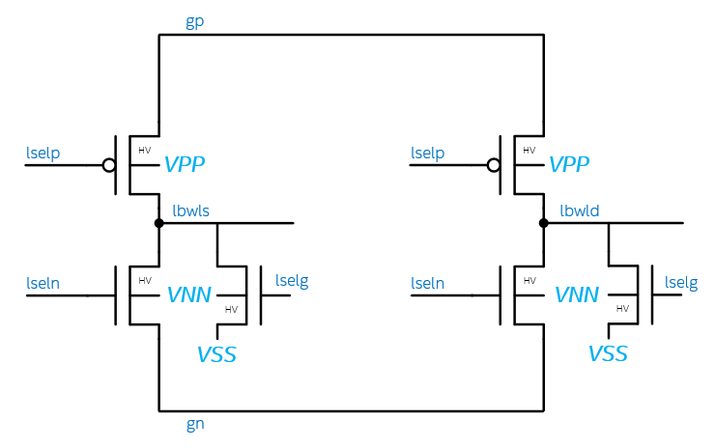
3T Bipolar
 | 3T
 | POS |  | NEG |  | IDLE
 | SEL | DESEL | SEL | DESEL
gp | 3.7 | 3.7 | 0 | 0 | 0
lselp | 0 | 3.7 | 0 | 3.7 | 3.7
lbwl | 3.7 | 0 | -3.7 | 0 | 0
lseln | 0 | -3.7 | 0 | -3.7 | -3.7
gn | 0 | 0 | -3.7 | -3.7 | 0
lselg | 0 | 1.2 | -3.7 | 1.2 | 1.2
vss | 0 | 0 | 0 | 0 | 0
#/patch | 32 | 992 | 32 | 992 | 1024
3.7
0
3.7
POS
NEG
IDLE
0
3.7
3.7
0
0
3.7
3.7
0
3.7
3.7
0
0
0
0
-3.7
1.2
0
0
-3.7
1.2
-3.7
1.2
-3.7
1.2
0
-3.7
-3.7
 | ALF32 | S24S | 3T
Status | POR | POR | Pre POR
Cell Arch | Unipolar | Bipolar | Bipolar
Decode Type | 2T | 2T | 3T
Deselect Togl. | No | Yes | No
Float Deselects | No | No | No
Energy | 104 | 154 | ~104
Die size | 198 | 221 | 227
3T Solves the energy problem present in 2T POR
No Deselect Toggle
At Cost of adding on transistor. (Small N Xtr.)
Die size problem remains ( Big P + Big N + Small N)
Need decoder layout to drive assessment.

Slide 7
2T Bipolar with Float
3.7
0
0/3.7
POS
NEG
IDLE
0
3.7
3.7
Fl 0
0
-3.7
3.7
Fl 0
3.7
Fl 0
3.7
Fl 0
 | algo
 | S24S W/ Desel float
 | POS |  | NEG |  | IDLE | REF+ | REF -
 | SEL | DESEL | SEL | DESEL
gp | 3.7 | 3.7 | 0 | 0 | 0/3.7 | 3.7 | 0
lselp | 0 | 3.7 | 0 | 3.7 | 3.7 | 3.7 | -1.2
lbwl | 3.7 | fl 0 | -3.7 | fl 0 | fl 0 | 0 | 0
lseln | 0 | -3.7 | 0 | -3.7 | -3.7 | 1.2 | -3.7
gn | 0 | 0 | -3.7 | -3.7 | 0/-3.7 | 0 | -3.7
# gt/patch | 32 | 992 | 32 | 992 | 1024 | 1024 | 1024
0
-3.7
0
-3.7
-3.7
-3.7
0
-3.7
0/-3.7
3.7
0
REF+
REF-
3.7
0
3.7
0
-1.2
-3.7
-1.2
0
1.2
1.2
-3.7
-3.7
0
-3.7
Alternate 2T scheme that reduces energy at the cost of Float deselects.
→ periodic refresh costing energy (TBD).
Die size ~2T S24S sizes.
Next: RWB impact of Float Deselects & Refresh Strategy/Energy
Sims/SR71/Bantu/ - Vehicle to learn deselect float implementation.
Next: Die size recovery strategy are needed to move this fwd.
Next: Need for CCELL.
 | ALF32 | S24S | 3T | 2T w/ Float
Status | POR | POR | Pre POR | Idea
Cell Arch | Unipolar | Bipolar | Bipolar | Bipolar
Decode Type | 2T | 2T | 3T | 2T
Deselect Togl. | No | Yes | No | No
Float Deselects | No | No | No | Yes
Energy | 104 | 154 | ~104 | TBD
Die size | 198 | 221 | 227 | 221

Slide 8
Summary & Plan
Plan
Make 3T the new PREPOR
Next Step is to draw out the Decoder.
Assess the Die size gap to goal.
2T W/Float Desel
Vehicle to validate float implementation (WIP)
Need for CCELL with BISM Cell.
Draw out Decoder and Assess gap to goal.
Develop ideas list to explore better solutions.
 | ALF32 | S24S | 3T | 2T w/ Float
Status | POR | POR | Pre POR | Idea
Cell Arch | Unipolar | Bipolar | Bipolar | Bipolar
Decode Type | 2T | 2T | 3T | 2T
Deselect Togl. | No | Yes | No | No
Float Deselects | No | No | No | Yes
Energy | 104 | 154 | ~104 | TBD
Die size | 198 | 221 | 227 | 221

Slide 9
Backup

Slide 10
Other Ideas
TGCMOST with Mirror on Pos Side + CCELL
TGCMOST with PMOS selector
1T HV Decoder.
ADM/SOI devices with ZERO body bias VT impact.

Slide 11
BiSM TGMOS RARMR WW50
Issue/Owner | Models/Strategy | Results/Next Steps
Problem Statement: TGNMOS has 1.6V gap in gate overdrive and not able to provide 12uA Type B leakage required for cell selection under positive 4.8V local/global select at 85C, while meeting the W.C. Ioff goal of 1nA Problem Characterization: Detect (requirements not met) Positive path: Ion <12uA for local select device at Vgs=1.1V, Vds=0.2V, and Vbs=-8.2V Negative path: Ioff > 1nA at Vds=4.31V, Vgs=Vbs=0V Owners: Luo, Balaji, Dipanjan, Divesh, Renata, Pracheetee Sponsors/Stakeholders: Derchang Phase: 4-Segmentation Risk: 1.5-High Risk/No Data | Models of Gaps 1.6V gap in gate overdrive Vgs-Vt (based on current TGNMOS silicon data under 4.8V positive path select gate supply) Off-state: zero-bias VT of 0.45V required to meet 1nA Ioff goal; On-state: VT@-8.2V is 1.65V, which requires 2.7V Vgs to meet 12uA Ion goal POR bias Vgs is 1.1V (=4.8-3.7), which has 1.5V Vgs gap to reach the required gate overdrive | Results Enabler1: 0.2V most (current Silicon/TCAD data is 0) Enabler3: 0.7V most (current silicon VT@BB reduction from Vbs=-8.2V to Vbs=-3.9V Enabler2 to close the remaining gap: need to raise VG by at least 0.7V (VG from 4.8V to >5.5V)
 | Strategy for gap-to-goal assessment: The strategy is to increase the gate overdrive through lowering the back-bias and bring up the positive select gate voltage Enabler1: process optimization (well doping engineering, asymmetrical channel, etc.) to lower the back-bias VT Enabler2: increase the positive select voltage. Die size, energy and reliability impact Enabler3: moving LSEL/GSEL Pwell from VNN to VSS, which lowers the back-bias VT | Next Step @ Quad 1 : TCAD Sims + Strategy for Enablers 1/3 Die size + Energy Gap Enabler 3 | ECD WW50_5 Luo/Dipanjan WW51_2 Balaji
TGNMOS Gap-to-Goal Summary |  | Enablers |  | Enabler 1: lower VT@BB through process change | Enabler 3: move LSEL/GSEL PWell bias to VSS | Enabler 2: raise LSEL/GSEL gate bias voltage
 |  | Projected Gain |  | 0 to 0.2V | Up to 0.7V | Need >0.7V
Device Performance Metrics | Description | Goal | Silicon at Ioff spec | Projected Device Performance
Select device Ion at the W.C. (uA) | Ion@Vds=0.2V,Vgs=1.1V,Vbs=-8.2V | 12 | 0 | 0 | 4 | 12
Select device Ioff at the W.C. bias (nA) | Idoff @Vds=5.0V, Vgs=Vbs=0V | 1 | 1 | 1 | 1 | 1
Ion Gap to Goal (uA) |  | 0 | -12 | -12 | -8 | 0
Gap to Goal measured by VGS-VT (V) |  | 0 | -1.6 | -1.4 | -0.7 | 0

Slide 12
TCAD Simulation Result (Ack. Dipanjan)
TCAD exploration of process options to improve Ion-Ioff intrinsic correlation
Symmetrical devices varying high/low energy well implant doses
Asymmetrical devices with source-side and drain-side halo implant
Ion-Ioff tradeoff with gate length scaling from 500nm to 350nm
Lowering well implant dose (to reduce body effect) and LDD dose (to suppress SCE)
Conclusion
Options 1 to 3 do not show any Ion-Ioff improvement compared to POR
Asymmetric device does not give any appreciable gain compared to symmetric device (on the same Ion-Ioff line with similar Vtlin, Idlin and Ioff)
Lg scaling is slightly worse in Ion-Ioff intrinsic correlation
Option 4 shows that, by lowering LDD dose and p-well doping at the same time, we can achieve ~200 mV Vt reduction at Vbs=-8.2V and ~150mV Vt reduction at Vbs=-3.7V
The best split shows up to 200mV back-bias Vt reduction can be achieved by lowering LDD and Pwell dose at the same time

Slide 13
W9209990 Wafer 467 Data
Total 1.6V gap in gate overdrive (Vgs-Vt) to meet Ion&Ioff goals
Zero VT 0.4 to 0.45V required to meet 1nA Ioff goal
12uA requires 1.05V gate overdrive (Vgs-Vt@Vbs=-8.2V)
Higher Vgs and lower Vt@Vbs needed to deliver 12uA Ion goal
Raise Vg to 5.8V from 4.8V (so Vgs increased to 2.1V from 1.1V)
Lower back-bias VT by 0.5V (85C VT@Vbs=-8.2V is 1.05V after reduction)
Device Performance Metrics | Test Condition | Goal | 30C 10x9.7 NHVLVT | 85C 10x9.7 NHVLVT | 11.43x9.56 SSH NHVLVT 30C | 11.43x9.56 SSH NHVLVT 85C
Select Device Ion at the W.C. (uA) | Idlin @ Vds=0.2, Vgs=1.1, Vbs=-8.2 (uA) | 12 | 0.664 | 0.758 | 0.0137 | 0.002
Select Device Ioff at the W.C. bias (nA) | Idoff @Vds=5.0, Vgs=Vbs=0 (nA) | 1 | 5890 | 7330 | 8.76 | 3.38
VT0 at zero back bias | VT @ Vds=0.1, Vbs =0 |  | -0.02 | -0.1 | 0.513 | 0.44
VT0 required to meet 1nA Ioff goal |  |  | 0.451 | 0.48 | 0.395 | 0.361
VT0 gap to required to meet 1nA Ioff goal | VT0(required) – VT0(silicon) |  | 0.471 | 0.58 | 0.118 | 0.079
VT@-8.2V at back bias of -8.2V | VT @ Vds=0.1, Vbs=-8.2 |  | 1.164 | 1.11 | 1.675 | 1.587
Delta VT at -8.2V back bias | Calculation = VT@Vbs=0 – VT@Vbs=-8.2V |  | 1.184 | 1.21 | 1.162 | 1.14
Gate overdrive Required (=Vgs-Vt@-8.2V) | Required Vgs-Vt@Vbs for Id=12uA |  | 0.886 | 1.04 | 1.175 | 1.113
VGS Required to meet 12uA Ion goal | Vgs for Id=12uA @Vds=0.2, Vbs=-8.2 |  | 2.050 | 2.150 | 2.85 | 2.7
VGS Available at Vsupply of 4.8V |  |  | 1.1 | 1.1 | 1.1 | 1.1
Gate overdrive gap to meet 12uA Ion goal | VGS(available) – VGS(required) |  | -0.95 | -1.05 | -1.75 | -1.6

