Slide 1
3t rev0 to do layout work ( pre-optimization)

Slide 2
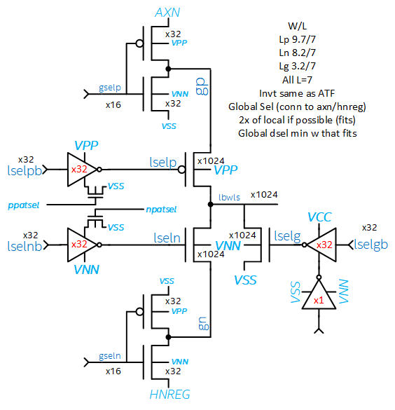
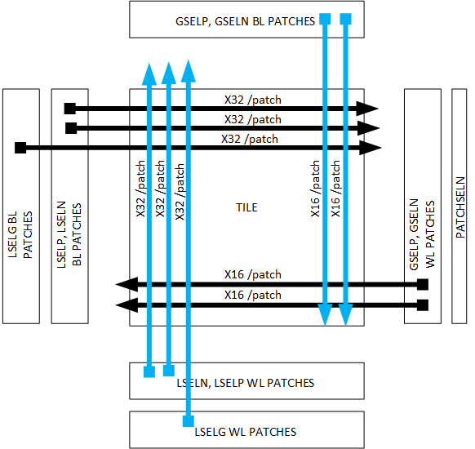
Eddie to build and route.

Slide 3
Bias Table
 | POS patch bias ( WL or BL ) |  |  |  |  | NEG patch bias (WL or BL)
 | slsg | sldg | dlsg | dldg |  | slsg | sldg | dlsg | dldg
axn | 4.2 | 4.2 | 4.2 | 4.2 | axn | 4.2 | 4.2 | 4.2 | 4.2
gselp | 0 | 4.2 | 0 | 4.2 | gselp | 4.2 | 4.2 | 4.2 | 4.2
gp | 4 | 0 | 4 | 0 | gp | 0 | 0 | 0 | 0
lselp | 0 | 0 | 4.2 | 4.2 | lselp | 0 | 0 | 4.2 | 4.2
lbwl | 3.7 | 0 | 0 | 0 | lbwl | -3.7 | 0 | 0 | 0
lseln | 0 | 0 | -4.2 | -4.2 | lseln | 0 | 0 | -4.2 | -4.2
gn | 0 | 0 | 0 | 0 | gn | -4 | 0 | -4 | 0
gseln | -4.2 | -4.2 | -4.2 | -4.2 | gseln | 0 | -4.2 | 0 | -4.2
hnreg | -4.2 | -4.2 | -4.2 | -4.2 | hnreg | -4.2 | -4.2 | -4.2 | -4.2
lbwl | 3.7 | 0 | 0 | 0 | lbwl | -3.7 | 0 | 0 | 0
lselg | 0 | 1.2 | 1.2 | 1.2 | lselg | -4.2 | 1.2 | 1.2 | 1.2
vss | 0 | 0 | 0 | 0 | vss | 0 | 0 | 0 | 0
 | IDLE |  |  |  |  | IDLE + GBL POS |  |  |  |  | IDLE + GBL NEG
 | slsg | sldg | dlsg | dldg |  | slsg | sldg | dlsg | dldg |  | slsg | sldg | dlsg | dldg
axn | 4.2 | 4.2 | 4.2 | 4.2 | axn | 4.2 | 4.2 | 4.2 | 4.2 | axn | 4.2 | 4.2 | 4.2 | 4.2
gselp | 4.2 | 4.2 | 4.2 | 4.2 | gselp | 0 | 4.2 | 0 | 4.2 | gselp | 4.2 | 4.2 | 4.2 | 4.2
gp | 0 | 0 | 0 | 0 | gp | 4.2 | 0 | 4.2 | 0 | gp | 0 | 0 | 0 | 0
lselp | 4.2 | 4.2 | 4.2 | 4.2 | lselp | 4.2 | 4.2 | 4.2 | 4.2 | lselp | 4.2 | 4.2 | 4.2 | 4.2
lbwl | 0 | 0 | 0 | 0 | lbwl | 0 | 0 | 0 | 0 | lbwl | 0 | 0 | 0 | 0
lseln | -4.2 | -4.2 | -4.2 | -4.2 | lseln | -4.2 | -4.2 | -4.2 | -4.2 | lseln | -4.2 | -4.2 | -4.2 | -4.2
gn | 0 | 0 | 0 | 0 | gn | 0 | 0 | 0 | 0 | gn | -4.2 | 0 | -4.2 | 0
gseln | -4.2 | -4.2 | -4.2 | -4.2 | gseln | -4.2 | -4.2 | -4.2 | -4.2 | gseln | 0 | -4.2 | 0 | -4.2
hnreg | -4.2 | -4.2 | -4.2 | -4.2 | hnreg | -4.2 | -4.2 | -4.2 | -4.2 | hnreg | -4.2 | -4.2 | -4.2 | -4.2
lbwl | 0 | 0 | 0 | 0 | lbwl | 0 | 0 | 0 | 0 | lbwl | 0 | 0 | 0 | 0
lselg | 1.2 | 1.2 | 1.2 | 1.2 | lselg | 1.2 | 1.2 | 1.2 | 1.2 | lselg | 1.2 | 1.2 | 1.2 | 1.2
vss | 0 | 0 | 0 | 0 | vss | 0 | 0 | 0 | 0 | vss | 0 | 0 | 0 | 0

Slide 4
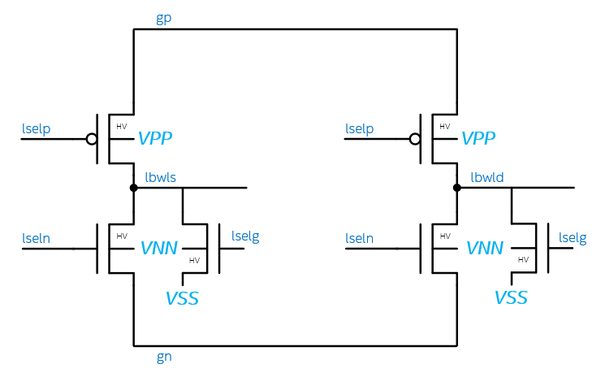
3T Bipolar
 | 3T
 | POS |  | NEG |  | IDLE
 | SEL | DESEL | SEL | DESEL
gp | 3.7 | 3.7 | 0 | 0 | 0
lselp | 0 | 3.7 | 0 | 3.7 | 3.7
lbwl | 3.7 | 0 | -3.7 | 0 | 0
lseln | 0 | -3.7 | 0 | -3.7 | -3.7
gn | 0 | 0 | -3.7 | -3.7 | 0
lselg | 0 | 1.2 | -3.7 | 1.2 | 1.2
vss | 0 | 0 | 0 | 0 | 0
#/patch | 32 | 992 | 32 | 992 | 1024
3.7
0
3.7
POS
NEG
IDLE
0
3.7
3.7
0
0
-3.7
3.7
0
3.7
3.7
0
0
0
0
-3.7
1.2
0
-3.7
-3.7
1.2
-3.7
1.2
-3.7
1.2
0
-3.7
-3.7
 | ALF32 | S24S | 3T
Status | POR | POR | Pre POR
Cell Arch | Unipolar | Bipolar | Bipolar
Decode Type | 2T | 2T | 3T
Deselect Togl. | No | Yes | No
Float Deselects | No | No | No
Energy | 104 | 154 | ~104
Die size | 198 | 221 | 227
3T Solves the energy problem present in 2T POR
No Deselect Toggle
At Cost of adding on transistor. (Small N Xtr.)
Die size problem remains ( Big P + Big N + Small N)
Need decoder layout to drive assessment.

