Slide 1
3D RRAM Analysis
10/22/2012
Khaled Hasnat
Shafqat Ahmed
Kyu Min
Sandeep Guliani
Krishna Parat

Slide 2
Agenda
Memory and Switch Assumptions
3D RRAM Architecture
Tile/Die architecture
Read operation (biasing/speed/energy)
Set/Reset operation (Bias/speed/energy)
Die Size and Cost Assessment
Key technology challenges
Summary

Slide 3
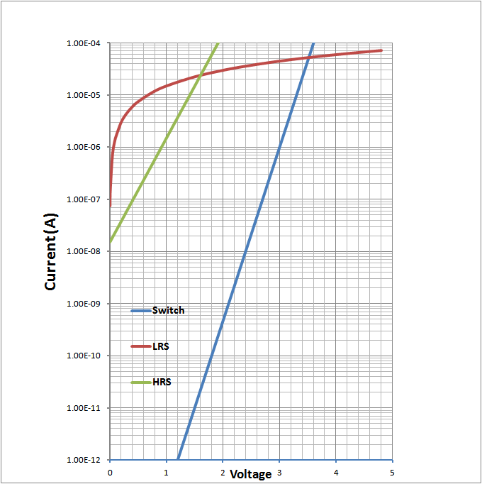
Memory & Switch Assumptions
Switch
  Vt of 3V at 1uA.
  Sub-threshold slope 300mV/dec (10% Vt).
Memory LRS
  Linear with ~67Kohm.
  Reset at 1.0V at 15uA.
Memory HRS
  Set voltage of 1.0V at 1.5uA.
  Sub-threshold slope of 500mV/dec
Combined M + S is assumed to have a Vt distribution of +/-200mV (+/-5 sigma)
  This assumptions is used to ensure operation window for read and disturb

Slide 4
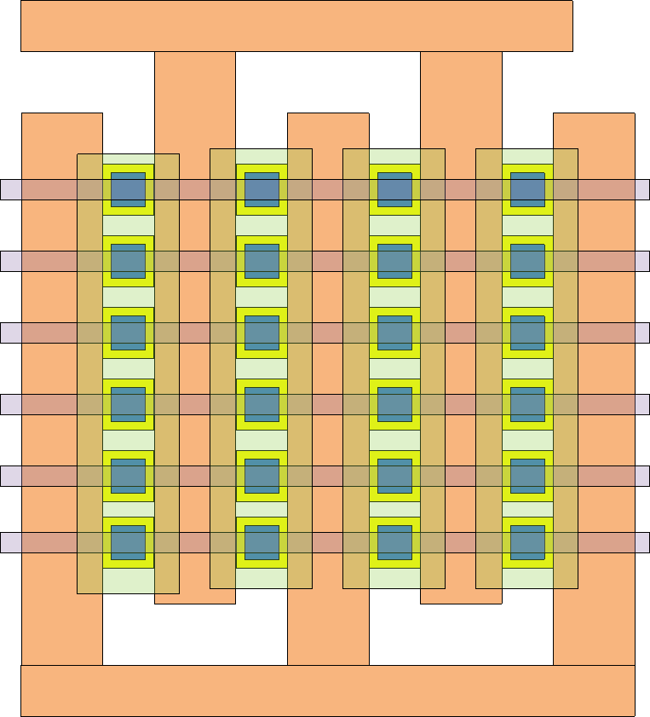
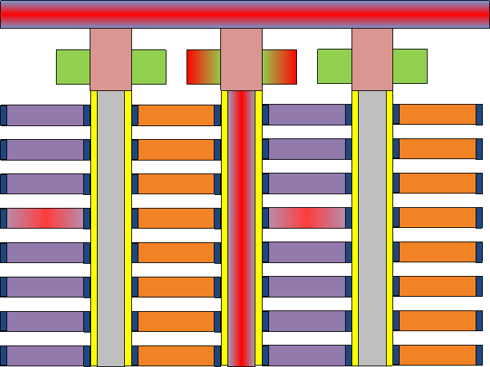
3D RRAM Architecture
Stacks of Wordline tiers separated by dielectric are patterned to create odd and even wordlines.
Via like pillars are etched between the wordlines and two memory cells are created at each tier of the wordlines, one for even and one for the odd wordlines.
The pillars are filled with tungsten and a select gate transistor is formed on top the pillar which connects to the BL.
A given cell is selected by turning on SGD/BL/WL associated with the cell.
Every 16 Odd and 16 even wordlines are tied are tied together as compromise between WL capacitance and routing complexity.
Each of these 16 odd and 16 even wordlines run across 1k BL and they constitute a sub-tile.
  Sub-tile size dictates WL RC and routing pitch for WL drivers.
  During read/write operations: only the “A-type” cells that belong to the same sub-tile are disturbed or contribute to leakae.
Top down Layout
X-section along BL
Selected SGD
Odd WL
SG
W Pillar
BL
Even WL
Selected WL

Slide 5
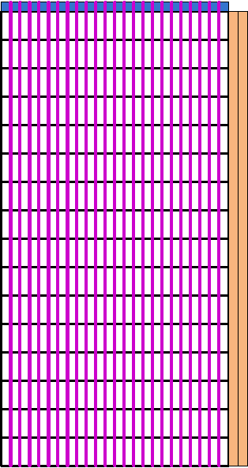
Tile Layout and Arrangement
Tiles consists of 128 sub-Tile.
BL exists on one end routing down to the drivers.
Both the odd/even WL’s are routed out from stair-step on one side of the tile.
  This is done to minimize stair-step overhead (~20% with single-sided).
  This will require one extra metal layer on top.
1024 BL
BL exit down to drivers
128 Sub-Tiles
WL stair-step exit down to drivers

Slide 6
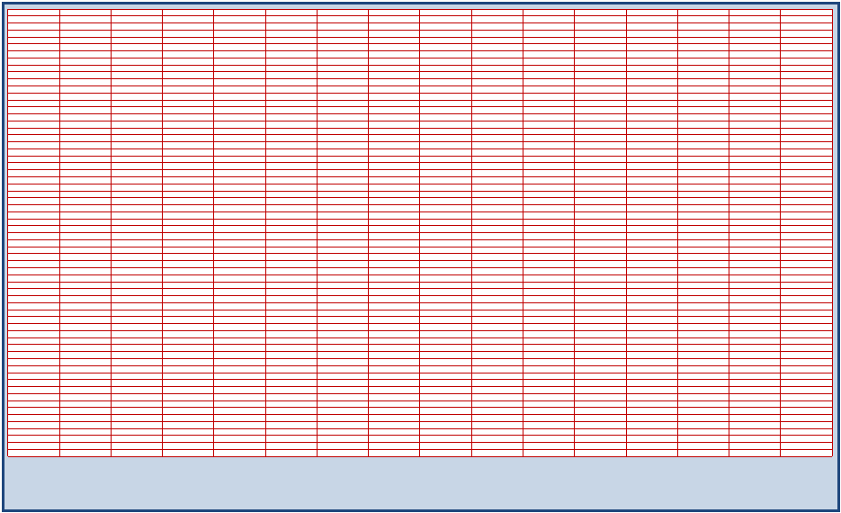
Die Layout
1kb/tile X 16 Tile per row
Die = 16 x 64 Tiles (1024 tiles/ 256Mb)
Tile = 1kb BL x 128 sub-Tile (0.25 Mb)
(each tile has its own local drivers)
Sub-Tile = 1024 BL x 32 Tiers
x 32 Select Gate x 2 Cells
= 2Mb
(sub-tiles share common
odd/even WL at each tiers)
64 rows of tiles
WL

Slide 7
Array BL/WL RC assessment
BL
  Assume Cu Bitline at 107nm pitch.
  With 5ohm/um resistance total BL R ~4.5K.
  BL Cap (projected from 100s) ~0.36pF/tile
    SGD junction cap increases the overall BL CAP.
WL
  Width WL of 120nm width between pillars and a height of 30nm is assumed.
  Assuming 70ohm/um, WL R is ~7.7Kohm for each fingers.
  WL Cap is estimated to be 2.5pF for all 16 fingers combined or ~0.15pF/finger.
SGD
  CoSix SGD is assumed to minimize SGD delay.
  SGD resistance ~16K/finger.
  SGD Capacitance ~0.24pF/finger.

Slide 8
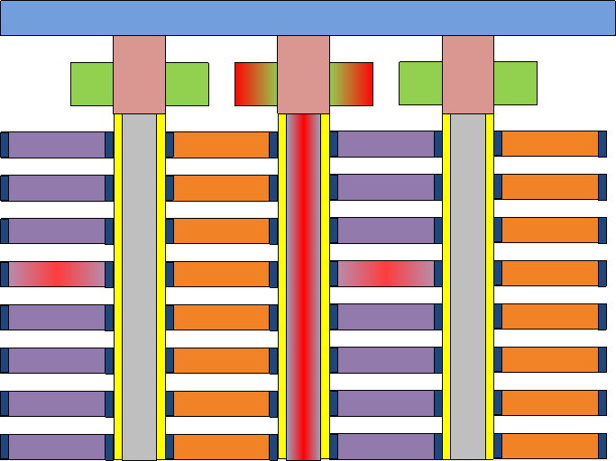
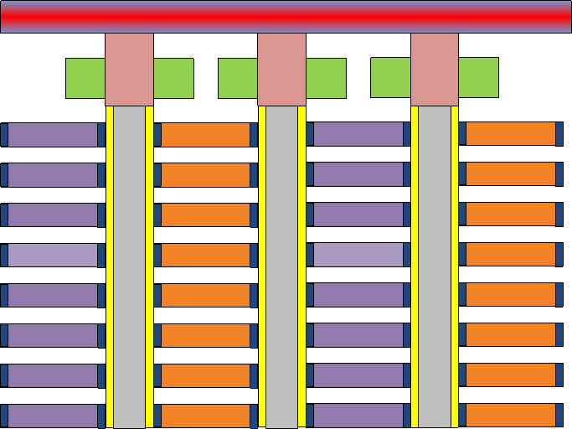
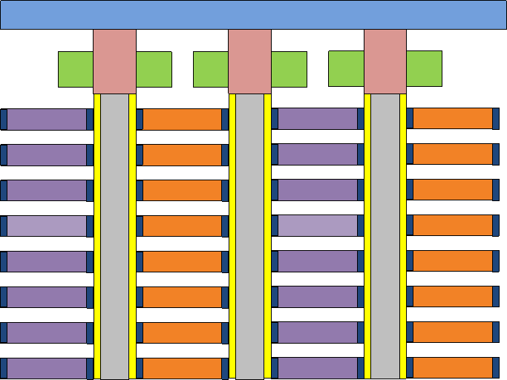
Read Bias
Selected BL
De-selected BL
3.2V
2V
0V
4.2V
0V
0V
4.2V
0V
2V
2V
2V
2V
2V
2V
2V
2V
2V
2V
2V
2V
2V
2V
2V
2V
2V
2V
2V
2V
Selected
Sub-Tile
2V
2V
2V
2V
0V
2V
0V
2V
0V
2V
0V
2V
2V
2V
2V
2V
2V
2V
2V
2V
2V
2V
2V
2V
2V
2V
2V
2V
2V
2V
2V
2V
2V
2V
2V
2V
2V
2V
2V
2V
2V
2V
2V
2V
3.2V
2V
0V
0V
0V
0V
0V
0V
2V
2V
2V
2V
2V
2V
2V
2V
2V
2V
2V
2V
2V
2V
2V
2V
2V
2V
2V
2V
De-selected
Sub-Tile
2V
2V
2V
2V
2V
2V
2V
2V
2V
2V
2V
2V
2V
2V
2V
2V
2V
2V
2V
2V
2V
2V
2V
2V
2V
2V
2V
2V
2V
2V
2V
2V
2V
2V
2V
2V
2V
2V
2V
2V
2V
2V
2V
2V

Slide 9
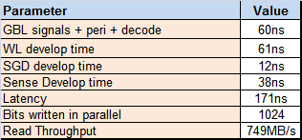
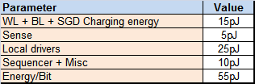
Read Performance
A NOR/(ABL) like sensing scheme is assumed due to lower read current (~1uA) and large BL cap discharge time.
  The scheme pre-charge the BLs to a voltage and then discharge an external capacitor to sense the current.
WL/BL are biased in parallel and then SG is biased to reduce latency.
Read BL voltage is about 3.2V, selected WL is grounded and selected SG is turned-on.
Slow LRS cell current is assumed to be ~0.9uA.
Below is summary or performance for write operation.
Read Speed
Read Energy

Slide 10
RESET to SET
Selected BL
De-selected BL
4.4V
2V
0V
5.4V
0V
0V
5.4V
0V
2V
2V
2V
2V
2V
2V
2V
2V
2V
2V
2V
2V
2V
2V
2V
2V
2V
2V
2V
2V
Selected
Sub-Tile
2V
2V
2V
2V
0V
2V
0V
2V
0V
2V
0V
2V
2V
2V
2V
2V
2V
2V
2V
2V
2V
2V
2V
2V
2V
2V
2V
2V
2V
2V
2V
2V
2V
2V
2V
2V
2V
2V
2V
2V
2V
2V
2V
2V
4.4V
2V
0V
0V
0V
0V
0V
0V
2V
2V
2V
2V
2V
2V
2V
2V
2V
2V
2V
2V
2V
2V
2V
2V
2V
2V
2V
2V
De-selected
Sub-Tile
2V
2V
2V
2V
2V
2V
2V
2V
2V
2V
2V
2V
2V
2V
2V
2V
2V
2V
2V
2V
2V
2V
2V
2V
2V
2V
2V
2V
2V
2V
2V
2V
2V
2V
2V
2V
2V
2V
2V
2V
2V
2V
2V
2V

Slide 11
SET to RESET
Selected BL
De-selected BL
0V
2V
0V
1V
0V
0V
1V
0V
2V
2V
2V
2V
2V
2V
2V
2V
2V
2V
2V
2V
2V
2V
2V
2V
2V
2V
2V
2V
Selected
Sub-Tile
2V
2V
2V
2V
4.6V
2V
4.6V
2V
4.6V
2V
4.6V
2V
2V
2V
2V
2V
2V
2V
2V
2V
2V
2V
2V
2V
2V
2V
2V
2V
2V
2V
2V
2V
2V
2V
2V
2V
2V
2V
2V
2V
2V
2V
2V
2V
0V
2V
0V
0V
0V
0V
0V
0V
2V
2V
2V
2V
2V
2V
2V
2V
2V
2V
2V
2V
2V
2V
2V
2V
2V
2V
2V
2V
De-selected
Sub-Tile
2V
2V
2V
2V
2V
2V
2V
2V
2V
2V
2V
2V
2V
2V
2V
2V
2V
2V
2V
2V
2V
2V
2V
2V
2V
2V
2V
2V
2V
2V
2V
2V
2V
2V
2V
2V
2V
2V
2V
2V
2V
2V
2V
2V

Slide 12
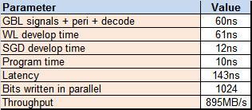
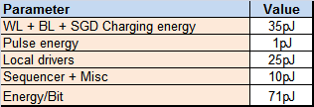
Write Performance
Programming scheme assume applying SET/RESET biases to one bit in each of the 1K tile based on the data pattern in parallel.
WL/BL are biased in parallel and then SG is biased to reduce latency.
Set/Reset Voltages ~4.5V.
Write current is about ~20uA (max.)
Switching time of 10ns is assumed.
Assume no verify (due to large read latency).
Below is summary or performance for write operation.
Write Speed
Write Energy

Slide 13
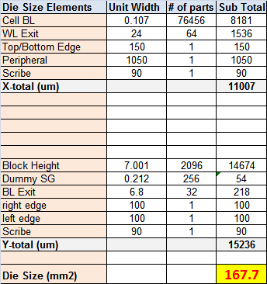
Die Size
BL Pitch 107nm
Sub-Tile Hieght 7um.
Die Size estimate
  166mm^2

Slide 14
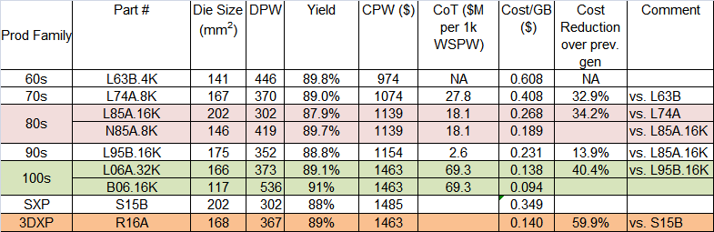
Process Cost
Comparable to 100s
  + No SGS processing
  - Need 1 additional metal layer.

Slide 15
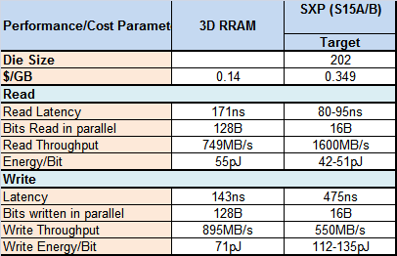
Performance/Cost Summary

Slide 16
Technology Challenges
M+S viability.
M+S distribution.
W recess etch.
Select Gate requirements
  Forming V/I requirements.
  4.5V Vdg support with low GIDL current.
Pillar etch through double pattern.

Slide 17
Backup

Slide 18


Process Flow
Cross Section
Top Down
WL PATTERN ETCH/FILL AND POLISH

Slide 19


Process Flow
Cross Section
Top Down
Slotted pillar pattern
PILLAR + RECESS ETCH

Slide 20
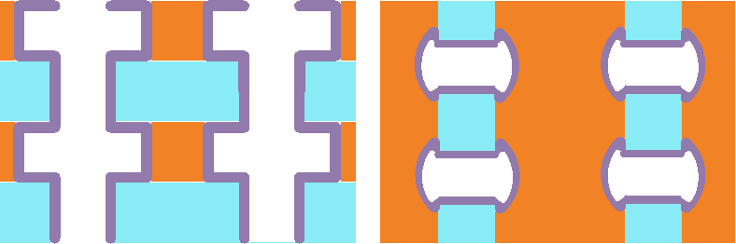
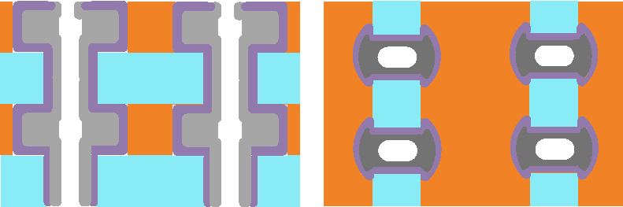
Process Flow
Cross Section
Top Down
Deposit switch material
Deposit middle electrode metal

Slide 21
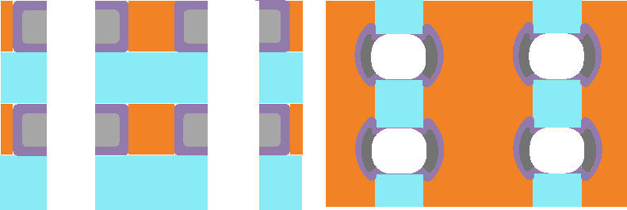
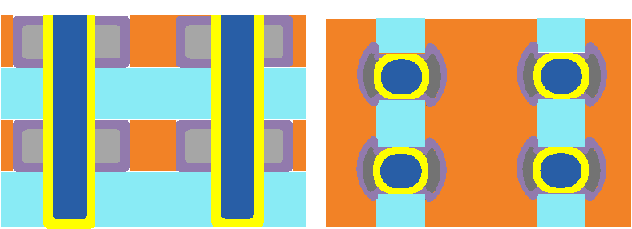
Process Flow
Cross Section
Top Down
Etch back middle electrode
Deposit memory + Pillar electrode

Slide 22
Biasing Scheme
Selected BL
De-selected BL
Selected SGD
Selected
Sub-Tile
Selected WL
Selected BL
De-selected
Sub-Tile

Slide 23
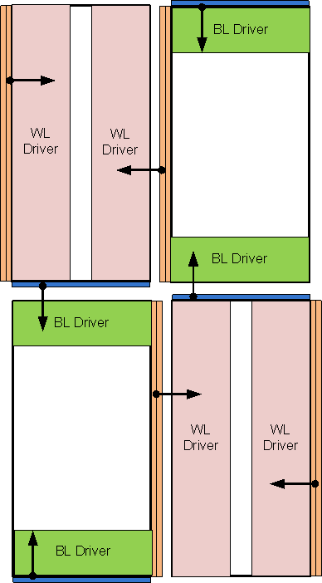
Tile Layout and Arrangement
To enable both WL/BL drivers to be placed under array, a quilt-like driver placement is assumed.

Slide 24
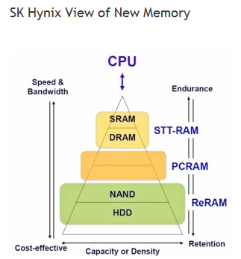

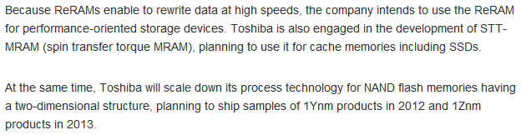
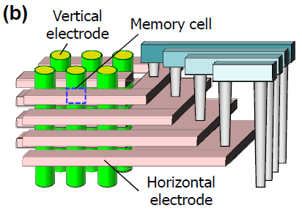
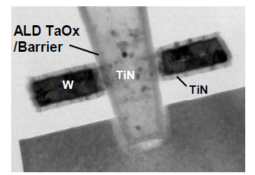
Industry Tidbits
Samsung IEDM 2011

