Slide 1
NAND Competitor Scaling Assessment
Khaled Hasnat
Original: 7/2/2020
Updated: 11/22/2020

Slide 2
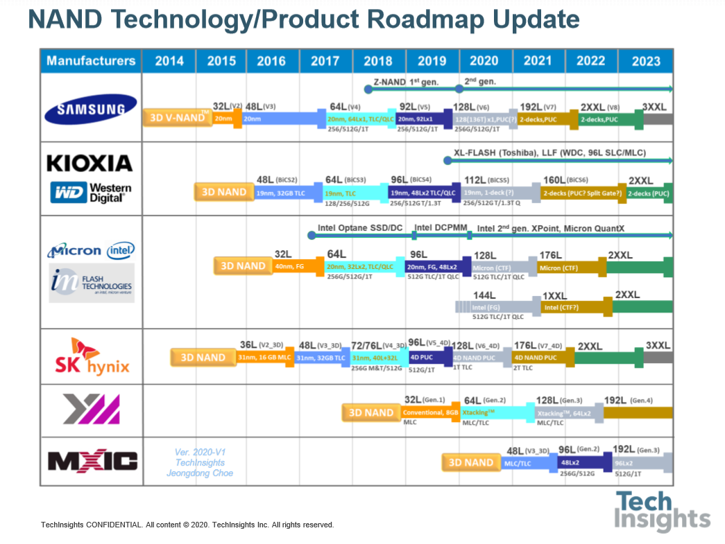



?
Reverse engineering data available.
160L
Company/press, published paper
Other media outlet.
7/2/2020

Slide 3


?
Reverse engineering data available.
176L
Company/press, published paper
Other media outlet.
New Reverse Engg. Data.
New paper.
Updates: 11/22/2020

Slide 4
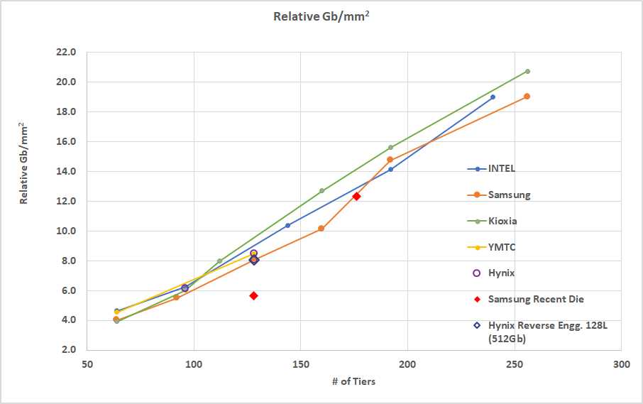
Comp Die Density
SS 176L 512Gb
Hynix 1Tb
Hynix 512Gb
SS 128L 256Gb

Slide 5
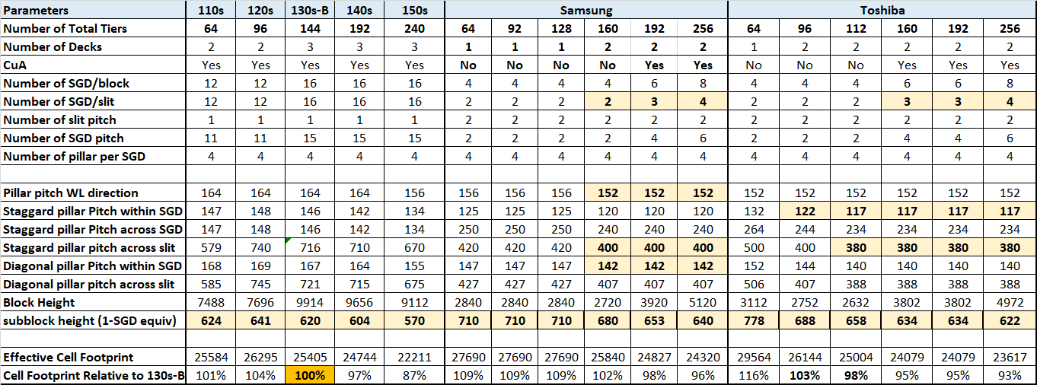
Cell footprint Scaling Possibility
Projection
Projection

Slide 6
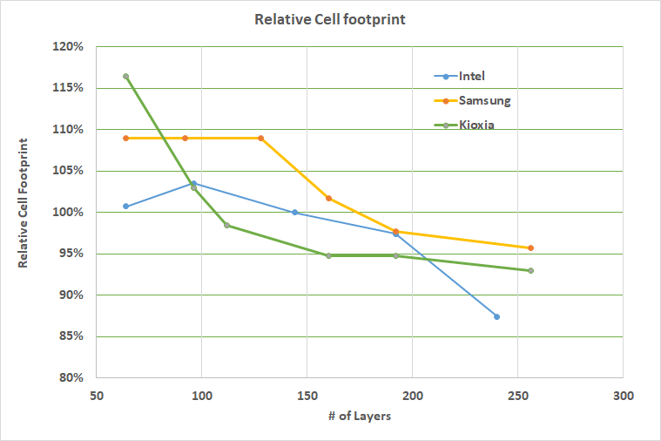
Cell Footprint
Projection
Projection

Slide 7
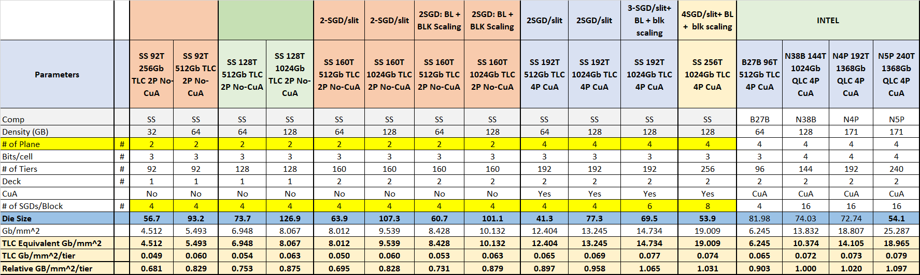
Die Size Scaling Comparison (SS)
Projection

Slide 8
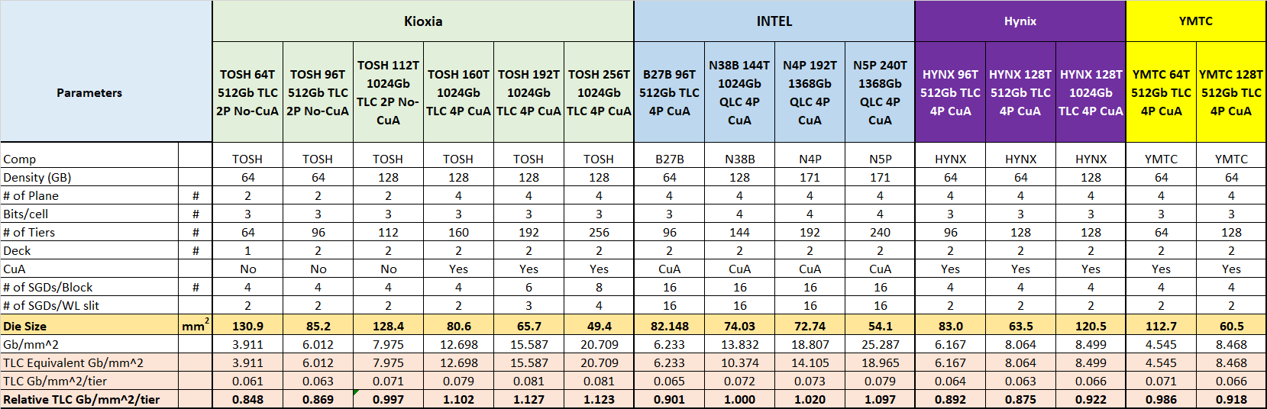
Die Size Scaling Comparison (Kioxia/Hynix/YMTC)
Projection

Slide 9
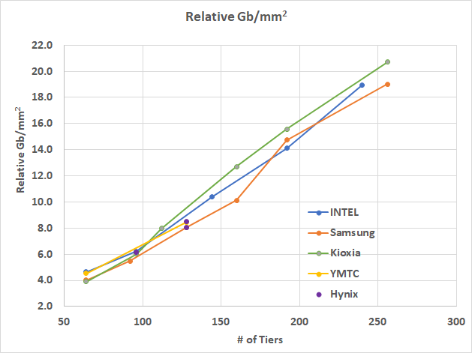
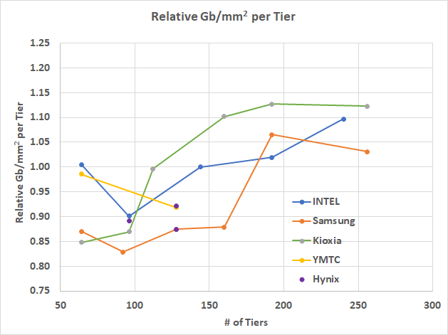
Bit Density/Scaling Efficiency
Projection
Projection
CuA
CuA

Slide 10
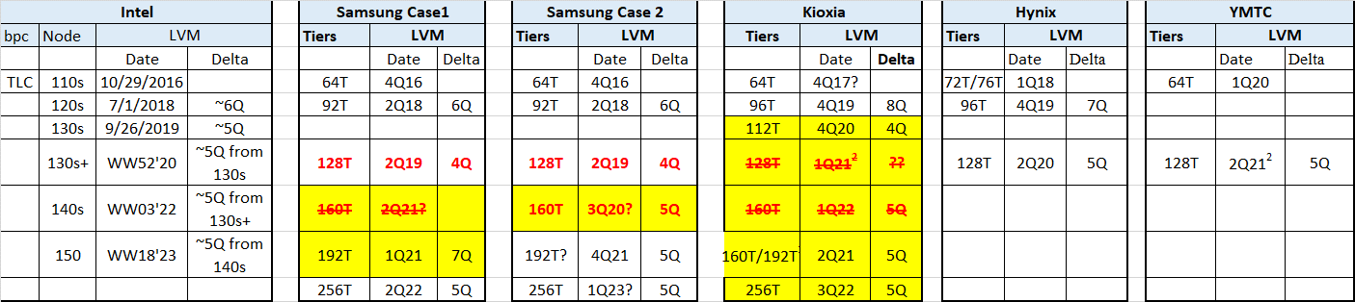
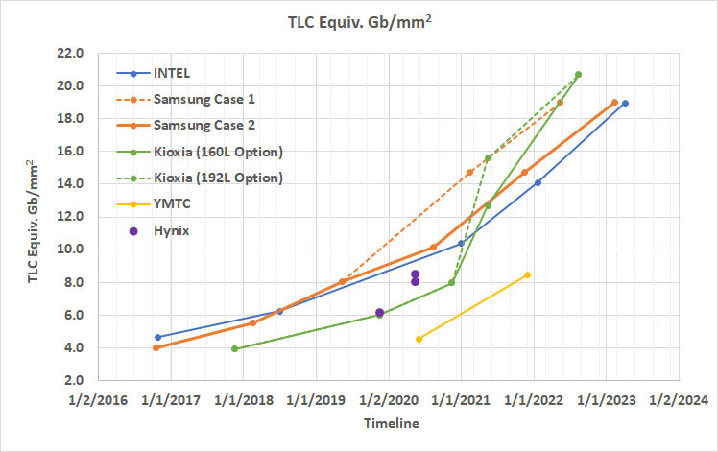
Tech-node Timeline

Slide 11
Summary
Our previous competitor scaling projection have been updated:
Cell footprint scaling has been incorporated based on recent finding on Kioxia 96T reverse engineering data and their announcement on 112T indicating further ~5% scaling.
WL slit scaling is assumed for competitors 192T and beyond nodes. (similar to our previous assumption).
Based on the new assessment: competitor may have density advantage at 192T (for equivalent TLC density).

Slide 12
Backup

Slide 13
Kioxia 112L
Western Digital and Kioxia have crossed the 3-digit layer count barrier, announcing 112-layer 3D NAND, with early shipping dates pegged at Q4 2020.
Their BiCS5 generation and succeeds their 96-layer BiCS4 technology. BiCS stands for Bit Cost Scaling and refers to the lower cost/bit with each succeeding generation. BiCS5 technology will be used to build TLC (3bits/cell) and QLC (4bits/cell) NAND. Dies will be available in a range of capacities, including 512Gb (64GB and TLC), 1Tb (128GB and TLC) and 1.33Tb (1,000,000,000,000 bits and QLC).
The layer count increase, from 96 to 112, means 16 per cent more capacity on that count alone. But WD says second-generation multi-tier memory hole technology, improved engineering processes and other cell enhancements increase BiCS5’s cell array density horizontally across the wafer. That results in up to 40 per cent more bits of storage capacity per wafer than 96-layer BiCS4.
Kioxia says cell array density has risen by approximately 20 per cent over the 96-layer product.

Slide 14
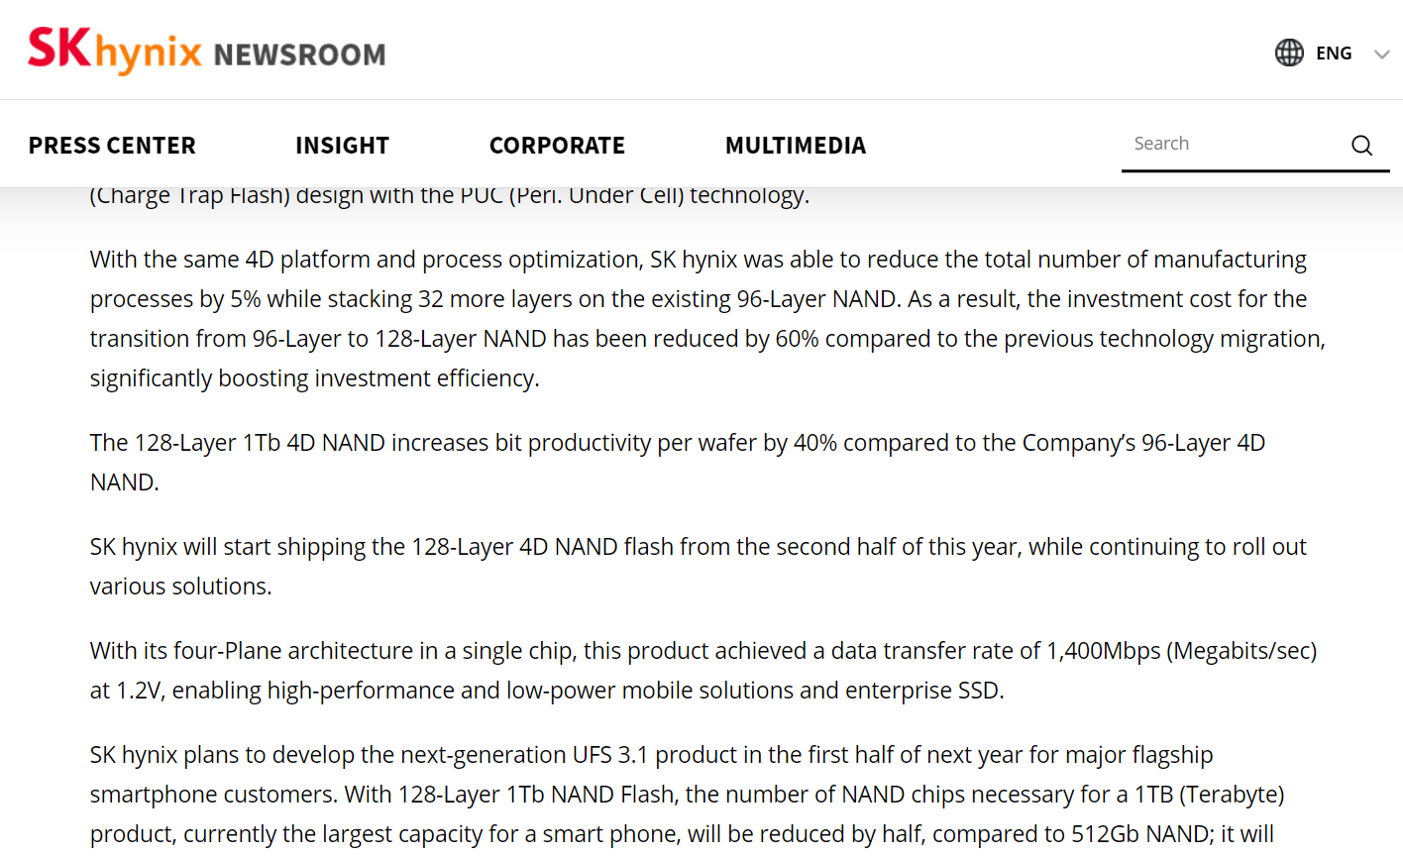

Slide 15
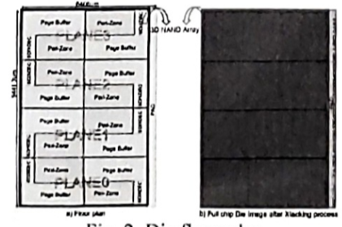
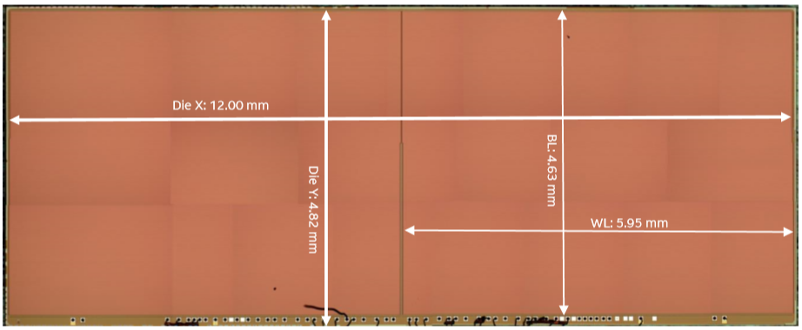
YMTC X-stacking
64-layer 256Gb 2-plane TLC die
Die size: ~58mm²
4.41 Gb/mm²
(Reverse Engineering)
128-layer 512Gb 4-plane TLC die
Die size: ~60.4mm²
8.47Gb/mm²
(2020 VLSI paper)

