Slide 1
Deck Select
DerChang Kau, 1/28/2019

Slide 2
Snap-On Cross Point Memory Array
Two Proposals
Deck Isolation – 20% die size reduction enabled by Deck Select TFT
MDP replacement – Enabled by Deck Isolation, 40% die cost reduction for each additional die in package with multi-wafer stacking by sharing CMOS decoder/data path and I/O

Slide 3
Deck Select TFTs enable decoder sharing cross decks
Reference Technology P1240
  ALF32 is 256Gb components in 200mm2
  4K tiles of 4 decks in 4K BL x 4K WL cross point array → 16K WL and 16K BL decoders per tile
Deck Select enables decoder sharing among decks.
  Estimated 45mm² die size reduction due to ½ of decoders reduction with deck-select

Slide 4
Single-Deck Cross Point Memory Array
B
Data Path
V_{PP}
V_{RR}
BL
Memory
Read/Write circuit
WL
A
A’
Address Mux
Global BL Decoder
1 Deck
1 set of WL drivers,
1 set of BL drivers
B’
Local BL Decoder
A
A’
b₀
b₁
Bit Lines
b_{m-1}
b_{m}
Isolation
V_{NN}
1 set WL Sockets
WL
w_{n}
w_{n+1}
Global WL
Decoder
Local WL
Decoder
w_{n+2}
_{B}
B’
W
Isolation
1 set BL Sockets

Slide 5
Dual-Deck Cross Point Memory Array
B
Data Path
V_{PP}
V_{RR}
BL
Memory
Read/Write circuit
WL
A
A’
2 Deck
2 set of WL drivers,
1 set of BL drivers
Address Mux
Global BL Decoder
B’
Local BL Decoder
A
A’
b₀
b₁
Bit Lines
b_{m-1}
b_{m}
Isolation
V_{NN}
2 sets WL
Sockets
WL
w_{n}
w_{n+1}
Global WL
Decoder
Local WL
Decoder
w_{n+2}
B’
_{B}
W
Isolation
1 set BL Sockets

Slide 6
Dual Deck Cross Point Memory Array with Deck Select
B
Data Path
V_{PP}
V_{RR}
BL
Memory
Read/Write circuit
WL
A
A’
2 Deck
1 set of WL drivers,
1 set of BL drivers
Address Mux
Global BL Decoder
B’
Local BL Decoder
b₀
b₁
Bit Lines
b_{m-1}
b_{m}
A
A’
Deck Sel
Isolation
V_{NN}
Deck Sel Mux
1 set WL
Sockets
WL
w_{n}
w_{n+1}
Global WL
Decoder
Local WL
Decoder
w_{n+2}
B’
_{B}
W
Isolation
1 set BL Sockets

Slide 7
Quad-Deck Comparison
A
A’
_{B}
B’
POR
2 set of WL drivers,
2 set of BL drivers
Isolation
Isolation
BL
2 set WL
Sockets
2set BL Sockets
Memory
WL
B
A
A’
_{B}
B’
Deck Select
1 set of WL drivers,
1 set of BL drivers
4 levels of Deck Select mux
A
A’
B’
Isolation
Isolation
Deck Sel Mux
1 set WL
Sockets
1set BL Sockets
Deck Sel Mux
For a 20nm Quad Deck 256Gb product, POR implementation (P1240/ALF32) is 200mm².
The invention enabled by Deck Select TFT can reduce die size by 45mm² (> 20% of die size reduction)

Slide 8
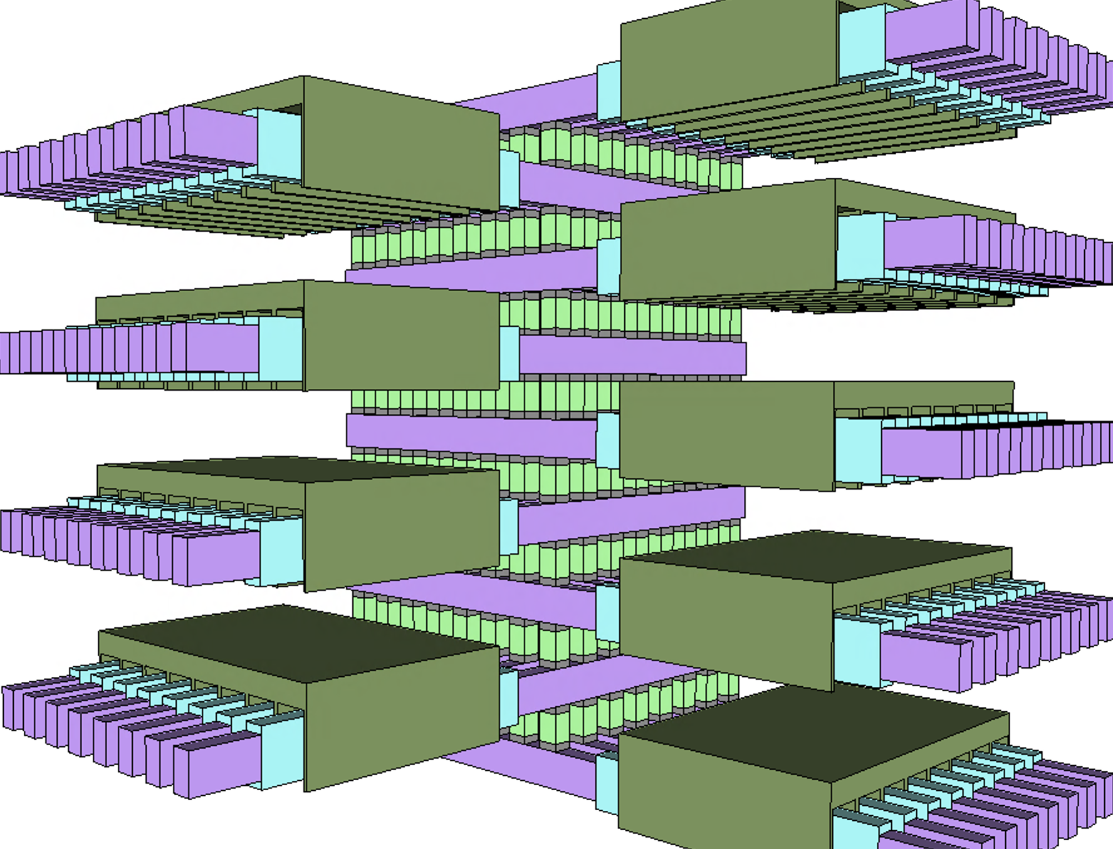
½ Kb Array: 8 decks of 8x8 cross point

Slide 9
3DXP Deck Select Architecture
Deck Select Transistors integrated with Cross Point Array Technology
2 masks adder @ 200nm CD

Slide 10
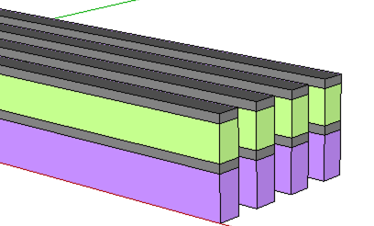
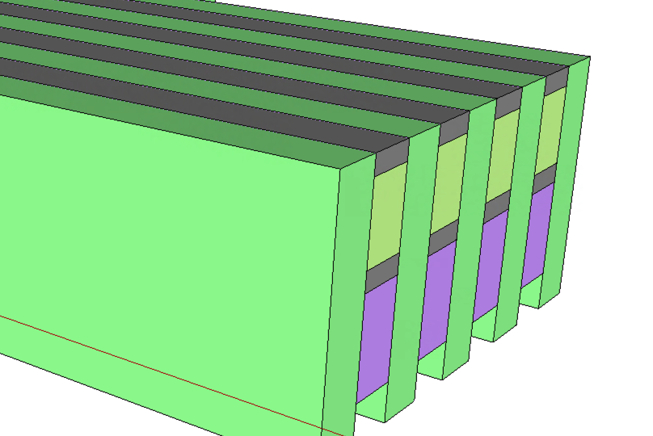
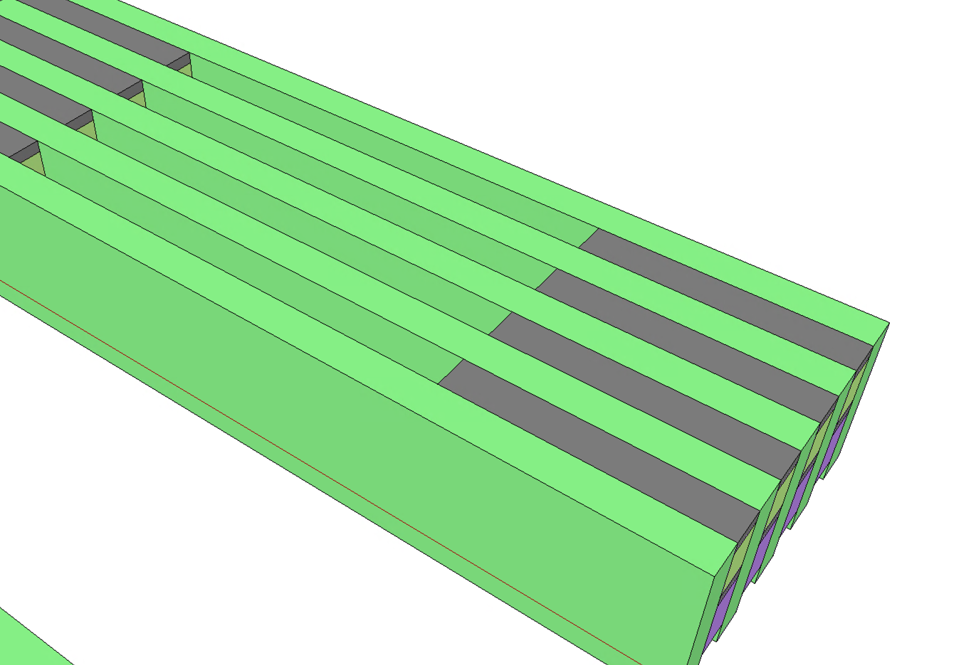
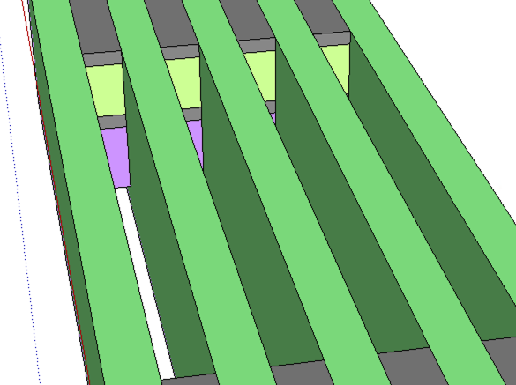
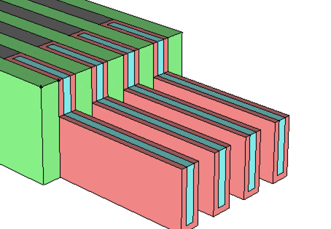
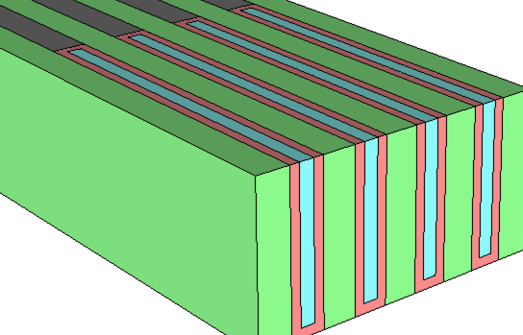
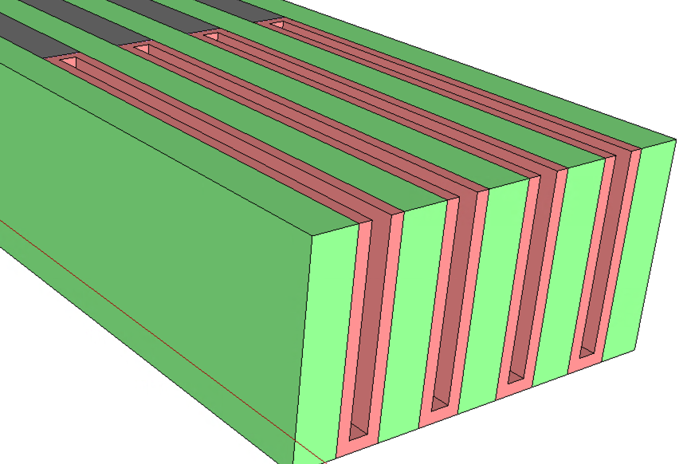
Process Flow
Deck Select TFT Placeholder:
200~400nm stripe opening,
Selective stack material removal
Array First Cut
First Cut Gap Fill
TFT Fin Height definition
TFT Fin Channel Material Dep
Optional Spacer to define TFT FinFET width

Slide 11
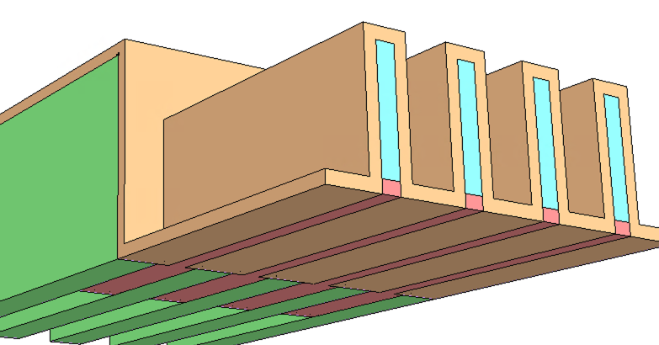
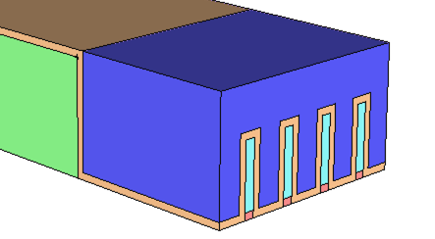
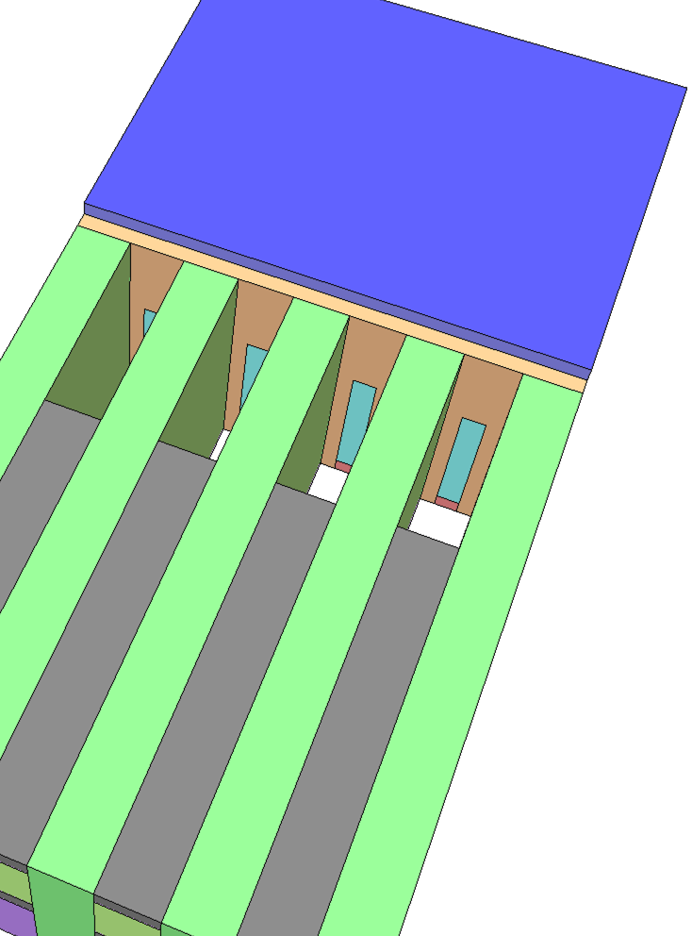
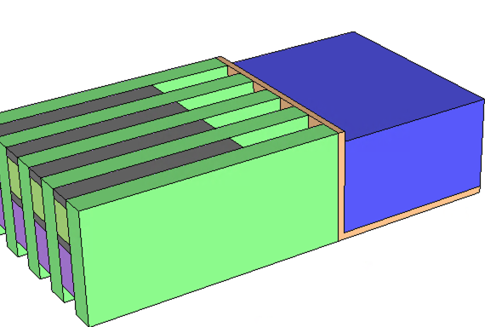
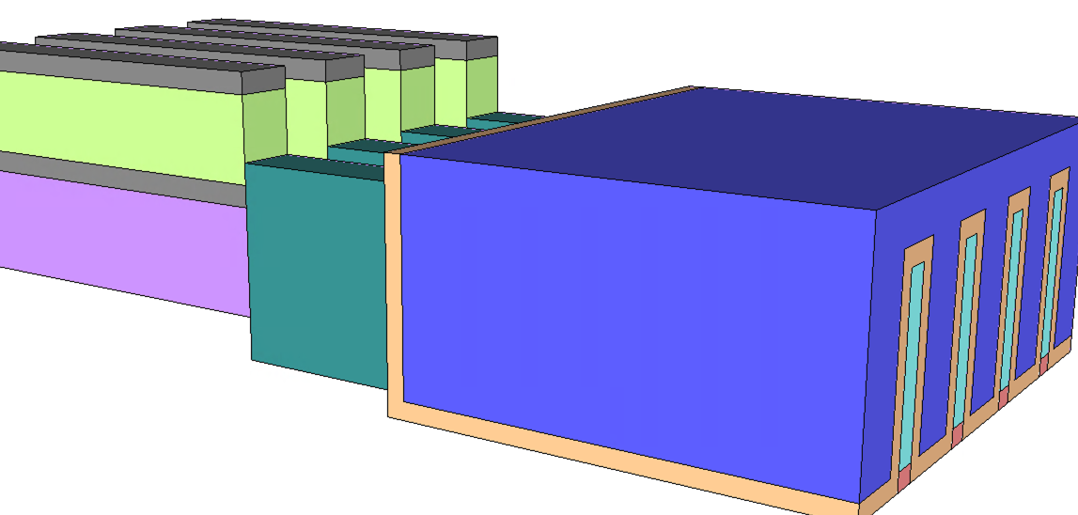
Process Flow (cont.)
TFT FinFET Oxide Dep
TFT FinFET Gate Dep
FinFET S/D Placeholder
TFT FinFET S/D Dep

Slide 12
Snap-On 3DXP

Slide 14
High Density 3DXP Array
Data Path
V_{PP}
V_{RR}
Read/Write circuit
Address Mux
Global BL Decoder
Local BL Decoder
b₀
b₁
Bit Lines
b_{m-1}
b_{m}
V_{NN}
WL
w_{n}
w_{n+1}
Global WL
Decoder
Local WL
Decoder
w_{n+2}
W

Slide 15
Embedded 3DXP
Data Path
V_{PP}
V_{RR}
Read/Write circuit
Address Mux
Global BL Decoder
Local BL Decoder
1TmC Memory Array
b₀
b₁
Bit Lines
b_{m-1}
b_{m}
WL
1T
Global WL
Decoder
Local WL
Decoder

