Slide 1
Deck Select
DerChang Kau, Prashant Majhi, Max Hineman,
NSG-CR Meeting, 2/4/2019 @ Santa Clara, CA
Deck Select Value Prop
3DXP Array with Deck Select Scheme
Deck Select Architecture

Slide 2
Snap-On Cross Point Memory Array Value Proposition
Deck Isolation – 20% die size reduction enabled by Deck Select TFT
MDP replacement – Enabled by Deck Isolation, 40% die cost reduction for each additional die in package with multi-wafer stacking by sharing CMOS decoder/data path and I/O

Slide 3
Deck Select TFTs enable decoder sharing cross decks
Reference Technology P1240
ALF32 is 256Gb components in 200mm2
4K tiles of 4 decks in 4K BL x 4K WL cross point array → 16K WL and 16K BL decoders per tile
Deck Select enables decoder sharing among decks.
Estimated 45mm² die size reduction due to ½ of decoders reduction with deck-select

Slide 4
Single-Deck Cross Point Memory Array
B
Data Path
V_{PP}
V_{RR}
BL
Memory
Read/Write circuit
WL
A
A’
Address Mux
Global BL Decoder
1 Deck
1 set of WL drivers,
1 set of BL drivers
B’
Local BL Decoder
A
A’
b₀
b₁
Bit Lines
b_{m-1}
b_{m}
Isolation
4K WL
V_{NN}
1 set WL Sockets
WL
w_{n}
w_{n+1}
Global WL
Decoder
Local WL
Decoder
w_{n+2}
_{B}
B’
4K BL
Isolation
W
1 set BL Sockets

Slide 5
Dual-Deck Cross Point Memory Array
B
Data Path
V_{PP}
V_{RR}
BL
Memory
Read/Write circuit
WL
A
A’
2 Deck
2 set of WL drivers,
1 set of BL drivers
Address Mux
Global BL Decoder
B’
Local BL Decoder
A
A’
4K WL
+
b₀
b₁
Bit Lines
b_{m-1}
b_{m}
Isolation
4K WL
V_{NN}
2 sets WL
Sockets
WL
w_{n}
w_{n+1}
Global WL
Decoder
Local WL
Decoder
w_{n+2}
B’
_{B}
4K BL
Isolation
W
1 set BL Sockets

Slide 6
Dual Deck Cross Point Memory Array with Deck Select
B
Data Path
V_{PP}
V_{RR}
BL
Memory
Read/Write circuit
WL
A
A’
2 Deck
1 set of WL drivers,
1 set of BL drivers
Address Mux
Global BL Decoder
B’
Local BL Decoder
b₀
b₁
Bit Lines
b_{m-1}
b_{m}
A
A’
Deck Sel
2
Isolation
4K WL
V_{NN}
Deck Sel Mux
1 set WL
Sockets
WL
w_{n}
w_{n+1}
Global WL
Decoder
Local WL
Decoder
w_{n+2}
B’
_{B}
4K BL
Isolation
W
1 set BL Sockets

Slide 7
Quad-Deck Comparison
A
A’
_{B}
B’
POR
2 set of WL drivers,
2 set of BL drivers
4K BL
+
4K BL
4K WL
+
4K WL
Isolation
Isolation
BL
2 set WL
Sockets
2set BL Sockets
Memory
WL
B
A
A’
_{B}
B’
Deck Select
1 set of WL drivers,
1 set of BL drivers
4 levels of Deck Select mux
A
A’
4K WL
4K BL
B’
2
Isolation
2
Deck Sel Mux
1 set WL
Sockets
1set BL Sockets
Isolation
Deck Sel Mux
For a 20nm Quad Deck 256Gb product, POR implementation (P1240/ALF32) is 200mm².
The invention enabled by Deck Select TFT can reduce die size by 45mm² (> 20% of die size reduction)

Slide 8
3DXP Deck Select Architecture
Deck Select Transistors integrated with Cross Point Array Technology
3 Deck Select TFT ideas – Ω, Fin, Saddle
Saddle TFT embodiment
Fin TFT embodiment

Slide 9
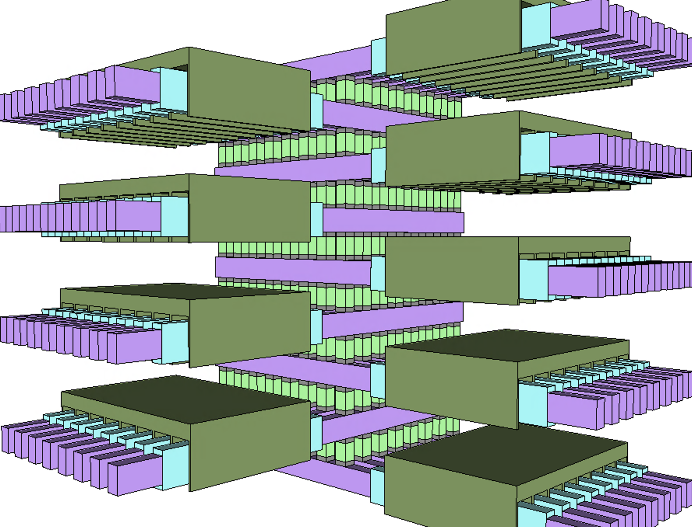
½ Kb Array: 8 decks of 8x8 cross point

Slide 10
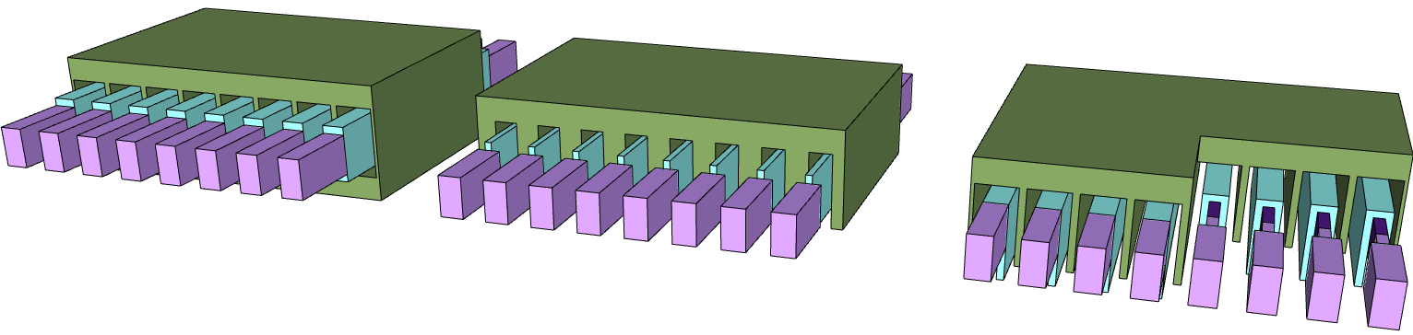
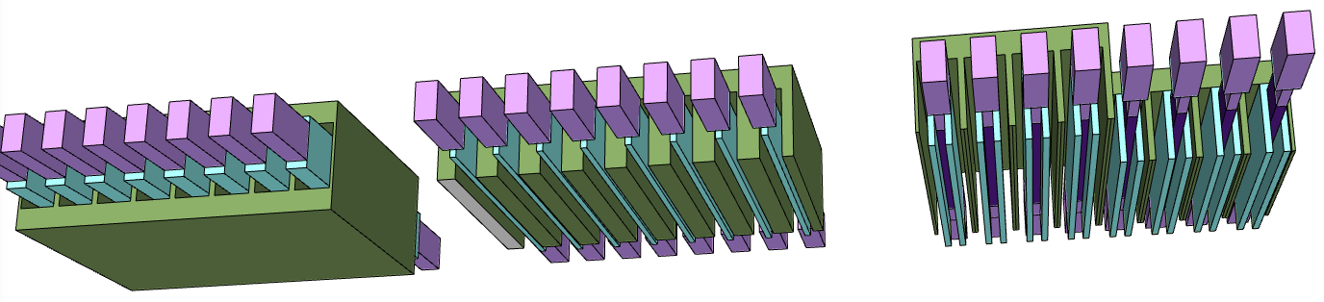
3 ideas
Ω-TFT
FIN-TFT
Saddle-TFT

Slide 11
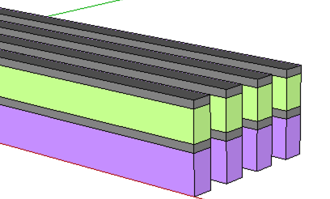
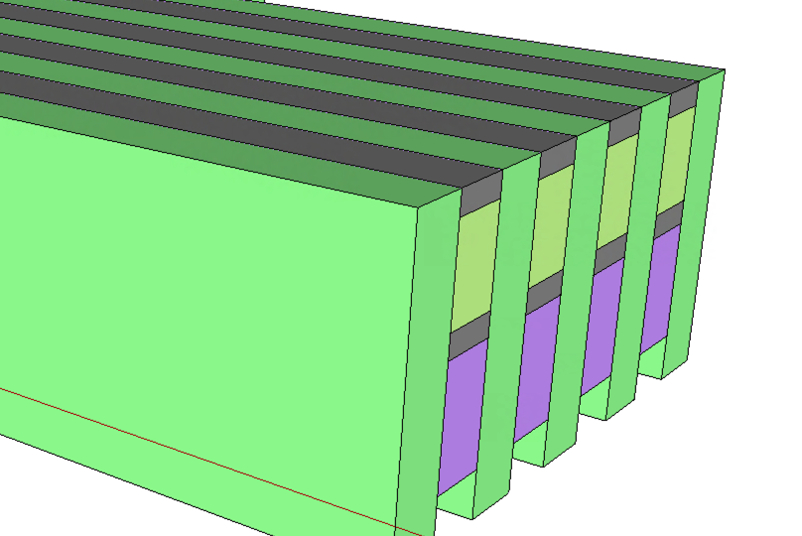
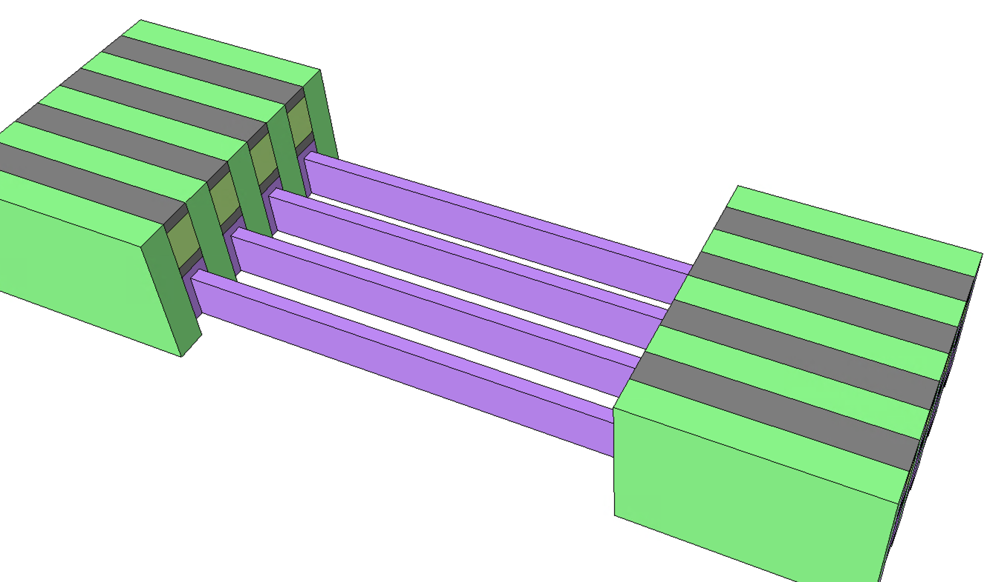
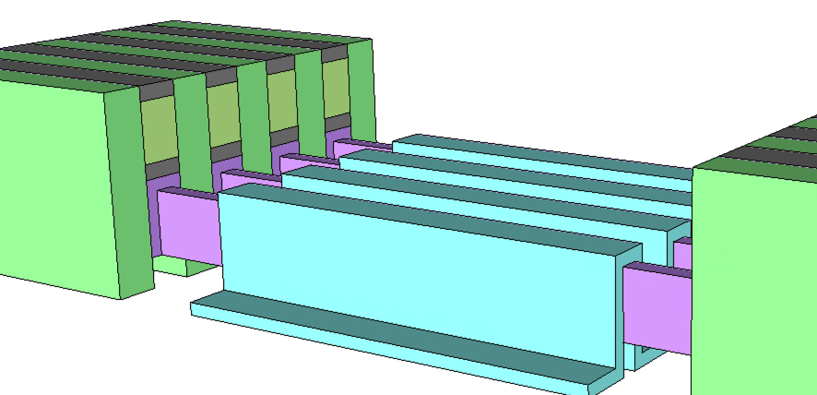
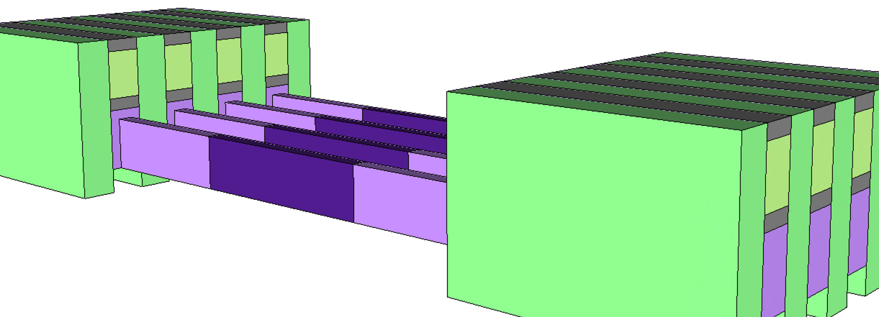
Saddle TFT Process Flow
Deck Select TFT Placeholder:
200~400nm stripe opening,
Selective etch, 4nm/side W CD reduction
21nm t_{W}+ 20nm dielectric recess
Array First Cut
14nm ½ pitch
First Cut Gap Fill
70~110nm height
Recess less challenged, no need of selectivity to lowk CDO
W trim dry will impact array protect layer, wet may be preferred, grain structure impacts?
Assumed: all done with chop mask array protect layer over array cells.
All depositions low temp (<300’C)
Saddling up TFT Fin Channel Material
(fin height 41nm)
Channel Length Definition (50~100nm)
Oxidize W
Need protect layer for area beyond channel which can be removed selective to everything including WOx
How will grain structure of W impact oxidation of the film? Volume expansion on oxidation – will lines buckle?

Slide 12
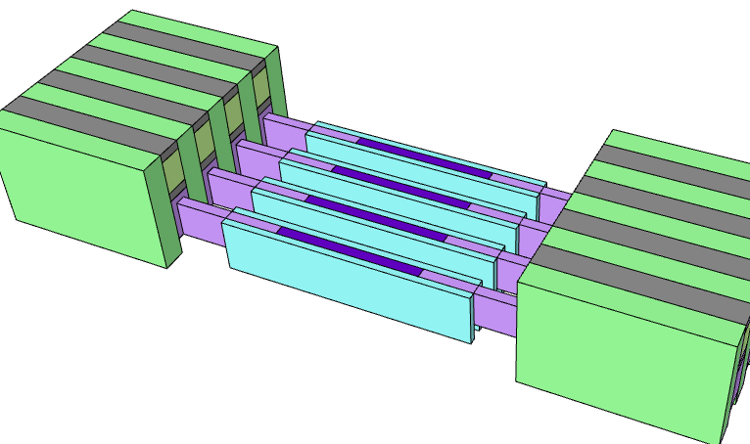
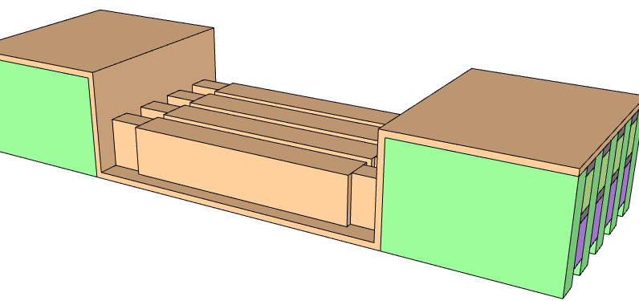
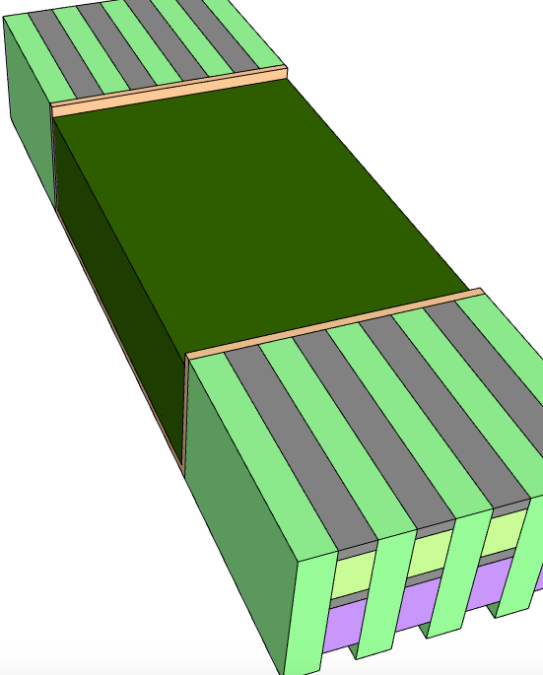
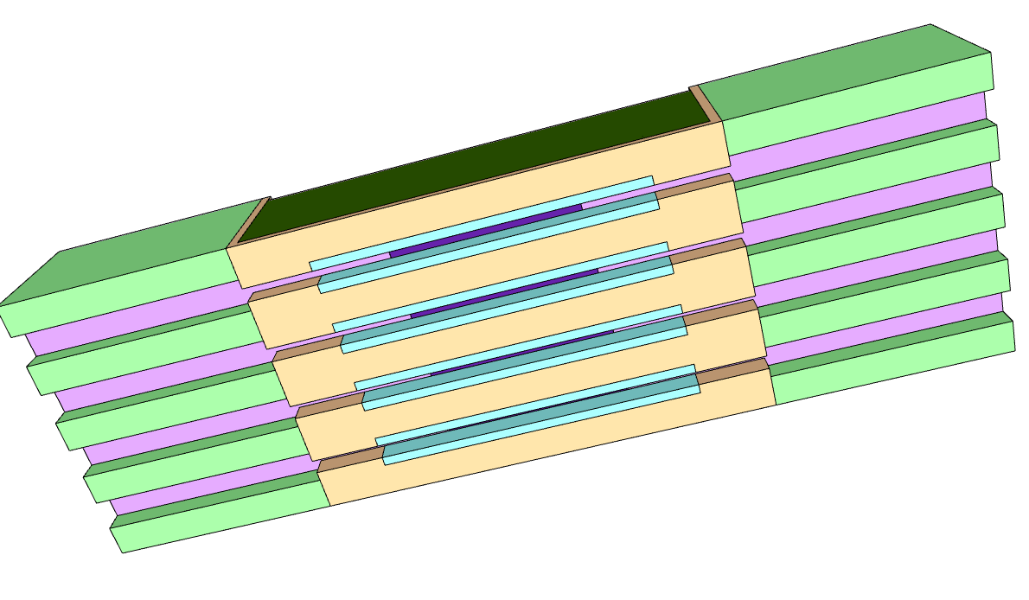
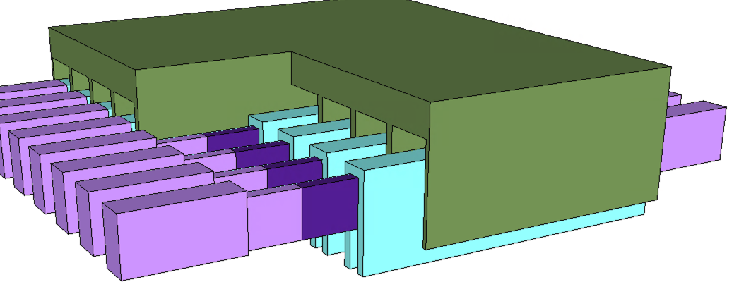
Saddle TFT Process Flow (cont.)
Saddle Isolation (Spacer Etch)
Saddle TFT Oxide conforming Dep
Saddle TFT Gate Dep
etch back
t_{Gate} = 20~25nm
Saddle TFT
W CMP SOO or SON (array protect) then Nit CMP stop on C and W. Prior to or following via process will determine CMP interactions.
How to protect from next cut W etch by l/s pattern and chop or provide sufficient budget of W thick on top of structure.

Slide 13
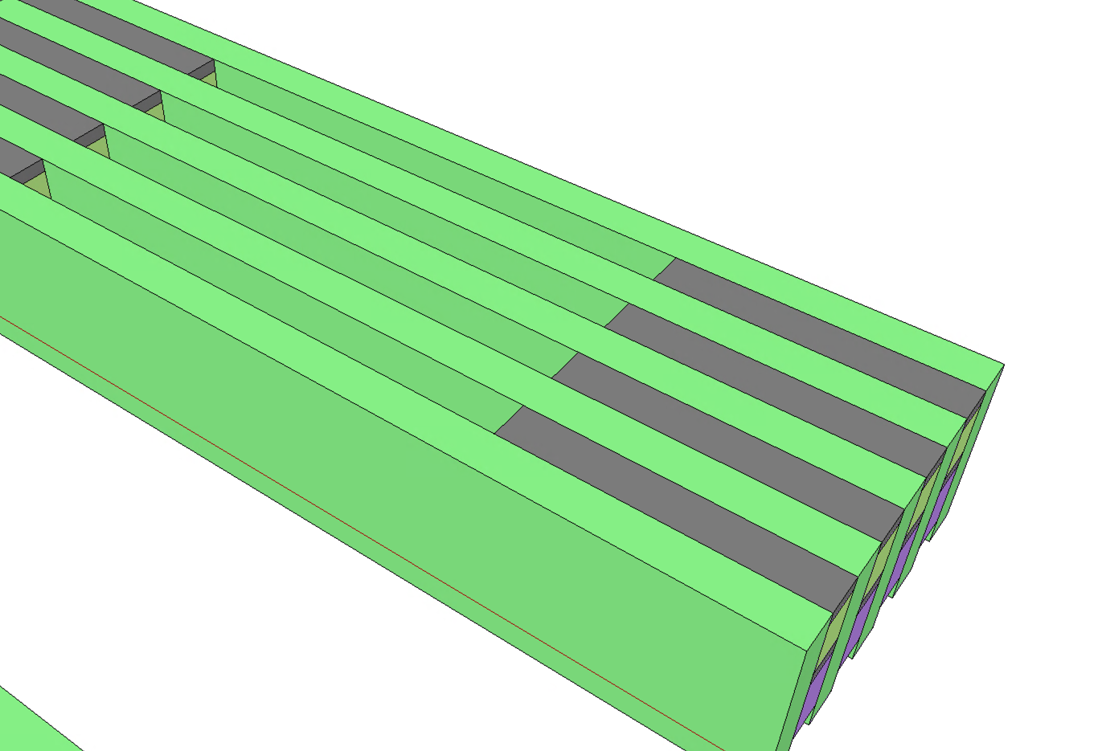
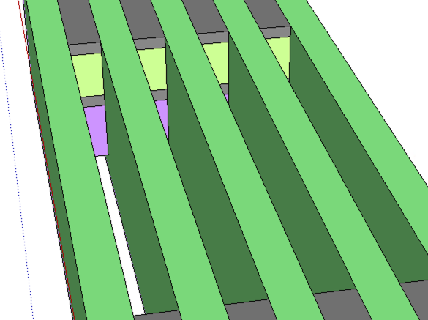
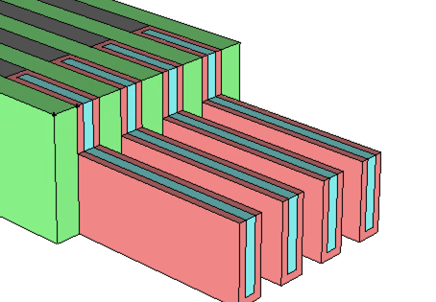
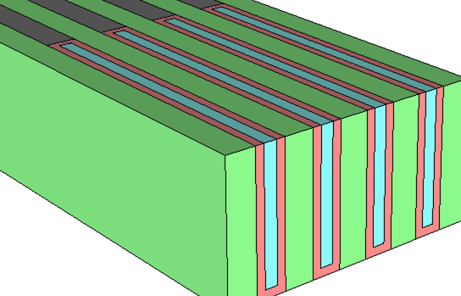
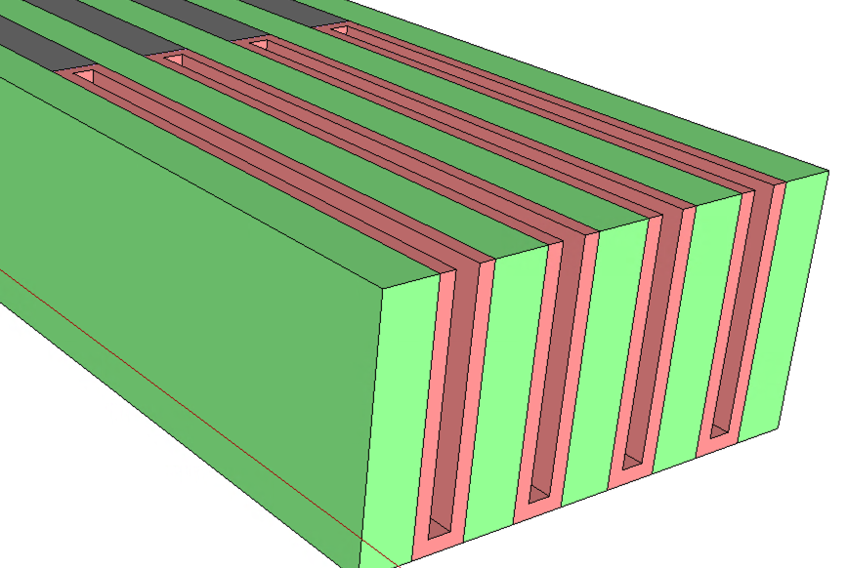
FinTFT Process Flow
Deck Select TFT Placeholder:
200~400nm stripe opening,
Selective stack material removal
Array First Cut
First Cut Gap Fill
TFT Fin Height definition
TFT Fin Channel Material Dep
Optional Spacer to define TFT FinFET width

Slide 14
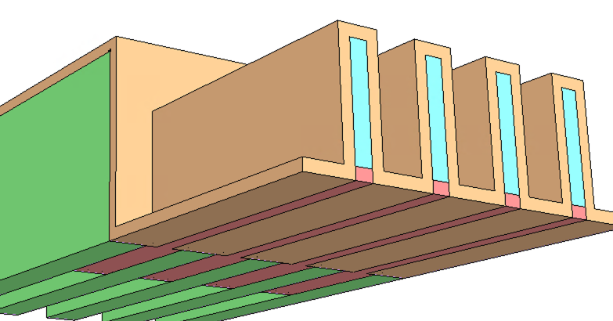
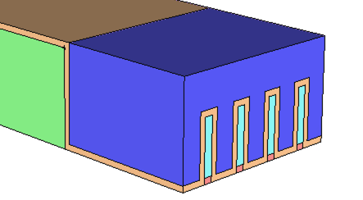
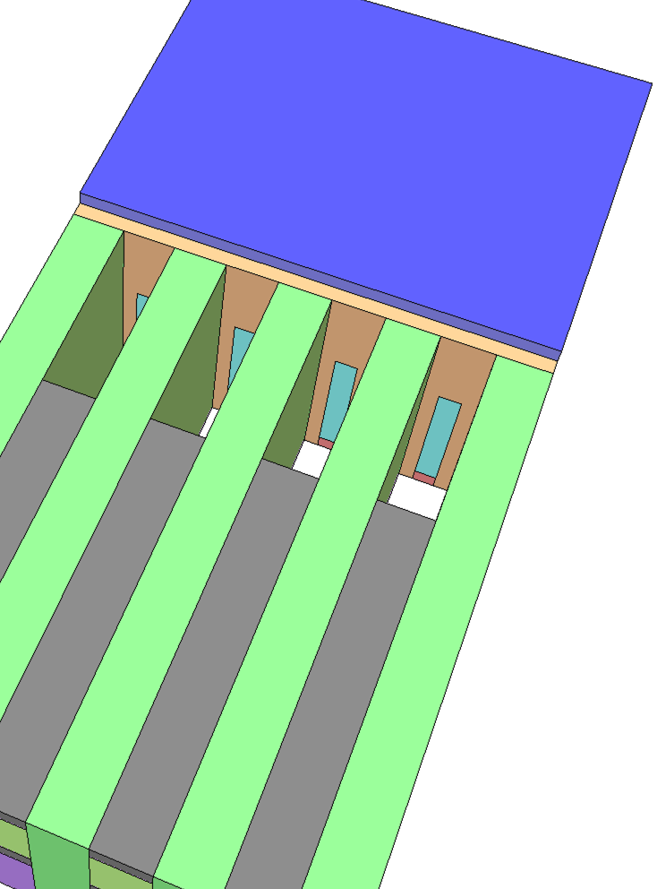
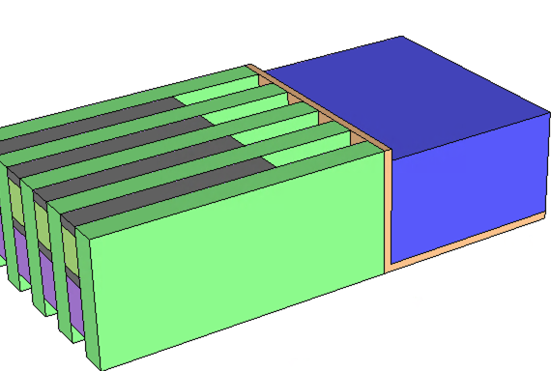
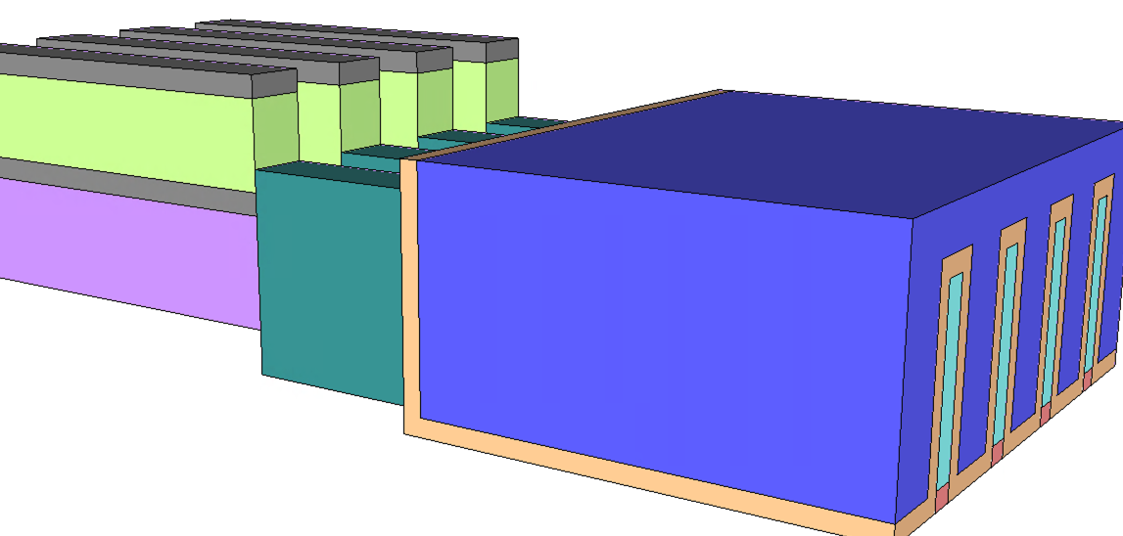
Fin TFT Process Flow (cont.)
TFT FinFET Oxide Dep
TFT FinFET Gate Dep
FinFET S/D Placeholder
TFT FinFET S/D Dep

