Slide 1
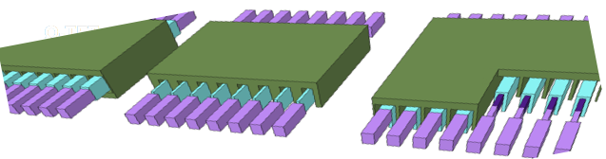
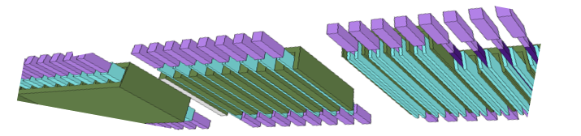
3 options
Ω-TFT
FIN-TFT
Saddle-TFT

Slide 2
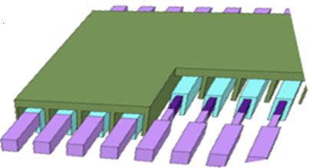
Saddle-TFT
TFT Dimension Considerations
  Saddle Pitch (28nm) limits Tox+Tch+Tw+Gate
    Need high Tox to keep gate capacitance low and sustain 5V
    Need minimum Tch for good channel conductivity
    Need minimum gate fill between saddle for low resistance of workfunction metal
  TFT Drawn Length = Lg + 2*Lov
    Need high overlap Lov for low contact resistance
    Need minimum Lg to sustain 5V; Lg and Tox defines needed mobility to deliver operating currents

Slide 3
Saddle TFT: Preliminary Needs Estimation Prashant
MG
Pitch ~ 28nm
HK
ADM
H
Lg
Z
W
Transistor width = We = 2 x H + W = 2x40 + 8 = 88 nm
Transistor Length = Lg = 50nm
S/D contact area = Z x H x 2 = 50 x 80 = 4 K nm2
Tch ~ 4nm; Tox ~5nm; Tw~8nm
Transistor Drive = 70 uA @ Vds =0.3V (i.e, Xtor R = 3Kohm)
2xContact resistance = 10% = 300 ohm
Contact Resistivity => Rc = 150x4K = 0.6 Mohm.nm2 (6e-9 ohm-cm2)
Transistor Mobility (@EOT 5nm and Vgs=4V) = 40 cm2/v-sec

Slide 4
Saddle TFT: ADM status and proposed changes Abhishek
MG
Pitch ~ 28nm
HK
ADM
H
Lg
Z
W
Transistor width = We = 2 x H + W = 2x40 + 8 = 88 nm
Transistor Length = Lg = 100nm
→Vbr from diode data ~10.8V; for Lg = 50nm Vbr ~ 6.3V; Ti cont
→Contacts have a key role to play in Vbr for ADM
S/D contact area = Z x H x 2 = 50 x 80 = 4 K nm2
→ Can this be doubled thru integration?
Tch ~ 4nm; Tox ~5nm; Tw~8nm
Transistor Drive = 70 uA @ Vds =0.3V (i.e, Xtor R = 4Kohm)
2xContact resistance = 10% = 2000 ohm (realistic target)
→ Currently at 3k ohm per contact levels for this geom
Contact Resistivity => Rc = 150x4K = 1-5 Mohm.nm2 (1-5e-8 ohm-cm2)
Transistor Mobility (@EOT 5nm and Vgs=4V) = 100 cm2/V-s
→ Shown with In2O3 on coupon, 300mm data pending

Slide 5
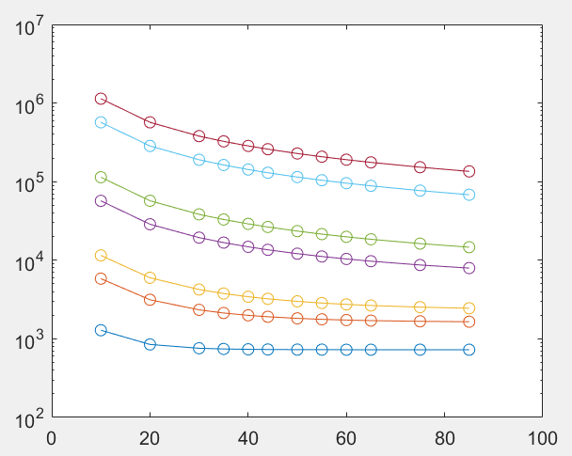
Estimation used Abhishek
eps = 8.854e-12;
tox = 5e-9; %tphys
vds = 0.3;
k = 4;
Z = 88e-9; %width
L = 100e-9; %length
A = Z*L; %area
t = 40e-7; %cm
contL = [10e-9 20e-9 30e-9 35e-9 40e-9 44e-9 50e-9 55e-9 60e-9 65e-9 75e-9 85e-9];
% Cox = k*eps*A/tox;
Cox = k*eps/tox*1e-4; %in F/cm2
mu = 100; %mobility
rho_c = [1e-7 5e-7 1e-6 5e-6 1e-5]*1e-4;
Rsh = 1e5; %dummy Rsheet for testing the program
for i = 1:length(rho_c)
Ich = mu*(Z/L)*(Cox)*((4-.4)*vds - vds^2/2); %linear xtor
Rch = vds/Ich;
Rsh2 = Rch*Z/L;
% Rsh2 = Rsh
Lt(i) = (rho_c(i)/Rsh2)^0.5; %transfer length
Rcont1 = (sqrt(rho_c(i)*Rsh2)/Z).*coth(contL/Lt(i)); %current crowding
Rcont = Rcont1*88e-3; %in ohm-um of width
Nd = (Rsh2*1.6e-19*mu*L*1e2)^-1;
figure(1);
semilogy(contL*1e9, Rcont1,'o-')
hold on
% figure(2)
% contour(contL*1e9, rho_c, Rcont);
end
This is the current operating region for CR
1e-5
5e-6
Rcontact (ohms)
1e-6
5e-7
1e-7
5e-8
1e-8
Lcontact (nm)
This is the possible extension with research
Below this will need significant breakthrough

Slide 6
Critical Challenges
Contact Resistivity
Module Integration
Hermetic Encapsulation + Stability

